Slide 1



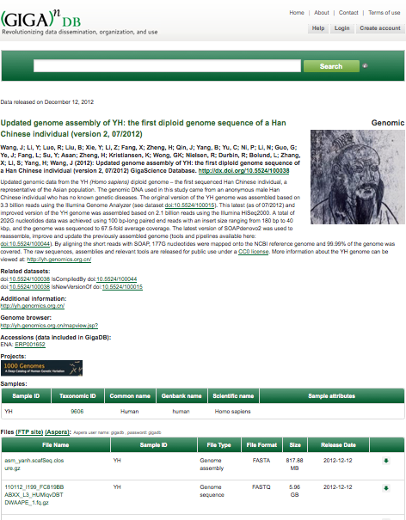


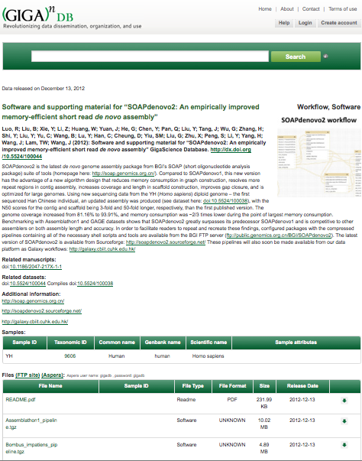

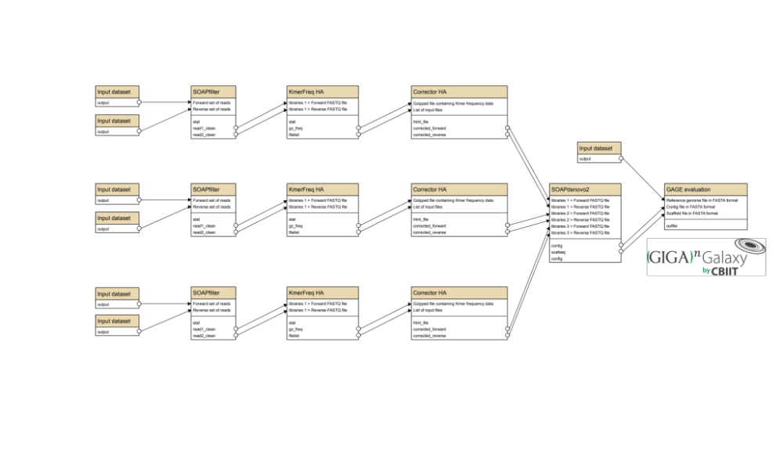


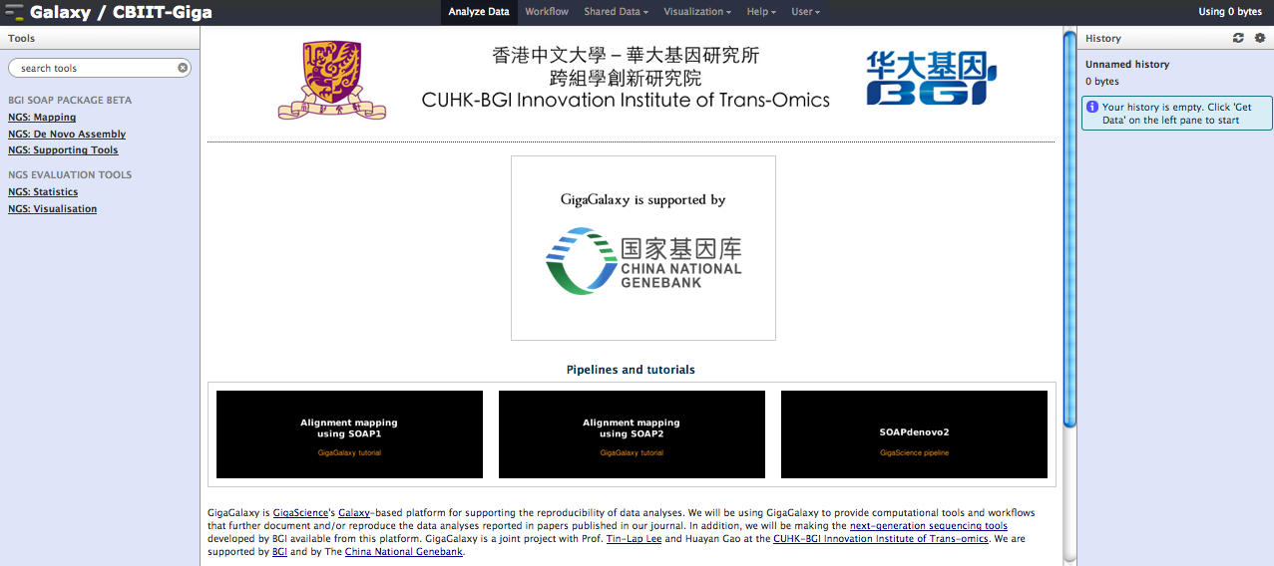
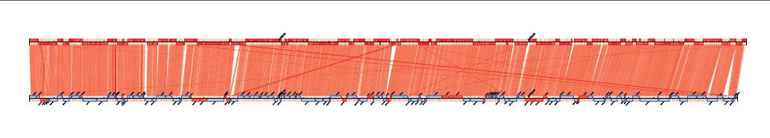










Edmunds GigaScience 2013
POSTER
Open Access
GigaGalaxy: A GigaSolution for reproducible and sustainable genomic data publication and analysis
Scott Edmunds^{1,2}, Peter Li^{1,2}, Huayan Gao^{3,4}, Ruibang Luo^{2,5}, Dennis Chan¹, Alex Wong¹, Zhang Yong², Tin-Lap Lee^{3,4}
Abstract
Today's next generation sequencing (NGS) experiments generate substantially more data and are more broadly applicable to previous high-throughput genomic assays. Despite the plummeting costs of sequencing, downstream data processing and analysis create financial and bioinformatics challenges for many biomedical scientists. It is therefore important to make NGS data interpretation as accessible as data generation. GigaGalaxy (http://galaxy.cbiit.cuhk.edu.hk) represents a NGS data interpretation solution towards the big sequencing data challenge. We have ported the popular Short Oligonucleotide Analysis Package (http://soap.genomics.org.cn) as well as supporting tools such as Contiguator2 (http://contiguator.sourceforge.net) into the Galaxy framework, to provide seamless NGS mapping, de novo assembly, NGS data format conversion and sequence alignment visualization. Our vision is to create an open publication, review and analysis environment by integrating GigaGalaxy into the publication platform at GigaScience and its GigaDB database that links to more than 20 TBs of genomic data. We have begun this effort by re-implementing the data procedures described by Luo et al., (GigaScience 1: 18, 2012) as Galaxy workflows so that they can be shared in a manner which can be visualized and executed in GigaGalaxy. We hope to revolutionize the publication model with the aim of executable publications, where data analyses can be reproduced and reused.
Keywords: Galaxy, workflows, reproducible research, genome assembly, next generation sequencing, GigaScience
Background
Example: SOAPdenovo2
Growing replication gap:
Linking papers to data and analyses
10/18 microarray papers cannot be reproduced
Ioannidis: “Most Published Research Findings Are False”
>15X increase in retracted papers in last decade
Lack of incentives to make data/methods available
Open-Paper
Open-Data
Data sets
DOI:10.5524/100038
Linked to
78GB CC0 data
DOI
Open-Pipelines
DOI
Open-Workflows
GigaSolution: deconstructing the paper
Linked to
Analyses
DOI:10.5524/100044
Combine and integrate (via citable DOIs):
Implement paper pipelines in GigaGalaxy
Open-access journal
www.gigasciencejournal.com
Data Publishing Platform
gigadb.org
Data Analysis Platform
galaxy.cbiit.cuhk.edu.hk
GigaGalaxy: screenshot
Visualization of results:
e.g. GAGE metrics and CONTIGuator 2 outputs:
NC_010079.pdf
gi_161510924_ref_NC_010063.1_.pdf
References
Wang, J; et al., (2012): Updated genome assembly of YH: the first diploid genome sequence of a Han Chinese individual (version 2, 07/2012). GigaScience Database. http://dx.doi.org/10.5524/100038.
Luo, R; et al., (2012): Software and supporting material for “SOAPdenovo2: An empirically improved memory-efficient short read de novo assembly”. GigaScience Database. http://dx.doi.org/10.5524/100044
Galardini et al.:CONTIGuator: a bacterial genomes finishing tool for structural insights on draft genomes. Source Code for Biology and Medicine 2011 6:11.
Ioannidis et al., Repeatability of published microarray gene expression analyses. Nature Genetics 2009 41: 14
Science publishing: The trouble with retractions Nature 2011 478, 26-28
Ioannidis J. Why Most Published Research Findings Are False. PLoS Med 2005 2(8): e124.
Luo R et al., SOAPdenovo2: an empirically improved memory-efficient short-read de novo assembler GigaScience 2012, 1:18
Acknowledgements
Thanks to:
Laurie Goodman, Chris Hunter, Xiao Si Zhe, Tam Sneddon (GigaScience), Shaoguang Liang (BGI-SZ), Qiong Luo, Senghong Wang, Yan Zhou (HKUST), Rob Davidson and Mark Viant (Birmingham Uni), Marco Galardini (Unifi)
doi:10.6084/m9.figshare.713512
Cite this poster as: GigaGalaxy: A GigaSolution for reproducible and sustainable genomic data publication and analysis. Scott C. Edmunds, Peter Li, Huayan Gao, Ruibang Luo, Dennis Chan, Alex Wong, Zhang Yong, Tin-Lap Lee. figshare
http://dx.doi.org/10.6084/m9.figshare.713512
Financial support from:
Correspondence: scott@gigasciencejournal.com
1. BGI HK Research Institute, 16 Dai Fu Street, Tai Po Industrial Estate, Hong Kong SAR, China.
2. BGI-Shenzhen, Beishan Industrial Zone, Yantian District, Shenzhen, China.
3. School of Biomedical Sciences, The Chinese University of Hong Kong, Shatin, Hong Kong SAR, China.
4. CUHK-BGI Innovation Institute of Trans-omics, The Chinese University of Hong Kong, Shatin, Hong Kong SAR, China.
5. HKU-BGI Bioinformatics Algorithms and Core Tecnology Research Laboratory & Department of Computer Science, University of Hong Kong, Pok Fu Lam, Hong Kong
Submit your next manuscript containing large-scale data and workflows to GigaScience and take full advantage of:
No space constraints, and unlimited data and workflow hosting in GigaDB and GigaGalaxy
Article processing charges for all submissions in 2013 covered by BGI
Open access, open data and highly visible work freely available for distribution
Inclusion in PubMed and Google Scholar
© 2013 Edmunds et al. This is an Open Access poster distributed under the terms of the Creative Commons Attribution License (http://creativecommons.org/licenses/by/2.0), which permits unrestricted use, distribution, and reproduction in any medium, provided the original work is properly cited.

