Slide 1


CBIIT GigaGalaxy – A Galaxy-based Platform for Large-scale Genomics Analysis
Tin-Lap, LEE
School of Biomedical Sciences,
CUHK-BGI Innovation Institute of Trans-omics,
The Chinese University of Hong Kong,
Hong Kong SAR, China.

Slide 2

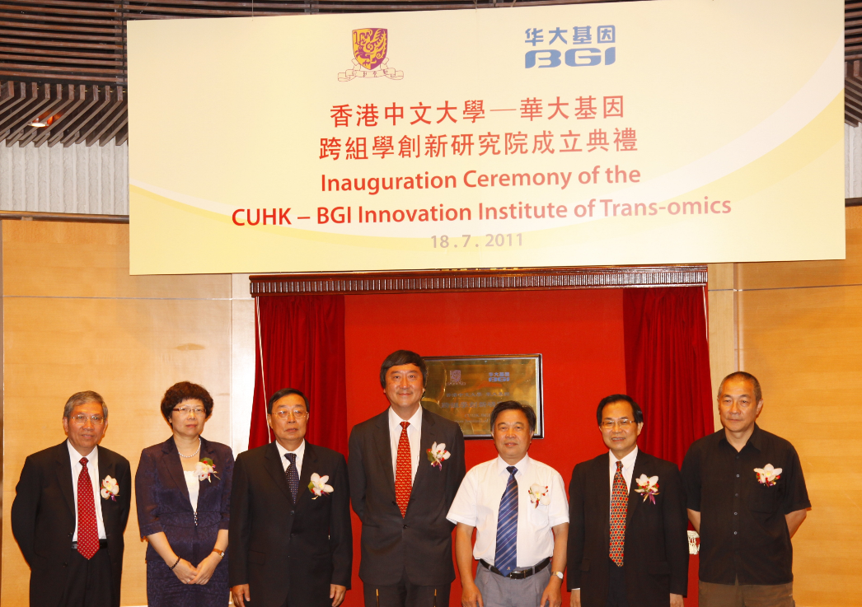
CBIIT
Jointly established between The Chinese University of Hong Kong (CUHK) and BGI.
“We aim to provide a platform conducive to training of multi-disciplinary talents conversant with the knowledge and application of genomics, proteomics, genetics , computation biology and bioinformatics, by capitalizing on both institutions’ expertise and strengths in genomic science.”

Slide 3

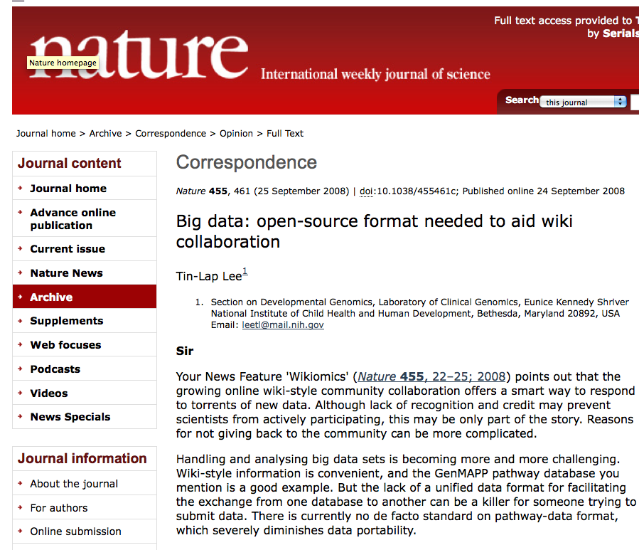

Big Data Translates into Big Opportunities... and Big Responsibilities

Slide 4
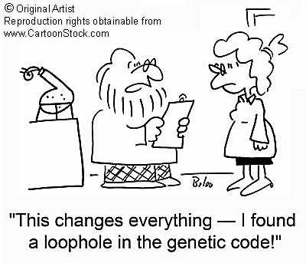
The challenges for biomedical scientists

Slide 5


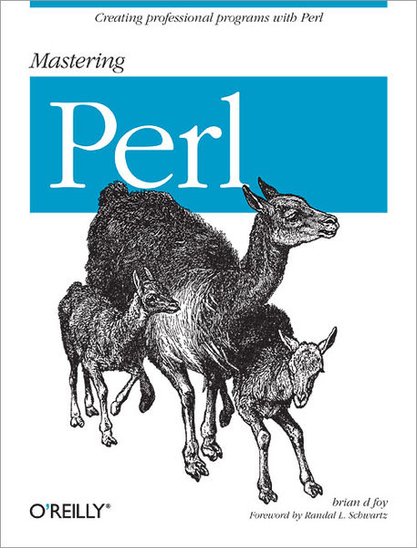



The challenges for biomedical scientists

Slide 6
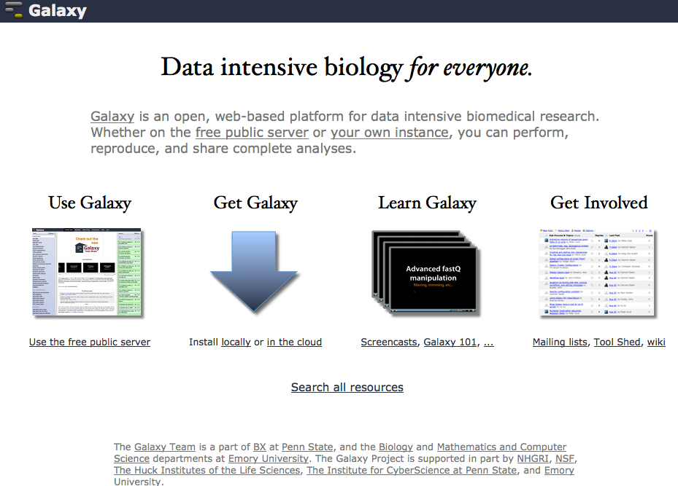
http://galaxyproject.org/

Slide 7
CBIIT GigaGalaxy
Highlights:
Provides enhanced functionality in additional to the original Galaxy functions
  Specialized instances
  Speed: local servers with SBS-UCSC genome database mirror in Hong Kong
  Reproducibility: Seamless integration with Taverna/myExperiment workflows
  Data exchange and publishing: GigaScience journal portal/GigaDB
  Customized functions and more…..

Slide 8
CBIIT GigaGalaxy
Benefits:
Simplifies complicated bioinformatics tasks, accelerate data processing and allow flexible analysis.
Significantly reduce software and hardware costs, encourage research collaboration.

Slide 9
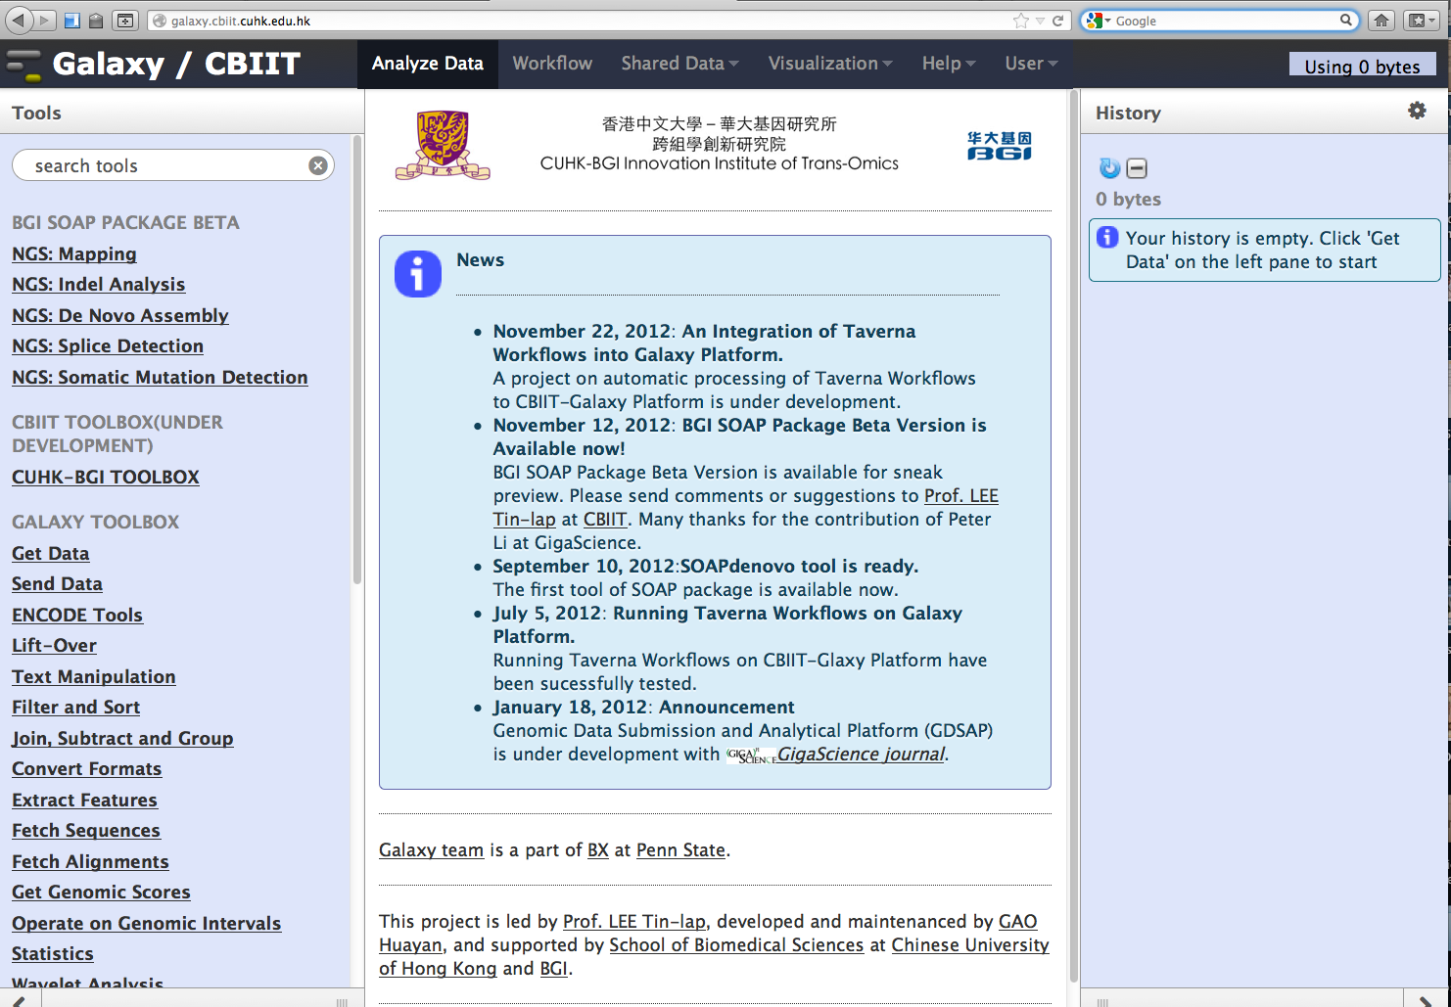
Galaxy/CUHK-BGI
http://www.cuhk.edu.hk/cbiit/galaxy.html

Slide 10








CBIIT GigaGalaxy Structure
Tool
Development
Biomedical and bioinformatics research
Publishing
Notes:
The first section of this talk is about implementation of public instance using galaxy tool shed. We are currently implement the first public SOAP instance to the platform.

Slide 11
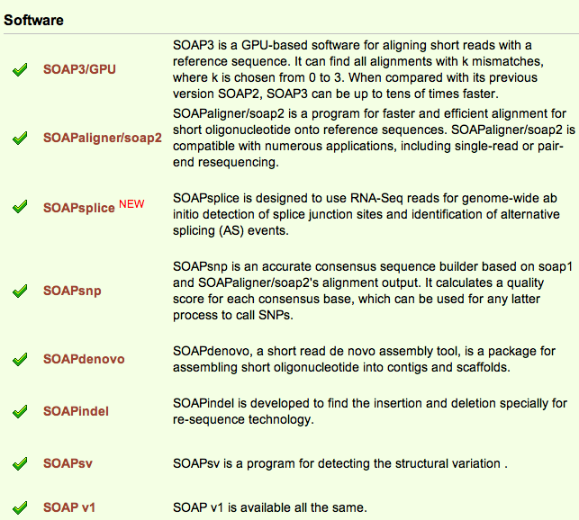
What is SOAP?
SOAP - a tool package that provides full solution to NGS data analysis by BGI.
http://soap.genomics.org.cn/
Notes:
The SOAP package provides a set of tools for processing NGS data. There are different versions of SOAP for mapping short reads to reference sequences. There are also tools like soapdenovo for construction of a new genome sequence and soapsnp which can assemble a consensus sequence and identify SNPs present on it in relation to a reference.
Documentation in the BGI SOAP package is limited in scope, making the tools difficult to use. We will be working with the BGI developers in providing test data and Galaxy pipelines demonstrating the use of SOAP.

Slide 12
Why SOAP?
Galaxy has been using SAMtools for consensus sequence calling, but the recent upgrade has left this part out, which is very limited to some biologists.
SOAPsnp is the only other method that can call full consensus sequences besides SAMtools.
The main galaxy site supports none of the SOAP tools, including SOAPsnp.
Notes:
Other than its popularity, another main reason to implement SOAP tool is that …

Slide 13
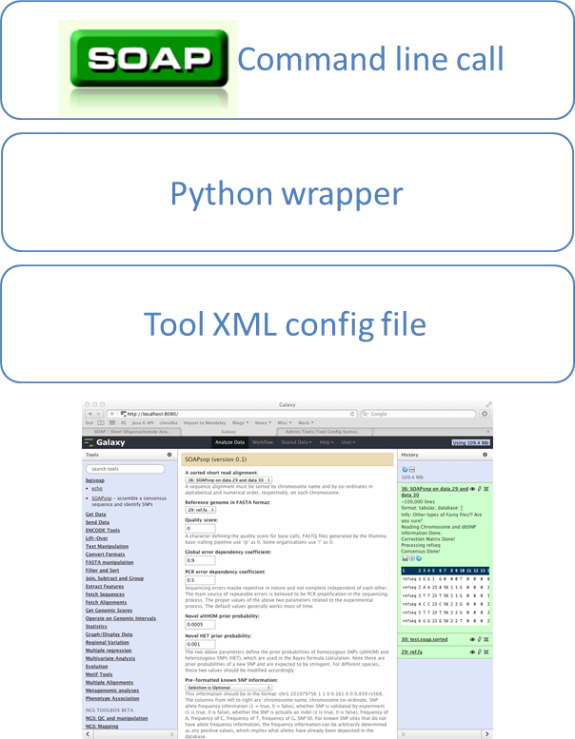
Galaxy Tool Shed
Enables sharing of Galaxy tools across Galaxy servers around the world.
SOAP package tools configured for use in Galaxy.
  SOAPsnp/SOAPdenovo
Notes:
We transform the command line base SOAP tool into galaxy instance by Galaxy tool shed. The tool shed is useful to transofrm any programs through python rapper. I should say the Galaxy team did a great job on this, and they are very helpful during the development process. By doing that.. It allows

Slide 14
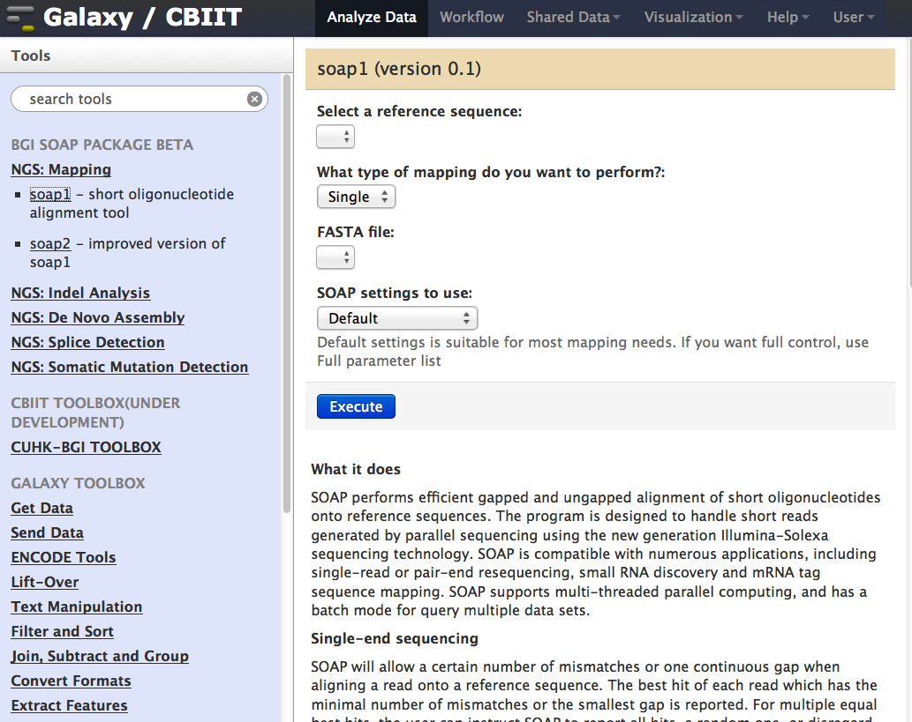
NGS mapping: SOAP1

Slide 15
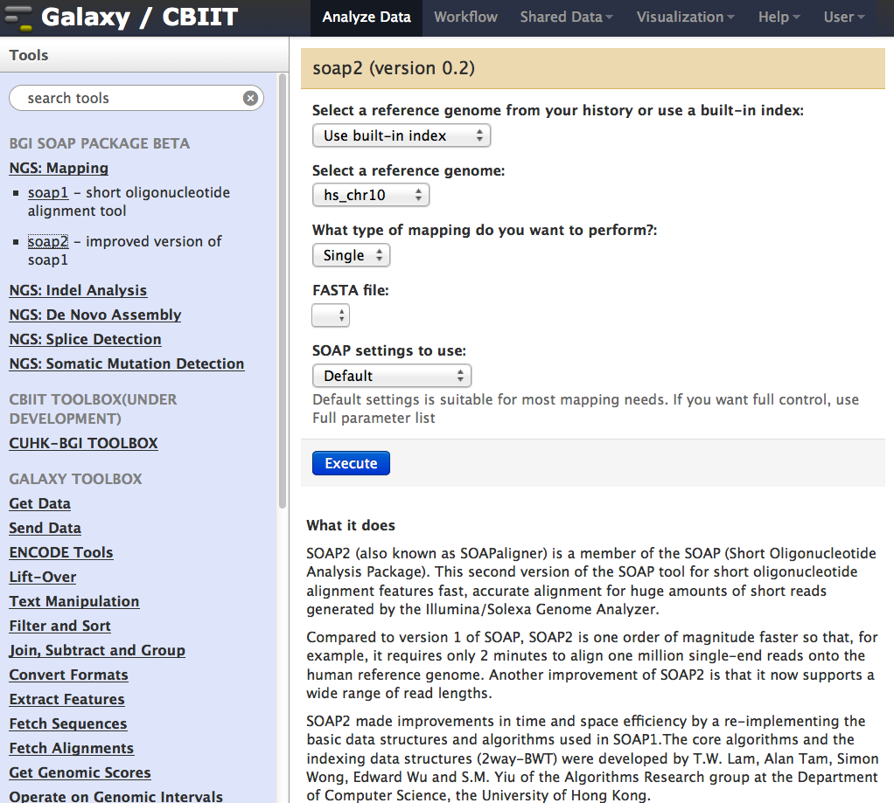
NGS mapping: SOAP2

Slide 16
SOAPsnp
Notes:
You can notice that all the parameters has been transformed into drop-down menu..
We also put an explanation for each par. So that the user has a better understanding on each item.

Slide 17
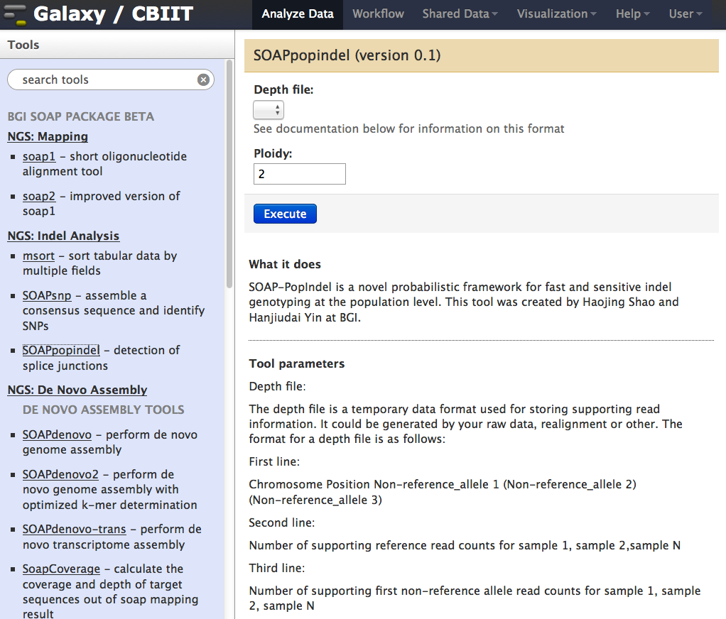
SOAPpopindel

Slide 18
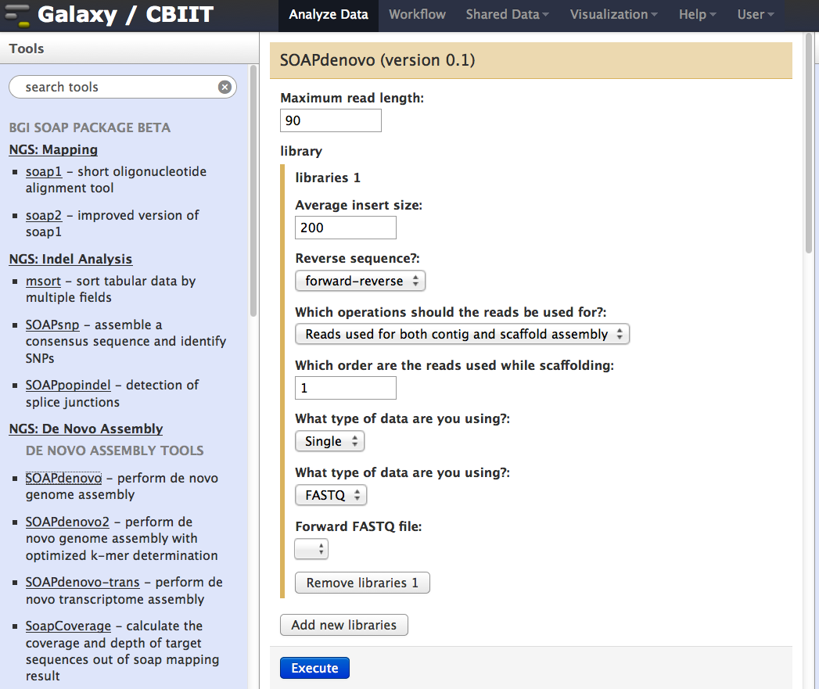
NGS De Novo Assembly: SOAPdenovo
Notes:
Similar to SOAPsnp, the complicated parameters or option has been transformed. The settings will be recorded in each run, so that one can track back easily.

Slide 19
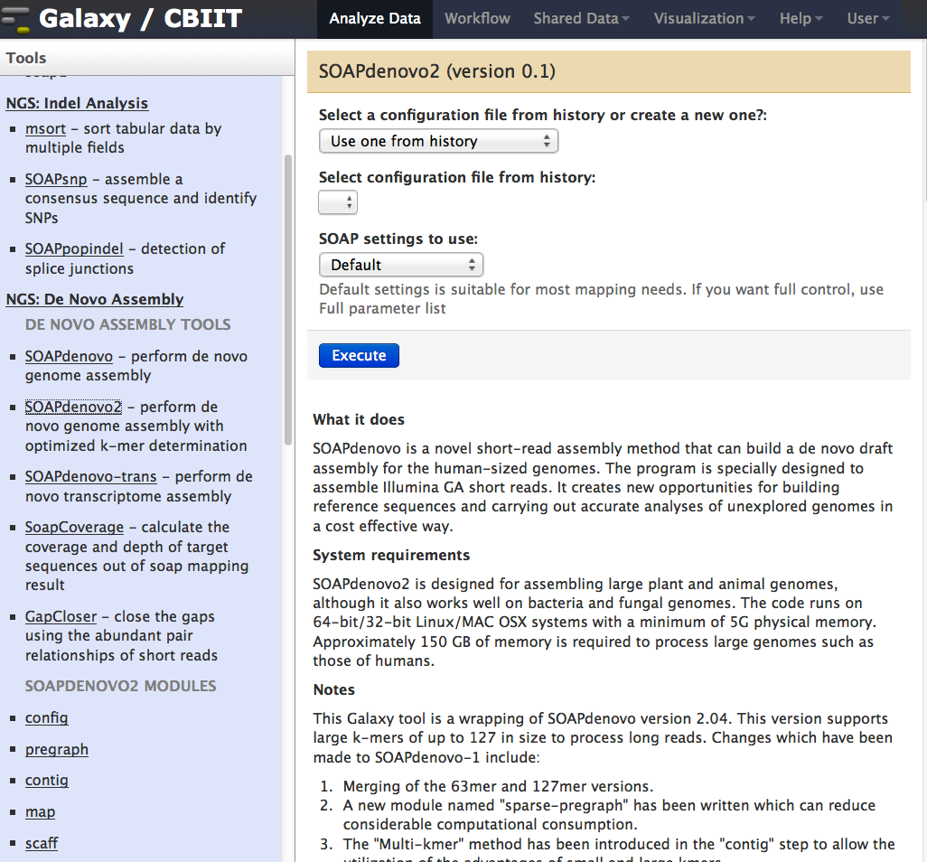
NGS De Novo Assembly: SOAPdenovo2

Slide 20
CBIIT GigaGalaxy structure
Bioinformatics
Development
Biomedical and bioinformatics research
Publishing
Notes:
So much for the tool development, the second part of the talk will focus on work flow implementation using the workflows from myexperiment.

Slide 21
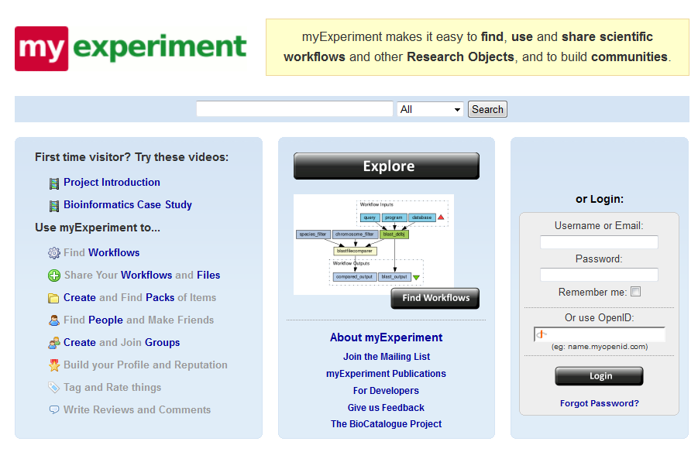


How does it work?
myExperiment -a repository for workflows.
Taverna workflows.
New: Galaxy workflows.
CBIIT GigaGalaxy integration
http://www.myexperiment.org

Slide 22
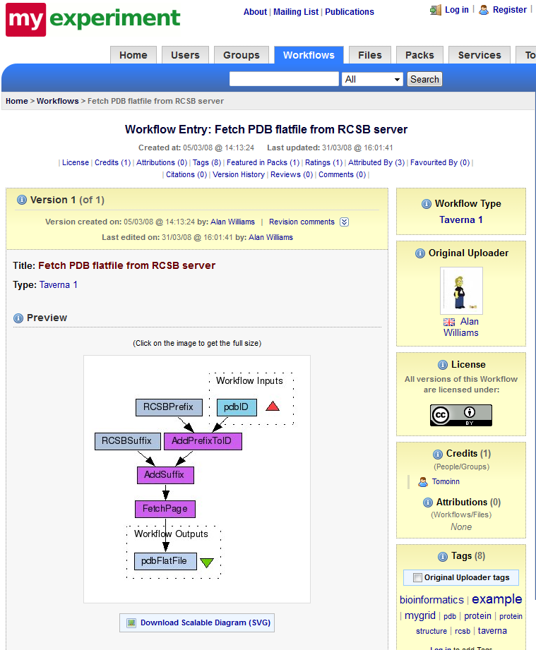
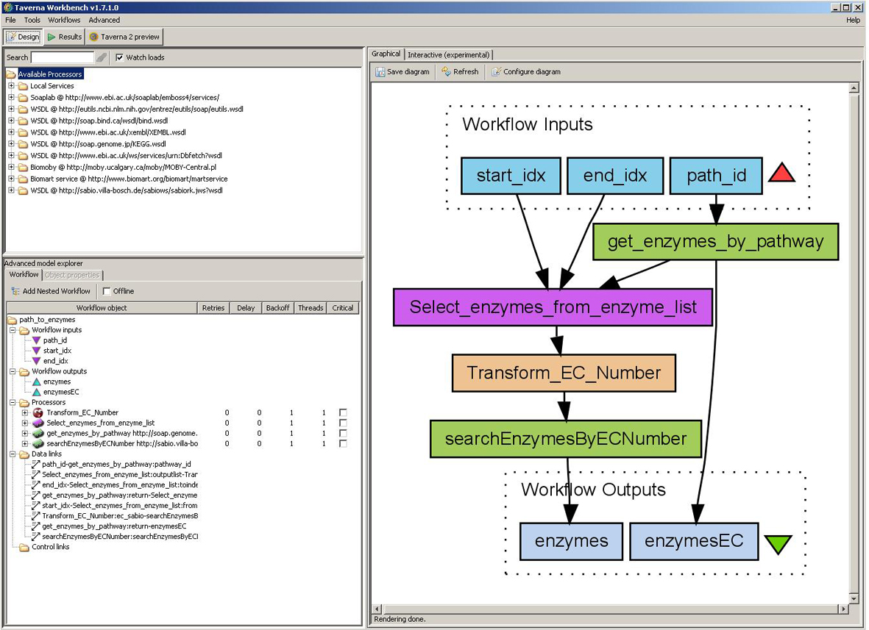
Taverna workflow
http://www.taverna.org.uk/

Slide 23
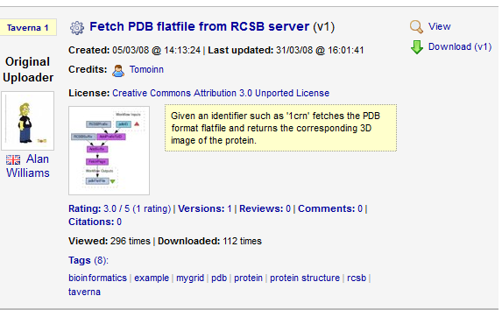
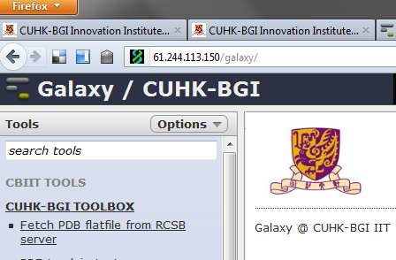
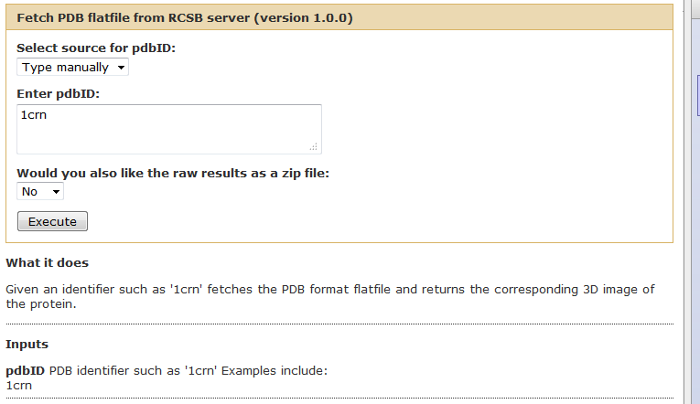

Slide 24
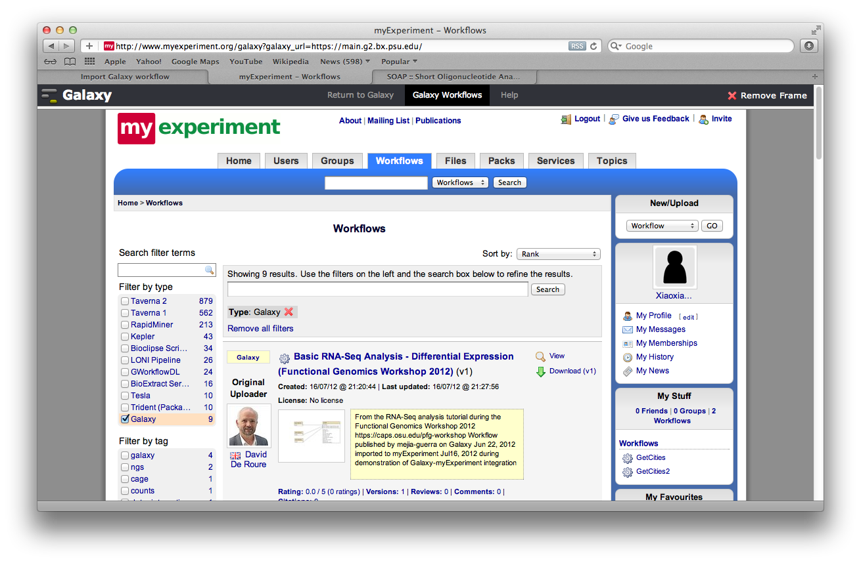
Galaxy workflow

Slide 25
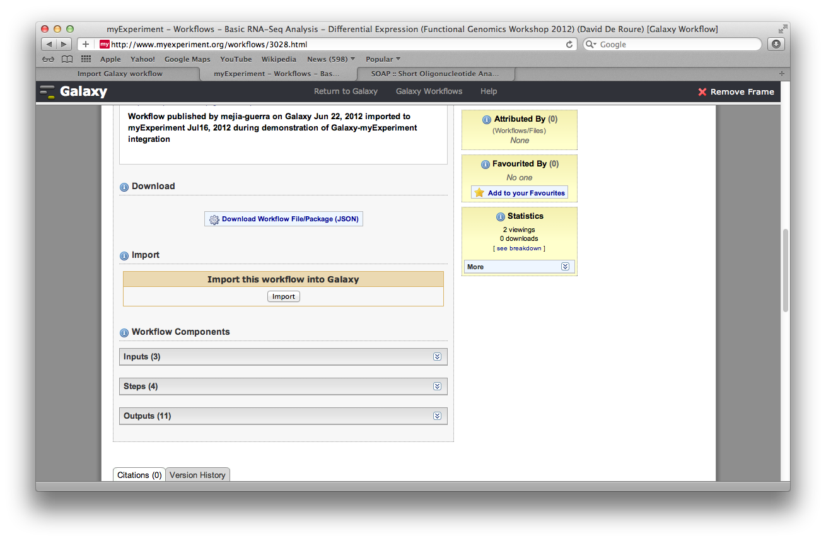
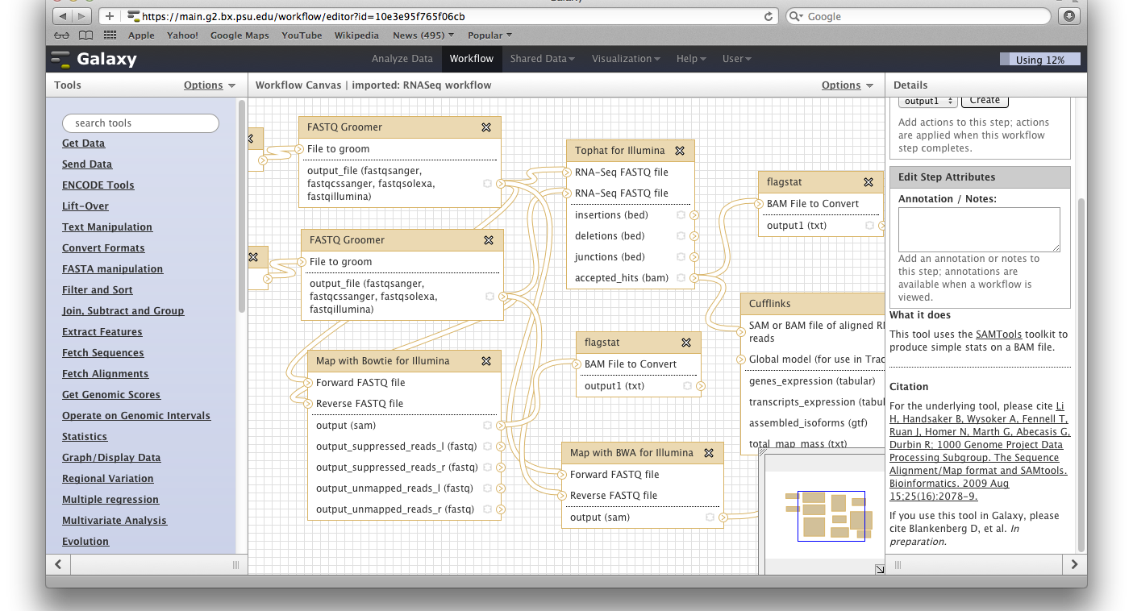
Import (1)

Slide 26
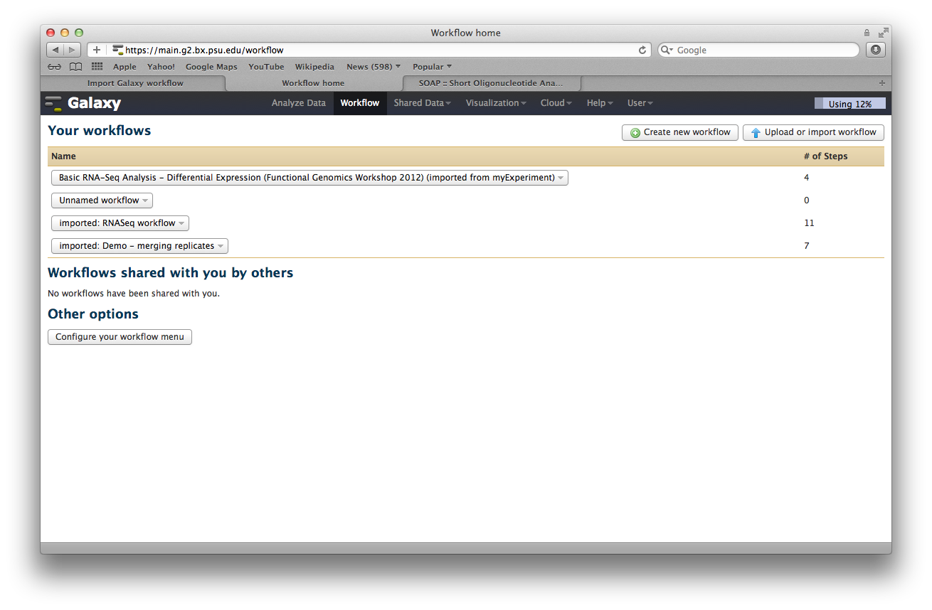
Import (2)

Slide 27
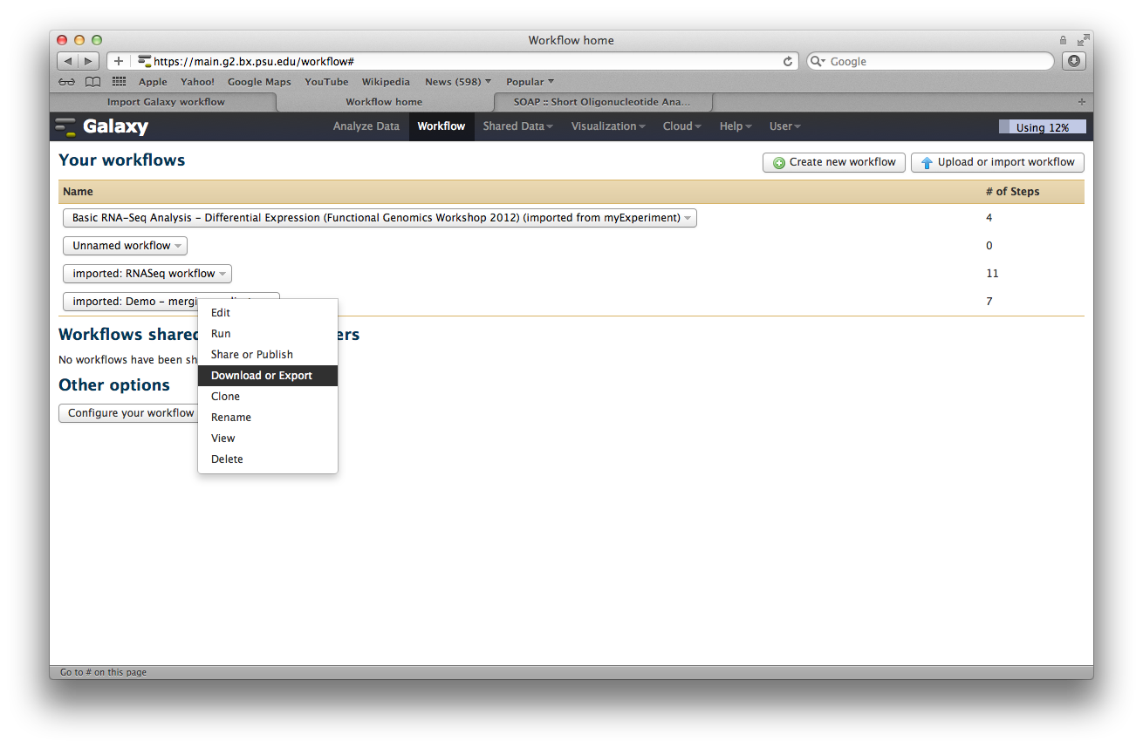
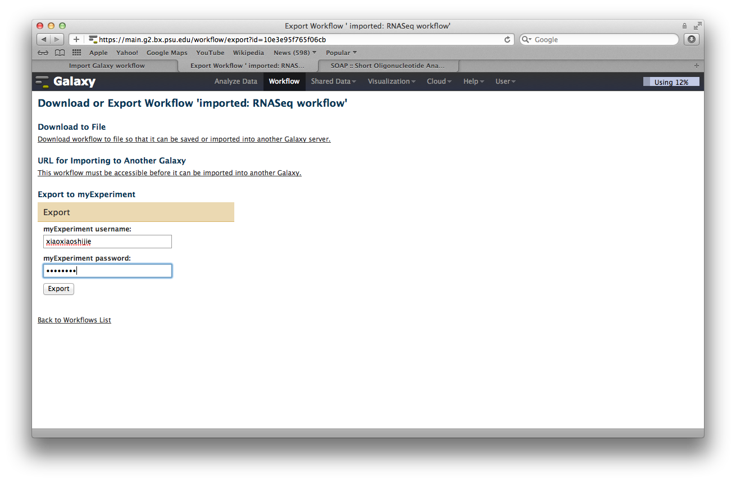
Export (1)

Slide 28
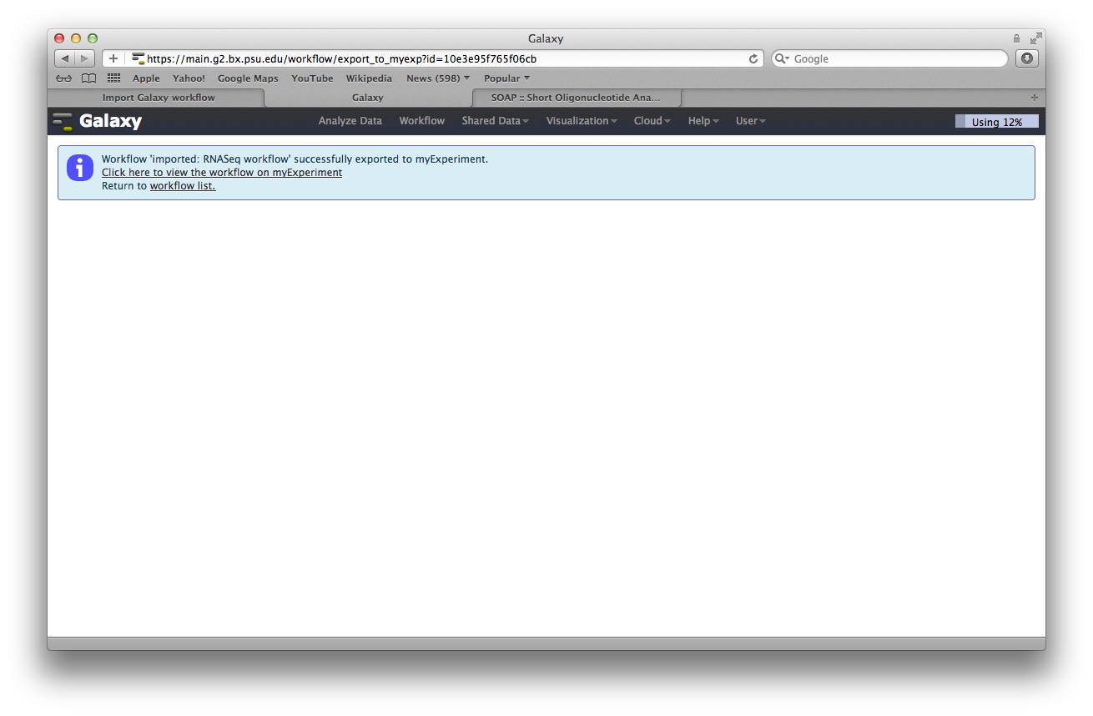
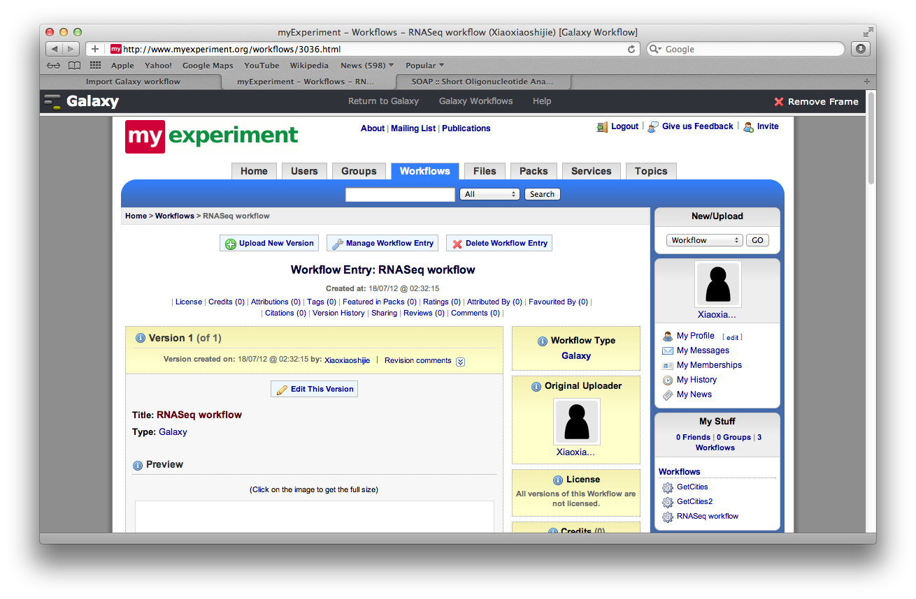
Export (2)

Slide 29
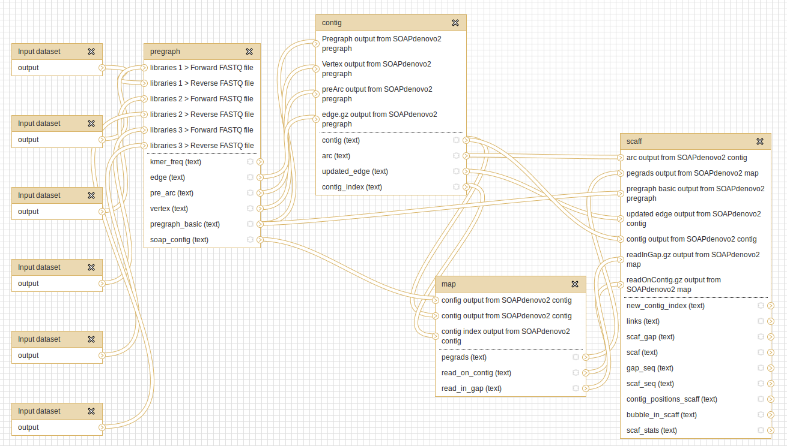
SOAPdenovo2 Galaxy workflow

Slide 30
CBIIT GigaGalaxy structure
Bioinformatics
Development
Biomedical and bioinformatics research
Publishing
Notes:
What does semantic mean in the

Slide 31



Now launched…
Large-Scale Data
Journal/Database
In conjunction with:
Editor-in-Chief: Laurie Goodman, PhD
Editor: Scott Edmunds, PhD
Commissioning Editor: Nicole Nogoy, PhD
www.gigasciencejournal.com
Notes:
Introduction into GigaScience, a journal published by BGI and BioMed Central which focuses on the publication of papers involving the analysis of large-scale omics data - show first issue slide. In addition, the journal has a focus on enabling the experimental data and results published in its papers to be reproducible for readers. Data produced from post-genomic experiments can be stored in GigaScience's GigaDB database. It currently holds 37 data sets of mainly NGS data - show slide. Each data set is allocated a DOI - Digital Object Identifier which enables the data set to be uniquely identified and used for its citation, providing a handle for tracking its usage.

Slide 32
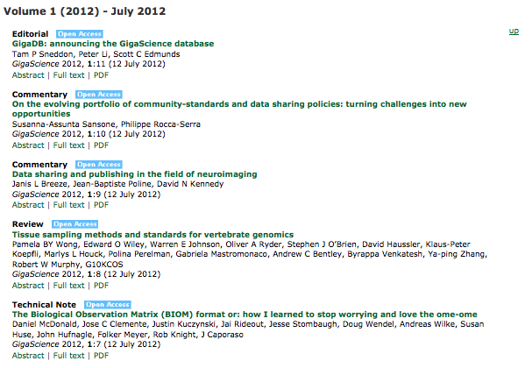
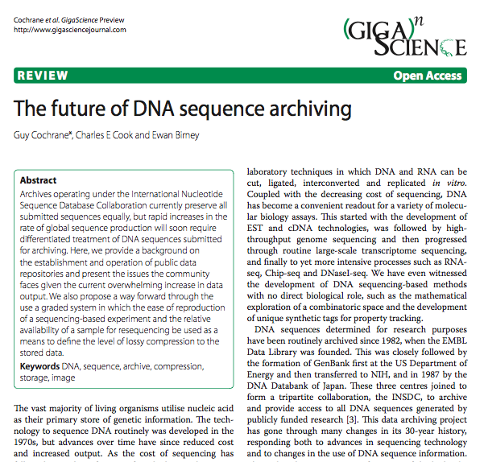
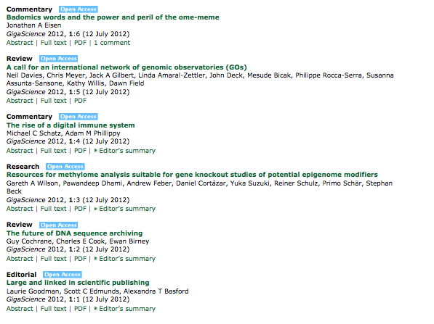
GigaScience is go…

Slide 33
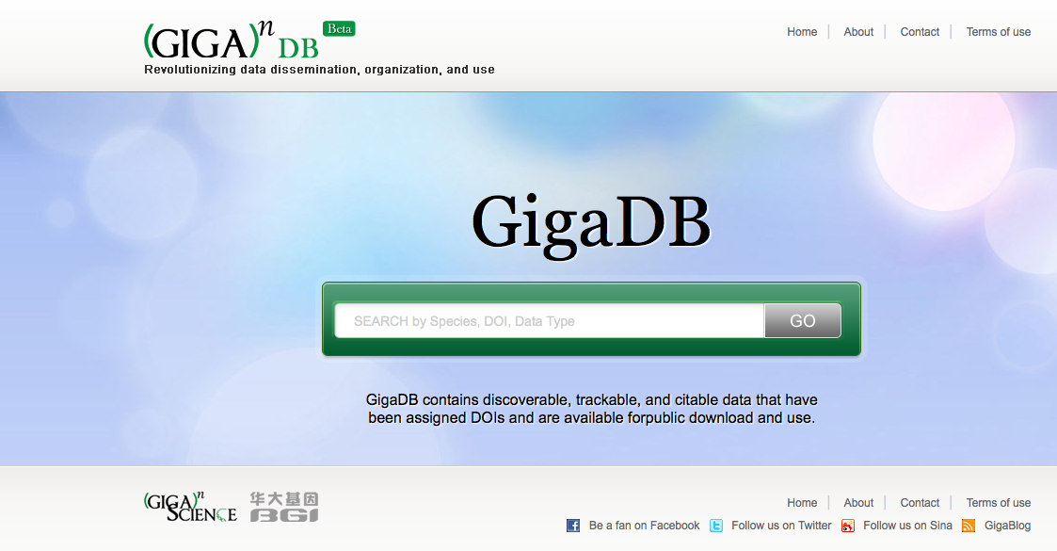
www.gigaDB.org
Data Publishing

Slide 34




40 Datasets with DOI®s
Invertebrate
Ant
- Florida carpenter ant
- Jerdon’s jumping ant
- Leaf-cutter ant
Roundworm
Schistosoma
Silkworm
Released pre-publication
Non-BGI
Paper in GigaScience
Vertebrates
Giant panda
Macaque
Chinese rhesus
Crab-eating
Mini-Pig
Naked mole rat
Parrot
Penguin
- Emperor penguin
- Adelie penguin
Pigeon, domestic
Polar bear
Sheep
Tibetan antelope
Plants
Chinese cabbage
Cucumber
Foxtail millet
Pigeonpea
Potato
Sorghum
Human
Asian individual (YH) v1+v2
- DNA Methylome
- Genome Assembly
- Transcriptome
Cancer (14TB)
Hep B infected exomes
Single Cell Bladder Cancer
Ancient DNA
- Saqqaq Eskimo
- Aboriginal Australian
Coming soon…
Microbiome data
Microbes
E. Coli O104:H4 TY-2482
Cell-Line
Chinese Hamster Ovary
Mouse Methylomes

Slide 35
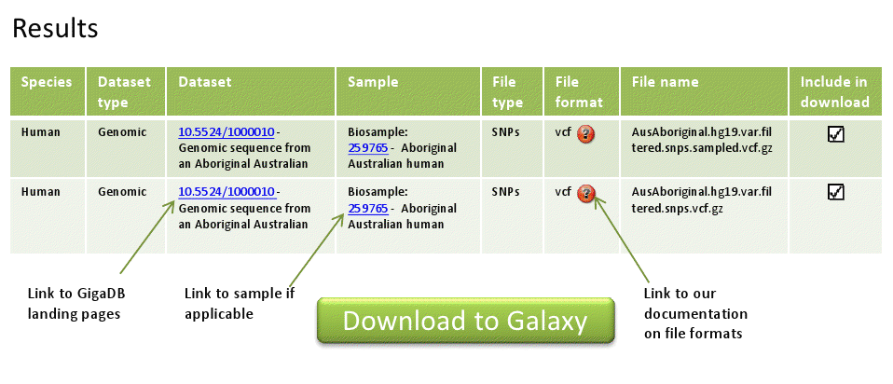
GigaDB v2 export to CBIIT GigaGalaxy

Slide 36



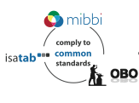
How are we supporting data reproducibility?
Linked to
Data sets
DOI
Linked to
GigaScience
paper
Analyses
Community tools for
data reproduction and reuse

Slide 37


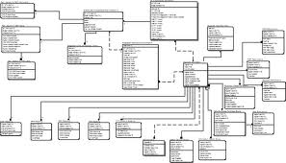

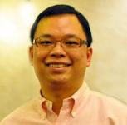

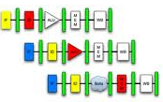


CBIIT GigaGalaxy
Data, Data, Data…
Tin-Lap Lee, CUHK

Slide 38


Acknowledgements
Lee Lab (CUHK)
  Huayan Gao
GigaScience
  Scott Edmunds
  Peter Li
  Tam Sneddon
BGI-Hong Kong
  Dennis Chan
  Edmond Leung
Galaxy team
  Nate Coraor
myExperiment
  Finn Bacall
  Dave De Roure
NBIC
  Kostas Karasavvas
BGI-Shenzhen
Ruiqiang Li
Ruibang Luo
Haofu Wu
SOAP team members

Slide 39
Thank you

