Slide 1
IRRI Galaxy: bioinformatics for rice scientists
Ramil P. Mauleon
Scientist – Bioinformatics Specialist
TT Chang Genetic Resources Center
International Rice Research Institute

Slide 2
Presented in behalf of my co-authors & the development team @ IRRI
Scientists/product/theme leaders
Michael Thomson
Kenneth L. McNally
Hei Leung
Laboratory, software team
Venice Margaret Juanillas
Christine Jade Dilla-Ermita

Slide 3
Outline
Overview of IRRI & it’s research agenda
Bioinformatics activities at IRRI
IRRI Galaxy: current state, future developments

Slide 4
International Rice Research Institute: part of the Consultative Group on International Agricultural Research
CGIAR

Slide 5

CGIAR - global partnership that unites organizations engaged in research for a food-secure future
International Rice Research Institute (IRRI)
Africa Rice Center
International Center for Tropical Agriculture (CIAT)
International Crops Research Institute for the Semi-Arid Tropics (ICRISAT)
International Maize and Wheat Improvement Center (CIMMYT)
International Potato Center (CIP)
International Center for Agricultural Research in the Dry Areas (ICARDA)
International Institute of Tropical Agriculture (IITA)
International Livestock Research Institute (ILRI)
International Water Management Institute (IWMI)

Slide 6
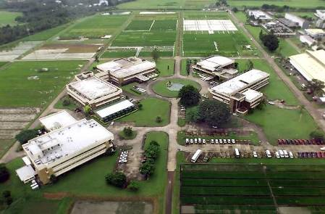
INTERNATIONAL RICE RESEARCH INSTITUTE
Los Baños, Philippines
Mission:
Reduce poverty and hunger,
Improve the health of rice farmers and consumers,
Ensure environmental sustainability
Through research, partnerships
Home of the Green Revolution
Established 1960
www.irri.org
  Aims to help rice farmers improve the yield and quality of their rice by developing..
  New rice varieties
  Rice crop management techniques

Slide 7






Global Rice Science Partnership : GRiSP
A single strategic and work plan for global rice research
Streamlines current research for development activities of the CGIAR, aligns it with numerous partners, and
Adds new activities of high priority, in areas where science is expected to make significant contributions.
IRRI
+++

Slide 8
6 GRiSP Research Themes (2 are rice – research, per se)
Harnessing genetic diversity to chart new productivity, quality, and health horizons
    1.1. Ex situ conservation and dissemination of rice germplasm
    1.2. Characterizing genetic diversity and creating novel gene pools (SNP genotypes, whole genome sequencing, phenotypes)
    1.3. Genes and allelic diversity conferring stress tolerance and enhanced nutrition (candidate genes)
    1.4. C4 rice (Converted from C3 photosynthesis)
Accelerating the development, delivery, and adoption of improved rice varieties
    2.1. Breeding informatics, high-throughput marker applications, and multi-environment testing

Slide 9
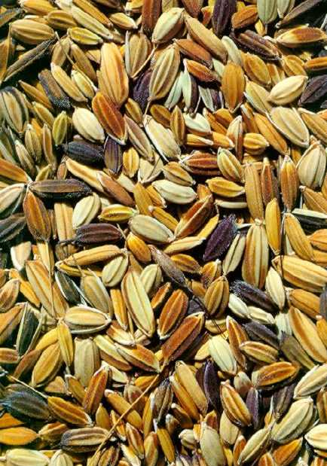
IRGC – the International Rice Genebank Collection
World’s largest collection of rice germplasm (located at IRRI) held in trust for the world community and source countries
Over 117,000 accessions from 117 countries
Two cultivated species
Oryza sativa
Oryza glaberrima
22 wild species
Relatively few accessions have donated alleles to current, high-yielding varieties
http://www.irri.org/GRC
Notes:
The IRGC accessions have served as a source for many traits for varietal improvement, but relatively few
accessions have been used. This project aims to enhance the value of the IRGC by identifying new alleles for
important traits for agronomic improvement. Central to this effort is the application of bioinformatics to the
genomic sequence and functional genomics data from rice and related species to identify promising loci for
allele mining.

Slide 10
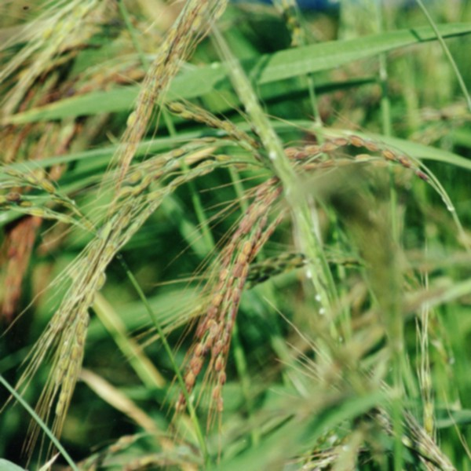
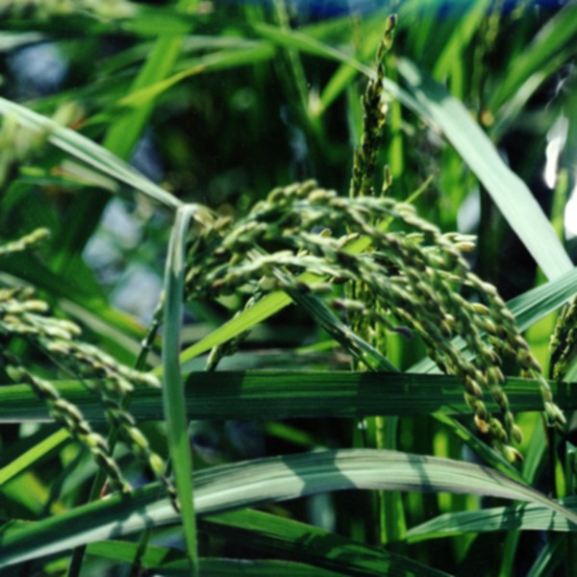
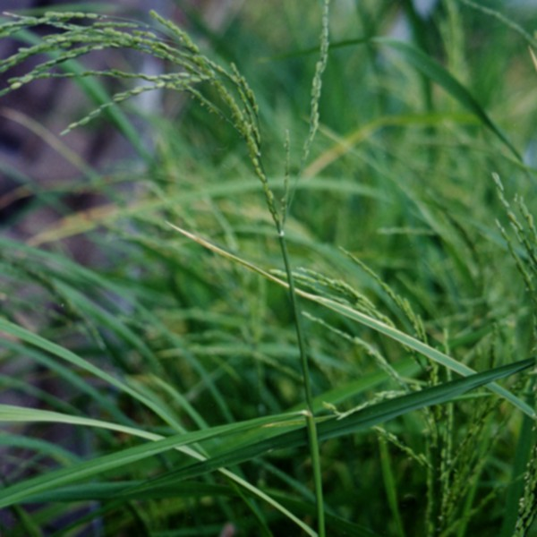
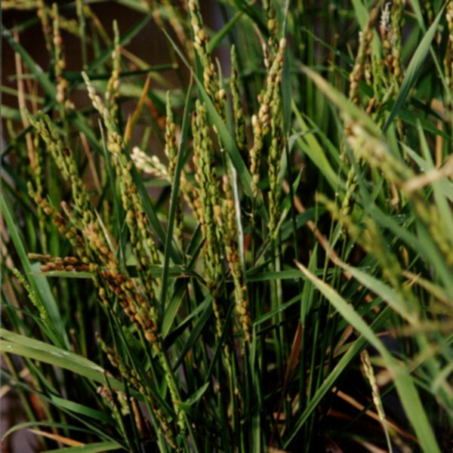
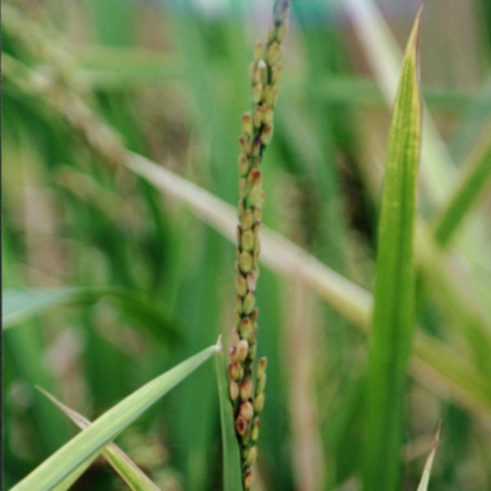
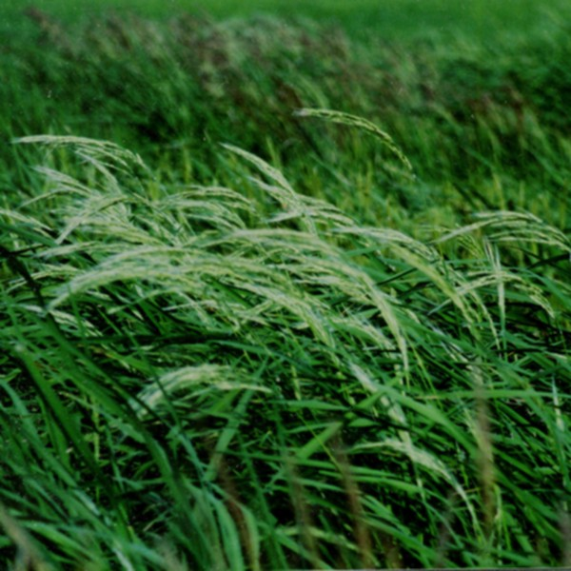
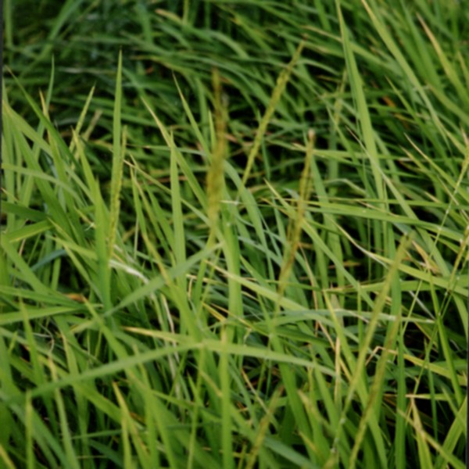
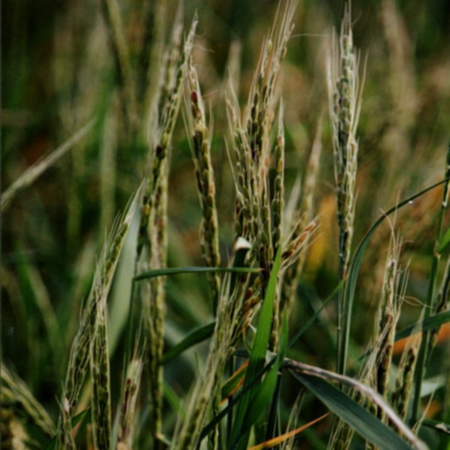
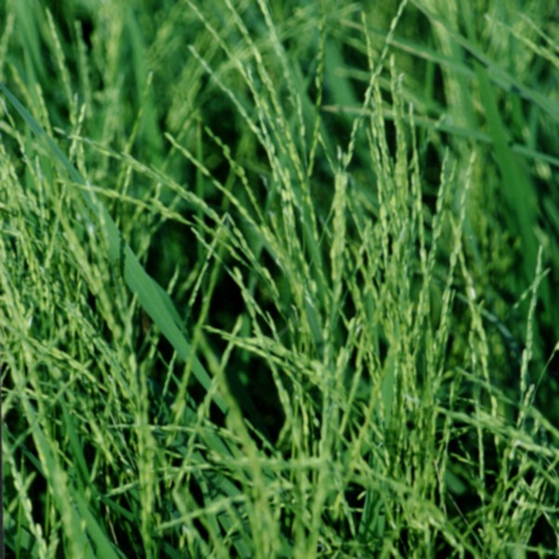
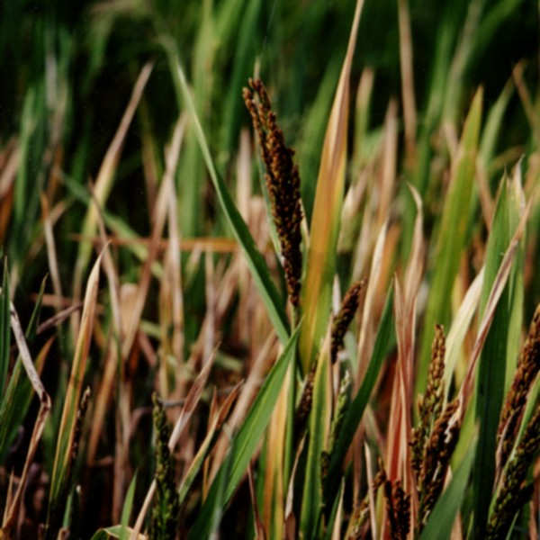
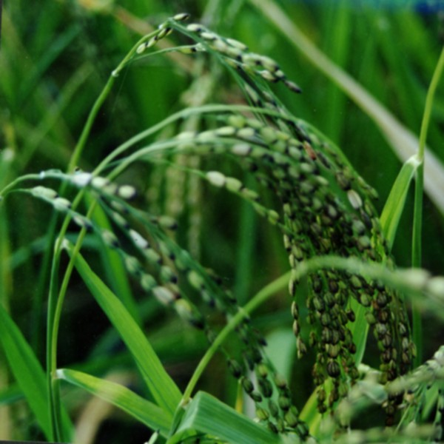
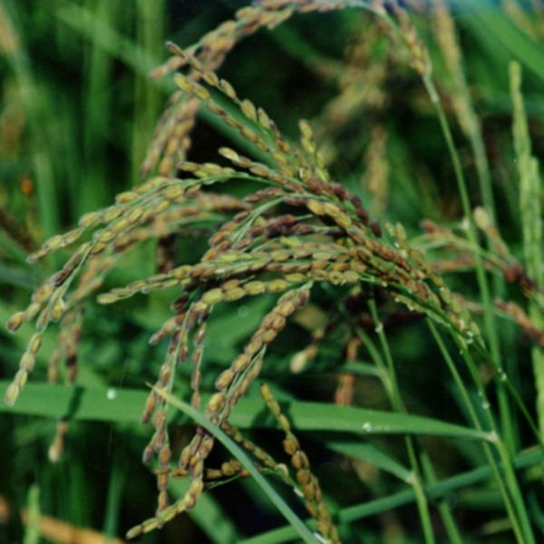
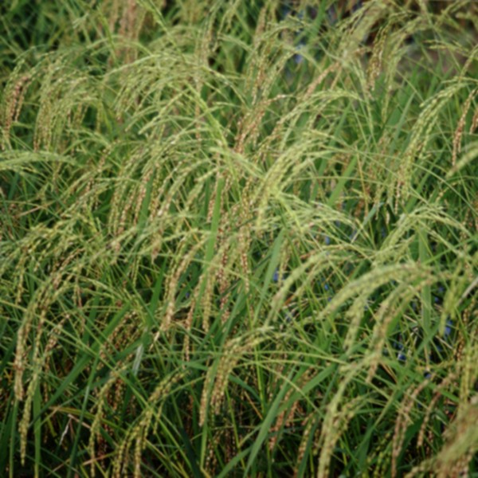
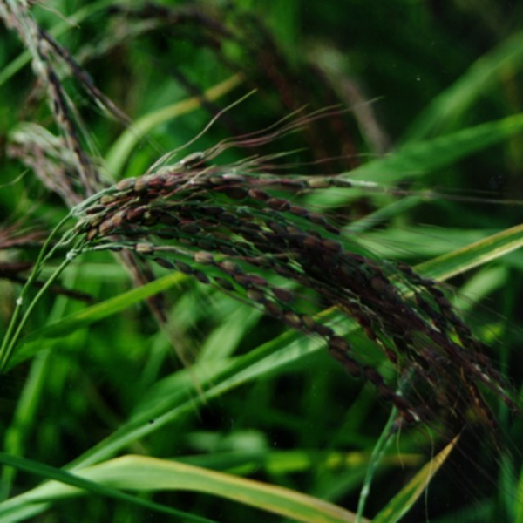
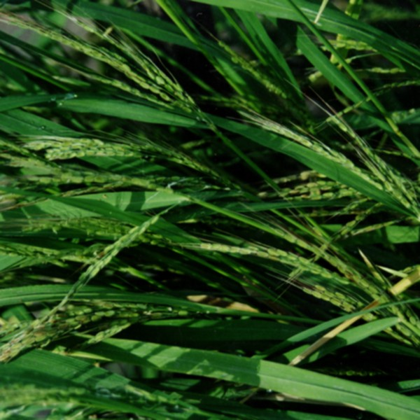
Rice is morphologically very diverse

Slide 11
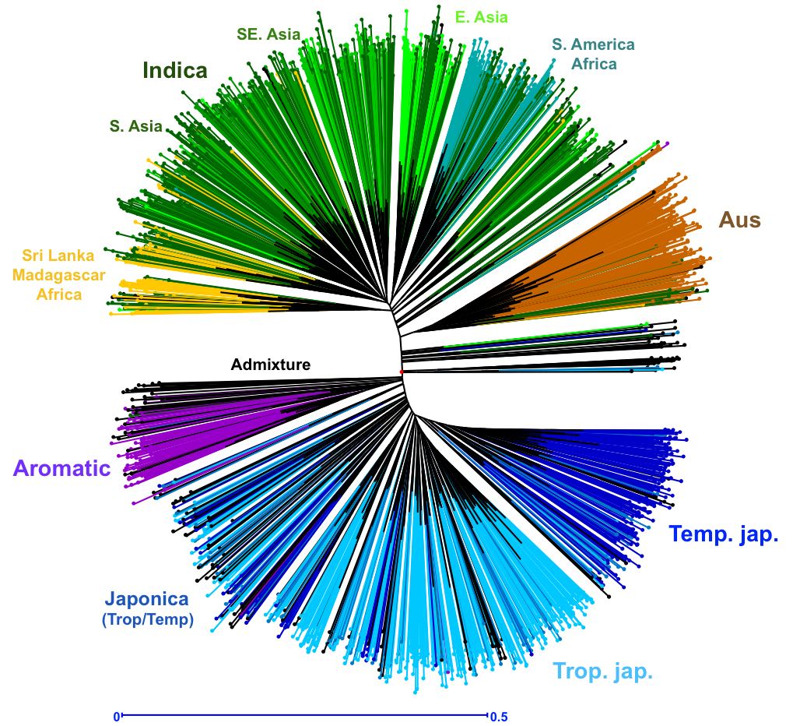


Structure of O. sativa
45 SSR Loci on 2252 lines.
(DARwin5, unwtd NJ, SM coef.)
The color represents group assignment for K= 9 with a minimum allele frequency of 0.65 for model-based structure analysis.
IRRI
Cornell
Rice exhibits deep population structure.

Slide 12
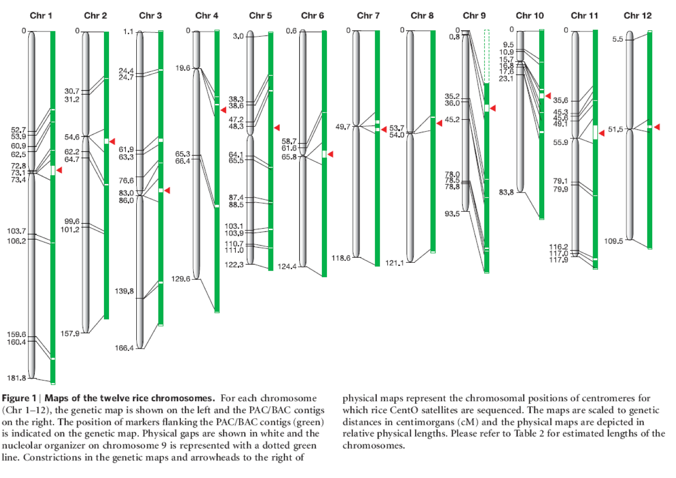
A high quality reference genome is available
HQ BAC-by-BAC Nipponbare
(< 1 error in 10K bases)
IRGSP 2005 Nature 436:793-800

Slide 13
Research themes, Bioinformatics & Galaxy
Leveraging the reference genome, datasets are sequencing technology-based
  Requires bioinformatics knowledge
  Small bioinformatics team at IRRI =
We need to
  enable field/bench researchers for bioinformatics
  share bioinformatics solutions across GRiSP partners
  share solutions with rice research community as a whole
Galaxy bioinformatics workbench (http://galaxyproject.org/) an easy choice

Slide 14
Galaxy features that fit our needs
Open, web-based platform for accessible, reproducible, and transparent computational biomedical research.
Accessible: Users w/o programming experience can easily specify parameters and run tools and workflows.
Reproducible: Galaxy captures info so that any user can repeat and understand a complete computational analysis.
Transparent: Users share and publish analyses via the web and create interactive, web-based documents that describe a complete analysis.

Slide 15
GRiSP 1.2.1: Rice SNP Consortium for enabling genome-wide association studies
Data from high-density genotyping using 44K, 700k Affymetrix SNP arrays and Illumina Beadstudio, Fluidigm medium density platforms
Bioinformatics needs
  Genotype data management system: SNP calling, storage, integration, retrieval, formatting for analysis
  Analysis: GWAS pipelines, genetic analysis tools (for standard & specialized populations)
  Genome browser: integrating published datasets & visualizing
GRiSP 2.1.3 High-throughput SNP genotyping platform for breeding applications

Slide 16
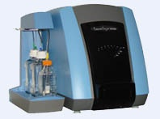


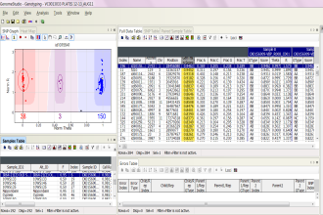
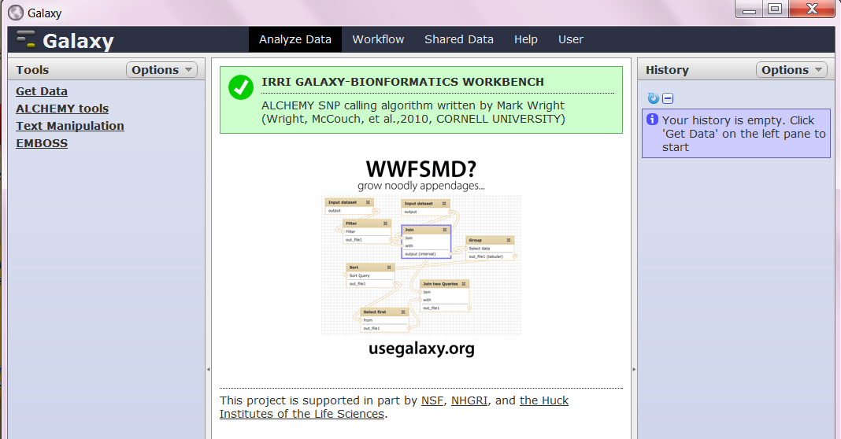
Our 1st Galaxy: SNP calling workflow at IRRI
GenomeStudio + Alchemy plug-in
BeadXpress Scan Results ( 384 SNPs)
Allele calling with ALCHEMY

Slide 17
Why ALCHEMY SNP calling
GenomeStudio’s genotype calling algorithm is designed for human applications
  does not consider inbred samples or population deficient in heterozygotes
Alchemy : Open source, developed at Cornell University by Mark “Koni” Wright et al. (2010)
  addresses the poor performance of the vendor’s software on inbred sample sets
  ability to estimate and incorporate inbreeding information on a per sample basis
  written in C ; compiles neatly under the GNU/Linux environment

Slide 18



GRISP 1.2.3: The Rice 3,000 Genomes Project: Sequencing for Crop Improvement
Kenneth McNally, Ramil Mauleon, Chengzhi Liang, Ruaraidh Sackville Hamilton,
Zhikang Li, Ren Wang, Hongliang Chen, Gengyun Zhang, Hongsheng Liang,
Hei Leung, Achim Dobermann, Robert Zeigler
CAAS
+ Many Analysis Partners
  NIAS Cornell TGAC
  MIPS Cirad IRD
  CAS CAAS BGI
  Academia Sinica MPI KZI
  EMBRAPA AGI Wageningen
  CSHL Gramene Plant Onto
  … Uni Queensland …

Slide 19
Bioinformatics challenges of the project…
Efficient database system that allows the integration of the genebank information with phenotypic, breeding, genomic, and IPR data for enhanced utilization
Development of toolkits/workbenches to enable gene/genotype->phenotype predictions by research scientists and rice breeders
Make these databases, tools, & analyses results available (& updated) along with the rice gene bank

Slide 20
Focus of bioinformatics developments in 3k project
Sequence/genotype data management, manipulation system
  include primary data visualization (SNPs, genome)
Data analysis workbench
  Analysis tools, w/ workflow management
  Results visualization (haplotypes, population structures, GWAS results)
  Highly efficient sequence/analysis results data storage model & phenotype database

Slide 21
Objective 1 : Sequence primary analysis
Milestone 1: Construction of new variety group reference genomes for the representative clades
  Quick draft genomes: SOAP de novo –based assembly (Assembl, V.J. Ulat - IRRI)
    Velvet fails with our dataset (legitimate out-of-memory error, likely due to repeats)
  New strategies (adapt/optimize/create algorithms) for high-quality assembly of new references, thru collaborations with partners mentioned before..

Slide 22
Assembl
New k-mer size iteration
SOAP denovo assembly
Contig
Scaffold
Gap closer
Automatically generate SOAP denovo config files
Draft genome
with tiling path
multi-mapped, unmapped scaffolds
Short reads data
Align scaffolds to reference (nucmer)
Bin to chromosomes
Segregate per chromosome unique, multi-hits
QC trim/filter (fastx toolkit)
Reference genome(s)

Slide 23
Objective 1 : Sequence primary analysis (contd)
Milestone 2: SNP genotypes construction & diversity analysis: Haplotype structure & local (genome-block) diversity analysis
  Main problem:
    Number of samples (3,042 varieties) overwhelms existing software & computers (for SNP discovery, a big problem)
  One Proposed Solution : PANATI
    Koni Wright PhD thesis, Cornell University – Very fast SNP discovery and genotype calling using SW alignment

Slide 24
PANATI (http://panati.sourceforge.net)
No hard limits on the number of mismatches and in/dels imposed by the algorithm
Designed for and best suited for analysis of population samples with high diversity or for the use of a divergent proxy reference sequence for species which have no adequate reference of their own
Fast execution even when there is high divergence between the sample and the reference sequence
free for academic use

Slide 25
PANATI technical features
Read lengths of any size
  Input can be mixes of different read lengths and single-end or paired-end formats
Flexible trade-offs between speed and memory usage
Multithreaded parallel execution of mapping and alignment scaling in linear performance up to 64 CPUs (higher has not been tested)
Ability to read compressed FASTQ files in bzip2 or gzip formats directly
  will automatically use pbzip2 for parallel decompression of pbzip2 compressed files if the program is available

Slide 26
Objective 1 : Sequence primary analysis (contd)
Milestone 3: Annotation of constructed variety reference genomes, genotypes/haplotypes of the 10k genomes, & diversity analyses results
  Intersection of results from various annotation pipelines
    RAP pipeline(NIAS , T. Itoh et al)
    PASA (TIGR)
    Gramene evidence-based method
    Maker (GMOD)

Slide 27
Objective 2 : Build database & visualization tools for the genomes / genotypes / haplotype/diversity analysis results
Milestone 1. Building the project genome browser; some issues:
  Multiple reference genomes to display & call SNPs from
    Per reference view, several at a time
    Super (“pan”) genome view
  So many varieties to display
    Pick & show subsets? Global Display?
    Regional/global genome comparisons between varieties

Slide 28
Option 1: UCSC Genome Browser
Good
  Fast even for large datasets
  Funded, with large community support base
  Nice integration with Galaxy
    Pick & choose varieties in Galaxy → UCSC gbrowser visualization
Not so good
  Painful installation
  Steep learning curve (esp. for customizations)
  Lack of comparative genome view

Slide 29
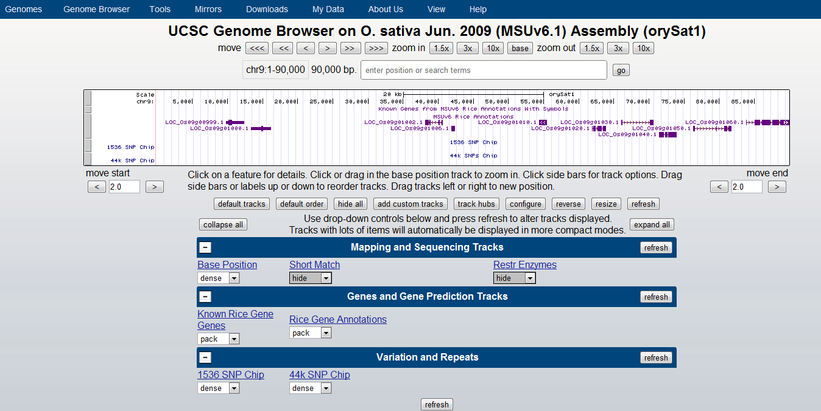
UCSC Browser hosted @ CU, mirror @ IRRI

Slide 30
Option 2: GMOD Gbrowse
Good
  “Comfort zone” genome browser – installation, customization
  Simple DB schema (basic install)
  Funded, with large community support base
  Comparative genome view supported
  Integrates with Galaxy (similar to UCSC Gbrowser)
Not so good
  Slow for large datasets

Slide 31
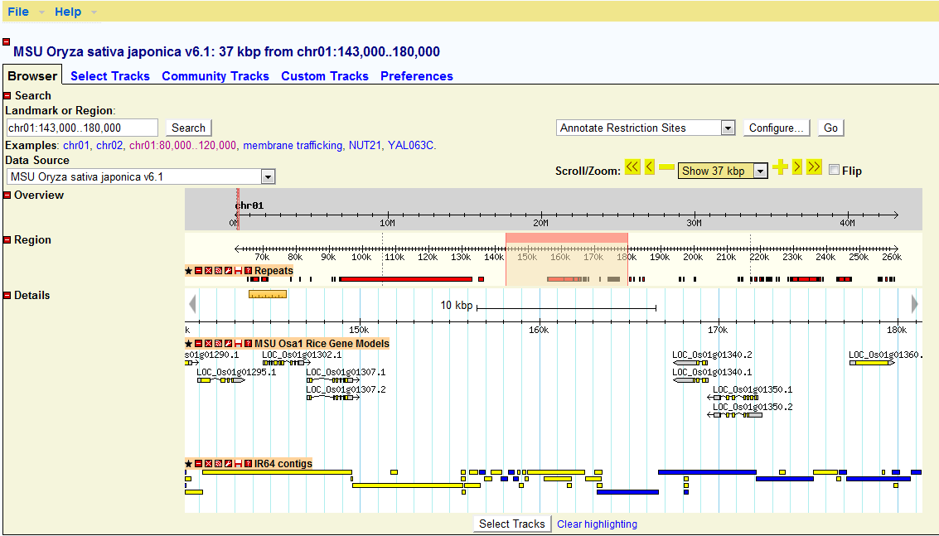
GMOD Gbrowse with draft genome assembly anchored rice reference genome

Slide 32
Objective 2 : Build database & visualization tools for the genomes / genotypes / haplotype/diversity analysis results (contd)
Milestone 2: Build data analysis application tools coupled to the sequence database
Some existing tools (input from collaborating institutes)
  EU- transPLANT project: computational infrastructures for plant genomics
  Haplophyle @ CIRAD
Build Galaxy for tools developed/adopted by project
  Sequence/genotype management
  Novel data analysis methods, workflows

Slide 33
Objective 3 : Genotype - > Phenotype analysis/ breeders’ toolkit
Milestone 1 – Create an integrated phenotype database
Milestone 2 - Association (GWAS) & genetic analysis tools
  TASSEL , java web start in IRRI GALAXY
  R packages integrated into IRRI GALAXY
    R-GENETICS
    GAPIT – Buckler, et al., Cornell University
Milestone 3 – The breeders’ toolkit
  Major project.. Putting all these tools together in a target user-friendly package
  Breeder’s use cases captured as workflows
  Is GALAXY up to this task??
  Will breeders use it??

Slide 34
IRRI Galaxy: Current status
Deployed in the cloud (Amazon Web Services Large instance – Singapore region)
Streamlined to contain rice-specific tools and genotyping data
NO NGS assembly tools in public site

Slide 35
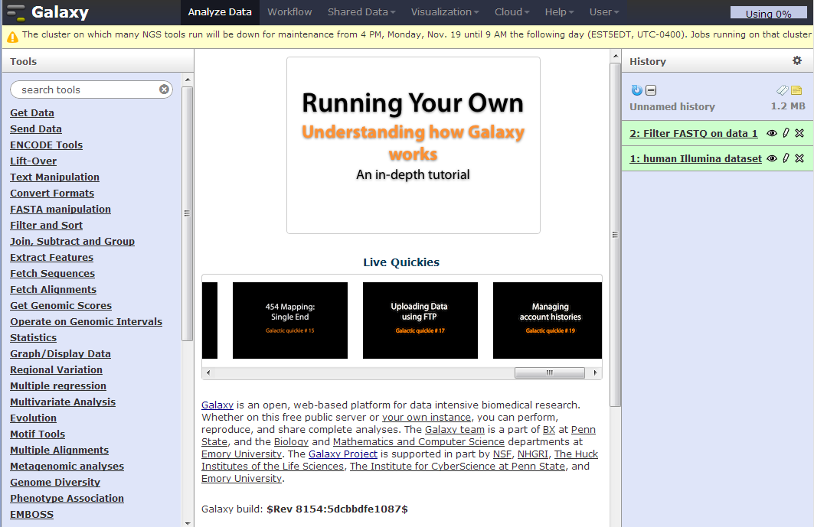
Standard Galaxy release

Slide 36
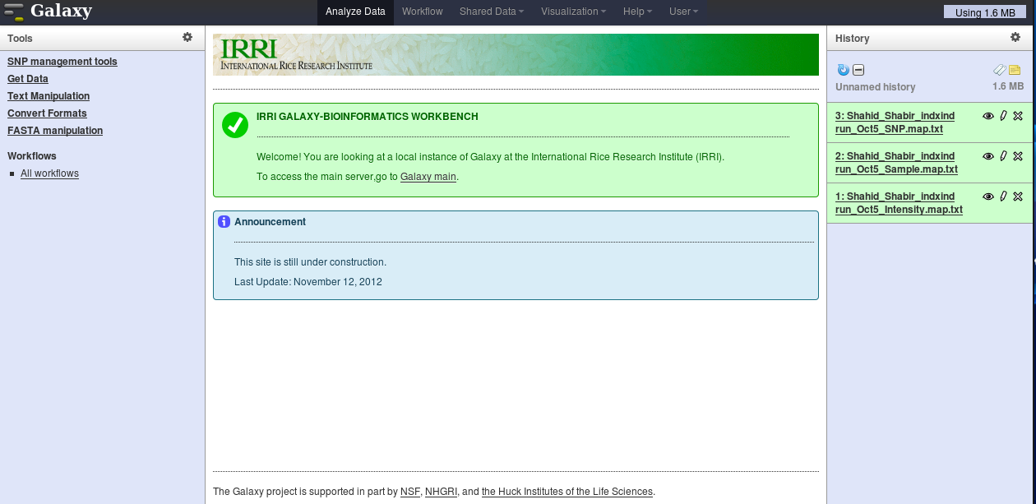
IRRI GALAXY (current)

Slide 37
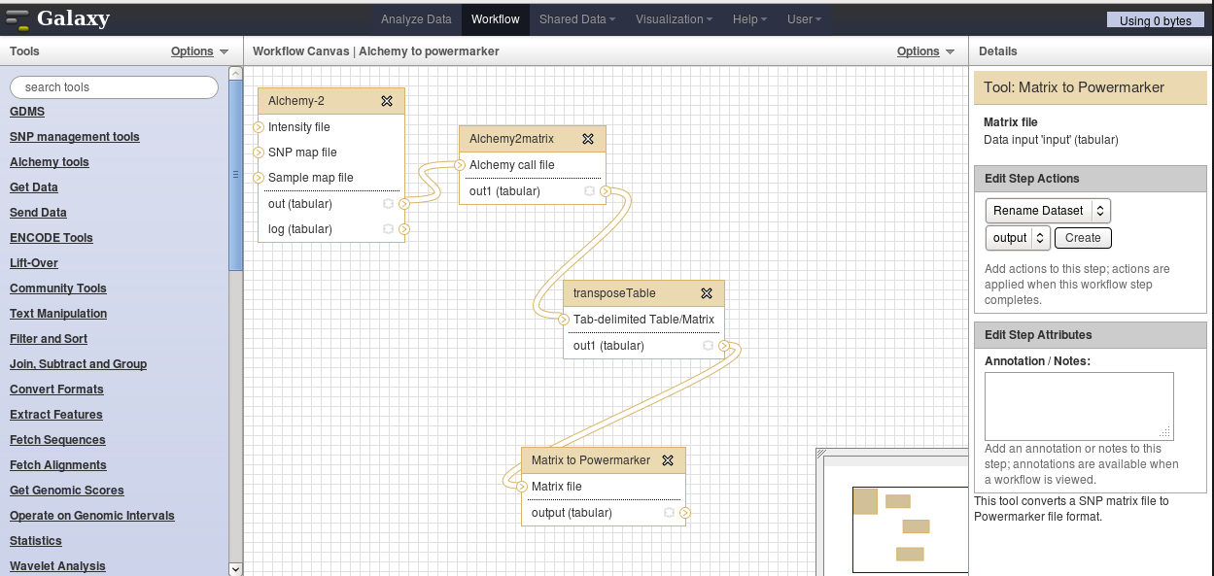
Workflows for rice data analysis already available

Slide 38
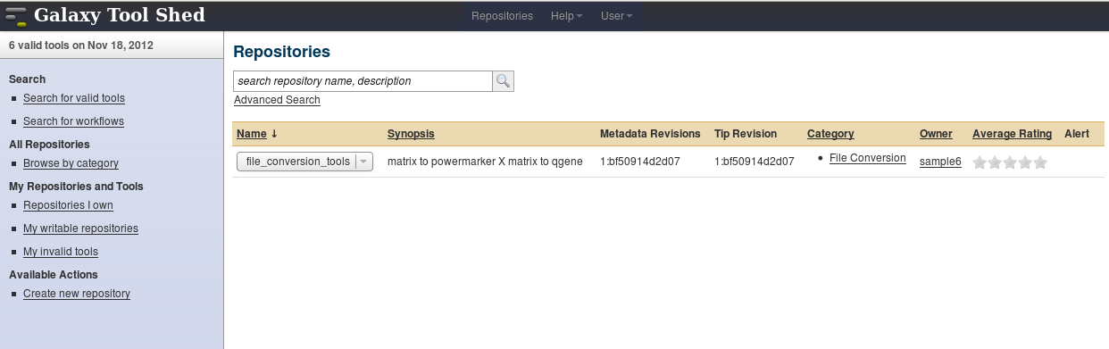
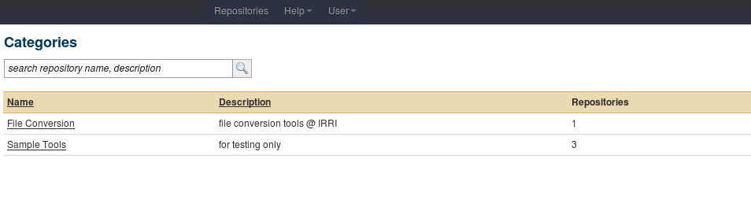
IRRI Galaxy Toolshed is under development (1)

Slide 39
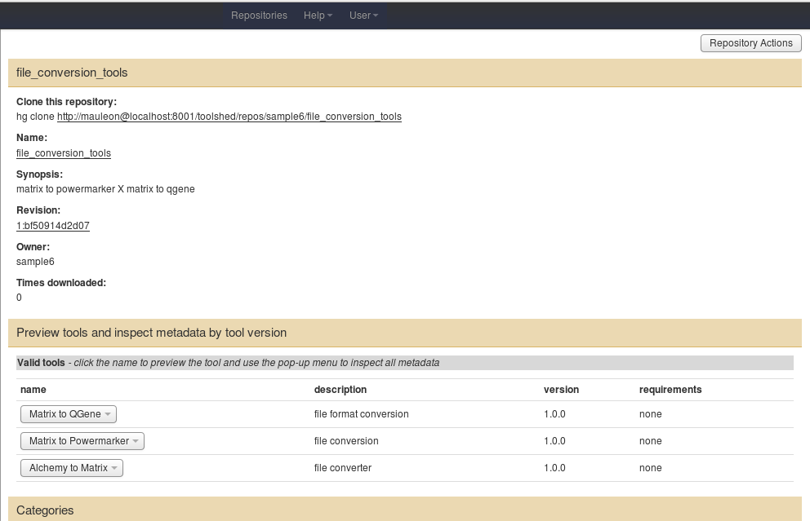
IRRI Galaxy Toolshed is under development (2)

Slide 40
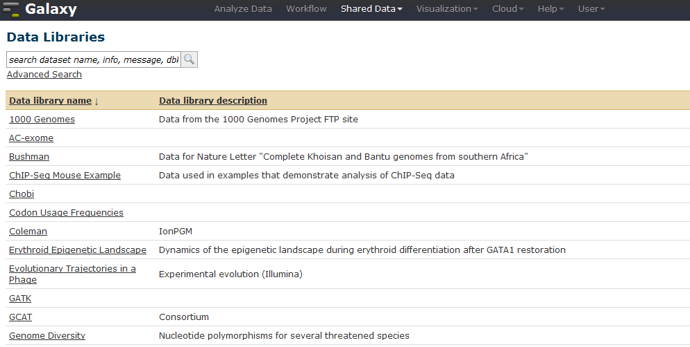
Share data, import into current analysis (upon publication of studies..)

Slide 41
Solving the data mining issue for large data/results sets
BIO HDF5 technology (Hierarchical Data Format) - http://www.hdfgroup.org/projects/biohdf/
Bottom line:
  very fast data mining of alignments (SAM/BAM), sequences when the data model/file organization & tools (C APIs & libraries) are used
  Pilot ongoing now for 2,000 samples genotype data
HDF5
C API
BAM/SAM files
SNP data
Sequences
annotation
Sequence analyses results
loader
queries
File system

Slide 42
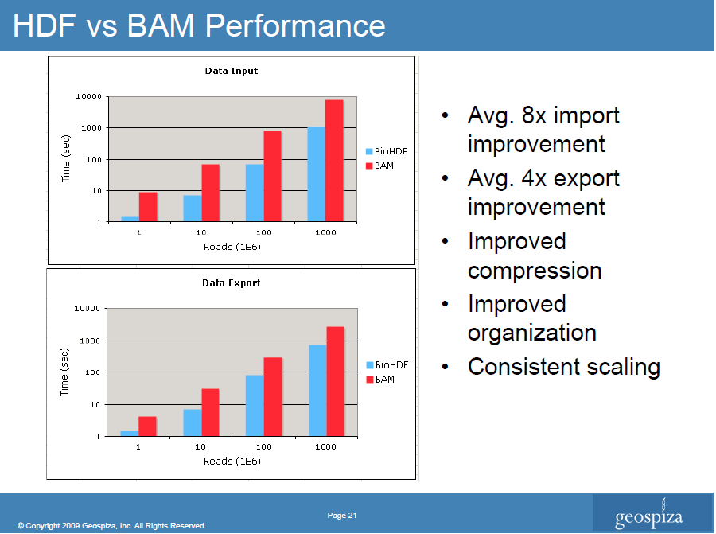
from www.hdfgroup.org/pubs/presentations/BIOHDF-BOF-SC09-final.pdf

Slide 43
Projects in IRRI Galaxy bioinformatics workbench
SNP data pre-processing & calling (Alchemy, PANATI - M. Wright)
Data format manipulation for downstream analysis tools
Population analysis tools
  Structure (Pritchard et al.)
  Ade4 R package (Chessel et al.) for Analysis of Molecular Variance
Downstream sequence analysis tools e.g. unique primer design (Triplett et al, Colorado State University, in prep)
Interfaces for SNPs data management & analysis
  GWAS: TASSEL (Bradbury et al.), GAPIT
  GBS analysis pipeline
Pick & choose data to visualize: Varieties → Genome browser

Slide 44
Summary
Bioinformatics and database to
Integrate sequence-phenotype data
Use in breeding programs
BGI de novo and
re-sequencing
Initial 5-10X coverage
Rice SNP Consortium
700k Affymetrix genotyping chip
2000 lines
10,000 GeneBank accessions¹
Cultivated + close wild relatives
Genebank as a reverse genetics system
Select accessions based on QTL prediction for targeted phenotyping of specific traits
Discover novel phenotypes
Phenotyping network
2000+ lines
Association genetics and
QTL mapping
Predict genotype-phenotype relationships at kb resolution
Specialized genetic stocks: MAGIC populations, biparental RILs, CSSL,
IRRI & GRiSP,
CAAS
¹ Including publicly accessible germplasm from IRRI, CIRAD, AfricaRice , CIAT and regional collections

Slide 45
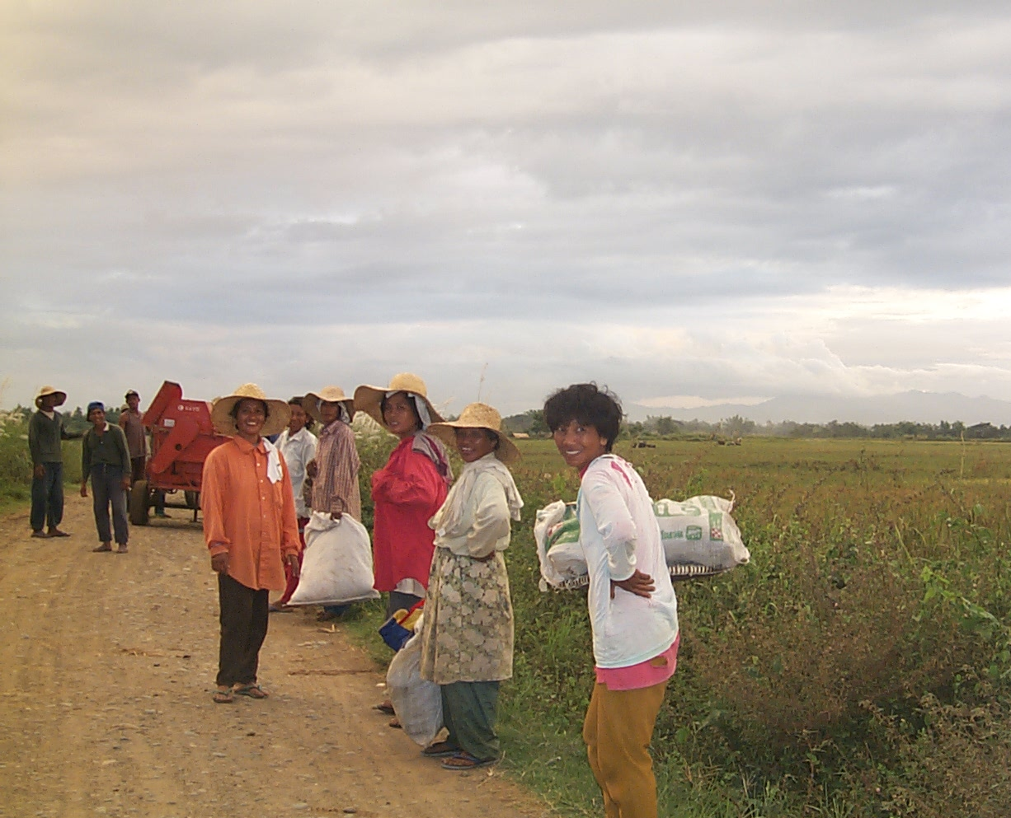
THANKS FROM OUR CUSTOMERS ☺

