Slide 1

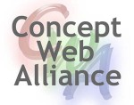


Newton's ideas and methods are preserved forever: how about yours?
Marco Roos, Kristina Hettne, Jun Zhao, Mark Thompson
Cloud and Workflows for Reproducible Bioinformatics
Shenzhen, December 19, 2012

Slide 2

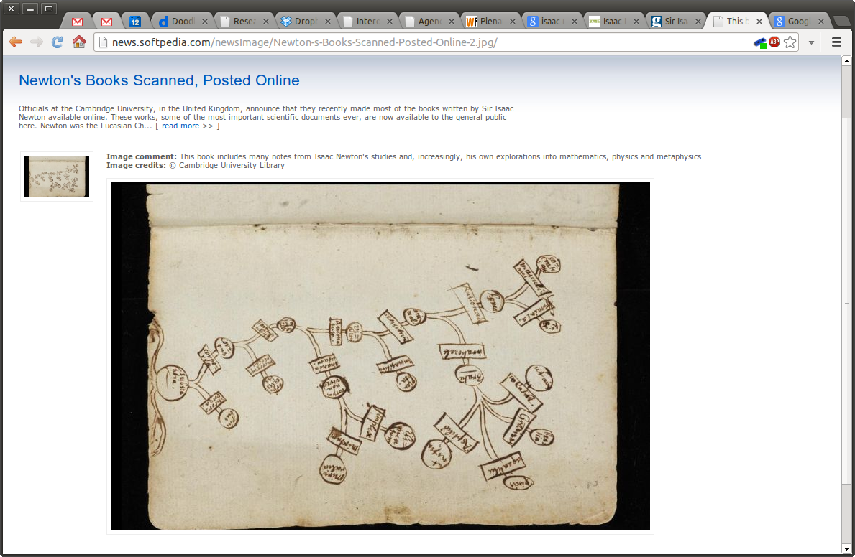
Notes:
This talk is about the value of preservation of good science, and what we can do about it.

Slide 3
Reproduced workflows
Mass
Power & Mass Web Service
Force
Acceleration

Slide 4
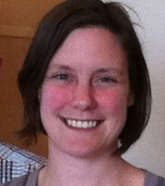
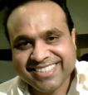
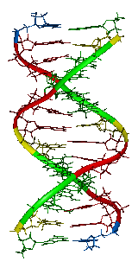
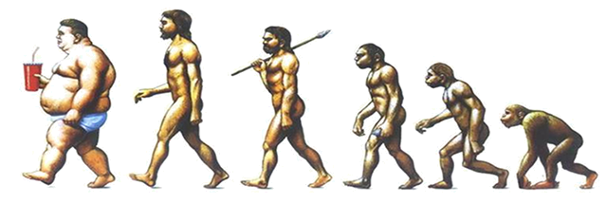
Case study
Bioinformatics analysis of Metabolic Syndrome
Kristina Hettne, Harish Dharuri
Genome Wide Association Studies
What is the genetic basis for the diseases associated with Metabolic Syndrome?

Slide 5
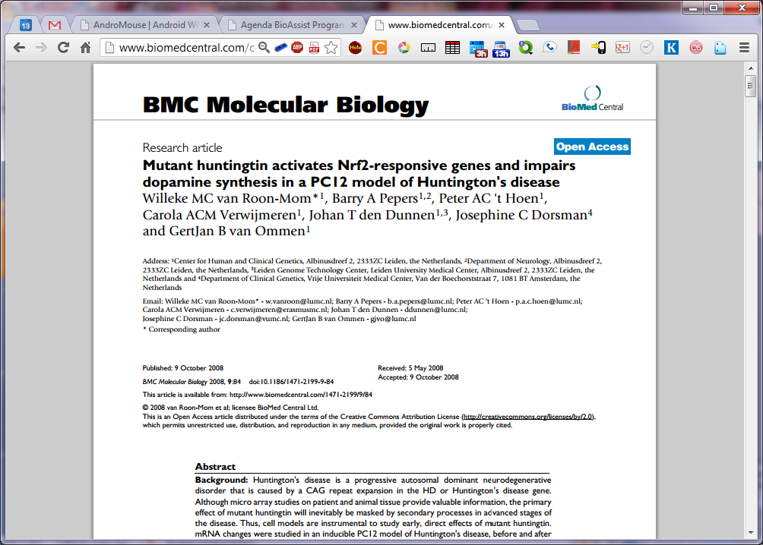
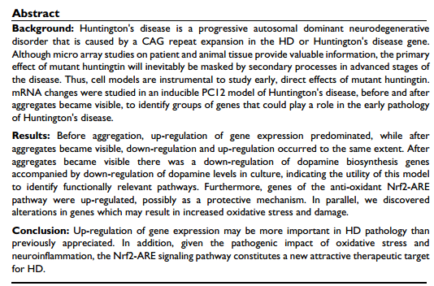
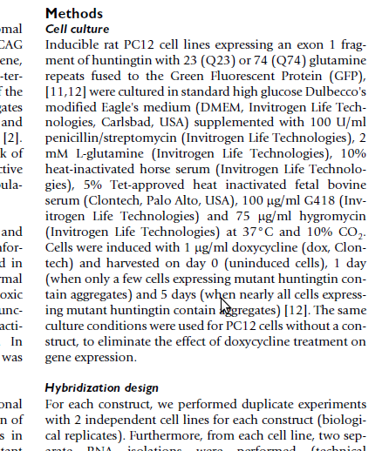
Reproducible Science
Preservation for the wet laboratory scientist
From Van Roon-Mom et al., BMC Molecular Biology 2008
doi: 10.1186/1471-2199-9-84.
Notes:
In wet-lab biology and other experimental sciences, we have addressed these questions in what we disseminate and how. The system is not perfect. It is flawed for real reproducibility, but it does give insight into how results were obtained. Sufficient to make up our own minds on whether to use the results for our own hypotheses, or build on the methods.
=> Do we have a good digital equivalent?

Slide 6
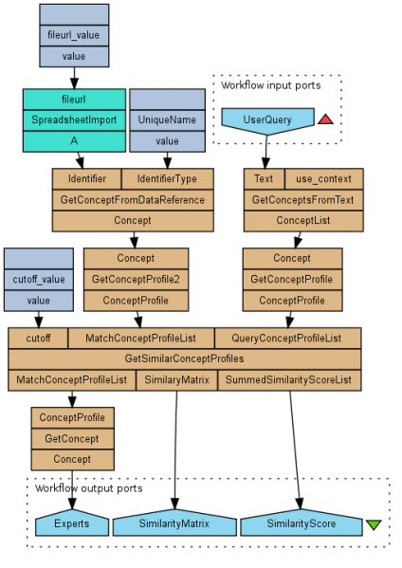
Reproducible Science?
What is the digital equivalent?
Is it equally good?
Can we do better?
- or worse?
GroundHog DB
Reproduced from Jelier et al., Schuemie et al., Hettne et al., Haagen et al.,
http://biosemantics.org , myExperiment.org/workflows/2197
Notes:
Workflows could be seen as an equivalent of wet lab protocols. Are they as good as Materials and Methods, better or worse?
=> Perhaps worse?

Slide 7
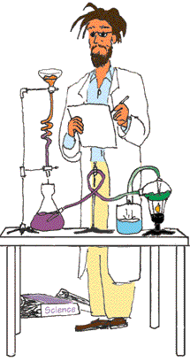
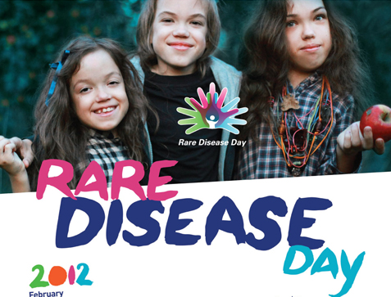
Reproducible Science
What is our incentive?
Nobility
Good Reproducible Science
Greater Good
Serve the public
Notes:
And then: what is our incentive to make it as good or better?
Is it nobility, or serving the greater good?
=> Getting on with it: publish

Slide 8
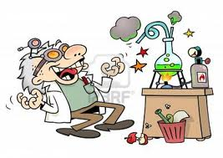
Reproducible Science
What is our incentive?
Fame and Glory
Getting on with it...
I’ll be the first in Nature
Notes:
Or is it helping me to me next Nature paper?

Slide 9
Stimulate preservation and reproducibility while speeding up the research process
Challenge

Slide 10
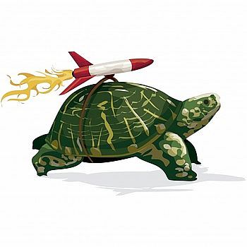
Enhance the research cycle
What slows us down?
SW
Research Question
Find Methods and Data, + their Owners
Get Methods and Data
Understand Methods and Data
Format (Align)
Data
Design the Analysis
Interpret Results
Compute
Publish

Slide 11
Bottlenecks
Loosing track of what you did
Messy storage
Preparing material for a publication
Understanding the computational procedure
Communication with (non-technical) colleagues
Keeping tools working
Getting credit for digital results outside of traditional publications

Slide 12
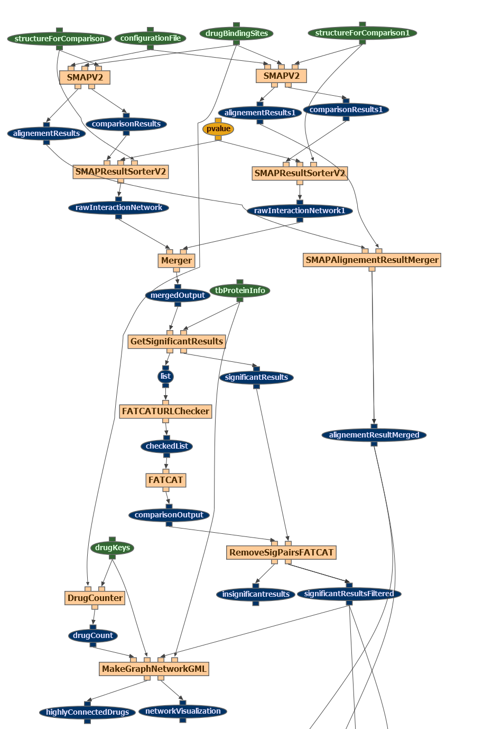
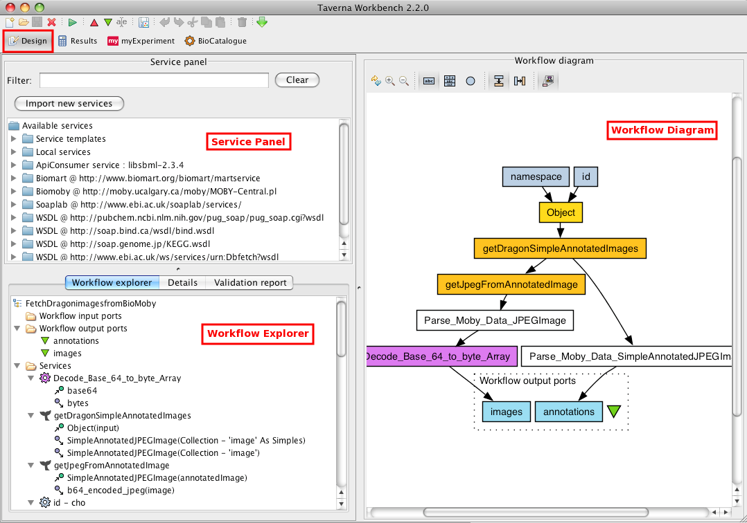
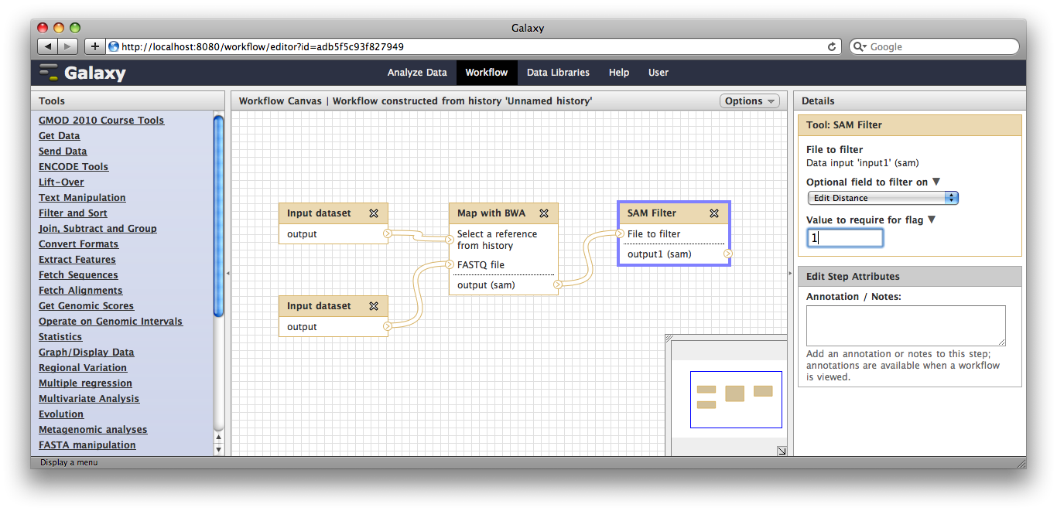
Getting on with workflows
Notes:
Some see workflows as a good way to help us get on with it, not just for preservation purposes. This is a discussion by itself, not the focus here.

Slide 13
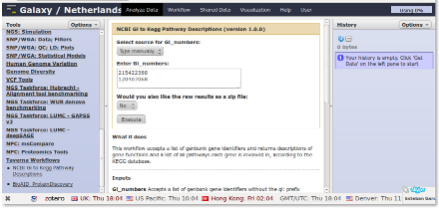
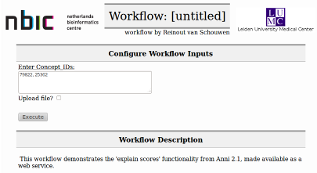
Monolithic Tool →
Web Services → Workflows → (Web) Tool
Example: Anni 2.0 → Anni workflows
AnniWF
http://workflow.biosemantics.org/t2web/workflow/2725

Slide 14
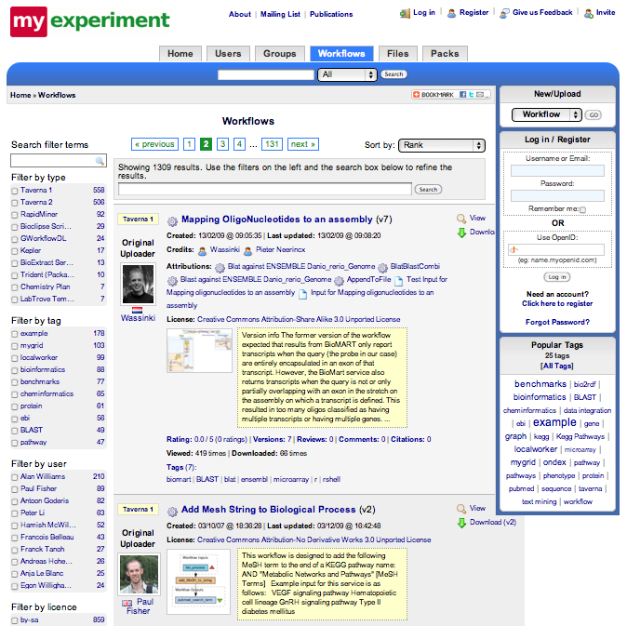
Digital Repository myExperiment.org
The recipes store
Find workflows
Share workflows & files
Find people
Build communities
Publish packages
Tag workflows
Score, rate, comment

Slide 15
Instructions for workflow authors
10 Best Practices for creating workflows
Make a sketch workflow
Use modules
Think about the output
Provide example inputs and outputs
Annotate
Test execution from outside local environment
Choose services carefully
Reuse existing workflows
Advertise
Maintain
10/10

Slide 16
Reproducible Science
Is a workflow sufficient?
Useful Preservation
=
Understandable Objects
Reproduce, Reuse, Repurpose, Repair, ...
What is this doing?
Reproduced from Jelier et al., Schuemie et al., Hettne et al., Haagen et al.,
http://biosemantics.org , myExperiment.org/workflows/2197

Slide 17
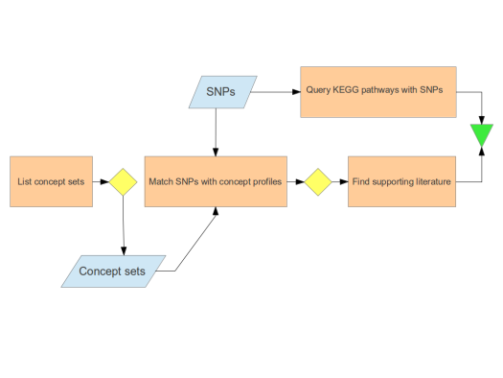
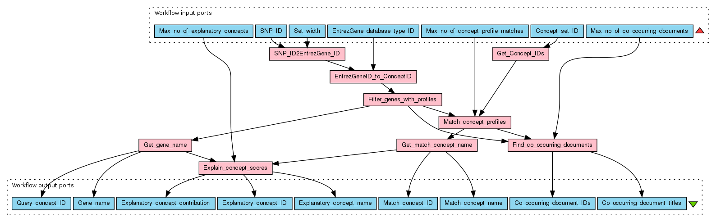
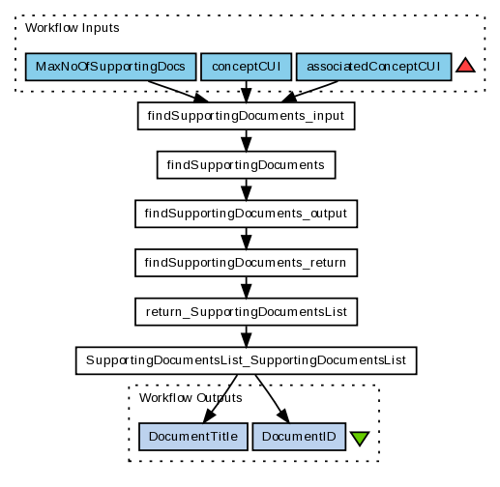
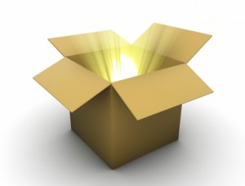

Useful preservation 1 myExperiment Packs
“Experiment sketch”
“Workflow to display supporting documents”
“SNPs from GWAS”
MedLine abstracts until 2009
Hypothesis document

Slide 18
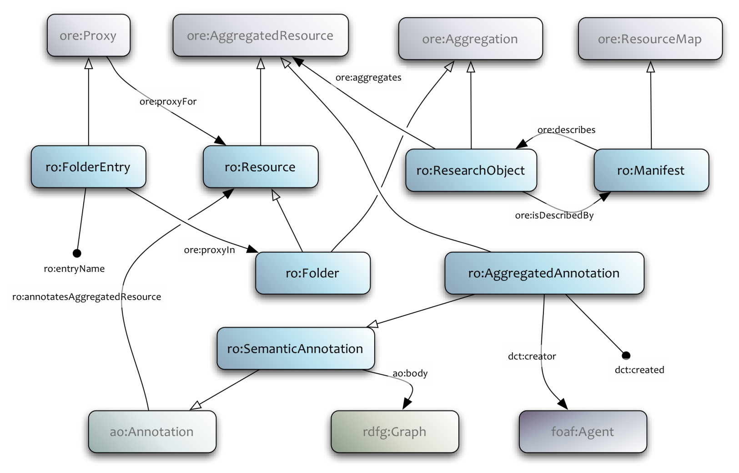
Useful preservation
Research Object Model
Research Object Model
Aggregation and Annotation Model for Digital Methods
http://wf4ever.github.com/ro/

Slide 19
Research Object (RO) Model
RO = ORE + AO + vocabularies
Object Re-use and Exchange (OAI-ORE)
  Describes aggregations of resources:
  data, metadata, papers, etc.
Annotation Ontology (AO)
  Associates RDF metadata descriptions with resources
Generic and domain-specific vocabularies
  Used in annotation bodies to provide information about resources (types, dependencies, descriptions, etc.)
Builds on RDF, leading to RDF as a natural implementation choice
Model specification: http://wf4ever.github.com/ro/
Notes:
The research model used to pull together information about an experiment is based substantially on existing technologies, notably Object Re-use and Exchange (ORE) and Annotation Ontology (AO).
Domain or application specific vocabularies and ontologies are added into this mix to provide supporting information as needed and available.
The structure has been built with RDF in mind, making RDF a natural choice for representing RO structures, but the RO Model is an abstraction which can be implemented with different tools.
The main irreducible underpinning is the use of URIs for linking resources and concepts.

Slide 20
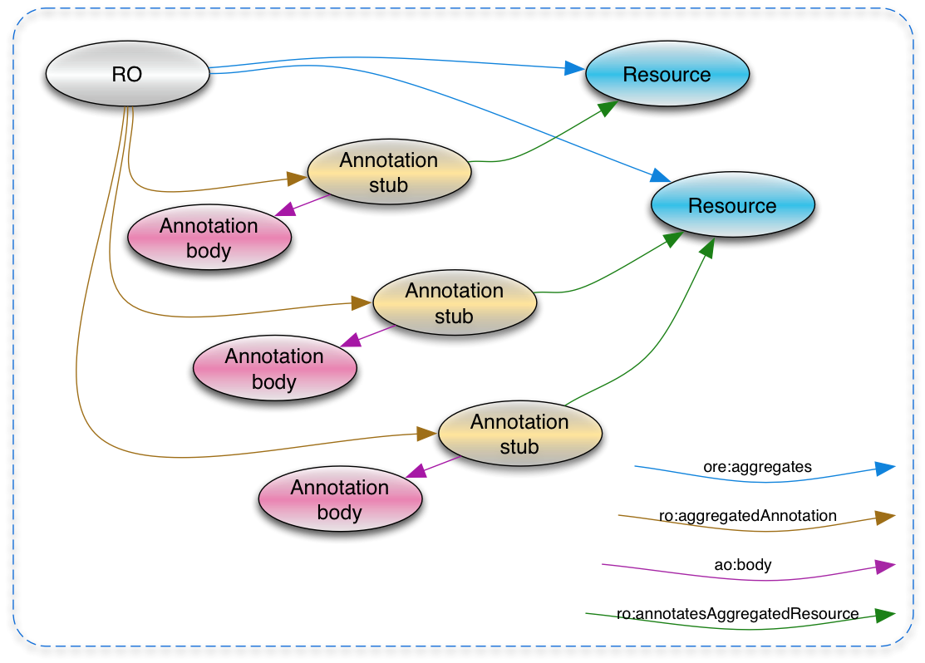
Research Object Model
Notes:
A Research Object aggregates resources
It also aggregates annotations, which are associated with resources
The annotations bodies are RDF documents that use additional, possibly domain-specific vocabularies.

Slide 21
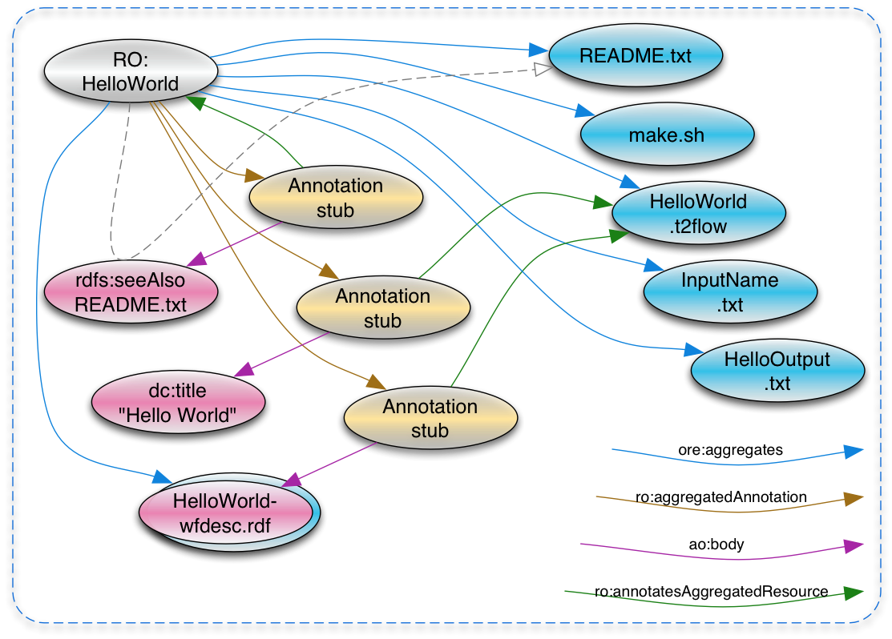
Research Object: “Hello World”
https://github.com/wf4ever/ro-catalogue/tree/master/v0.1/HelloWorld
Notes:
A Research Object aggregates resources
It also aggregates annotations, which are associated with resources
The annotations bodies are RDF documents that use additional, possibly domain-specific vocabularies.

Slide 22
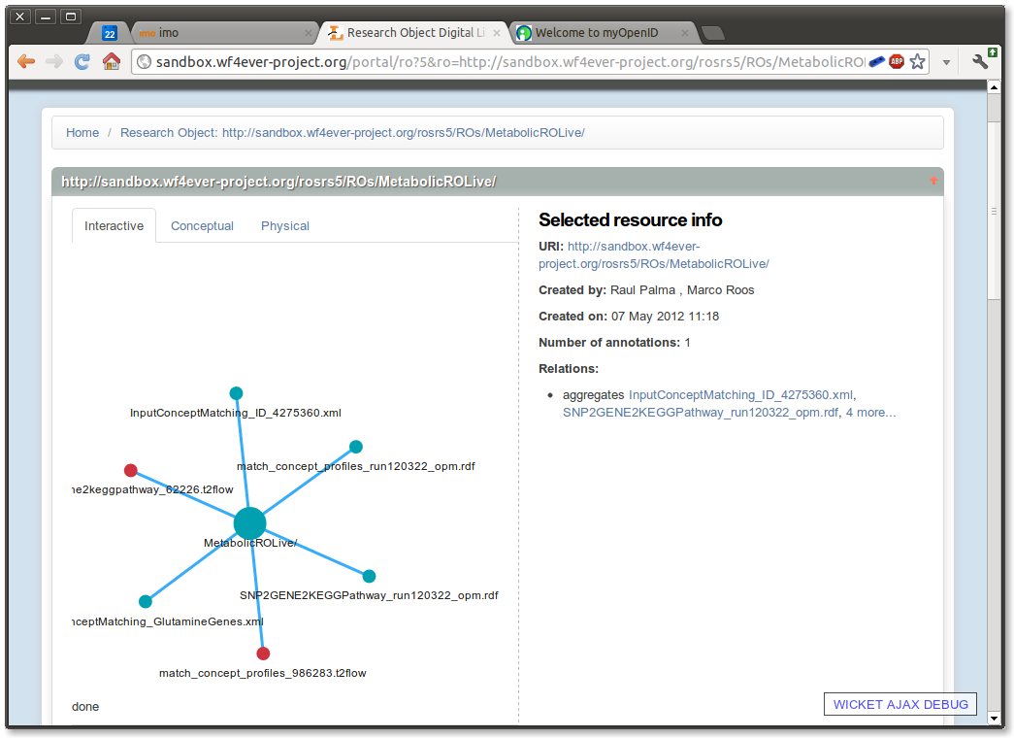
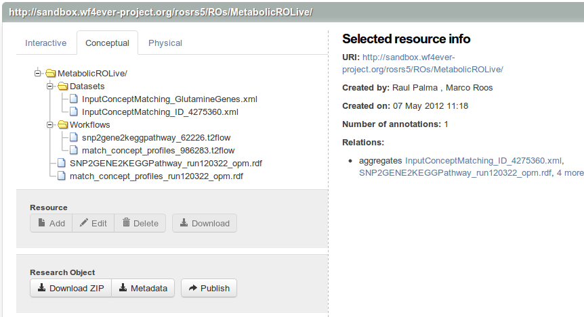
Help organize the materials and methods of computational analysis
Research Object Portal
Materials & Methods of
Metabolic Syndrome
Analysis
Kristina Hettne
Harish Dharuri
http://sandbox.wf4ever-project.org/portal

Slide 23
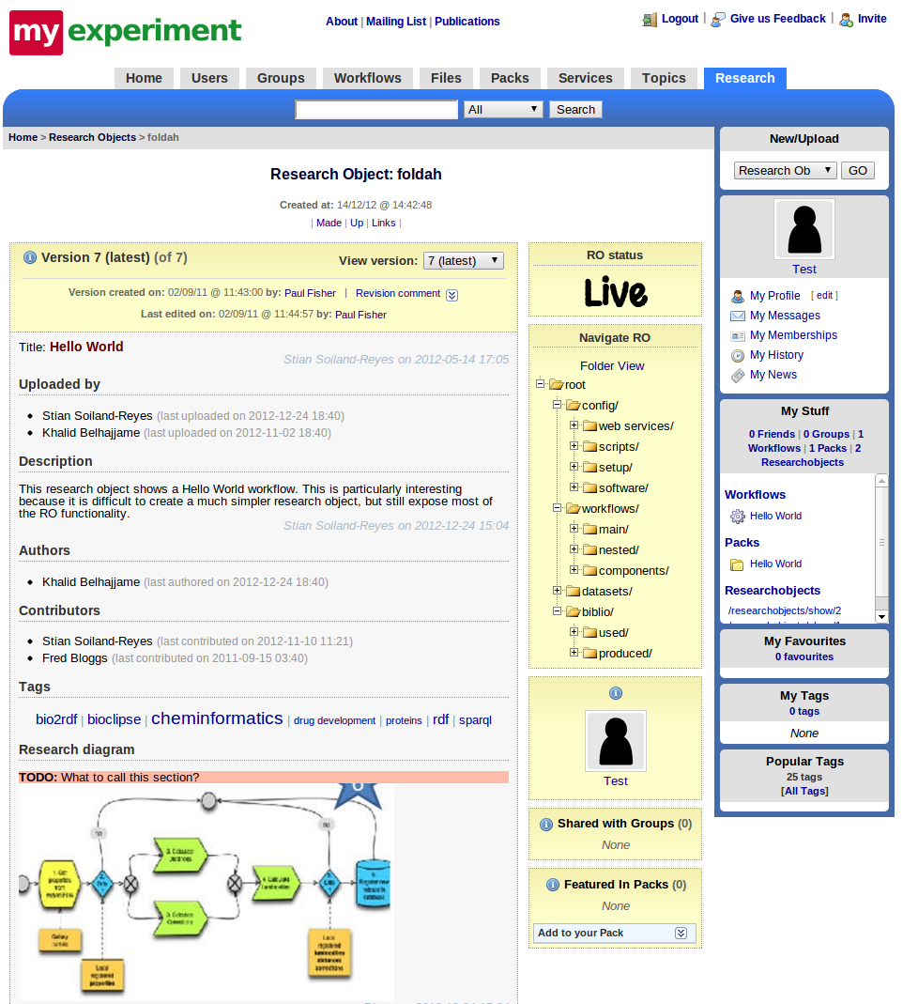
Expected on myExperiment
Research Objects inside!
Packs more prominent
Start a pack when you upload a workflow
Upload wizards, pack management, export
Checklists, automated star ratings
Add workflow runs and example data
Sticky annotations
RO-enabled myExperiment mockup

Slide 24
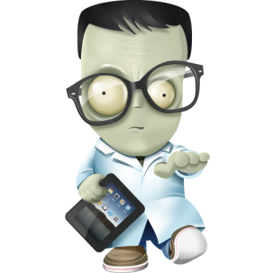
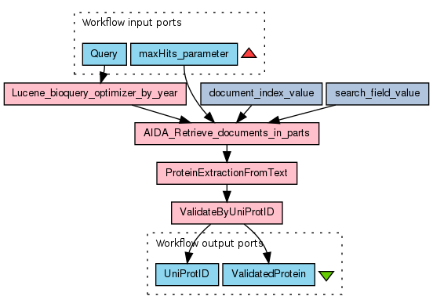
Fame and Glory
It was me, me, me!
What I found
HDAC1 interacts with Parvb
Discovered by: me
Published by: me
Research Object
How I found it
Notes:
Attribution is part of the RO model and myExperiment, but we are also developing something specifically to address this aspect of digital preservation and publishing… Nanopublications

Slide 25

Nanopublication Model
Getting credit for digital results
Integrity Key
Nanopublication ID
Assertion
Provenance
associa-tion
is
sio:statis-ticalAssociation
Supporting
Attribution
sio:has-measurementValue
Association_1_p_value
this
nanopub
dcterms:
created
2012-03-28T11:32
^^xsd:dateTime
Nanopublication 123
sio:
refers-to
assertion
opm:
was
Derived
From
http://rdf.biosemantics.org/…profiles_matching_1980_2010
pav:
authored-By
researcherid.com/rB-6035-2012
is
sio:has-value
…
Assertion
Provenance
http://bio2rdf.org/geneid:55835
http://bio2rdf.org/omim:210600
opm:
wasGene-ratedBy
Sio:probability-value
6.56 e⁻⁵
^^xsd:float
dcterms:
DOI
http://dx.doi.org/
….
Supporting
Attribution
http://bio2rdf.org/geneid:55835
sio:
refers-to
http://bio2rdf.org/omim:210600

Slide 26


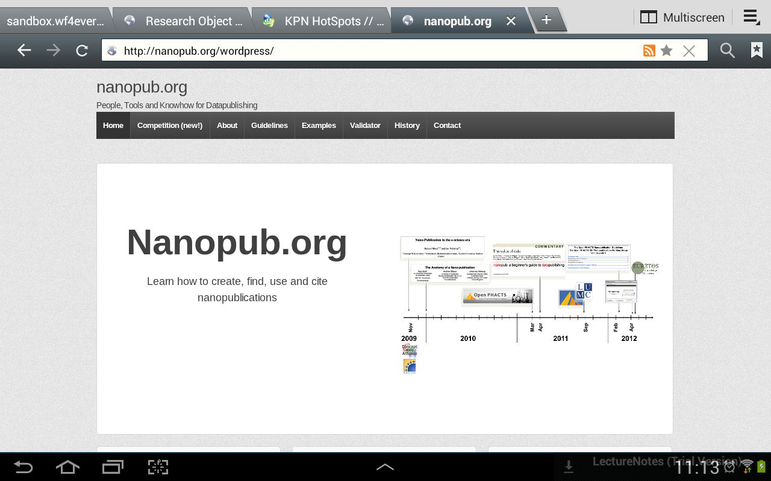
Nanopub.org

Slide 27
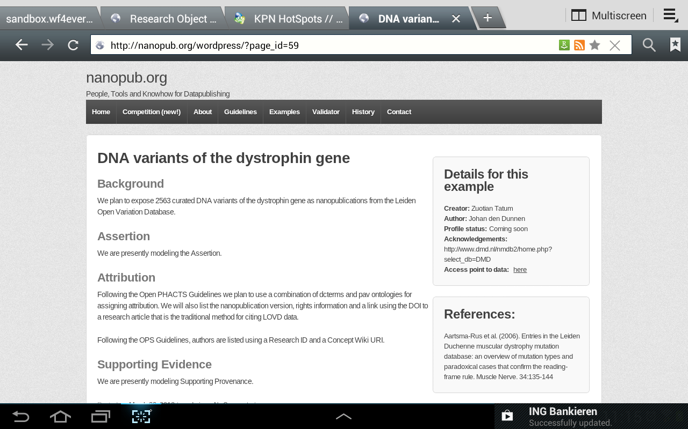
Examples

Slide 28
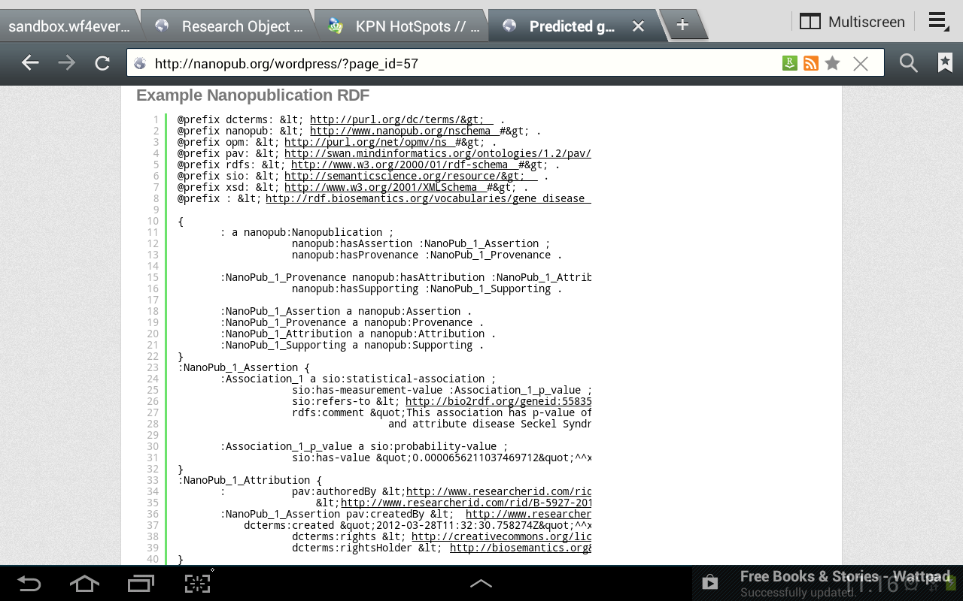
Examples in RDF format

Slide 29
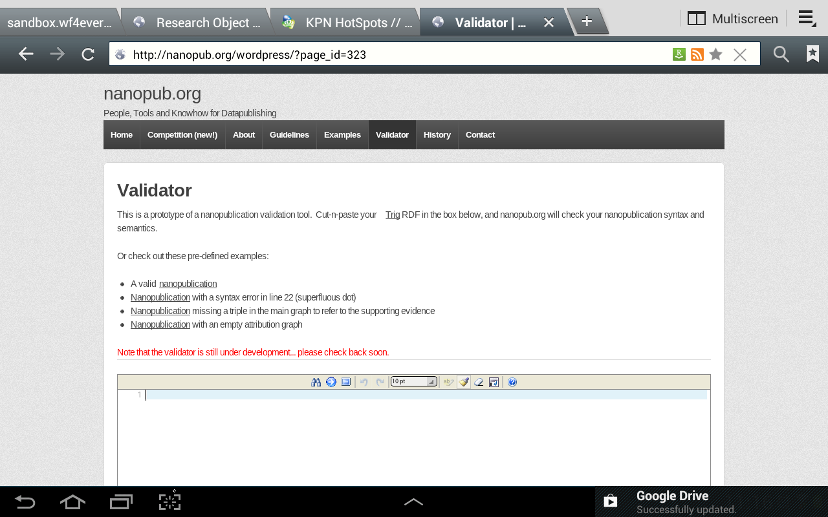
Validator

Slide 30
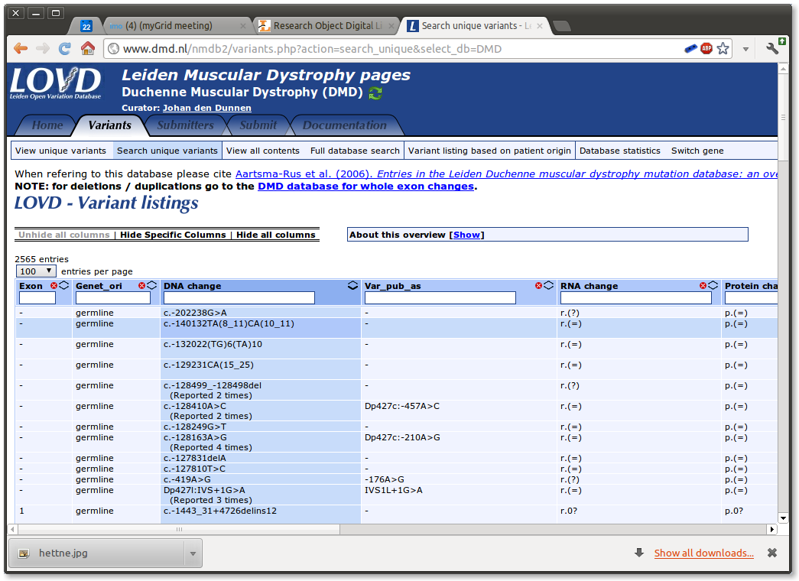
Example: LOVD

Slide 31
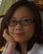
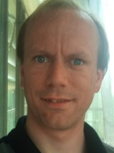

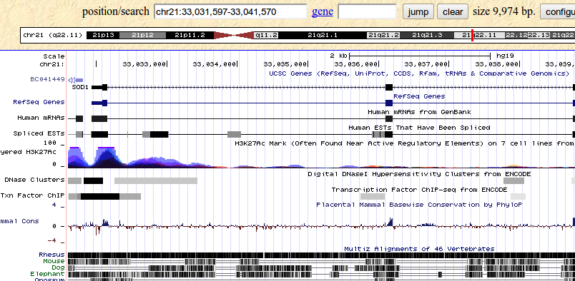
Nanopublications of Genetic Variations visualized on the genome
Zuotian Tatum, Jesse van Dam
Other Sources
Other Tools
Nanopublication
Store

Slide 32
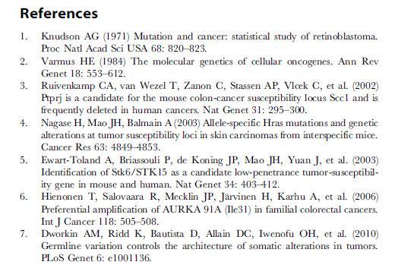
Fame and Glory
It was me, me, me!
Nanopublication
What I found
<CS7183> <associatedWith> <MetS>
Discovered by: me
Published by: me
Research Object
How I found it
http://purl.org/nanopub/123
http://purl.org/ResObj/345

Slide 33
Summary (1/2)
Preservation under the hood of digital research tools
Research Object Model: annotated aggregates
Nanopublication: fine-grained digital credit
Check Nanopub.org to stay updated

Slide 34
Summary (2/2)
Semantic Web for exchange and interoperability
In progress: RO-enabling myExperiment
Watch myExperiment.org in 2013!
Plans to RO-enable Taverna, Galaxy, GenomeSpace

Slide 35
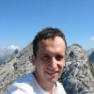

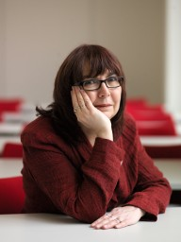




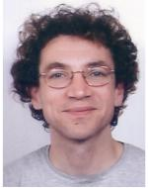

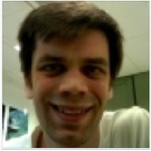

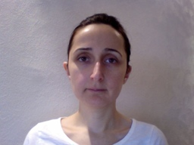
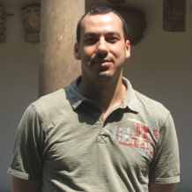



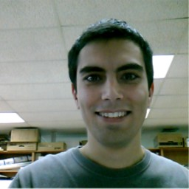




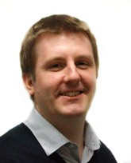

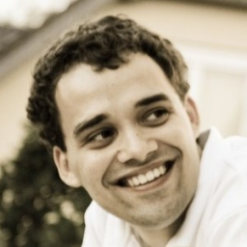


Acknowledgements
EU Wf4Ever project (270129)
funded under EU FP7 (ICT- 2009.4.1).
(http://www.wf4ever-project.org)

Slide 36






Thank you for your attention
http://biosemantics.org

Slide 37
Reproducible Science
Preserved materials and methods for the ‘wet laboratory’ scientist
From Van Roon-Mom et al., BMC Molecular Biology 2008
doi: 10.1186/1471-2199-9-84.
Notes:
In wet-lab biology and other experimental sciences, we have addressed these questions in what we disseminate and how. The system is not perfect. It is flawed for real reproducibility, but it does give insight into how results were obtained. Sufficient to make up our own minds on whether to use the results for our own hypotheses, or build on the methods.
=> Do we have a good digital equivalent?

Slide 38
Reproducible Science?
What is the digital equivalent?
Is it equally good?
Can we do better?
- or worse?
Reproduced from Jelier et al., Schuemie et al., Hettne et al., Haagen et al.,
http://biosemantics.org , myExperiment.org/workflows/2197
Notes:
Workflows could be seen as an equivalent of wet lab protocols. Are they as good as Materials and Methods, better or worse?
=> Perhaps worse?

Slide 39
Reproducible Science
What is the digital equivalent?
Is it equally good?
Can we do better?
– or worse?
Can you tell what this is doing?
Reproduced from Jelier et al., Schuemie et al., Hettne et al., Haagen et al.,
http://biosemantics.org , myExperiment.org/workflows/2197
Notes:
For instance, can we all tell what this workflow is doing? - Do we miss things?
=> Incentive to do good

Slide 40
Reproducible Science
What is our incentive?
Nobility
Good Reproducible Science
Greater Good
Serve the public
Notes:
And then: what is our incentive to make it as good or better?
Is it nobility, or serving the greater good?
=> Getting on with it: publish

Slide 41
Reproducible Science
What is our incentive?
Fame and Glory
Getting on with it...
I’ll be the first in Nature
Notes:
Or is it helping me to me next Nature paper?

Slide 42
Our aim
‘Useful’ preservation
Support reproducibility
in tools and by guidelines that
speed up your research
get you acknowledgement
Notes:
Therefore we like to speak of ‘Useful Preservation’

Slide 43




Preservation
What?
How?
Nanopublication
Assertion
Research Results
Provenance
Attribution
Supporting

Slide 44
Preservation
Deemed of scientific value by scientists
Valuable for scientists
Digital Value
Deemed of scientific value by scientists
What?
How?
Nanopublication
Assertion
Research Results
Provenance
Attribution
Supporting

Slide 45






Acknowledgements
http://biosemantics.org/
Erik Schultes
Andrew Gibson
Reinout van Schouwen
Kostas Karasavvas
Kristina Hettne
Harish Dharuri
Eleni Mina
Jesse van Dam
Herman van Haagen
Zuotian Tatum
Johan den Dunnen
Peter-Bram ‘t Hoen
Barend Mons
Gert-Jan van Ommen
Paul Groth
Frank van Harmelen
Christine Chichester
Kees Burger - NBIC
Spyros Kotoulas - VU
Antonis Loizou - VU
Valery Tkachenko - RSC
Andra Waagmeester - Maastricht
Sune Askjaer - Lundbeck
Steve Pettifer - Manchester
Lee Harland - Pfizer/CD
Carina Haupt - Fraunhofer
Colin Batchelor - RSC
Miguel Vazquez - CNIO
José María Fernández - CNIO
Jahn Saito - Maastricht
Andrew Gibson (Outside Expert) - Amsterdam
Louis Wich - DTU
Erik van Mulligen
Bharat Singh
Jan Kors
Melton
Foundation

