Slide 1


GigaDB and Galaxy: revolutionizing data dissemination, organization and analysis
Peter Li
GigaScience
peter@gigasciencejournal.com

Slide 2




Journal and database for
large-scale data
in conjunction with
Editor-in-Chief: Laurie Goodman
Editor: Scott Edmunds
Commissioning Editor: Nicole Nogoy
Lead Curator: Tam Sneddon
Data Platform: Peter Li
www.gigasciencejournal.com

Slide 3
Notes:
Mini-ping genome published this month

Slide 4
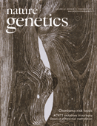
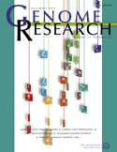
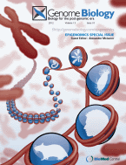
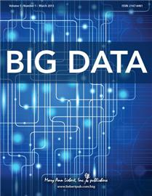
Why another *omics journal?
Already many journals publishing research
involving large data sets
Results
reproducibility

Slide 5
Unrepeatability of scientific results
Out of 18 microarray papers, results
from 10 could not be reproduced
Ioannidis et al., 2009. Repeatability of published microarray gene expression analyses.
Nature Genetics 41: 149-155.

Slide 6



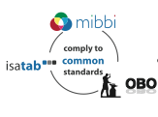
How are we supporting data reproducibility?
Linked to
Data sets
DOI
Linked to
GigaScience
paper
Analyses
Community tools for
data reproduction and reuse

Slide 7
Linking of papers and data
by citation of DOIs
Data set DOI
Paper DOI
Notes:
DOIs
Provide example of a GigaScience paper
Mention DOI for the paper itself
Highlight data set generated and its DOI

Slide 8
http://gigadb.org

Slide 9
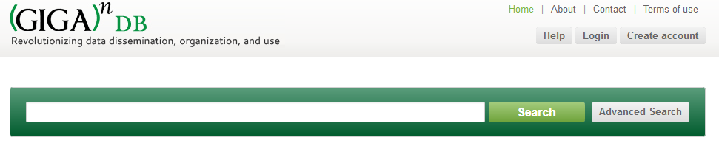
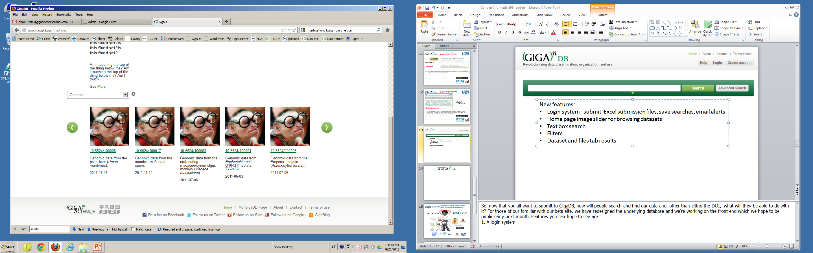
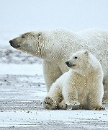
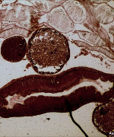
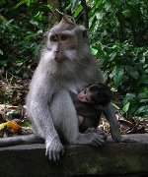
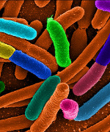
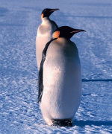
GigaDB is a new database integrated with the GigaScience journal to meet the needs of a new generation of biological and biomedical research as it enters the era of “big-data”… (see more)
Notes:
And now that you all want to submit to GigaDB, how do you do that and how will people search and find your data and, other than citing your DOI, what will they be able to do with the data? We have redesigned the underlying Giga database and we’re working on the front end which we hope to be public early next month so the following slides are a mix of screenshots from the development site overlaid with tweaks made in powerpoint to illustrate features you can hope to see when we go live.
These include:
a home page image slider for browsing datasets
a text box search which I will demonstrate shortly

Slide 10

Faster download speeds
Aspera data transfer
Notes:
***NEEDS REWORKING!!!!***
This is an example landing page for DOI 10.5524/100015 for the YH genome dataset.
These pages are still in development but you can see the date released, title and abstract and how the dataset should be cited.
Additional information includes links to manuscripts and data accessions at EBI, NCBI or DDBJ.
There is then information on the samples and files.

Slide 11


BGI Datasets Get DOI®s
Invertebrate
Ant
- Florida carpenter ant
- Jerdon’s jumping ant
- Leaf-cutter ant
Roundworm
Schistosoma
Silkworm
Parasitic nematode
Pacific oyster
Released pre-publication
Paper published in GigaScience
Microbe
E. Coli O104:H4 TY-2482
T2D gut metagenome
Cell-Lines
Chinese Hamster Ovary
Mouse methylomes
Vertebrates
Darwin’s Finch
Giant panda Macaque
Chinese rhesus
Crab-eating
Mini-Pig
Naked mole rat
Parrot, Puerto Rican
Penguin
- Emperor penguin
- Adelie penguin
Pigeon, domestic
Polar bear
Sheep
Tibetan antelope
Human
Asian individual (YH)
- DNA Methylome
- Genome Assembly
- Transcriptome
Cancer (14TB)
Single cell bladder cancer
HBV infected exomes
Ancient DNA
- Saqqaq Eskimo
- Aboriginal Australian
PLANTS
Chinese cabbage
Cucumber
Foxtail millet
Pigeonpea
Potato
Sorghum
39 data sets

Slide 12


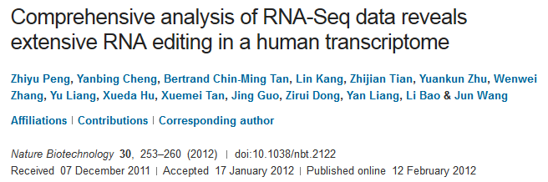
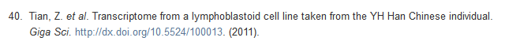


Currently: 39 public datasets
*10 citations in references*
Humans
Ancient DNA
- Aboriginal Australian
- Saqqaq Eskimo
Asian individual (YH)
Notes:
A GigaDB dataset citation is also included in the YH Transcriptome paper published in Nature Biotechnology in February this year.
As you can see the dataset was published in 2011 but this did not prevent subsequent publication of the analysis paper.

Slide 13
What about the analyses?
Linked to
Data sets
Linked to
GigaScience
paper
Analyses
How will we make analyses available
for downloading and execution?

Slide 14





















Bioinformatics data analyses as workflows
Example workflow: Investigate the evolutionary relationships between proteins
Protein
sequences
Multiple
sequence
alignment
Query
Notes:
What happens in bioinformatics is that there are a lot of tools which are available on the Web and the way people use these tools to combine the use of 2 or more of these tools in a pipeline. For example, you might be a biologist interested in how a protein of interest is related to other proteins in its family.
How does tcoffee align protein sequences? The alignment tools uses a number of computational algorithms to compare sequences. They can be divided into 2 types: global alignment tools which attempt to align every residue in the sequence and local alignment which attempts to match regions of similarity between sequences.

Slide 15
Implement GigaScience workflows in a community-accepted format
Open source
Over 20,000 main
Galaxy server users
Over 500 papers
citing Galaxy use
Over 55 Galaxy
servers deployed
http://galaxyproject.org
Notes:
Over 20,000 users on the main server
Over 500 papers citing the use of Galaxy
Over 55 servers deployed on the Web

Slide 16
Tool list
Tool parameterisation
Results panel
Notes:
Allows scientists who may not have programming skills to be able to compose data analysis pipelines.

Slide 17
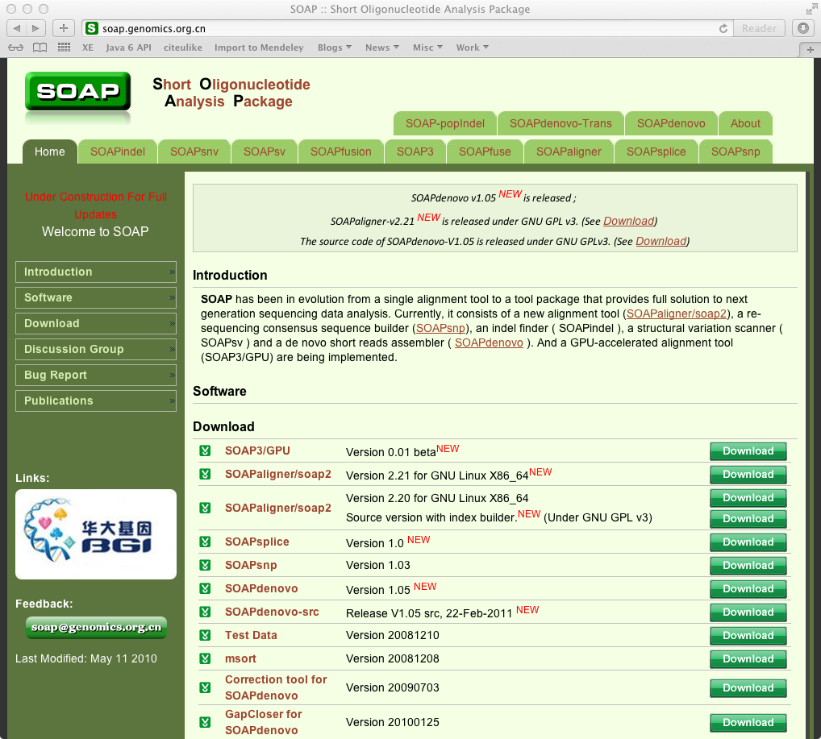
Pilot project - Integrate BGI SOAP package into Galaxy
Enable SOAP tools to be used from within Galaxy workflows

Slide 18
Integrate BGI SOAP package into Galaxy
Data analysis pipelines
Python
wrapper
Python
wrapper
Python
wrapper
Python
wrapper
Python
wrapper
Python
wrapper
SOAP1
SOAP2
SOAPdenovo1
SOAPdenovo2
SOAPsnp
SOAPsplice

Slide 19
GitHub open code repository
https://github.com/gigascience

Slide 20
Tool list
Tool parameterisation
Results panel

Slide 21
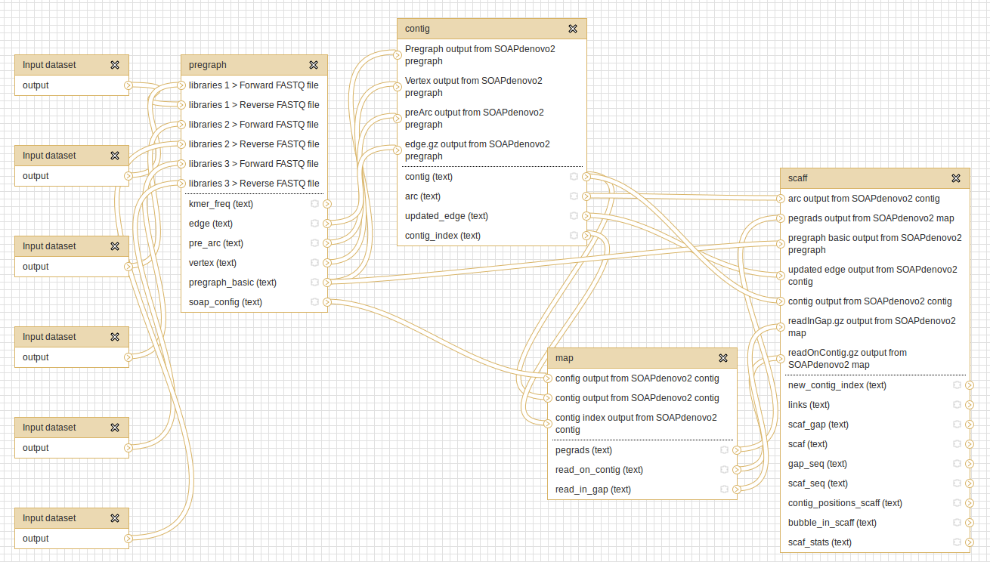
SOAPdenovo2 Galaxy workflow

Slide 22
http://www.myexperiment.org

Slide 23
Why publish in GigaScience?
Benefit
Added value
Data hosted in GigaDB
Allocation of DOIs to data
Metadata in isa-tab format
Galaxy tool integration
Use of tools in Galaxy workflows
No need to use own servers
Citable data
Aids reuse of data
Supports reuse of tools
Improves documentation
Shows how tool can be used with other bioinf. software
Notes:
DOIs can now be tracked in the new Thomson Reuters Data Citation index - which gives form of credit and makes the data more discoverable (Scott)

Slide 24
Thanks to:
Tin-Lap Lee and Huayan Gao - CUHK
Tam, Jesse, Scott, Nicole & Laurie - GigaScience
peter@gigasciencejournal.com

