Slide 1
The National Center for Genome Analysis Support and Galaxy
William K. Barnett, Ph.D. (Director)
Richard LeDuc, Ph.D. (Manager)
National Center for Genome Analysis Support

Slide 2
Summary
NCGAS and its mission
NCGAS cyberinfrastructure
The 100 Gigabit demonstration
Scaling genomics analysis
Trinity optimization

Slide 3
Changing genomics analytical needs
Next Gen sequencers are generating more data and getting cheaper
Sequencing is:
  Becoming commoditized at large centers and
  Multiplying at individual labs
Analytical capacity has not kept up
  Bioinformatics support
  Computational support (thousand points solution)
  Storage support

Slide 4


NCGAS widens the analytical bottleneck
Funded by National Science Foundation
Large memory clusters for assembly
Bioinformatics consulting for biologists
Optimized software for better efficiency
Open for business at: http://ncgas.org

Slide 5

Making it easier for Biologists
Computational Skills
Galaxy interface provides a “user friendly” window to NCGAS resources
Supports many bioinformatics tools
Available for both research and instruction.
LOW
Common
HIGH
Rare

Slide 6
NCGAS Cyberinfrastructure at IU
Mason large memory cluster (512 GB/node)
Quarry cluster (16 GB/node)
Data Capacitor (1 PB at 20 Gbps throughput)
Research File System (RFS) for data storage
Research Database Cluster for managing data sets.
All interconnected with a high speed internal network (40 Gbps)

Slide 7
GALAXY.IU.EDU Model
UITS/NCGAS establishes tools, hardens them, and moves them into production.
Virtual box hosting Galaxy.IU.edu
Individual labs can get duplicate boxes – provided they support it themselves.
The host for each tool is configured to meet IU needs
Quarry
Mason
A custom Galaxy tool can be made to import data from the RFS to the DC.
Policies on the DC guarantee that untouched data is removed with time.
RFS
Data Capacitor

Slide 8
NCGAS Sandbox Demo at SC 11
STEP 1: data pre-processing, to evaluate and improve the quality of the input sequence
STEP 2: sequence alignment to a known reference genome
STEP 3: SNP detection to scan the alignment result for new polymorphisms

Slide 9

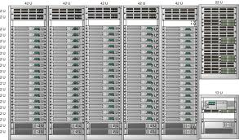
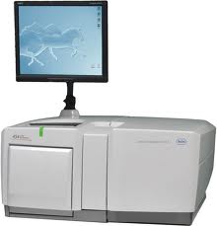



Two Options for Computation and Storage
NCGAS Mason
(Free for
NSF users)
Your Friendly
Neighborhood
Sequencing Center
Lustre WAN
File System
IU POD
(12 cents
per core hour)
Data Capacitor
NO data storage Charges
Your Friendly
Neighborhood
Sequencing Center
100 Gbps
10 Gbps
Your Friendly
Neighborhood
Sequencing Center
Amazon EC2
(20 cents
per core hour)
Amazon Cloud Storage
$80 – 120 per TB per month
Notes:
Assumed talking points: 1. No linkage between DC and Amazon as diagram might imply. 2. DC mounts directly as a filesystem to sequencing centers. 3. 100G networks aren’t available to commercial users over I2..but might be over NLR soon-ish (should verify). Should be careful how we use NO data charges for DC…we need to start making money on DCWAN if we don’t get the DC-NG award…but I am not sure how. Being vague here is probably good. -mrl

Slide 10
100
Internet2 (100Gbps)
This Architecture Scales!
Gbps
DDR3 SDRAM (51.2 Gbps, 6.4GBps, )
IU Data Capacitor (20 Gbps throughput)
NLR to Sequencing Centers (10Gbps/link)
Ultra SCSI 160 Disk (1.2 Gbps, 160 MBps)
0
Commodity Internet (1Gbps but highly variable)
Notes:
How did you arrive at the 15Gbps throughput of the DC?

Slide 11
How would this work at scale?
Biologists use Galaxy to execute workflows
Sequence data mounted via Lustre WAN or automatically transferred using Internet2
Data Capacitor flows data into Mason or other computational clusters
Data Capacitor mounts or mirrors reference data from NCBI or other sources
Results delivered through web interfaces and to visualization or other science tools

Slide 12
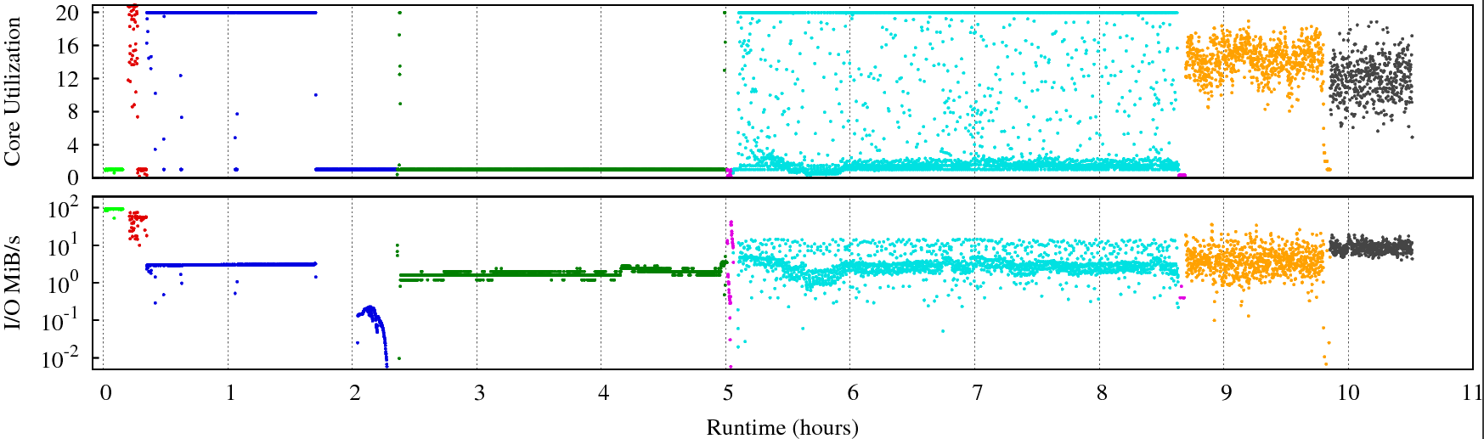
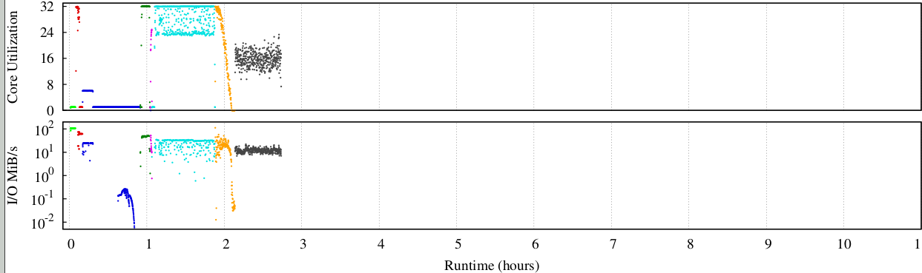
Performance Improvements
Butterfly
Inchworm
GraphFromFastA
ReadsToTranscripts
QuantifyGraph
Richard LeDuc
GCC 2012
7/27/2012

Slide 13
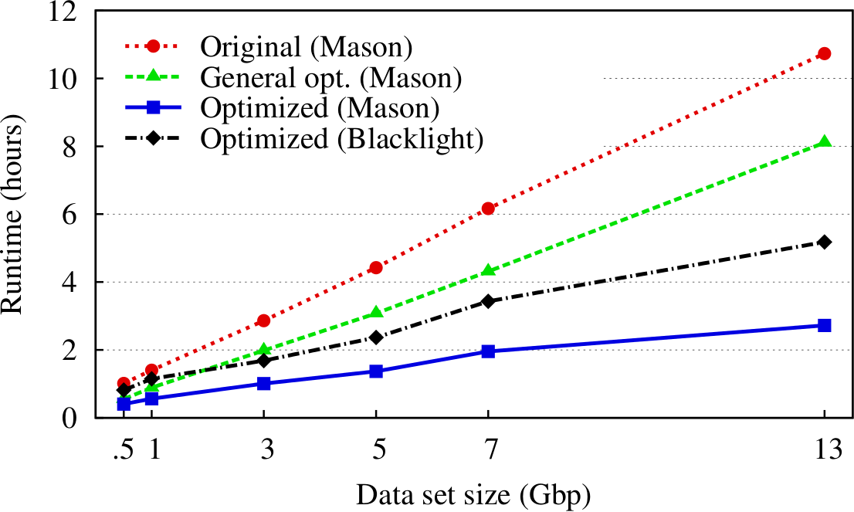
Final Results
Richard LeDuc
GCC 2012
7/27/2012

Slide 14
Trinity Results
Significantly reduced runtime, while maintaining correctness of results
Results are published
Source code is commit to official SourceForge repository
Continued support for HPC optimization for Trinity
Brian Haas at Broad is developing Trinity workflows for Galaxy
Richard LeDuc
GCC 2012
7/27/2012

Slide 15
In Sum…
NG Sequencing is creating a analytical problem that cannot be solved at sequencing centers
NCGAS can provide a global scale infrastructure to better serve the needs of biologists who cannot become bioinformaticians to accomplish their research.
Trinity is no longer a resource hog

Slide 16
Thank You
Questions?
Bill Barnett (barnettw@iu.edu)
Rich LeDuc (rleduc@iu.edu)

