Slide 1
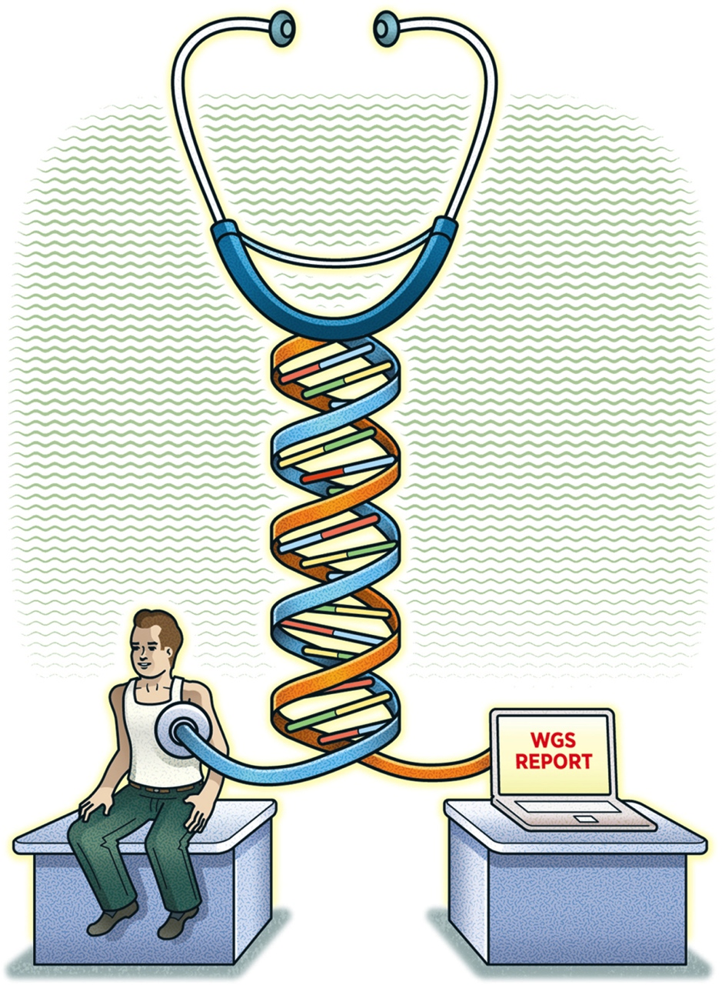
Customizing Galaxy for
a Hospital Environment
GCC2012 Lightening Talks
Larry Helseth, PhD
Bioinformatician, Center for Molecular Medicine
NorthShore University HealthSystem
Clinical Researcher, University of Chicago
Evanston, Illinois
27 July 2012
from- Drmanac Science 6/1/12
Notes:
Tied to Eric Green’s talk about NIHGS mission of “Helix to Healthcare”

Slide 2
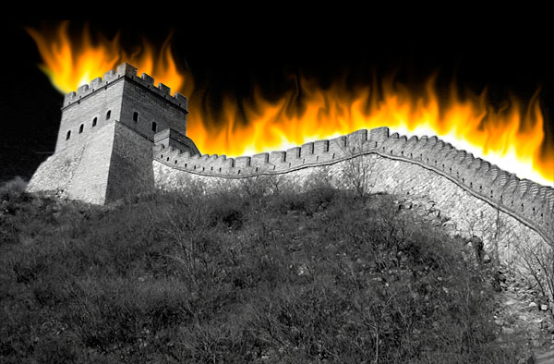
Installation challenges:
http://gorancson.wordpress.com/
Everything is locked down for HIPAA
Notes:
HTTP proxy slows downloads. Problems running “git” and other version control software. Mercurial (“hg”) works but had to install via sneaker-net.

Slide 3
Other Challenges
Corporate browser standard = IE8
  Galaxy status won’t auto refresh and can’t download result files
  Can’t visualize alignment using Trackster
    Visualize using IGV/IGB
Intranet access only
Built Galaxy without root access
Notes:
IE can preview (“eye” icon) SeattleSeq results in browser.

Slide 4
Advantages
Human only (+/- mm10)
No storage or backup concerns (co-located with EMR system which has existing petabyte storage & off-site backup)
Corporate IT already provides 7 X 24 support
Fast intranet (no need for sneaker-net)
One of the best EMR installs in US w/ several dozen EPIC workflow developers

Slide 5
Current Environment
Current environment (cloned from Galaxy-Dist on 5/30/12):
Analyzed three pairs of exome sequences simultaneously (6 FASTQ files -> VCF -> SeattleSeq annotation) in ~8 hours
  Time sensitive information. Don’t just want genomic autopsy
24 core (48 virtual)
32 GB RAM
Currently 5 TB storage (expandable on demand)
Hacked BWA wrapper to use 20 cores
Apache load balancing with web0 ,web1 ,web2 ,web3, handler0, handler1 & manager per Galaxy Admin docs
Modified Linux tmp environment. Use galaxy_env
Notes:
Changed /tmp to /research/galaxy/tmp

Slide 6
Customize Interface using Workflows
Simplify Galaxy UI for clinicians by stripping out menu options
  Consolidate tools under “Expert Tools”
Clinicians rely on workflows curated by bioinformatician
  Tumor-Normal exome pairs
  RNAseq, etc.
Manage data using Galaxy Data Libraries so users don’t have to upload or FTP

Slide 7
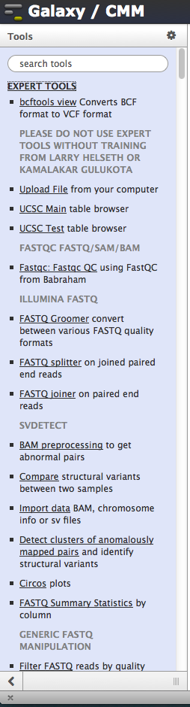
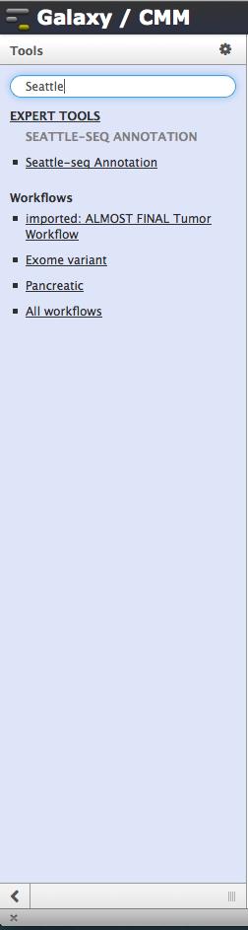
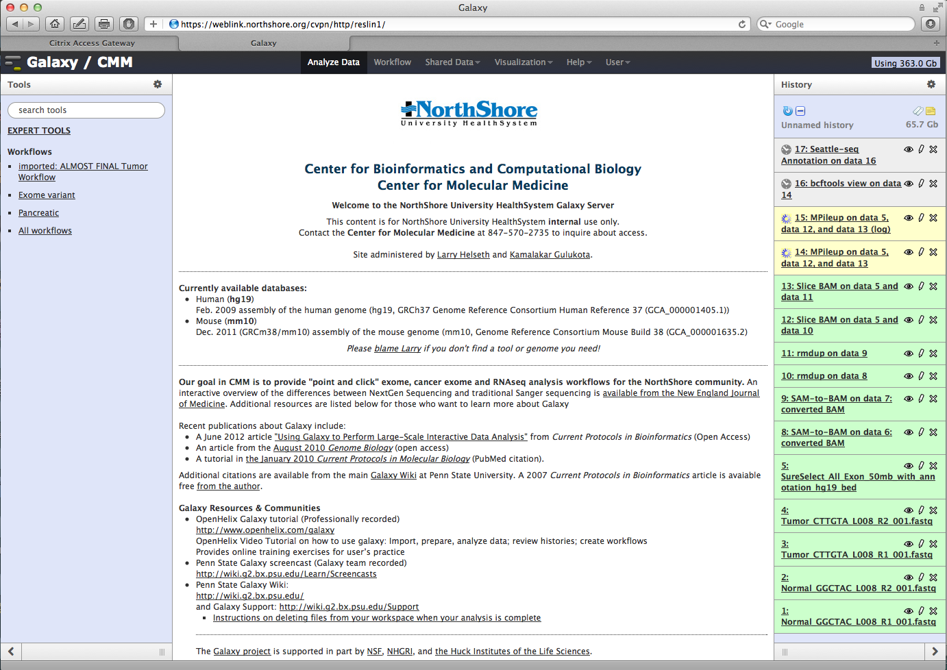
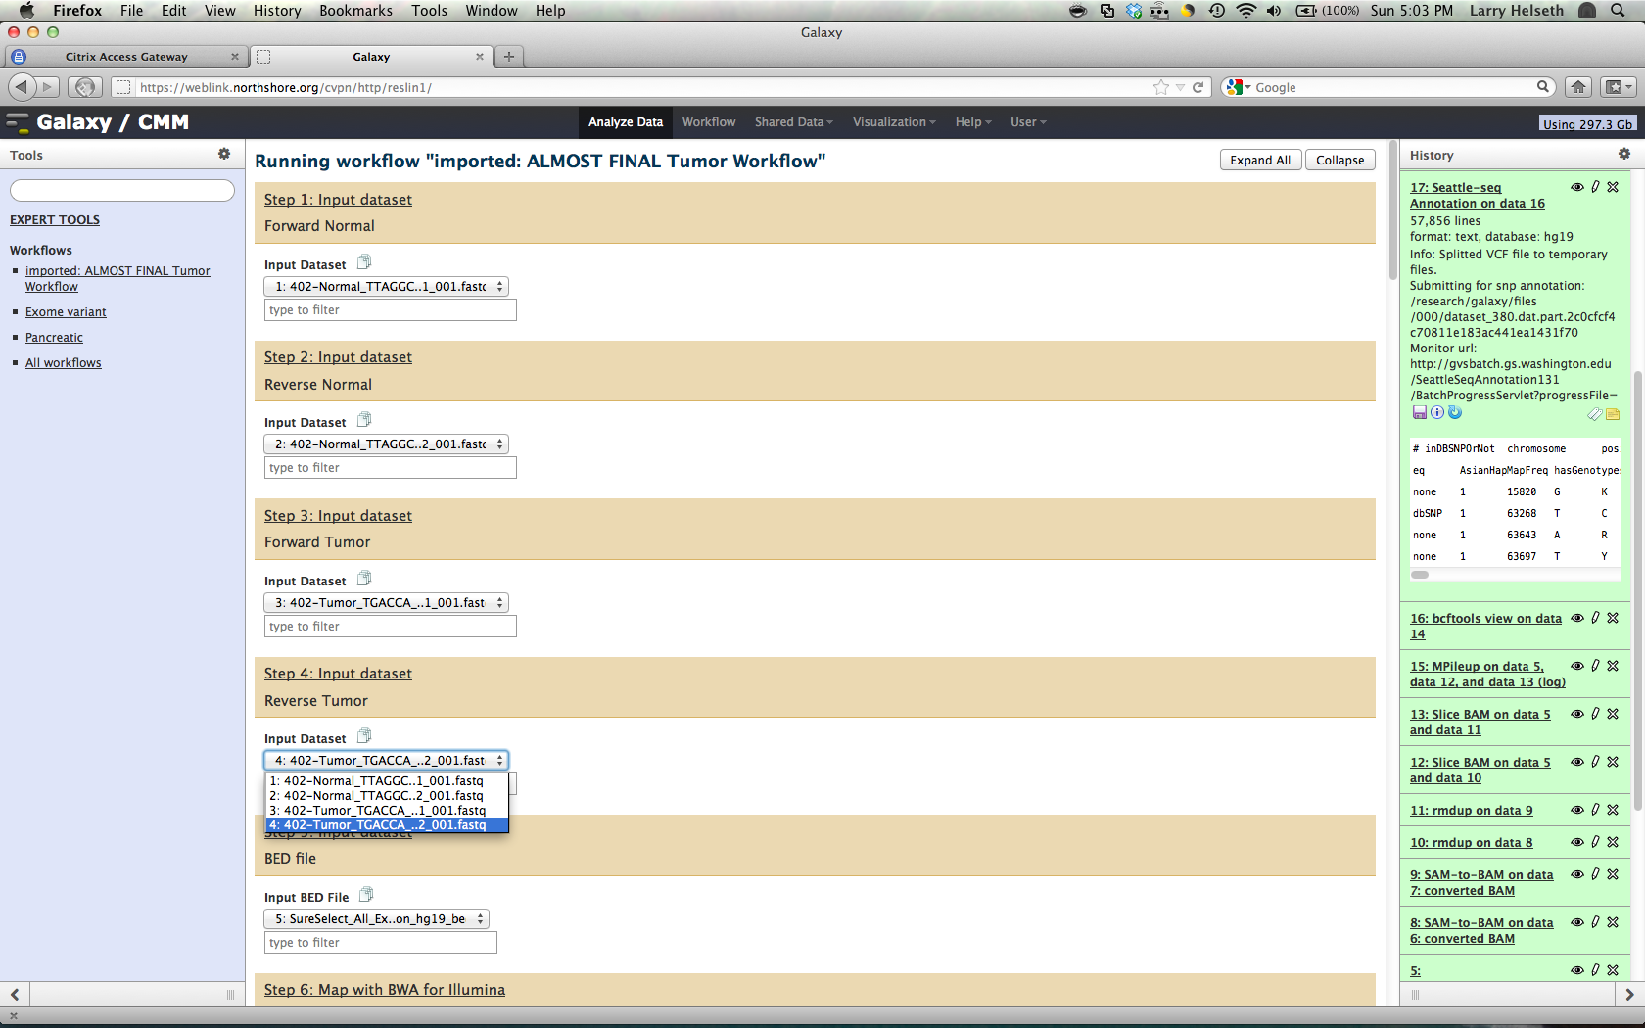
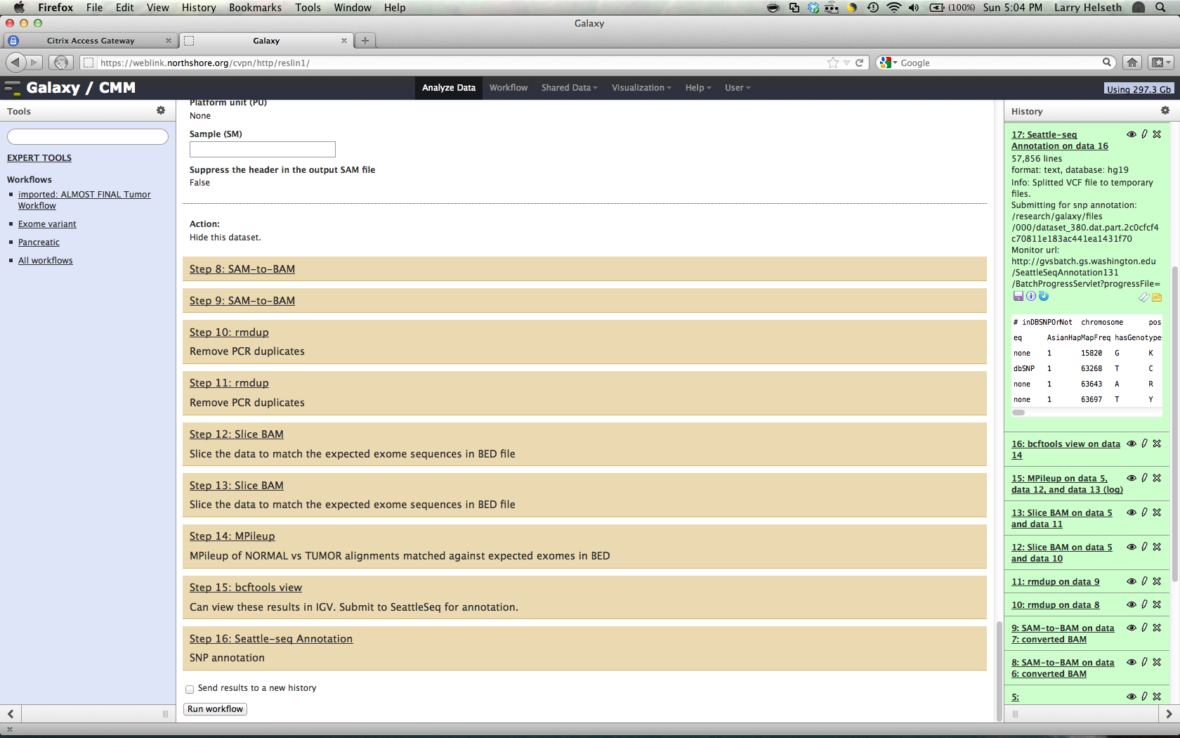
Customize Tool Menu

Slide 8
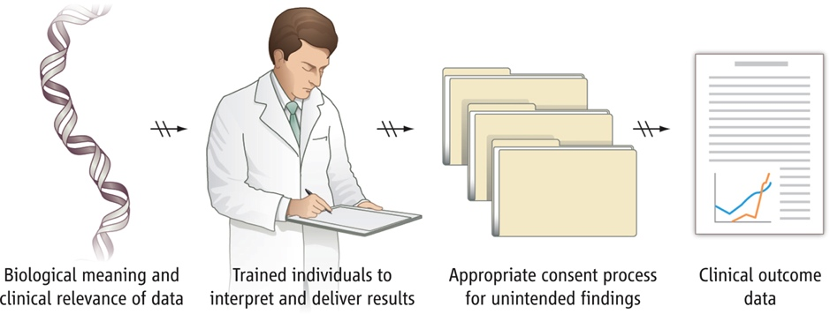
Next Steps:
Brunham & Hayden, Science 6/1/12
Automate local annotation using Annovar → Excel
http://www.openbioinformatics.org/annovar/annovar_accessary.html#excel
Annotation, annotation and annotation.
    Evaluating Seattleseq code provided by Martijn Vermaat, Leiden University Medical Center, Belgium and Annovar code provided by Dr. Yasukazu Nakamura, DDBJ Center, National Institute of Genetics, Japan
    SomaticSnipper →SeattleSeq or Annovar (still manual)
    Visualization with Circos (Bruno Zeitouni, Inst. Curie)
    Integration with VAT (Gerstein lab)?
Implement Galaxy sample tracking and automated workflow
Notes:
Implemented SeattleSeq but decided to go with Annovar to keep everything local

Slide 9
Next Steps (cont):
Currently ”Research Use Only". Planning to lock down version of server and VALIDATE before full clinical use.
Interface annotation results with EMR system possibly using Illumina-like visualization
Scale current environment as needed
User training
    SUGGESTIONS/FEEDBACK TO lhelseth@gmail.com
Notes:
Integration to EMS system, possibly using Illumina-like visualization (cf- “MyGenome” iPad app)

Slide 11
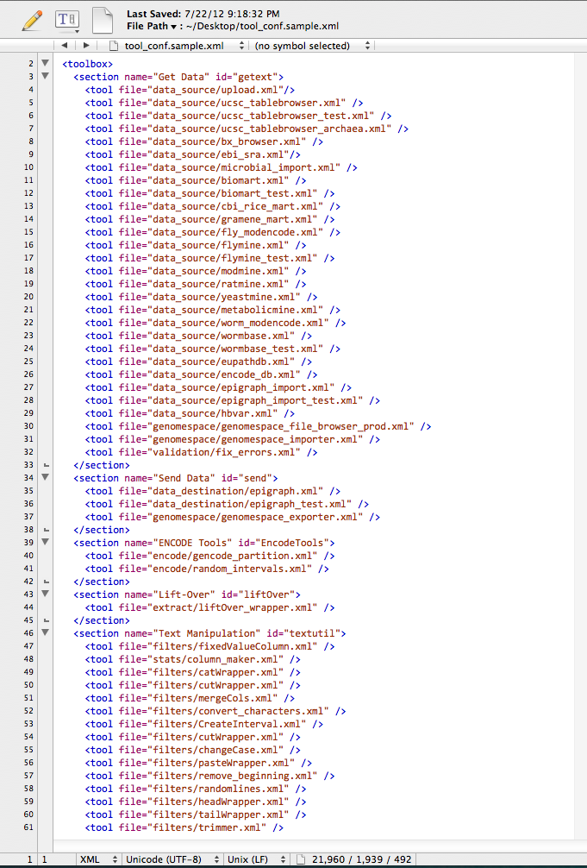
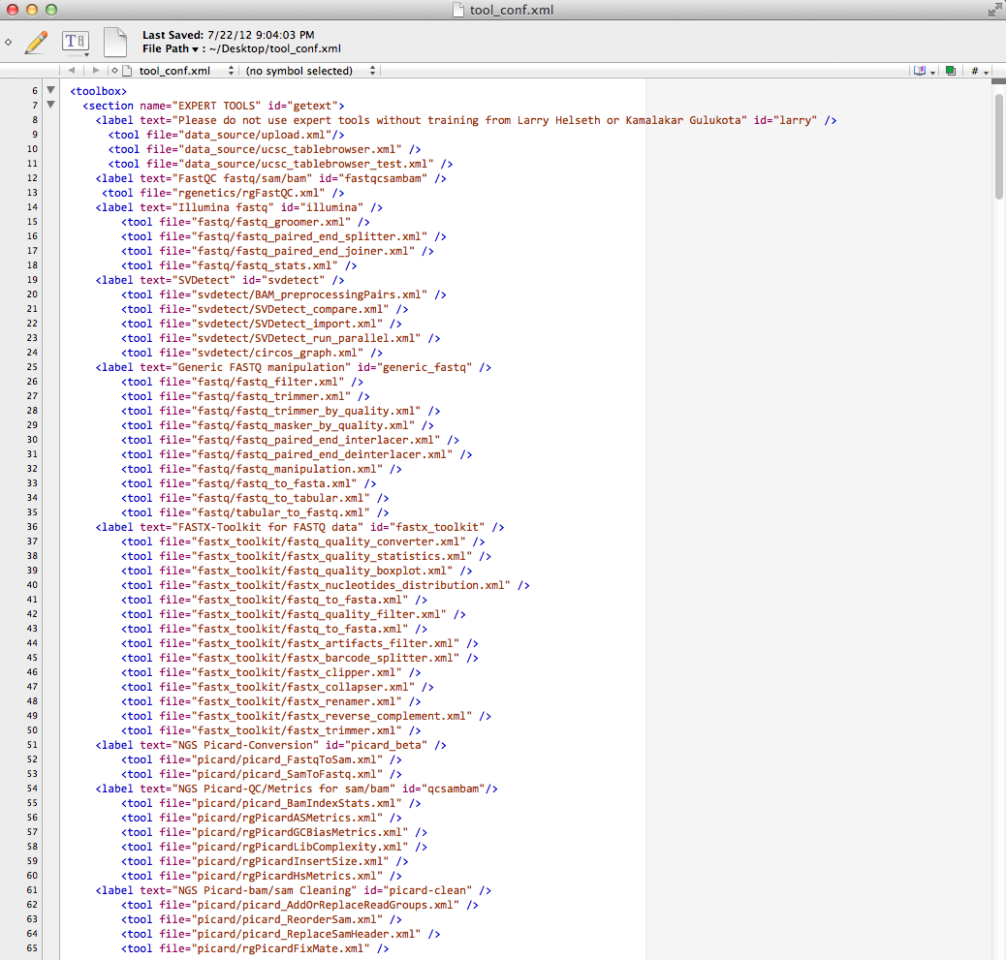
How’d You Do That?
Hacked tool_conf.xml
  Convert <section…. to <label …

Slide 12
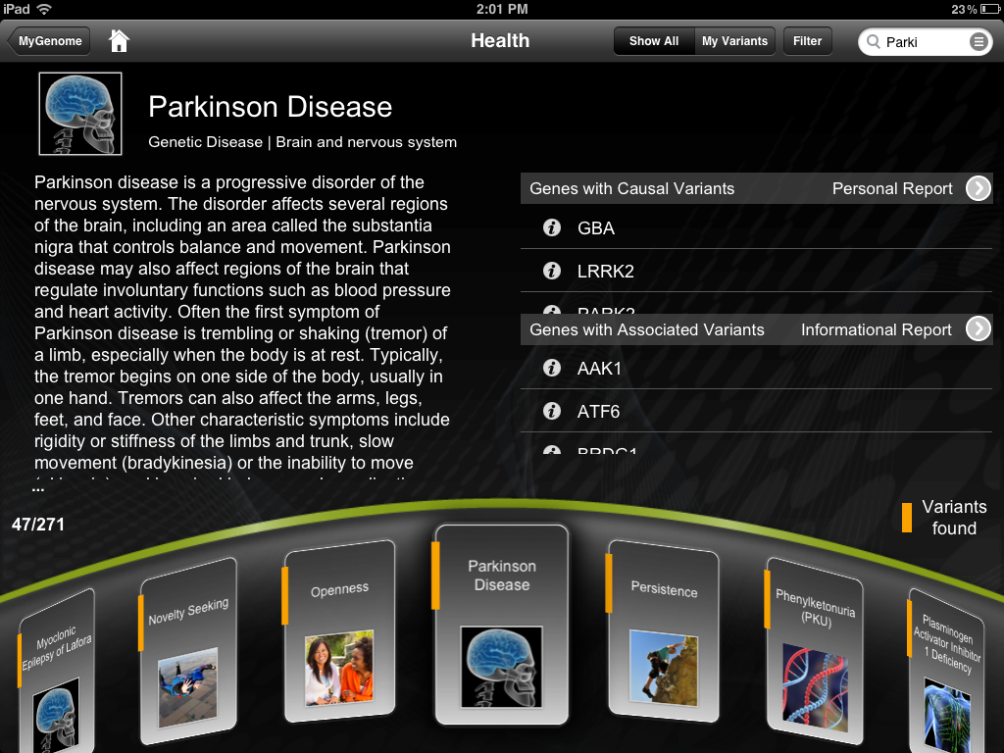
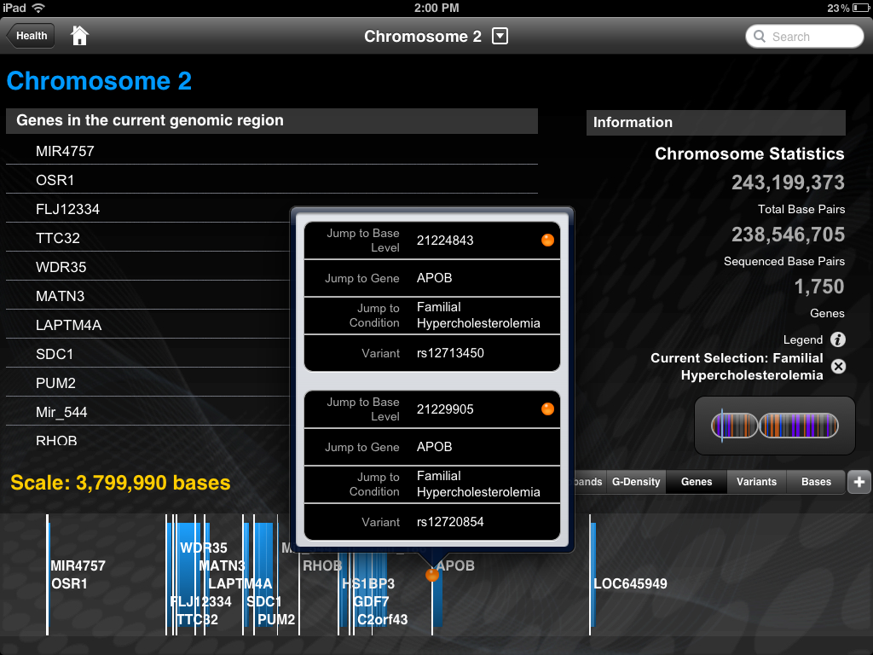
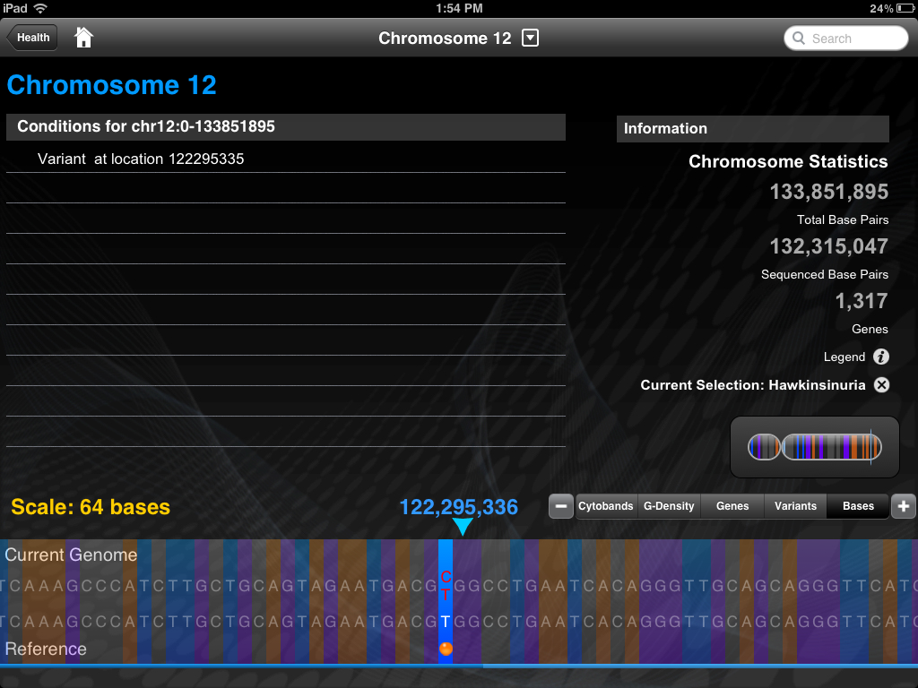
Illumina’s MyGenome iPad App

Slide 13
BWA Hack
~/galaxy-dist/tools/sr_mapping/bwa_wrapper.xml
<tool id="bwa_wrapper" name="Map with BWA for Illumina" version="1.2.3">
<description></description>
<parallelism method="basic"></parallelism>
<command interpreter="python"> bwa_wrapper.py --threads="20" ## DLH hacked from 4 to 20 on 12 June to improve throughput
#if $input1.ext == "fastqillumina": --illumina1.3 #end if
.
.
.

Slide 14
How Bad Can It Be?!?
It took 2 hours to download hg19.2bit from UCSF (~778 MB) through our firewall to my server using HTTP
It took 20 minutes to download the same file to my laptop on my kitchen WiFi using HTTP
It took 70 seconds to transfer hg19.2bit from my server to my desktop via HTTP
Notes:
It took ~30 minutes to FTP download a 2.7 GB hg19 bowtie index from umd.edu to reslin1 so FTP is preferable whenever possible!

