Slide 1

Biologists on the cloud
our experiences using galaxy for next-gen sequencing analyses
Karen Reddy, Johns Hopkins University School of Medicine
Mo Heydarian, Johns Hopkins University School of Medicine

Slide 2
Warning!!!
WE ARE END USERS…
Blinking cursors on a black screen make us break out in a cold sweat (i.e. anything remotely resembling command line)
Putty, SOAP, keys etc may mean something different to us

Slide 3
Who we are:
Interested in organization of the nucleus with respect to gene regulation
  Epigenetics, transcription, cell biology, structure

Slide 4
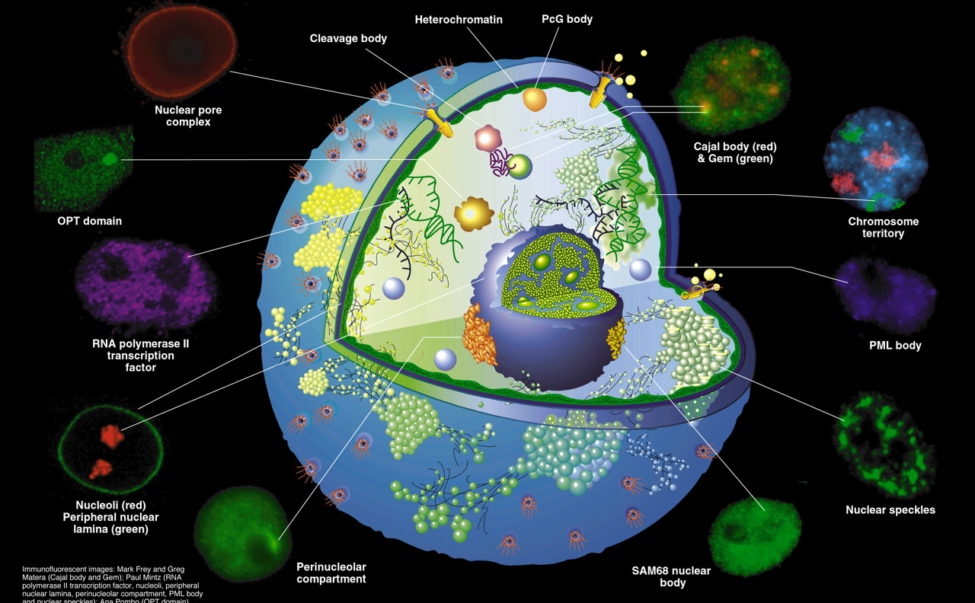
Proteins , DNA and RNA are compartmentalized
‘Nuclear domains’ Spector, Journal Cell Science

Slide 5
Who we are:
Interested in organization of the nucleus with respect to gene regulation
  Epigenetics, transcription, cell biology, structure
Molecular approaches
  ChIP-seq
  Hi-C
  DamID/DamID-seq
  RNA-seq
  SmallRNA-seq
  Proteomics
Cellular approaches
  Immuno-DNA/RNA-FISH
  Immunofluorescence
  Phenotype/developmental assays
GALAXY
Validation , cellular and functional Assays

Slide 6
We need to be able to make sense of our billions of NGS reads
Why Galaxy?
  We need to perform the analysis
    Lack of bioinformatician availability
    We need to understand what is being done to our data
    Create “workflows” and infrastructure for the lab (and the community)
    Additional and portable skill set for trainees

Slide 7
Analysis options using Galaxy
On a cluster/local instance
  Resources
    Expertise ($$$)
    Space ($$$)
    Access
  Command line....
Galaxy Cloudman
  we do not have to maintain!!
  Portable
  ‘pre-packaged’

Slide 8
Additional Benefits Using Galaxy Cloudman
  User community (http://wiki.g2.bx.psu.edu/Learn/Screencasts)
  Graphical user interface
  Intuitive packages
  Alleviates dependency on external resources
  Scalability perfect for intermittent need and smaller laboratories
  Extensively vetted tools avaialble

Slide 9
Two examples

Slide 10
DamID-seq
Adapted protocol
  No analysis pipeline existed
    We consulted with a bioinformatician on the broad strokes
    A workflow was created using common straightforward Galaxy tools
    The resultant data was confirmed by independent DamID array hybridization
    Traditional peak-calling does not work as these regions are very broad domains in the genome

Slide 11
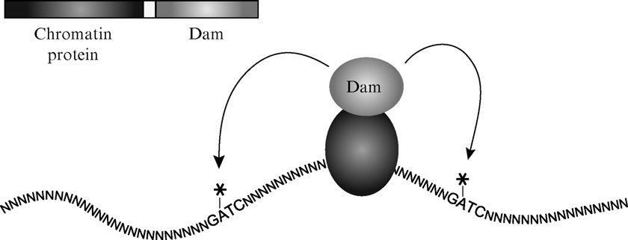
Strategy: DamID
Greil, Moorman and van Steensel 2006

Slide 12
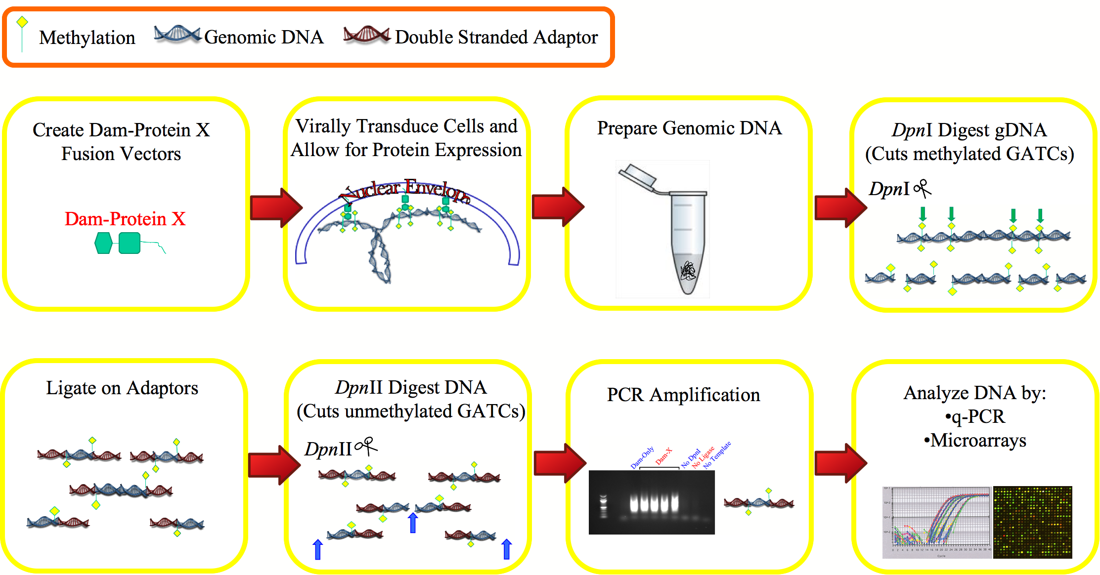
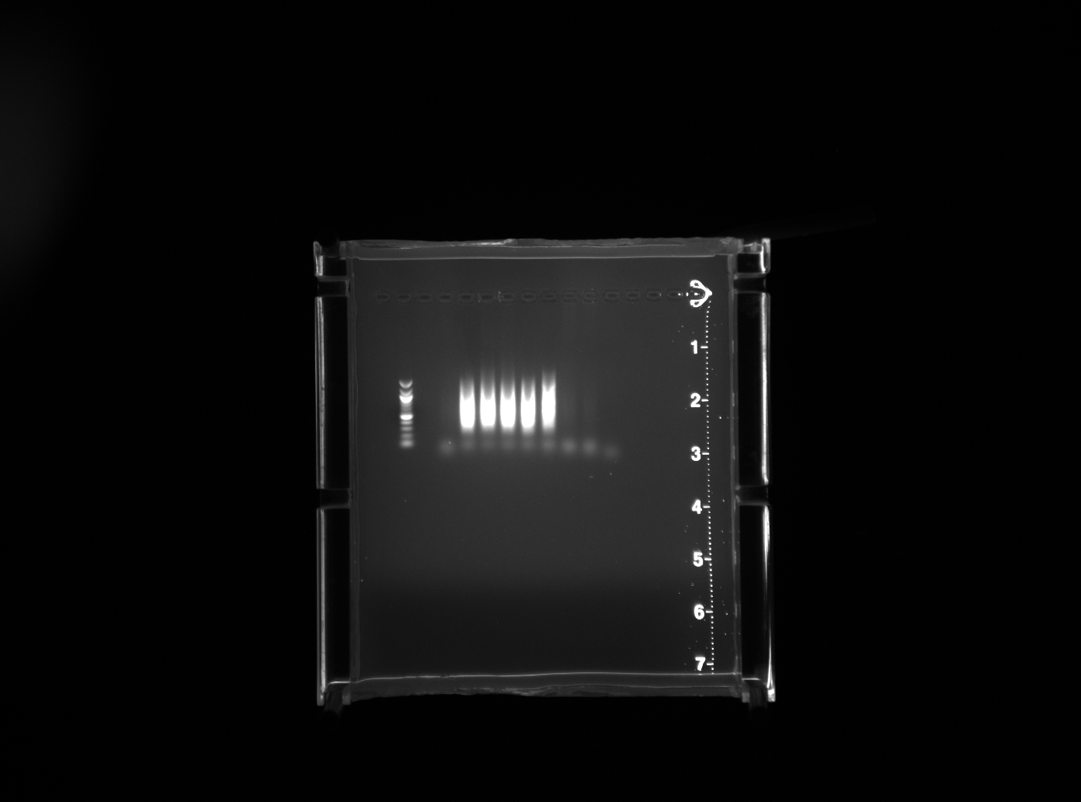

DNA Adenine Methylase Identification
DamID

Slide 13
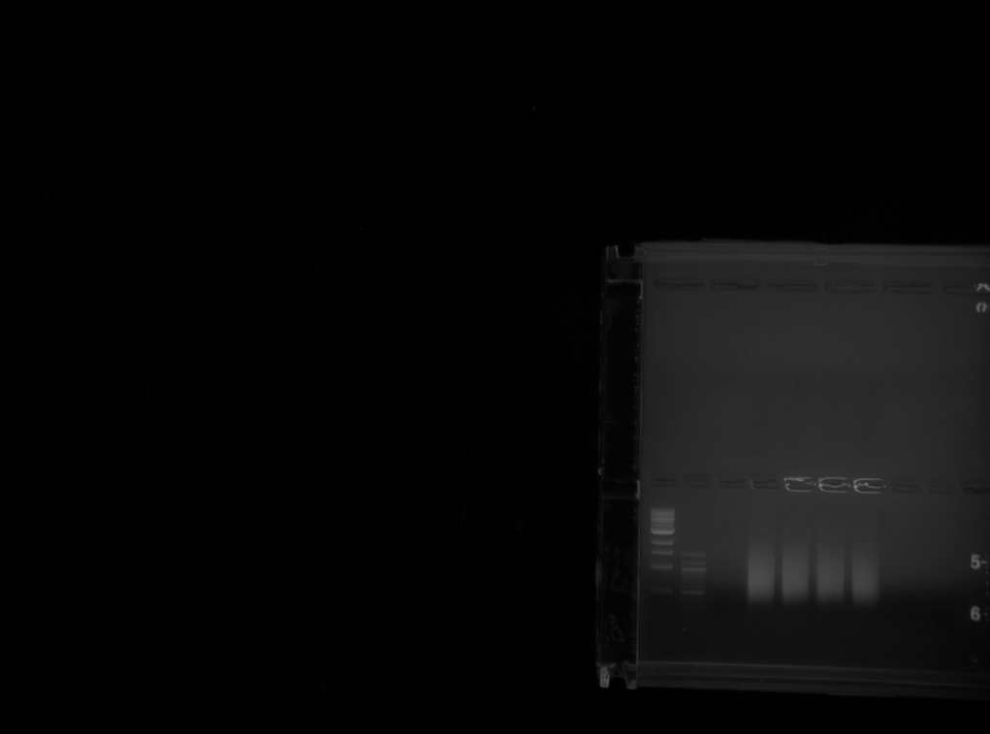
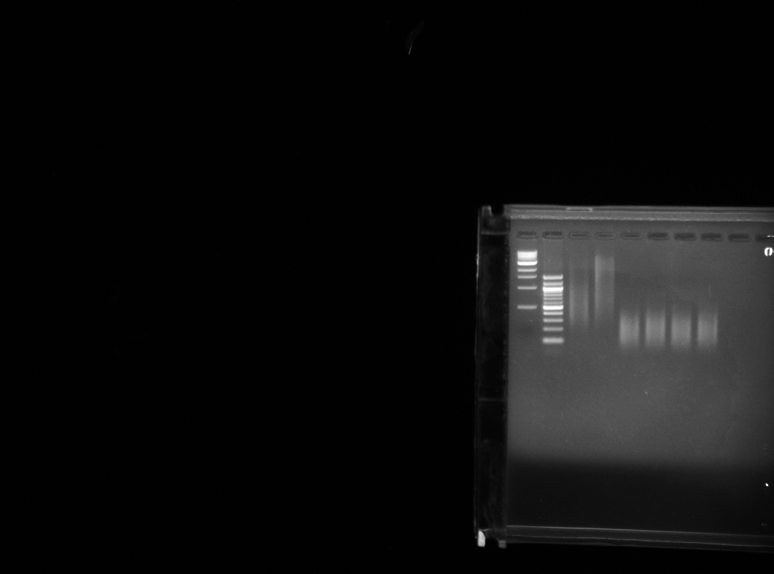
DamID-Seq : NOT DRAWN TO SCALE! Lamina Associated Domains (LADs) should be much longer than adapters! (LADs ~ 200 – 4000 bp; Adapter – 15 bp)
Randomisation:
End Repair and ligate
Sonication
Library Prep: End Repair, A tailing, adapter ligation, PCR -> cluster generation and sequencing
Notes:
Note that primer dimers and dsAdR sequences can ligate to the DamID amplified pool during the randomisation step. Accounted for in galaxy workflow.

Slide 14
Galaxy Workflow
Quality trimming ends of reads (FASTQ); sliding window of size 3; Threshold: mean of scores ≥ 30.
Replace DamID adapter or primer sequences by delimiters.
Bin 1:
Reads with DamID primer (AdrPCR) consistent with DamID protocol (ie GATC regenerated)
Bin 2:
Reads with DamID primer (AdrPCR) not consistent with DamID protocol (Primer dimers, genomic sequences with AdrPCR)
Bin 3:
Truncated DamID primers at the ends of reads AND Reads without adapter or primer sequences
Replace delimiters by tab to retrieve flanking sequences
For sequences without any indication of primer dimers (ie only one AdrPCR delimiter is observed without adjacent delimiters), replace the delimiter assigned for AdrPCR back with its respective sequence to regenerate genomic sequences that might contain the AdrPCR sequence
Concatenate files end to start to combine reads
1st Bowtie; mm9 (default settings)
Convert to FASTA and Filter by length > 25.

Slide 15
Filter Sam to retrieve mapped and unmapped reads
Unmapped Reads (might contain truncated primers at either end);
Mapped Reads; Convert to intervals
Trim 13 bases off 5’ end of reads; filter by length > 25
2nd Bowtie; mm9 (Default Settings)
Filter Sam to retrieve mapped and unmapped reads
Unmapped Reads (might contain truncated primers at 3’ end);
Mapped Reads; Convert to intervals
Trim 12 bases off 5’ end of reads; filter by length > 25
3rd Bowtie; mm9 (Default Settings)
*Concatenate files start to end
Filter Sam to retrieve mapped reads
Mm9 genome is binned by DpnI sites and an interval file is generated. Count number of times a genomic fragment that is flanked by DpnI sites has a mapped read that overlaps with it to obtain fragment scores
Mapped Reads; Convert to intervals
Normalise fragment score by frgment size and #lines from * to obtain normalised fragment scores.
For each interval, normalise the fragment score of DamX to Dam and take the log2 ratio.

Slide 16
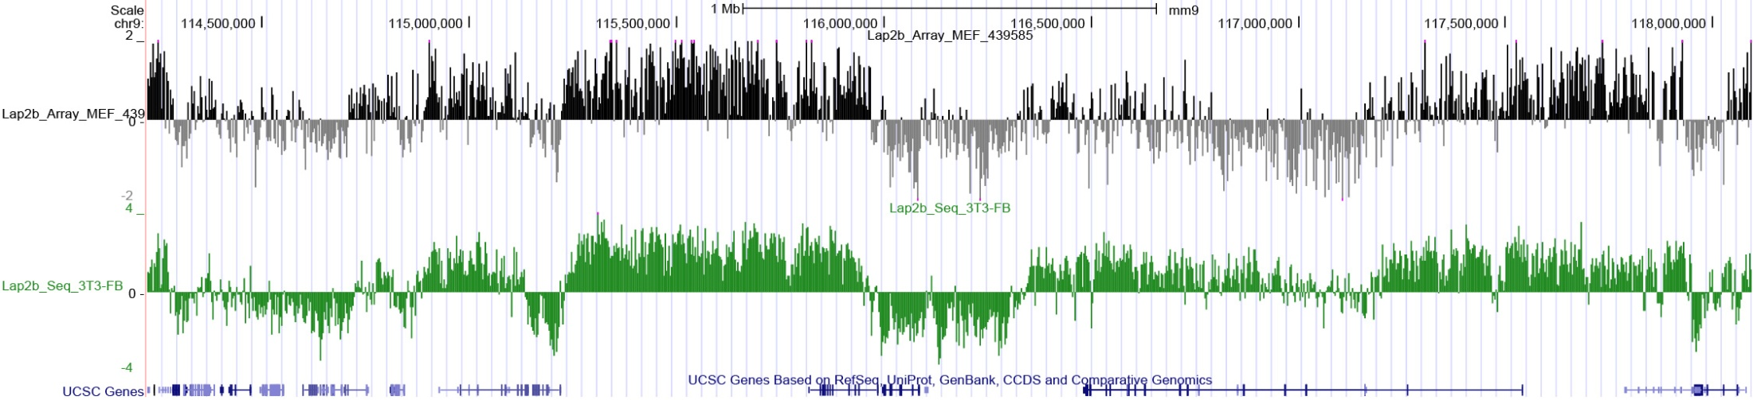
Verification of workflow/analysis by comparing DamID-seq with DamID-tiled array

Slide 17
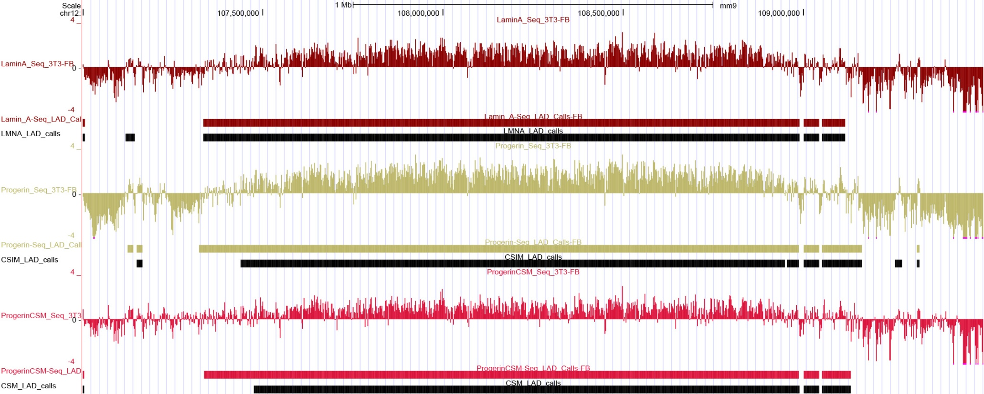
We want to do more of the ‘fun’ stuff with bioinformaticians—
like developing algorithms to further analyze our data

Slide 18
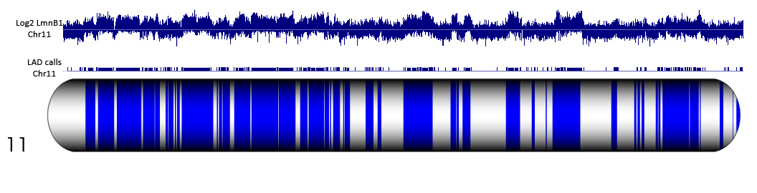
Probes were made to LADed regions (red, Cy3) and unLADed regions (cyan, Cy5)
Collaboration with Agilent

Slide 19
RNA-seq
We performed directional RNA-seq on mouse primary lymphoid cell lines
Aimed to profile gene expression and discover ncRNAs
With assistance from the Galaxy community and the literature we were able to perform the analysis on our own using the intuitive Galaxy Cloudman
  https://main.g2.bx.psu.edu/u/jeremy/p/galaxy-rna-seq-analysis-exercise
  Trapnell, C., et. al.. Differential gene and transcript expression analysis of RNA-seq experiments with TopHat and Cufflinks. Nat Protocols. March 1 2012.

Slide 20
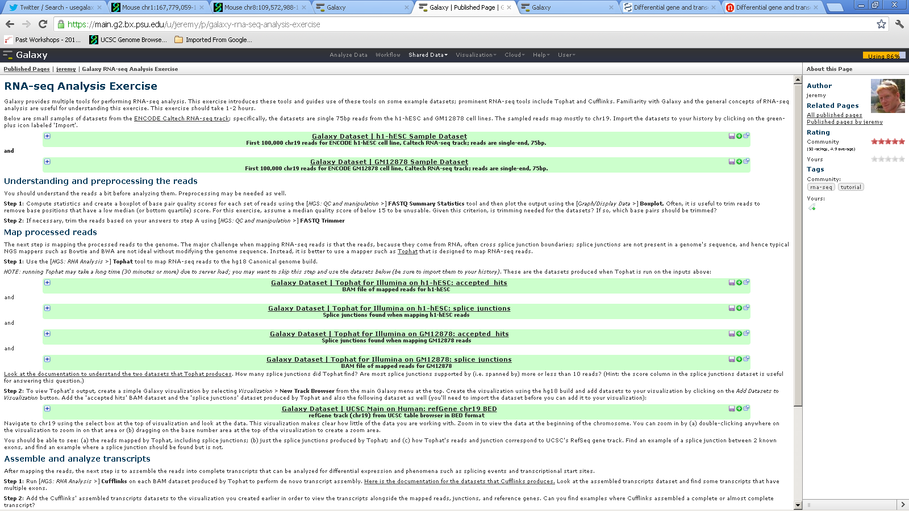
On-line tutorials, guides and workflows invaluable

Slide 21
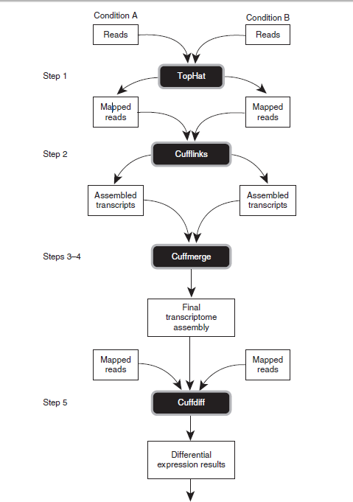
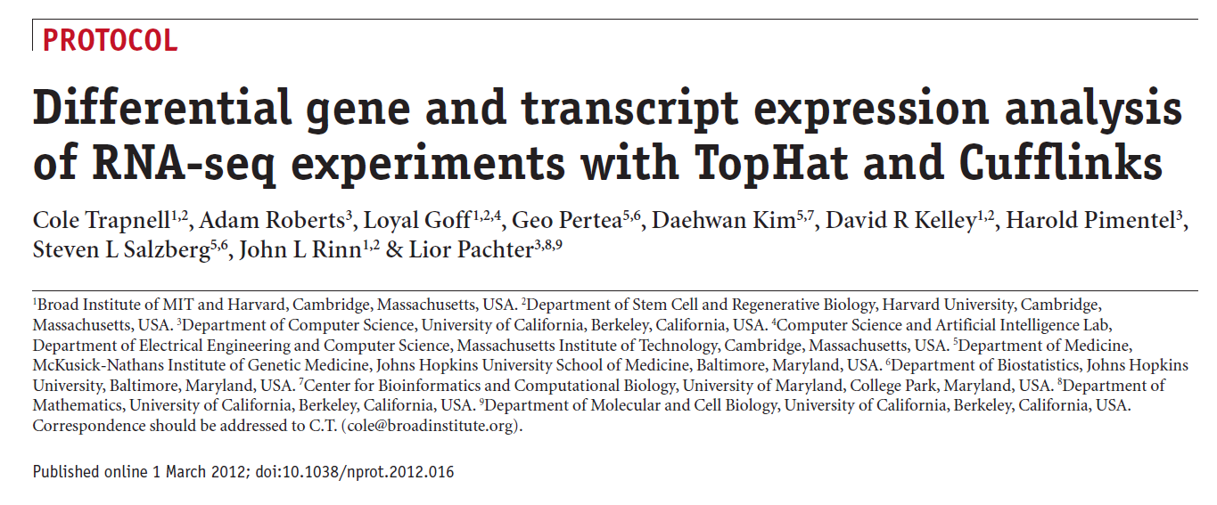

Slide 22
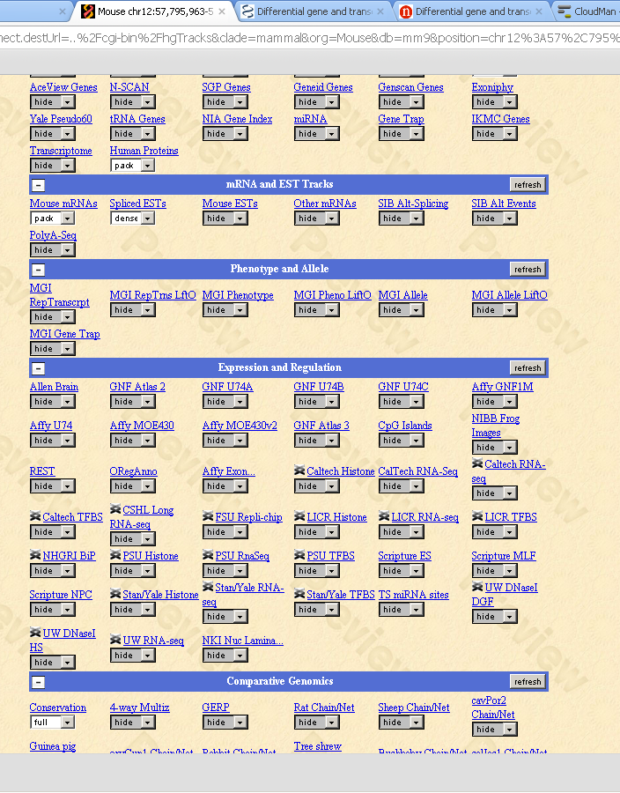
Visualization-UCSC

Slide 23
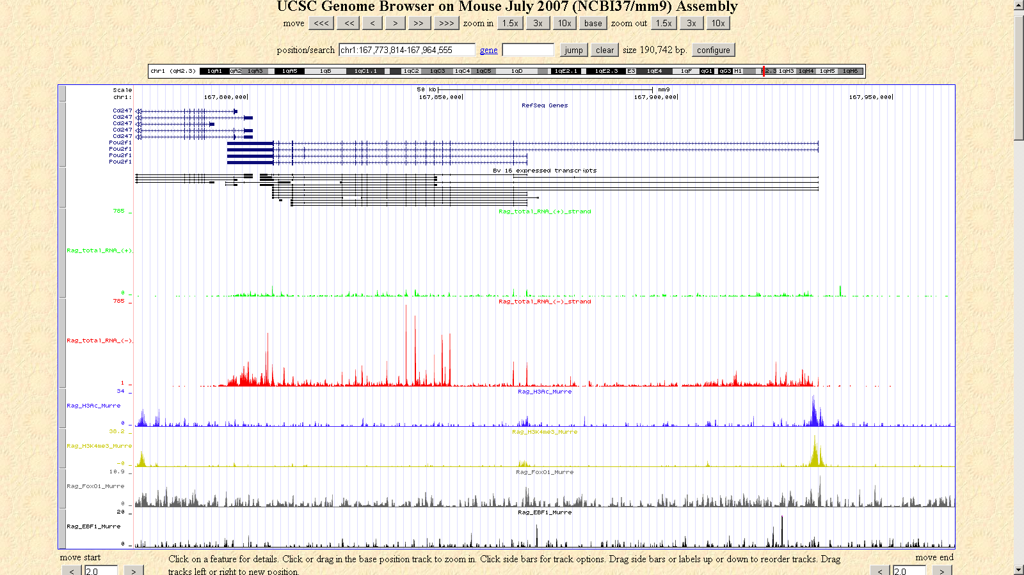
Visualization-UCSC
TSS
Epigenetic modifications associated with active transcription

Slide 24
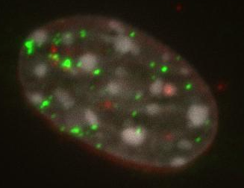
The ultimate visualization (for us)

Slide 25
Issues encountered on the cloud
Institutional issues
  IT and bioinformaticians not fluent in cloud based computing
  University does not have clear policies about data on the cloud (especially important for clinical data)
Not many issues with using—we have been pretty happy…HOWEVER
We have encountered two major issues:

Slide 26
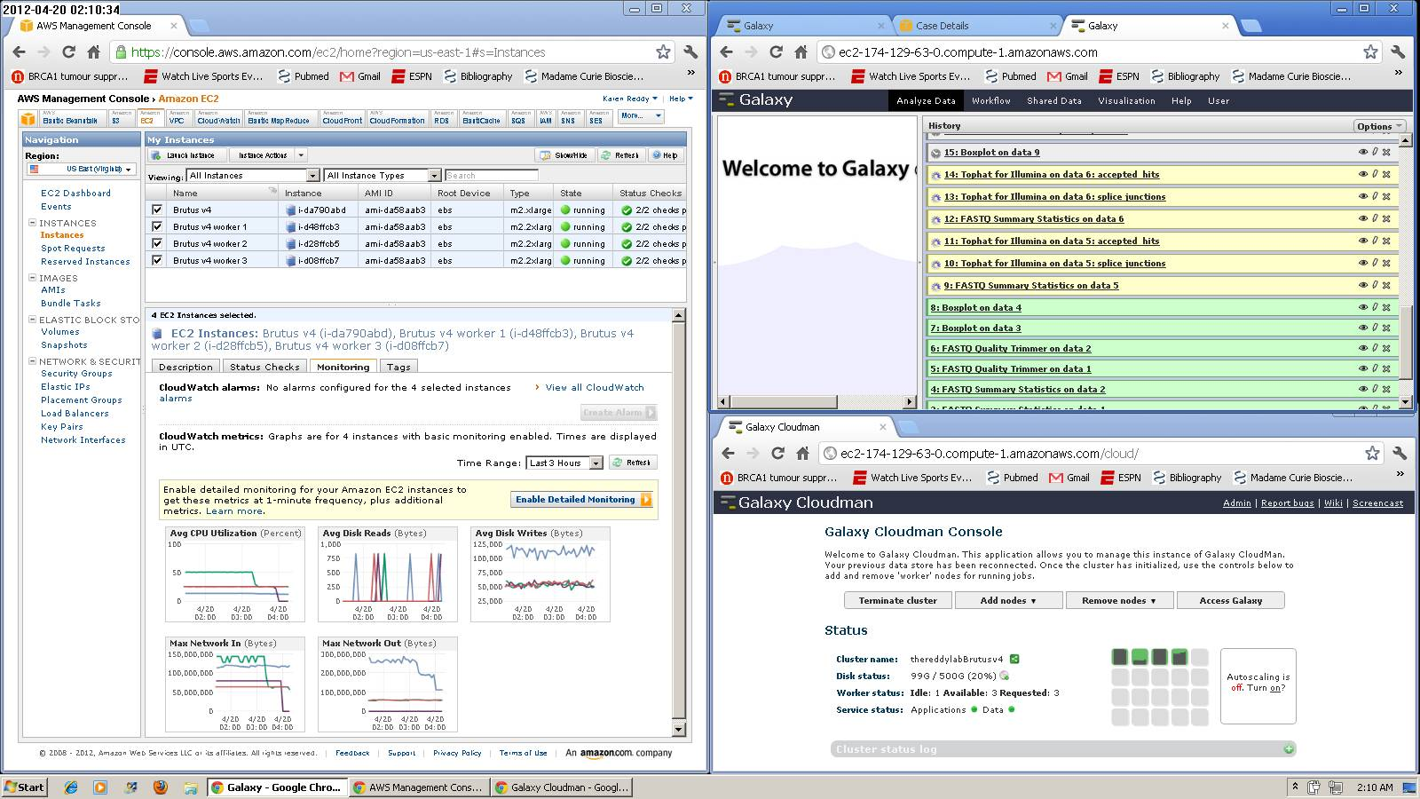
Issue 1 (which led to issue 2)
  Judging capacity planning (http://wiki.g2.bx.psu.edu/CloudMan/CapacityPlanning)
  We use “Brutus” configuration now: head=High Memory XL
                Worker(s)=High Memory 2XL

Slide 27
Issue 2: Keys, keys and more keys
Secret key
Security Key
Private Key
Public Key
Key pair
Access Key
  Connecting EBS to EC2 drives

Slide 28
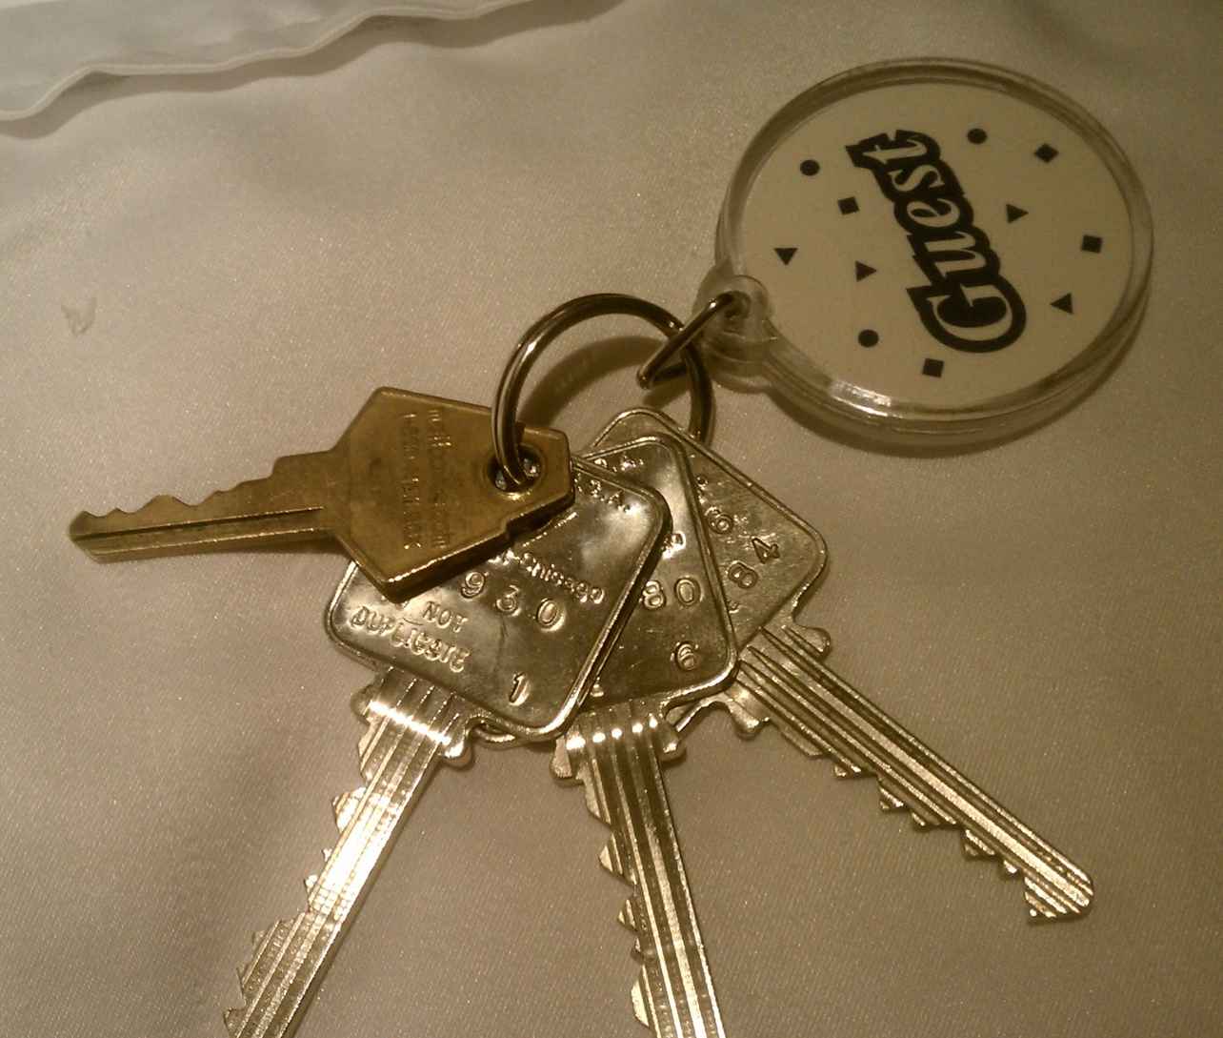
Keys, keys and more keys
What key(s) do we need for what?
A bit of difficulty in biologists communicating with technical support (which key??)

Slide 29
Lessons learned and words of advice
Better communication between tech support and the end user would make life easier
Use the tutorial/wiki (http://wiki.g2.bx.psu.edu/CloudMan)
Capacity planning. Go big.
  We like using at least Hi-Mem Double XL workers
Keep small head node up and running (EC2) and shunt all jobs to workers—this will avoid mounting issues and data loss.

Slide 30
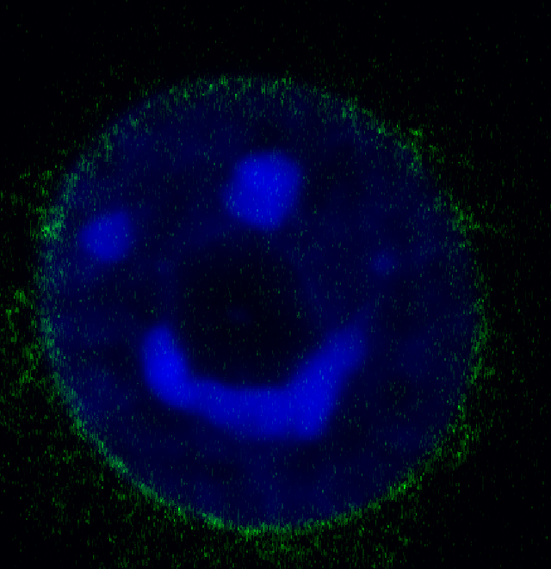
Acknowledgements:
Mo Heydarian- RNA –seq, lncRNA, proteome
Xianrong “Jose” Wong-nuclear structure in aging
Teresa Romeo—DamID mapping and nuclear structure in development
Agilent (tiled OLIDS-chromosome paints)
Alice Yamada and team
GALAXY TEAM AND COMMUNITY!!!!!!!

