Slide 1
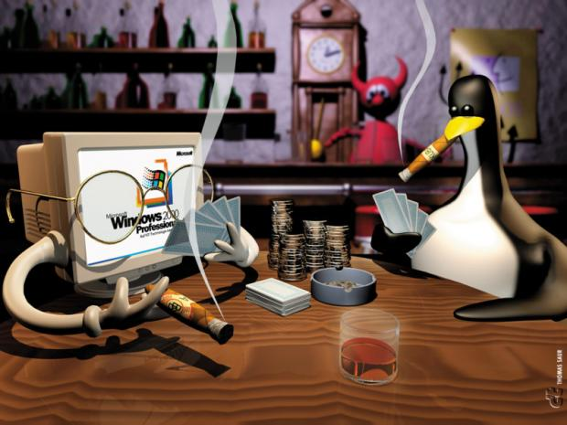

A Window to Galaxy
Liram Vardi and Amir Ben-Dor
Agilent Labs, Tel Aviv
Notes:
My Name is …
I works at Agilent Labs, Tel –Aviv.
Thanks to the committee for letting me speak hear, it is great honor.
Today I will talk about a “loaded” subject, related to the on-going struggle between Linux and Windows, where Galaxy is just one “front line”.
So, lets start..

Slide 2

Galaxy is a Linux Fan
Galaxy is a great framework for Bioinformatics researchers.
Which OS? Windows or Linux?
  Great community support for Linux based Galaxy
  Many RNA-seq analysis tools available for Linux
  NO support for Windows-based Galaxy
  We chose Linux ☺
Notes:
There is no argue on that Galaxy is a great framework, for bioinformatics researchers,
especially for those who don’t wish to “dirty” their hands with “low level” scripting and tools configurations…
But if you are a Galaxy administrator, there is a need for a crucial decision to be made before installing you’re a local instance of Galaxy: And that is which OS to install Galaxy on ?
The main advantage at Linux based Galaxy is ,of course, the great community support.
Moreover, at Agilent we use Galaxy mainly for RNA-seq research, where there are already many ready-to-use pre-compiled Linux tools available.
On the other hand, there is no support for Windows based Galaxy and you are more or less “on your own” …
So, we didn’t have a real choice and, surprisingly, we chose Linux.

Slide 3


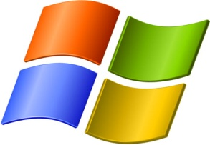
Mixed Workflow
There are many tools that are developed and compiled for Windows, and therefore cannot be integrated into Galaxy workflows.
Galaxy needs to embrace all developers (even if they made a mistake with the OS ☺) .
Notes:
However, there are tools that work only on Windows and therefore cannot be easily integrated into Galaxy workflows.
we seriously believe that Galaxy should be accessible and relevant for all developers, even if they chose the wrong OS ☺

Slide 4

Galaxy @ Agilent
Within Agilent we have both Linux and Windows developers.
Genomics:
  RNA-seq
  Most of the tools are executed on Linux platform
Proteomics:
  Mass spectrometry data analysis
  Agilent Spectrum Mill (Windows based)
  http://www.chem.agilent.com/en-US/products-services/Software-Informatics/Spectrum-Mill/Pages/default.aspx
Notes:
Let me give you a little contexts on the stuff we are doing with on Agilent Labs…
At Agilent labs, we have both Linux and Windows developers.
RNA-seq analysis tool are mostly developed under Linux.
In contrast, Mass Spectrometry data analysis tools are typically written in .NET framework.
One such example is Agilent Spectrum Mill software, which contains a large set of tools for the analysis of data measured by the mass spectrometer.
Those tools are available only for Windows, and if we wish to integrate them into Galaxy , we first have to find a way to run them under Linux.

Slide 5
The Problem
Executable that refers to “Dynamic Link Libraries” (DLLs) will execute only on windows.
Code written in .NET languages (C#, VB.net, etc) is compiled to a windows specific runtime
Notes:
The problems occurs when we are dealing with tools that refers to Dynamic Link Libraries (or Dlls).
Those libraries are already compiled to Windows specific platform and cannot directly executed on Linux.
Furthermore, at Agilent we have large developers community that is developing new tools at Microsoft .Net framework.

Slide 6
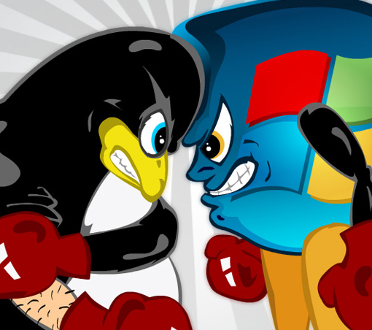
Do we really have to choose?
Notes:
So finally, we came up with question:
Do we really have to choose?
Do we really have to decide between Linux-based Galaxy to Windows-Based one?

Slide 7

Existing Solution I - Mono
Mono is a free and open source project led by Xamarin.
Able to run Microsoft .NET applications cross-platform.
Includes .NET Framework-compatible set of tools including:
  C# compiler
  Common Language Runtime
Notes:
This problem is not new, and some solutions already exist.
One of the existing solutions is Mono. Mono is open source project aims to allow Linux, Apple and Windows users to run .Net application in a cross-platform fashion.
Mono offers a Linux based C# compiler and a alternative implementation of the Windows specific Runtime machinery.

Slide 8

Existing Solution II - Wine
Wine is a open source compatibility layer.
Aims to allow computer programs written for Windows to run on Unix-like operating systems.
It duplicates functions of a Windows computer by providing alternative implementations of the DLLs.
Notes:
Another solution is Wine.
Wine is another open source project with the goal of running windows application on Linux. It is a software layer that provide alternative implementation of windows DLLs, hence enabling running windows applications on Unix-like OS

Slide 9
Drawbacks (personal experience)
Both are NOT supported by Microsoft
Mono:
Partial support for the .NET features, such WPF, WCF, etc.
In many cases a Mono recompilation of the source code is needed.
  Additional work
  Not always possible due to unavailability of the source code.
Wine:
Only an old version exists at the Red Hat distribution.
Problematic to install on remote machine without a display adaptor.
Requires Mono to execute .Net programs.
Notes:
The main drawback: those are not supported by Microsoft.
(All in the slide)

Slide 10
Our Proposed Solution
Goals:
Enable running any Windows application from Linux
Integrate Linux and Windows tools within the same galaxy workflow.
Transparency of the integration to the Galaxy end user.
Notes:
So, we had to come up with another solution. First, we defined a few main goals:
This tool should enable running ANY windows application from the Linux side.
This tool should give us the power of integration of both Linux and Windows tools at the same galaxy workflow.
Furthermore, this integration should be, ideally, transparent to the Galaxy end user.

Slide 11
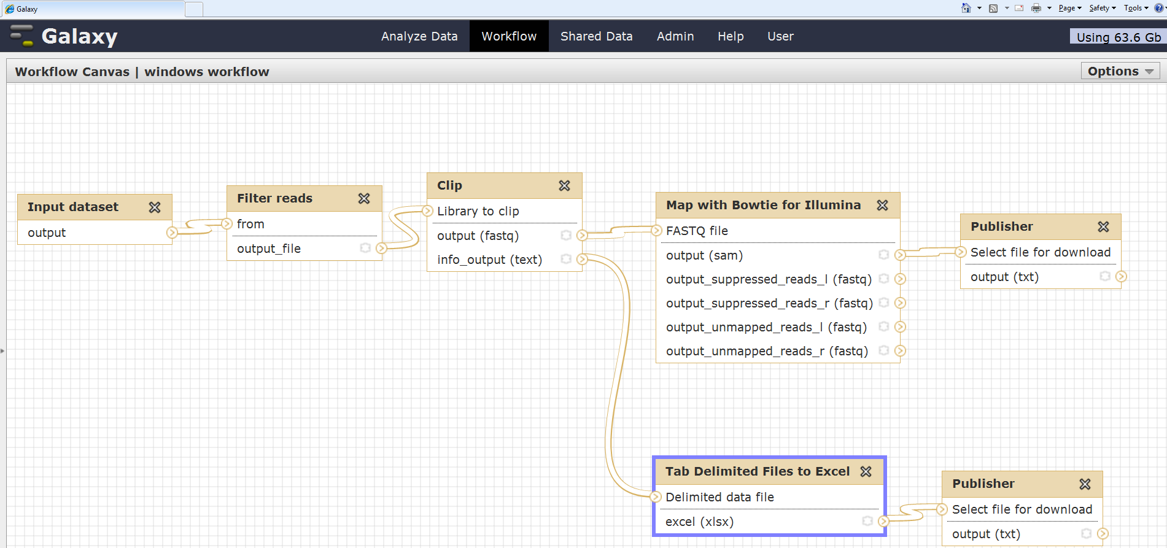
Example Hybrid Galaxy Workflow
This step is done on a Windows machine
Notes:
What do I mean by “totally transparent”?
Here is a very simple galaxy workflow we currently use for RNASeq data analysis. This workflow is run on our local, Linux based, galaxy server. The details of each tools are not important for this talk, however, it is important to note that all steps (beside the highlighted one), are performed on the local Linux server, while the highlighted tool (which takes a tab-delimited-file and using Microsoft Excel to creates a report) is performed on a windows machine. however, from the user perspective, this is a normal galaxy workflow, where each tool output feeds the next inputs.
The point is that the user does not need to know on which platform the tool is running.

Slide 12
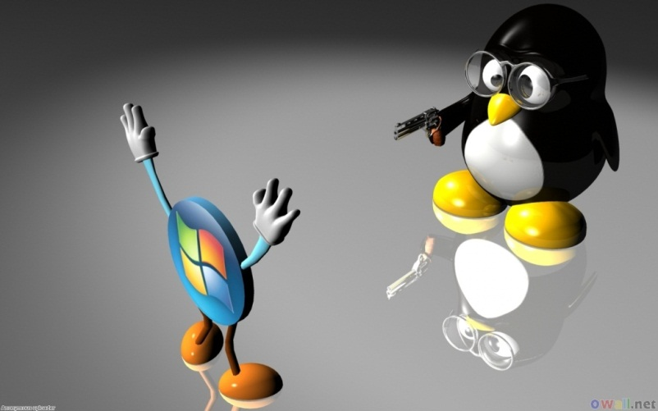
A Window to Galaxy
Method:
Create a collaboration (relationship…) between two separate machines (Linux client and Windows server)
The “server” can be also a guest VM.
Notes:
Now, let me explain how we achieved those goals:
Well, we have established a collaboration between two separate machines – One will be a Linux and the second will be a Windows one.
Just to be clear – While we did use two separate machines, there is no obligation to use a physical Windows computer -
The Windows machine can be a Virtual machine that is run on the main Linux server.

Slide 13
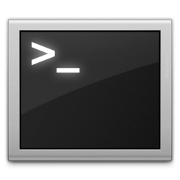
Galaxy Layers Model
User interface (history)
my_data.fastq
results.fastq
Galaxy
Data_012.dat
Data_013.dat
Your Linux tool
$ your_tool data_012.dat data_013.dat
Notes:
The current way Galaxy works, as you probably know, is that there is a layer separation between the user, Galaxy and the OS platform.
The user upload a data sets and start a tasks. The data is sent throw Galaxy to the tools which are executed on the Linux shell “behind the scenes”.

Slide 14

However, with a Windows-based Tool
User interface (history)
my_data.fastq
results.fastq
Window2Galaxy client (Linux)
Window2Galaxy
Galaxy
Data_012.dat
Window2Galaxy server (Windows)
Data_013.dat
Your windows tool
> your_tool data_012.dat data_013.dat
Notes:
But, when we are dealing with Windows Application, we need to overcome the operation system barrier.
Therefore, we are proposing to add two more layer to the Galaxy model:
1. The Window2Galaxy client (running on the linux side and sending execution request to the windows machine)
And 2. The Window2Galaxy server (running on the Windows side and actually executes the windows tools).
In this view the blue boxes are executed on Linux, and the orange ones, on Windows.

Slide 15
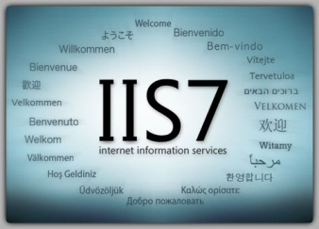

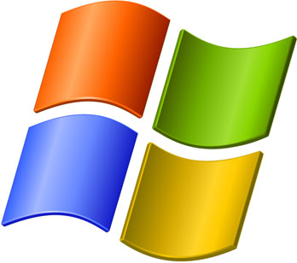

Window2Galaxy Implementation
HTTP requests
Samba
VM share directory
Notes:
On the Linux machine we have the galaxy and the window2galaxy client, and on the windows machine we have the window2galaxy server.
The connections between those two machines is based on simple HTTP protocol and some temporal repository, that both machines have access to.
We have used Samba for the shared directory, but other approaches are possible.

Slide 16


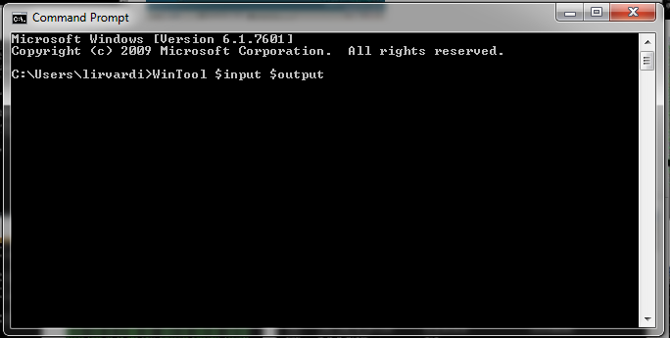
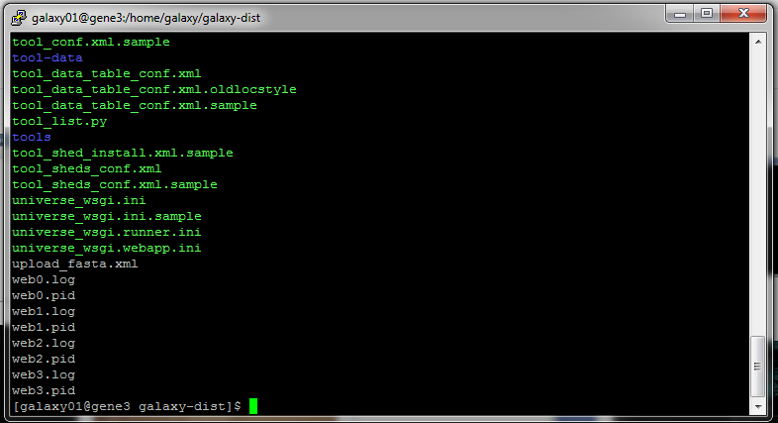
WinTool execution
“WinTool $input $output”
HTTP request: “Execute WinTool $input $output”
$Input / $output
$input
WinTool <Win_path>\$input <Win_path>\$output
Window2Galaxy “WinTool <Linux_path>/$input <linux_path>/$output”
Notes:
So,
As an example, let us assume that we have a windows based tool called “WinTool”.
This Wintool gets one input file and generates one output file.
when Galaxy gets a request to execute a job with this tool, it execute the command specified in the tool configuration file.
In this case, Wintool command is wrapped by “Window2Galaxy” call, as you can see on the bottom of the screen.
Basically, Galaxy asks “Window2Galaxy” client to execute this command: WinTool $input $output.
When called, Window2Galaxy client first copies the input file to the shared directory.
Second, it sends an HTTP request to the Server with the needed command.
On the Server side, Window2Galaxy service will respond to the request by executed the command “WinTool input Output”, through the Windows command-line.
The web service is also update the correct path of the files to the relevant Windows path.

Slide 17
WinTool Execution
HTTP request: Is job done?
Respond: Yes/No
$output
Standard Output Stream
Standard Error Stream
Notes:
In the meantime, the client is monitoring the task progress by querying the server.
When the client will get an approval from the server that the task has completed,
Those results will be moved back to the Galaxy repository and from there to the user.
In addition, both Standard streams (i.e. std-out and std-err) will also be reordered and transferred to the user throw the Linux standard steams.

Slide 18

The Gory Details – Server Side
Web service implemented on ASP.NET (Active Server Pages)
Embedded in IIS7
Window2Galaxy can execute any command (security breach?)
  Job executed under IIS Worker (limited permissions) account
  Users cannot integrate new tools and XML configuration without Galaxy administrator permissions
Notes:
Let me show you on slide of technical details:
The Web service is implemented by using ASP.NET active server pages technologies and it is embedded in IIS7 – The standard Windows Web Server.
Another important question is that since Window2Galaxy can execute any command:
Are there security concerns?
Can this service harm the windows machine?
For instance, can some tool, even as part of failure resulting from a bug, clean all the hard drive?
Well, there are two “safeguards” exist to prevent that:
One, is that ‘windows2galaxy server process is executed on the Window side under special low permission account (web-runner?),
and those processes can get access to the share directory.
Second, tool developers can not integrate new tools into Galaxy without the Galaxy administrator, and of course it is her or his responsibility to verify the tool is not malicious.

Slide 19
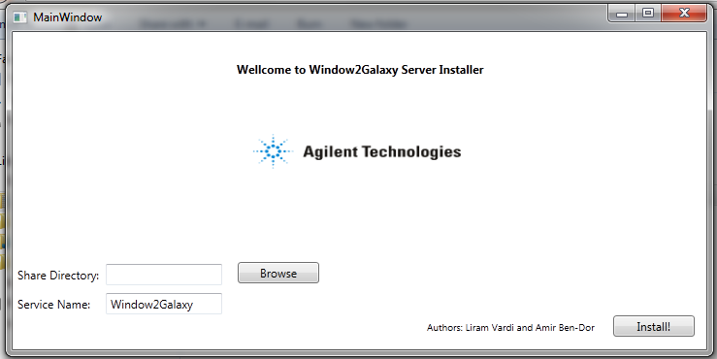
Easy Installation
Prerequisites:
  Server side: IIS7 installed
  Setting up a shared directory
Client installer (Linux side).
Server Installer:
Notes:
In order to make Window2Galaxy deployment easy, we have made tools to automate the installation and configurations.
The system requirements are minimal: All the user has to do before the installation, is to make sure he has IIS7 installed on his Windows (included with Windows7),
and after that to generate a shared directory. The heavy lifting (installing the windows2galaxy service on the windows side and configuring IIS7) are done automatically by the windows installer.
There is also am installer for the Linux side.

Slide 20
Summary
Galaxy is a great framework (already said?).
There are business and research needs to incorporate Windows-based tools into Galaxy workflows.
Benefits of Window2Galaxy:
  Enables running any Windows tool in a native fashion.
  Totally transparent to the Galaxy end user
  General mechanism for running Windows tools from Linux (not just for Galaxy users)

Slide 21
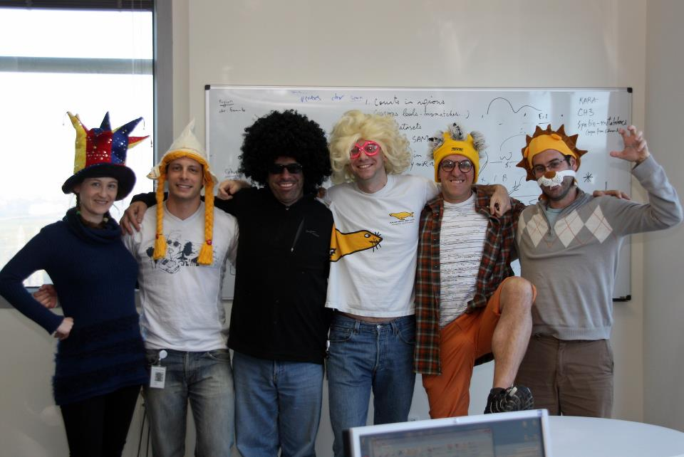
Agilent Labs - Israel
Amir Ben-Dor
Zohar Yakhini
Ilona Kifer
Me ☺
Roy Navon
Israel Steinfeld
Notes:
I would like to introduce you the group that I fortunate to be part of…
The guy in the middle is Amir Ben-Dor which is my co-author on this project.

Slide 22
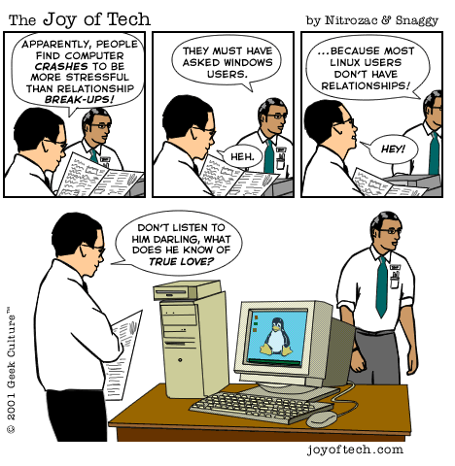
Thank you!

