Slide 1
GCC Workshop 9
RNA-Seq with Galaxy
Curtis Hendrickson (curtish@uab.edu)
David Crossman (dkcrossm@uab.edu)
Jeremy Goecks (jeremy.goecks@emory.edu)

Slide 2
Agenda
RNA-seq flash review
  Tophat (RNA-seq read mapping)
  Cufflinks (Isoform assembly)
  Cuffmerge (cross-sample consensus)
  Cuffdiff (expression analysis)
Galaxy flash review
RNA-seq exercises
  installed genome: mouse (mm9)
  Non-standard genome : tree shrew from Ensembl
2

Slide 3
Why RNA-Seq?
Gene/transcript expression quantification
Isoform analysis (alternate splicing)
5’ and 3’ UTR analysis
Sequencing of new genomes (paired genome/transcriptome sequencing)
etc

Slide 4
What type of analysis?
Compare gene or transcript levels between samples or conditions?
  Sequence the whole transcriptome
Discovery of alternate splice forms?
  >= 75bp Paired End for splice site detection
  Consider target enrichment
  Even at 100x coverage, a rare (1:100) splice junction would only average 0.4x coverage of it’s splice junction – not enough to detect.

Slide 5
Reads in RNA-seq
Exon A
Exon B
Exon C
Exon D
chromosome
?
?
?
?
?
?
?
?
?
?
Exon A
Exon B
Exon C
Exon D
transcript
7

Slide 6
An RNA-Seq Analysis Pipeline
TopHat
Align reads & discover transcriptome
Cufflinks
Assemble reads into isoforms
Cuffmerge
Build consensus transcriptome across samples and replicates
Cuffdiff
Quantify and compare transcript expression levels

Slide 7
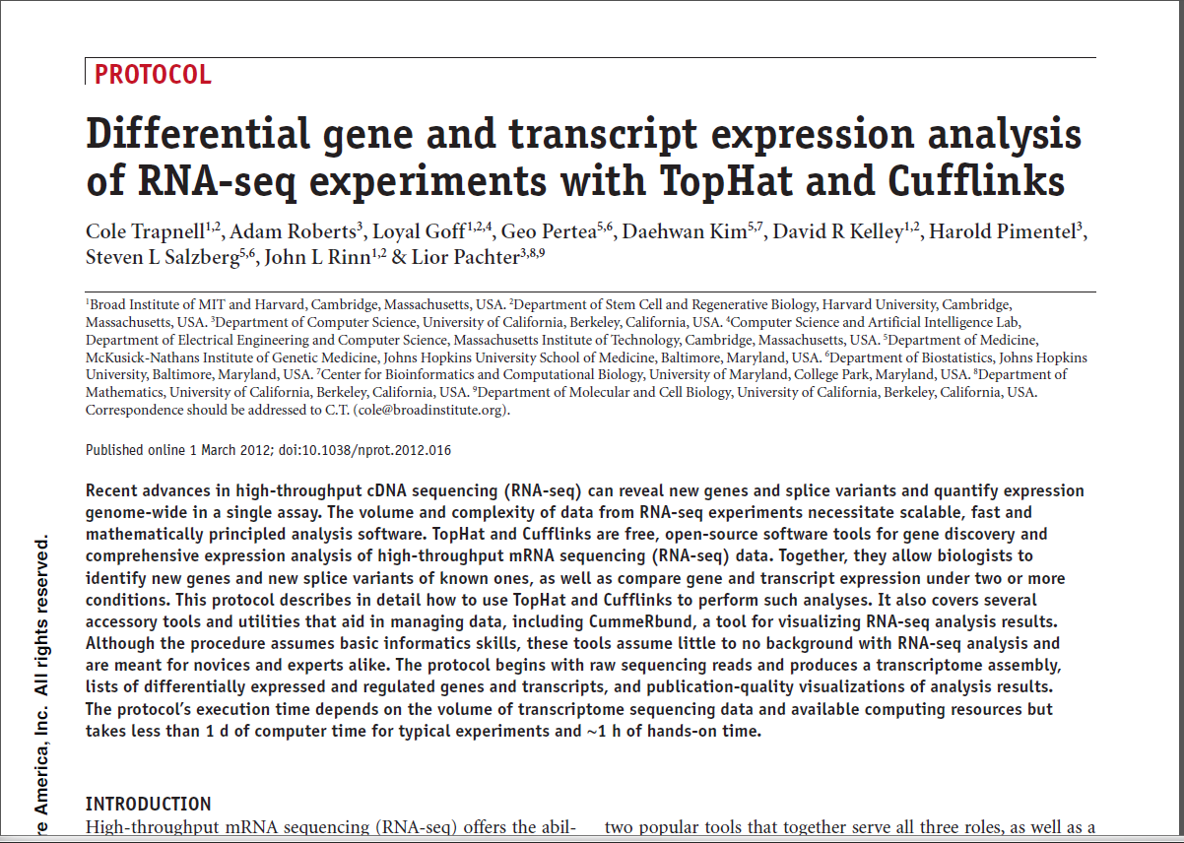
See Trapnell et al, 2012, Nat Protocols

Slide 8
Types of data
FASTA <1G Genomes
FASTQ 1-12G/ea Sequencing reads
BAM 1-5G/ea Mapped Reads (binary)
BED <1G Genomic intervals
GTF < 1G Gene/transcript location

Slide 9
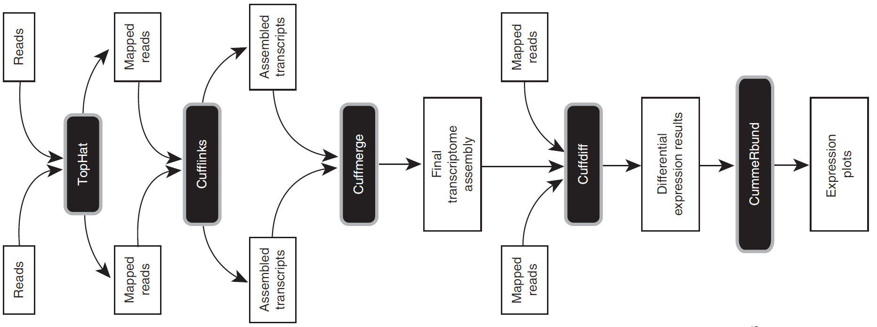
2-Condition Differential Expression
Protocol Overview
(Trapnell et al, Nat Protocols, 2012)

Slide 10
2-Condition Differential Expression
Protocol Overview
QC:
FastQC
!!QC!!
FastQC
!!QC!!
Flatstat
QC:
Flatstat
(Trapnell et al, Nat Protocols, 2012)

Slide 11

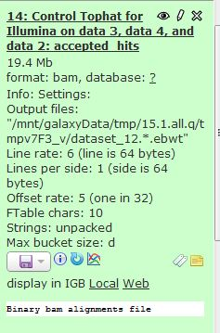
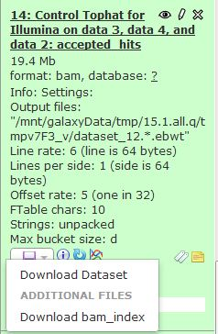




Random Galaxy icons/colors
Colors
Download/Save
Queued
Running
Completed
Failed
Icons
Display data in browser
Edit attributes
Delete
Edit dataset annotation
View details
Run this job again
View in Trackster
Edit dataset tags

Slide 12
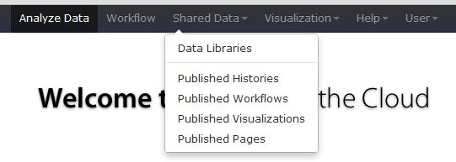
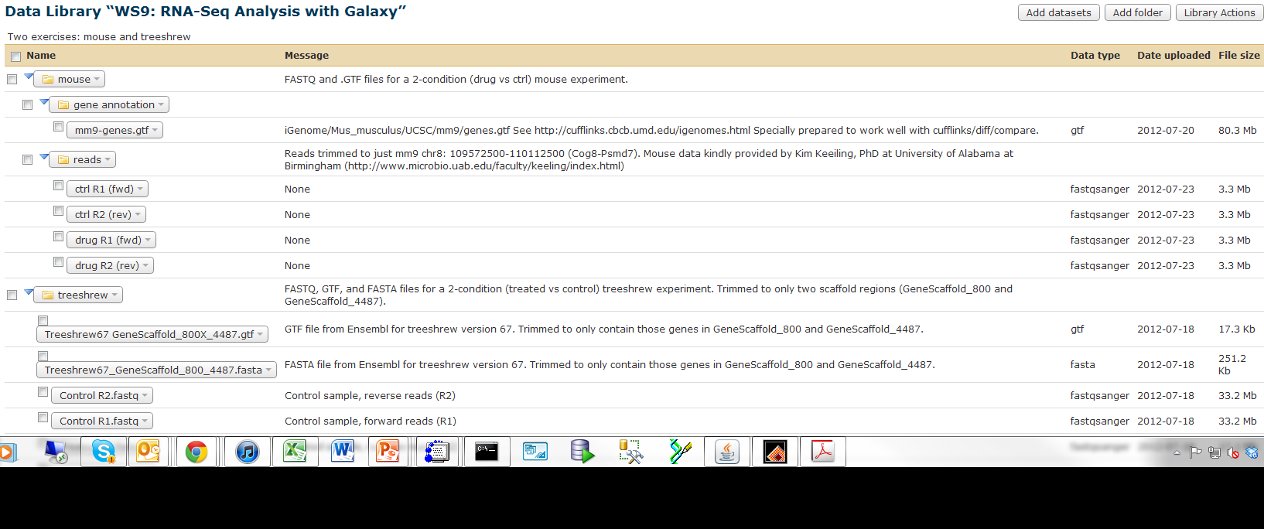
In the beginning there were reads…
Get them from Shared Data
Click on “Shared Data” (located on top toolbar)
Drop down box appears; click on “Data Libraries”
Will see this Data Library. Click on it to expand (as shown)
1
2
3

Slide 13
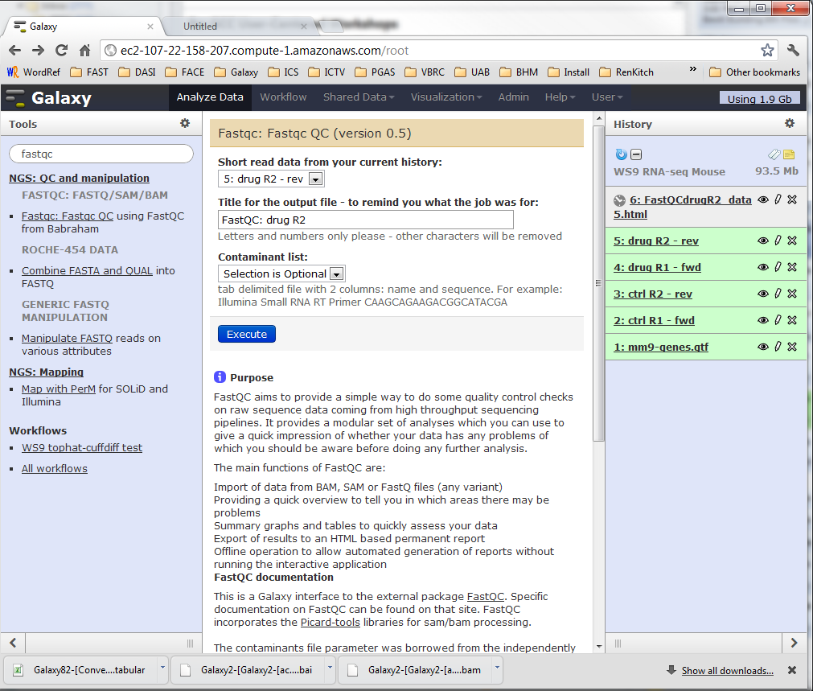
So we used FASTQC to QC them…
Tools > > Tool Search
Enter “fastqc”
Select the tool
Enter a data set & Execute
Trick for quick entry of multiple samples:
  Immediately hit “BACK”
  Update parameters and re-execute

Slide 14
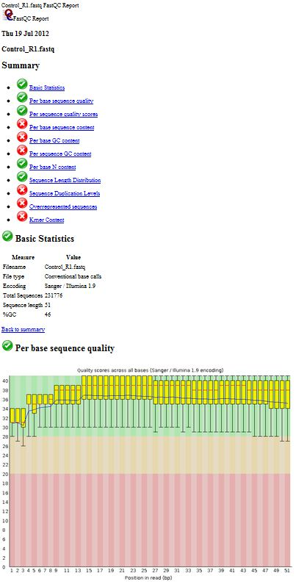
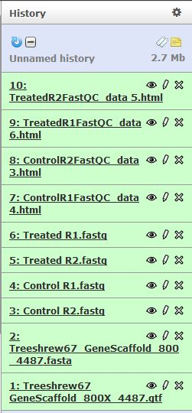
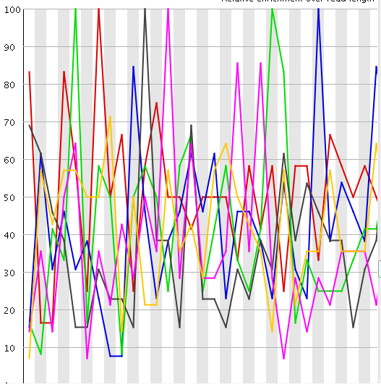
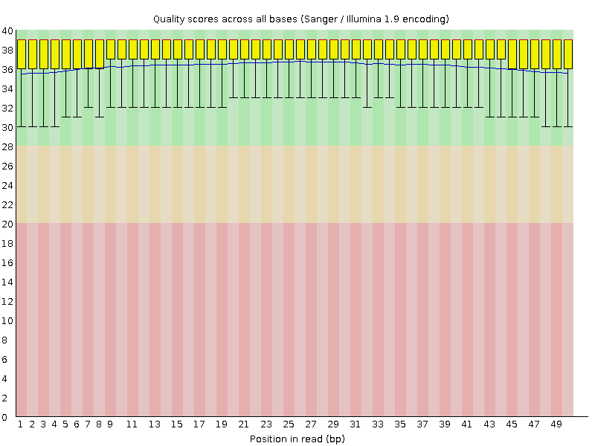
FastQC Output Report
This data looks awful because this is filtered data from a much larger fastq file. Better results when using entire file!

Slide 15
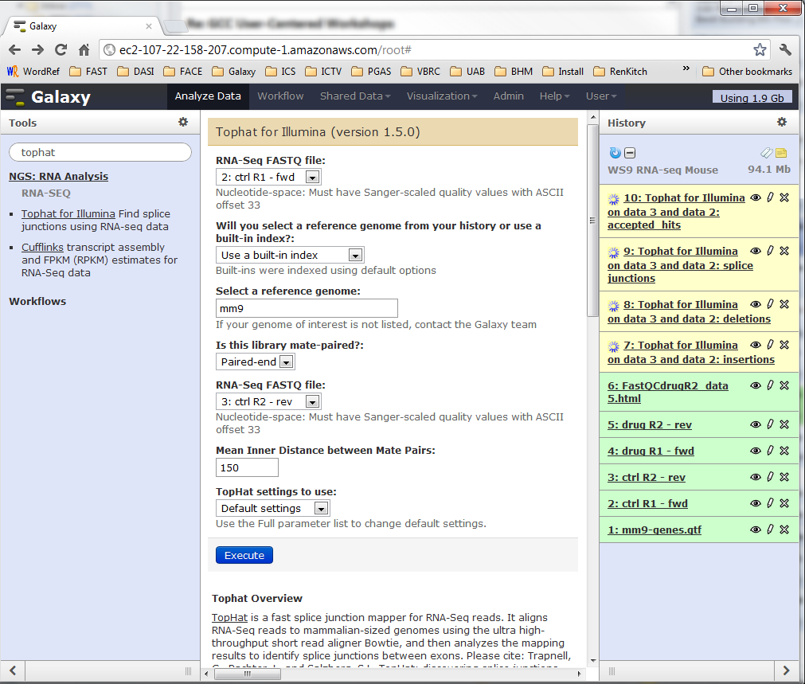
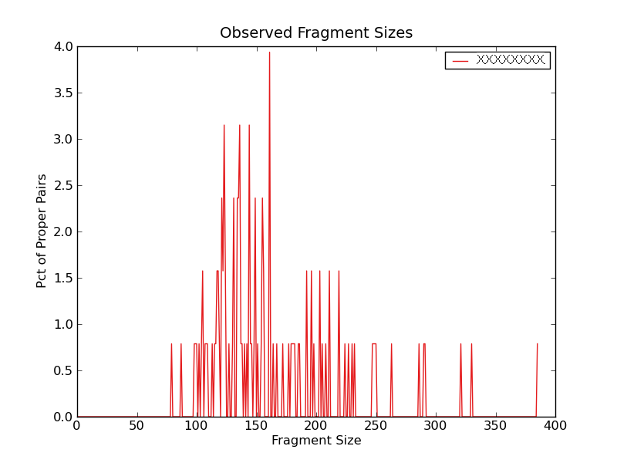
Tophat: map reads, create transcriptome
Paired-end, so 2 FASTQ per Tophat run
Select forward FASTQ
Set the ref. genome
Set PAIRed ends
Select reverse FASTQ
Select inner distance (get from sequencing group)

Slide 16
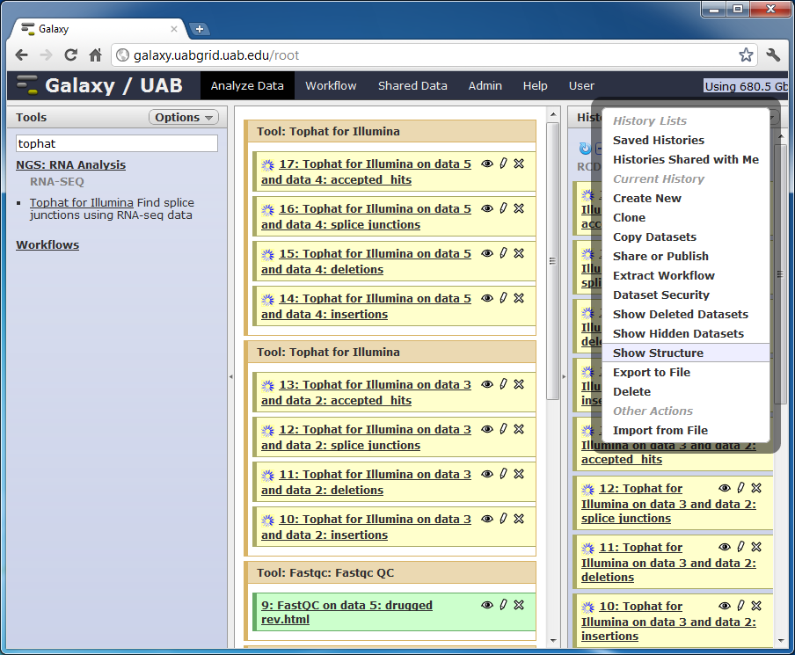
Launched 2 tophats (4 outputs each)
TIP:
> Show Structure
groups datasets produced by the same tool.
Edit “accepted_hits”
Datasets to give shorter names with sample info:
[ctrl] tophat.accepted_hits

Slide 17
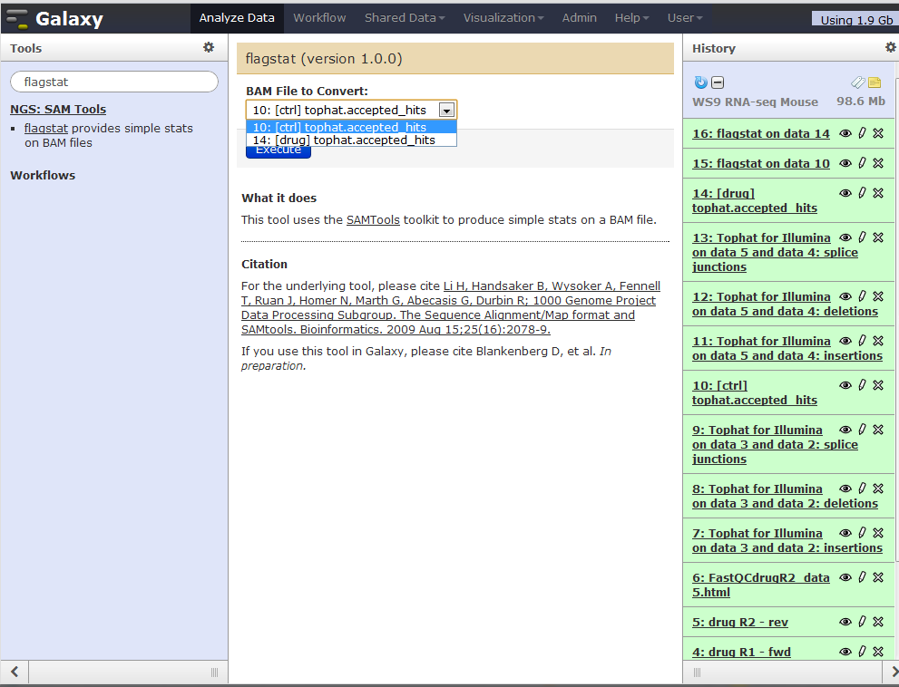
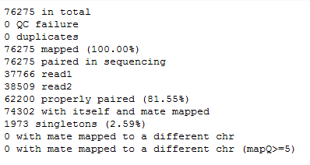
Launch 2 flagstats: QC mapping
TIP:
You can execute a tool before it’s predecessors have finished running.
Galaxy will queue it until all the dependencies are satisfied!
Ignore!
Always 100%

Slide 18
Viewing Alignments
UCSC
IGV via “web current” (JNLP)
  Set Visibility window & restart
  Un-collapse gene track!
IGV via “local”
  Make sure it’s running on your machine first!
Trackster
  Build visualizations inside galaxy!

Slide 19
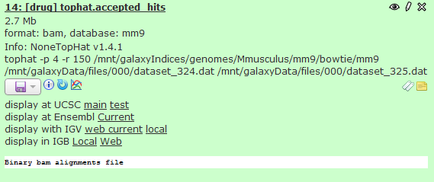
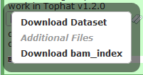
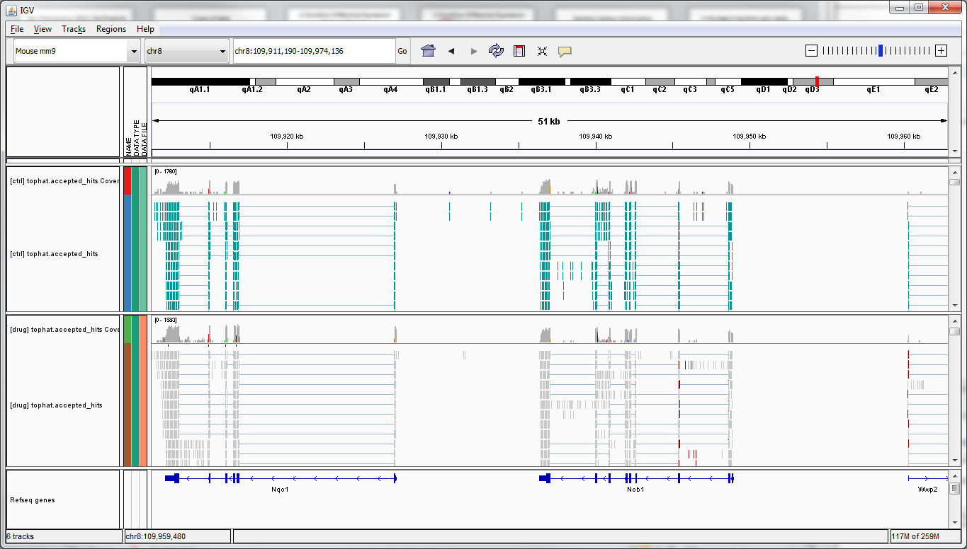
Display mapped BAM & BAI
Visually validate in IGV, or like

Slide 20
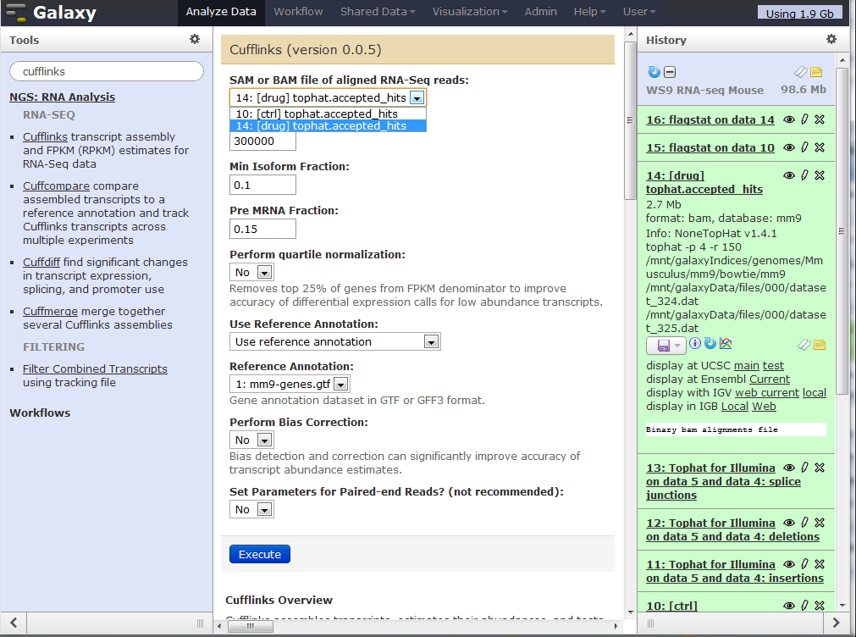
Cufflink: Construct Transcripts
Read data:
accepted_hits (BAM)
Use Reference Anno = yes
then pull down appears you can choose a GTF file from your history.
Reference annotation: iGenome genes.GTF
Other Parameters
“Perform quartile normalization”&
“Perform Bias Correction”
Normally YES is best
because we're not working with a full read-set, use NO or statistics will go haywire

Slide 21
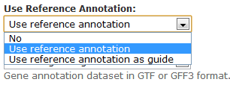
Cufflinks: discovery
No – for novel transcript discovery
requires very deep sequencing – consider sample enrichment!
Slow, memory intensive
Discover ONLY transcripts proven by reads
Ref
use reads only to quantify reference annotation
All novel splices ignored
Ref as Guide – most common
use reference annotation
Extend reference, when there is sufficient evidence

Slide 22
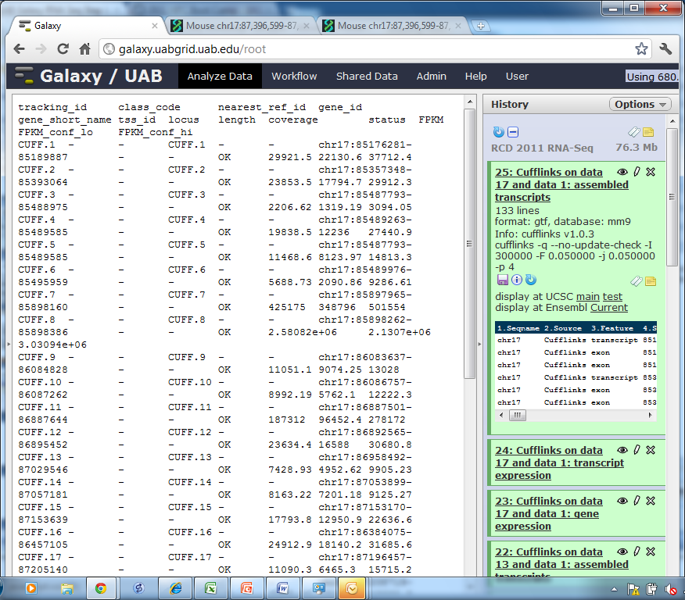
Cufflinks outputs
TIP: hide the cmd bar!
assembled_transcripts (GTF)
list of isoforms
transcript_expression (tab)
isoforms w/ FPKM
gene_expression (tab)
genes w/ FPKM
QC steps
Check FPKM not all 0.0!
Check you have gene symbols
Visualize assembled_transcripts in a genome browser (UCSC, IGV, IGB, etc)

Slide 23
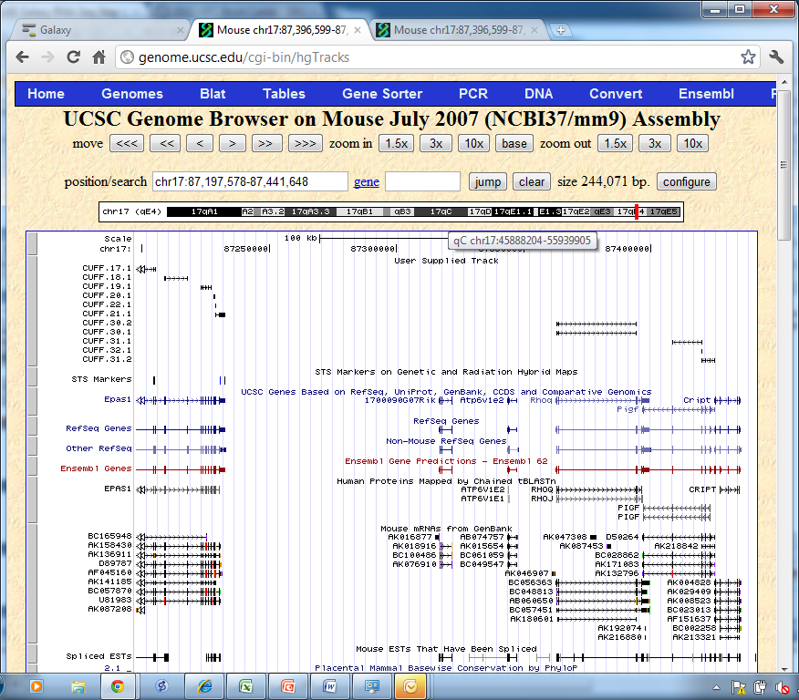
assembled_transcripts Visualization

Slide 24
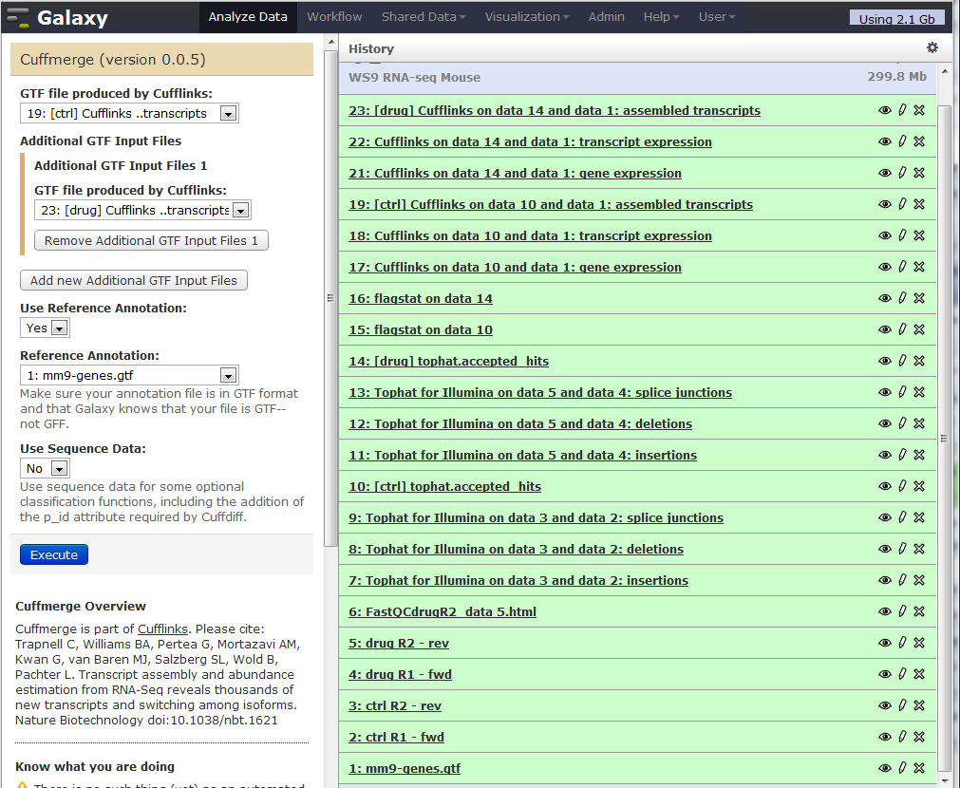
Cuffmerge: combine transcripts samples & replicates -> complete transcriptome
Run once, using both samples
Inputs
[ctrl] assembled _trans…
[drug] assembled_trans…
Reference_annotation (GTF)

Slide 25
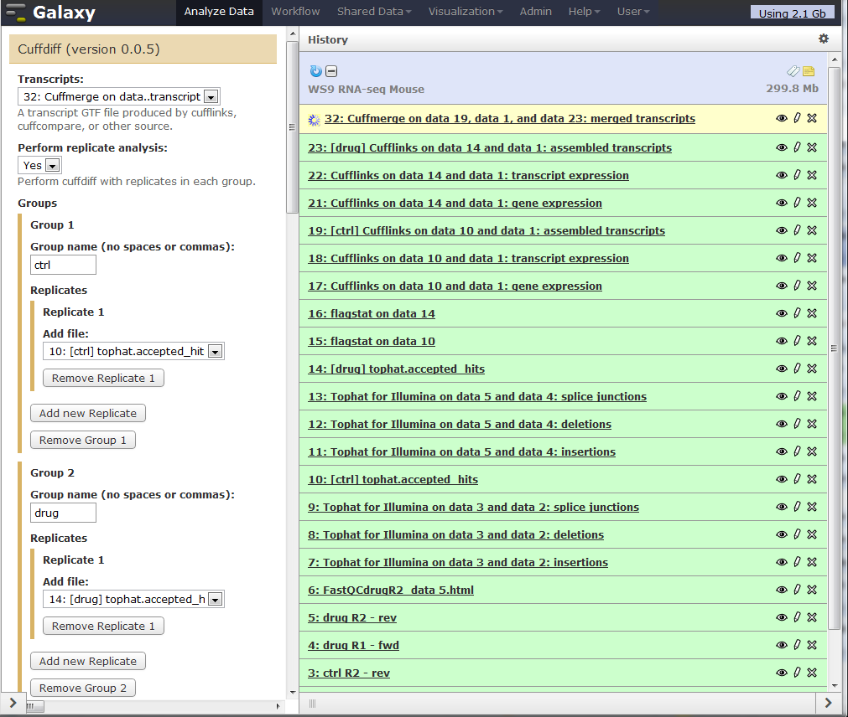
Cuffdiff: Quantize Transcripts
Compute fold change between conditions
Run once,
use all samples & replicates
ALWAYS create replicate groups for each condition
ALWAYS name your groups
even if you have only one replicate!

Slide 26
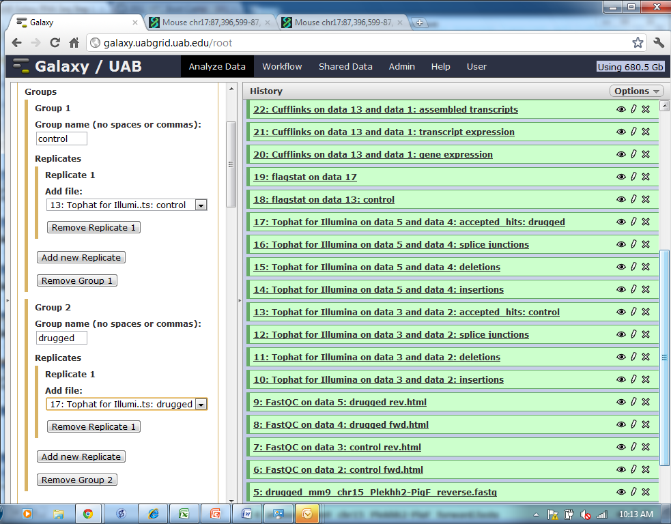
Cuffdiff: Fold Change Between Conditions
Run once, using both samples
ALWAYS create replicate groups for each condition, even if you have only one replicate!
Short names – no spaces or special characters!!!

Slide 27
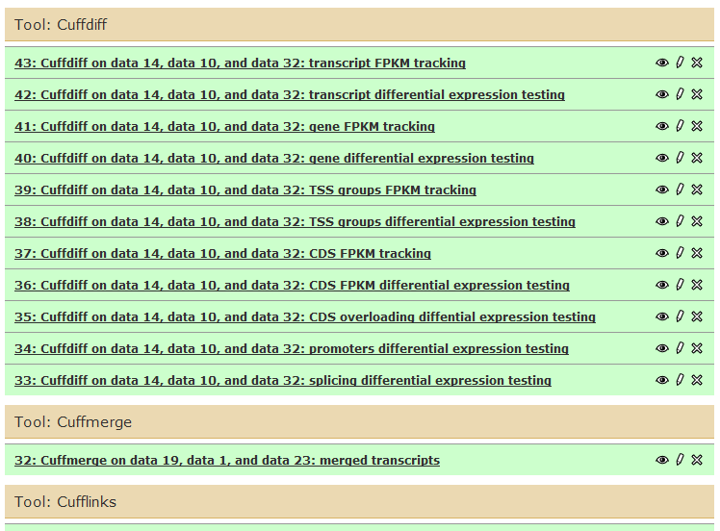
Cuffdiff output
( > view structure)
FILTER!!

Slide 28
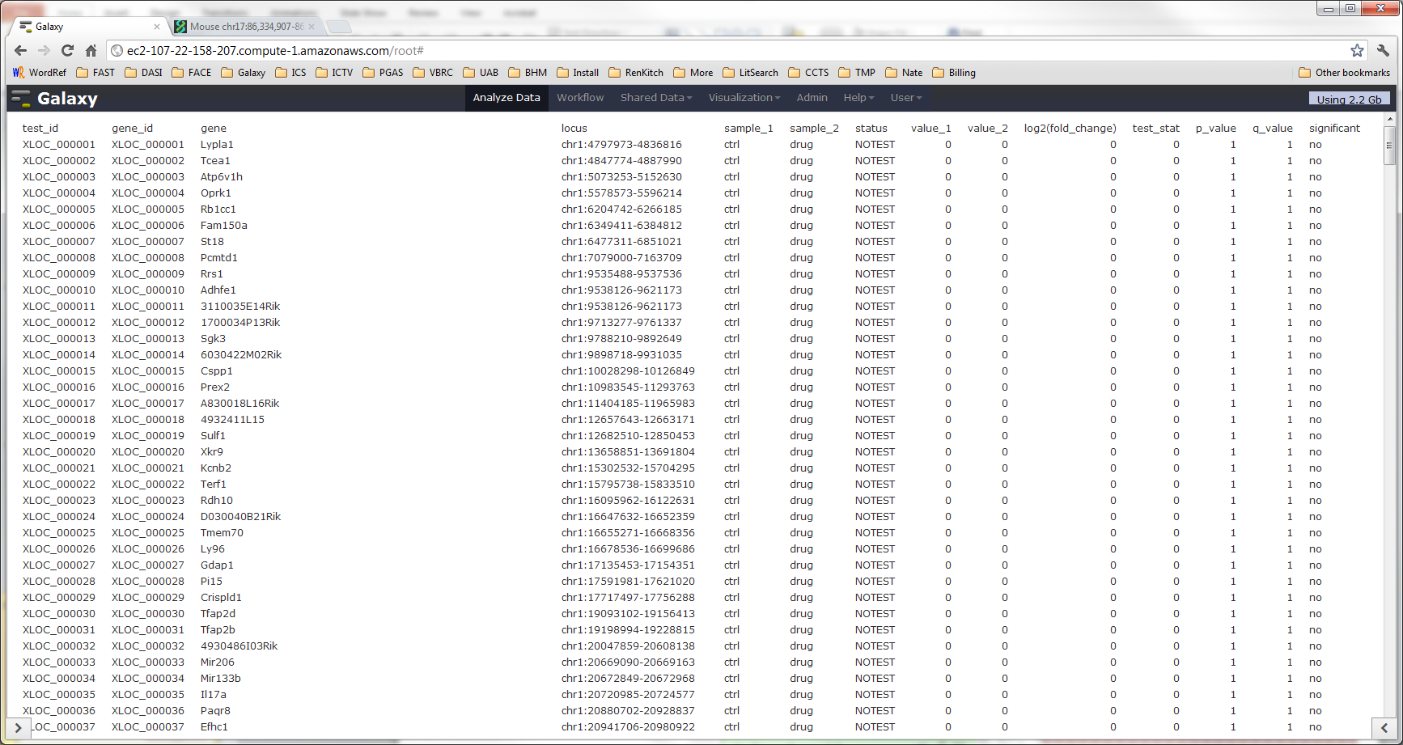
Cuffdiff “gene diff”: 23,113 lines!
( -> value for all genes in gene.gtf)
Tools > Filter and Sort > Filter: c7 <> 'NOTEST' and c14 <> 'no'

Slide 29
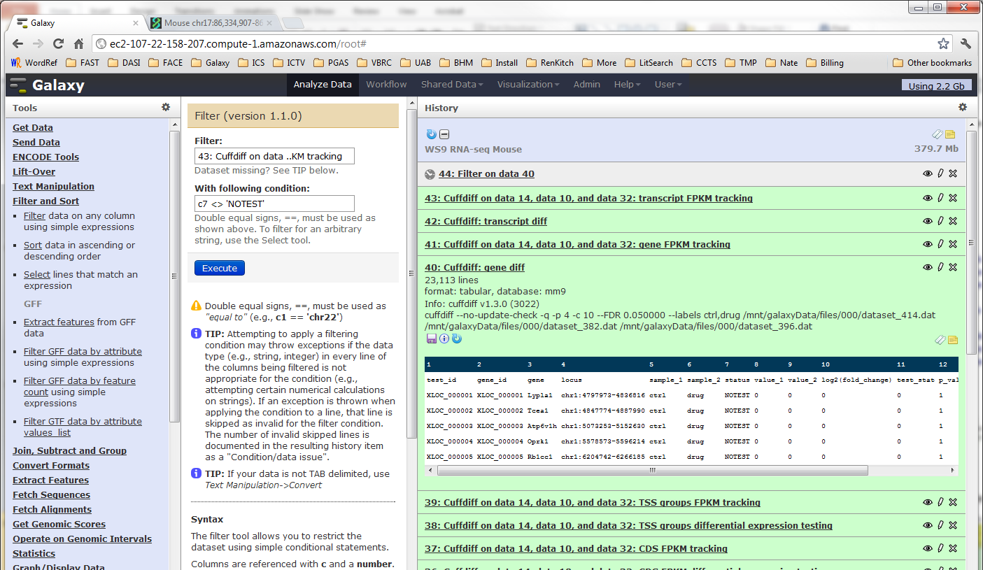
Gene diff: genes with enough reads
14 genes

Slide 30
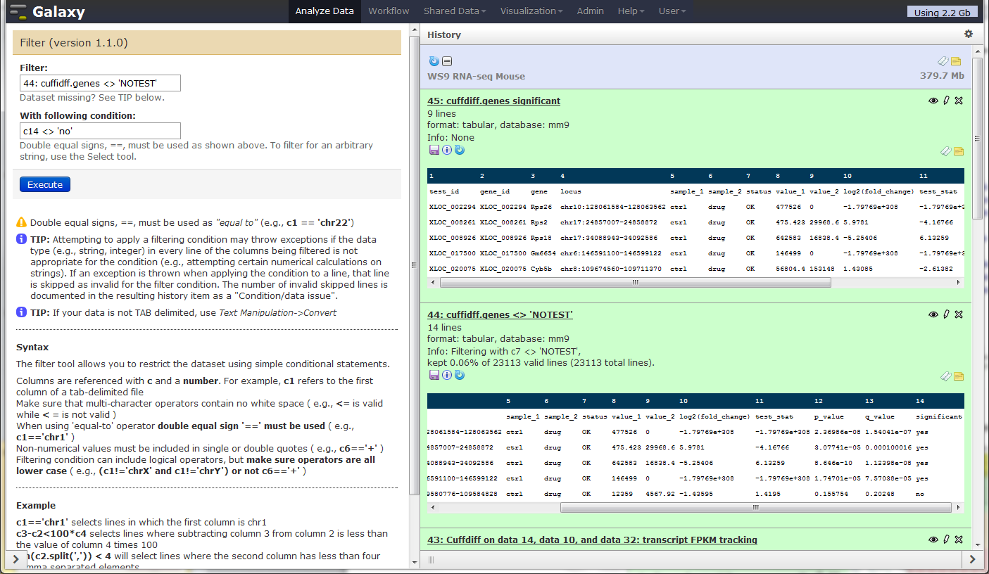
Gene diff: statistically significant
9 genes
1
2

Slide 31
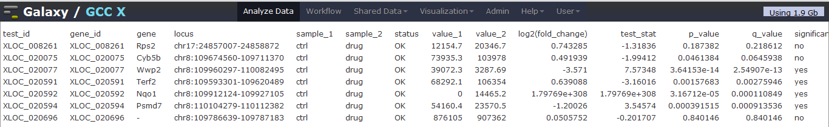
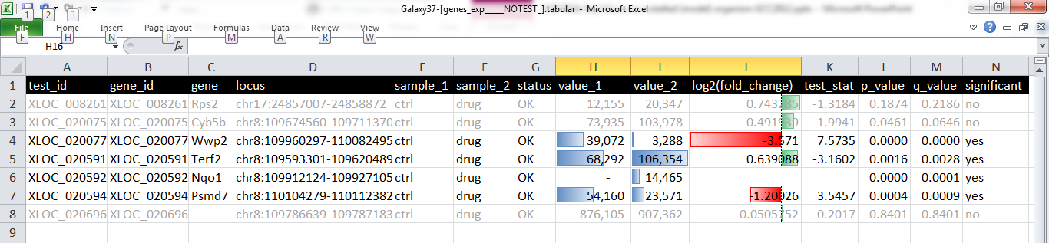
“Final” gene list
Download
Excel
Conditional Formatting

Slide 32
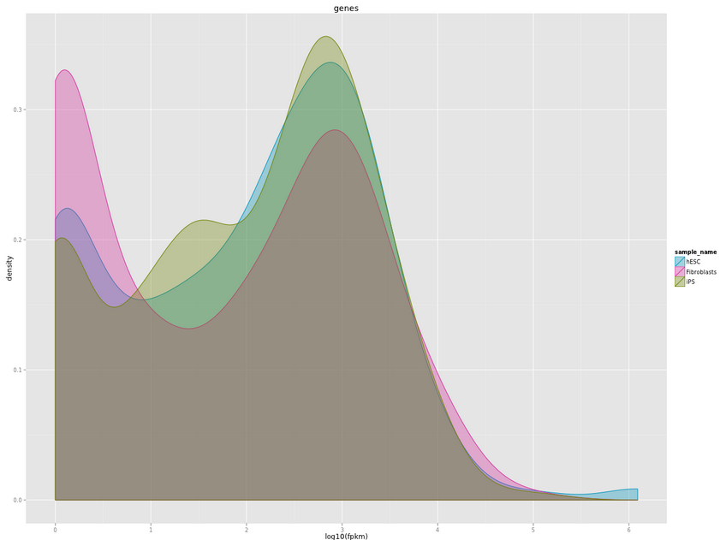
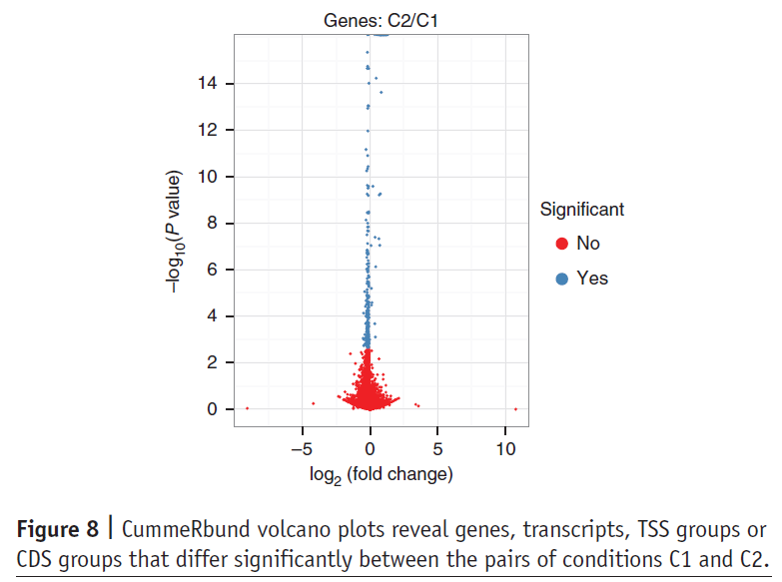
Visualization of Gene Expression cummeRbund in Galaxy
Galaxy wrapper created, but not yet in tool shed
http://cvrgrid.org/node/235
http://ec2-23-20-5-163.compute-1.amazonaws.com:8080/u/boliu/h/cummerbund
(courtesy of Liu Bo @ University of Chicago)
(Trapnell et al, 2012, Nat Protocols)

Slide 33
References and web links
TopHat
  Trapnell C, Pachter L, Salzberg SL. TopHat: discovering splice junctions with RNA-Seq.Bioinformatics doi:10.1093/bioinformatics/btp120
  http://tophat.cbcb.umd.edu/
Bowtie
  Langmead B, Trapnell C, Pop M, Salzberg SL. Ultrafast and memory-efficient alignment of short DNA sequences to the human genome. Genome Biol 10:R25.
  http://bowtie-bio.sourceforge.net/index.shtml
Cufflinks
  Trapnell C, Williams BA, Pertea G, Mortazavi AM, Kwan G, van Baren MJ, Salzberg SL, Wold B, Pachter L. Transcript assembly and quantification by RNA-Seq reveals unannotated transcripts and isoform switching during cell differentiation Nature Biotechnology doi:10.1038/nbt.1621
  Roberts A, Trapnell C, Donaghey J, Rinn JL, Pachter L. Improving RNA-Seq expression estimates by correcting for fragment bias Genome Biology doi:10.1186/gb-2011-12-3-r22
  Roberts A, Pimentel H, Trapnell C, Pachter L.Identification of novel transcripts in annotated genomes using RNA-Seq Bioinformatics doi:10.1093/bioinformatics/btr355
  http://cufflinks.cbcb.umd.edu/
TopHat and Cufflinks protocol
  Trapnell C, Roberts A, Goff L, Pertea G, Kim D, Kelley DR, Pimentel H, Salzberg SL, Rinn JL, Pachter L. Differential gene and transcript expression analysis of RNA-seq experiments with TopHat and Cufflinks Nature Protocols 7, 562-578 (2012) doi:10.1038/nprot.2012.016
Illumina iGenomes: indexes and annotations for use with Cufflinks, etc.
  http://cufflinks.cbcb.umd.edu/igenomes.html

Slide 34
Thanks! Questions? Contact info:
R. Curtis Hendrickson
Research Associate
Microbiology
Center for Clinical and Translational Science
University of Alabama at Birmingham
http://www.uab.edu/ccts/ResearchResources/BMI
curtish arabesque uab.edu

