Slide 1
WS9: RNA-Seq Analysis with Galaxy
(non-model organism )
David Crossman, Ph.D.
UAB Heflin Center for Genomic Science
GCC2012
Wednesday, July 25, 2012

Slide 2
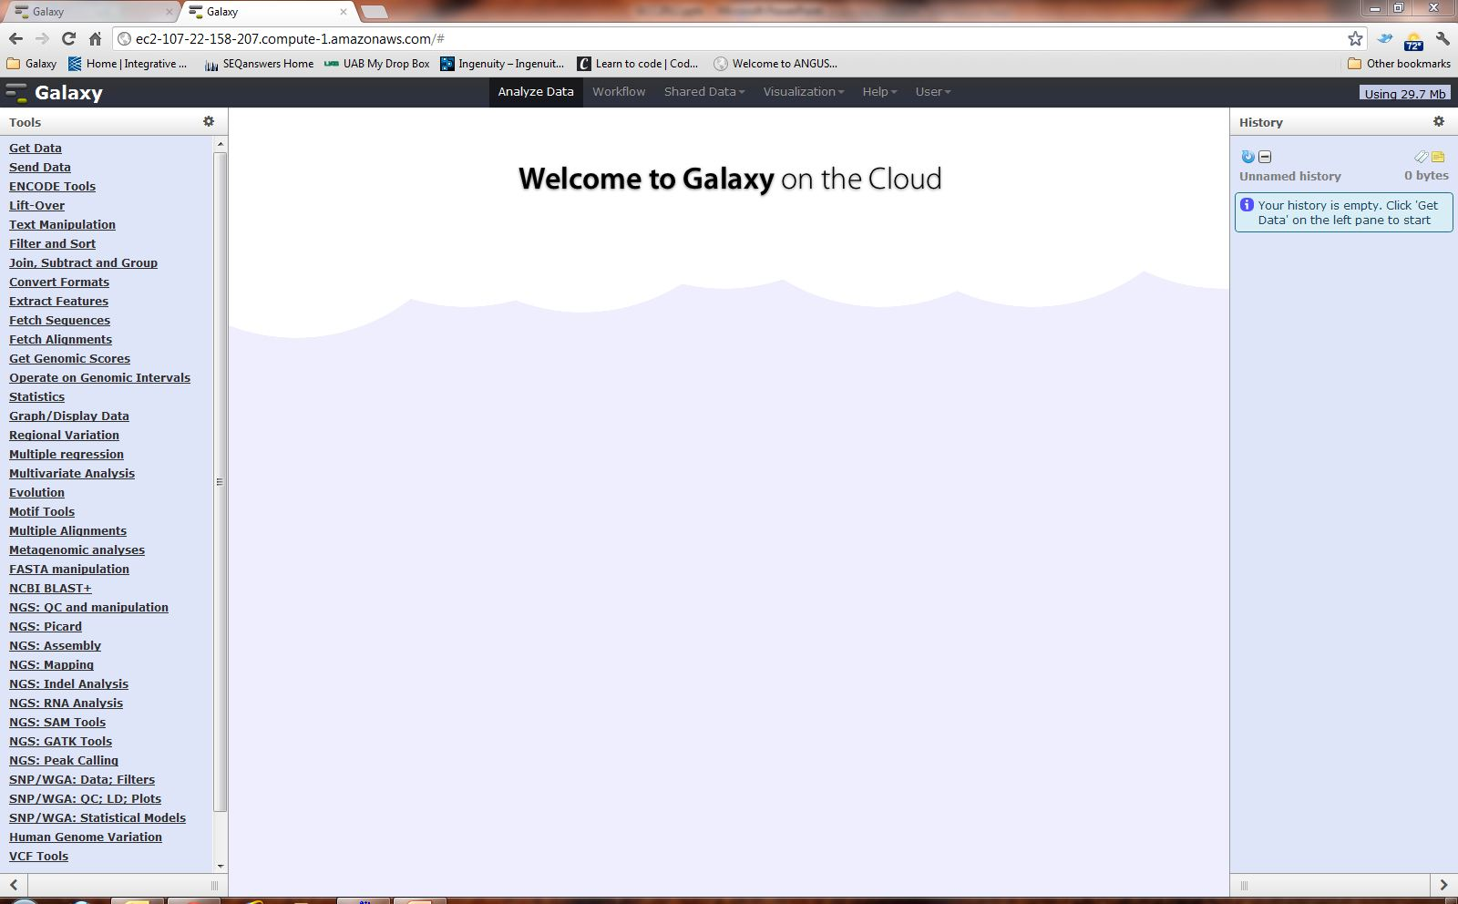
Galaxy Splash Page

Slide 3

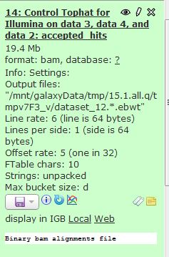
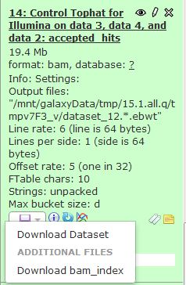




Random Galaxy icons/colors
Colors
Download/Save
Queued
Running
Completed
Failed
Icons
Display data in browser
Edit attributes
Delete
Edit dataset annotation
View details
Run this job again
View in Trackster
Edit dataset tags

Slide 4
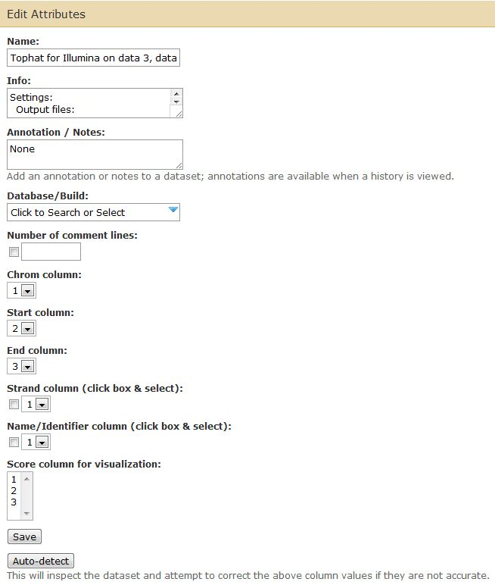


Edit files in History
*

Slide 5
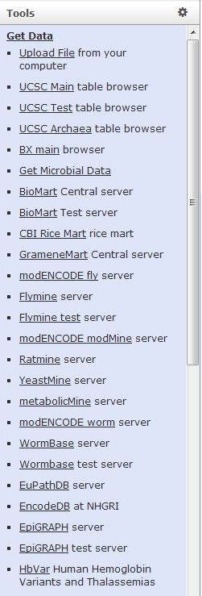
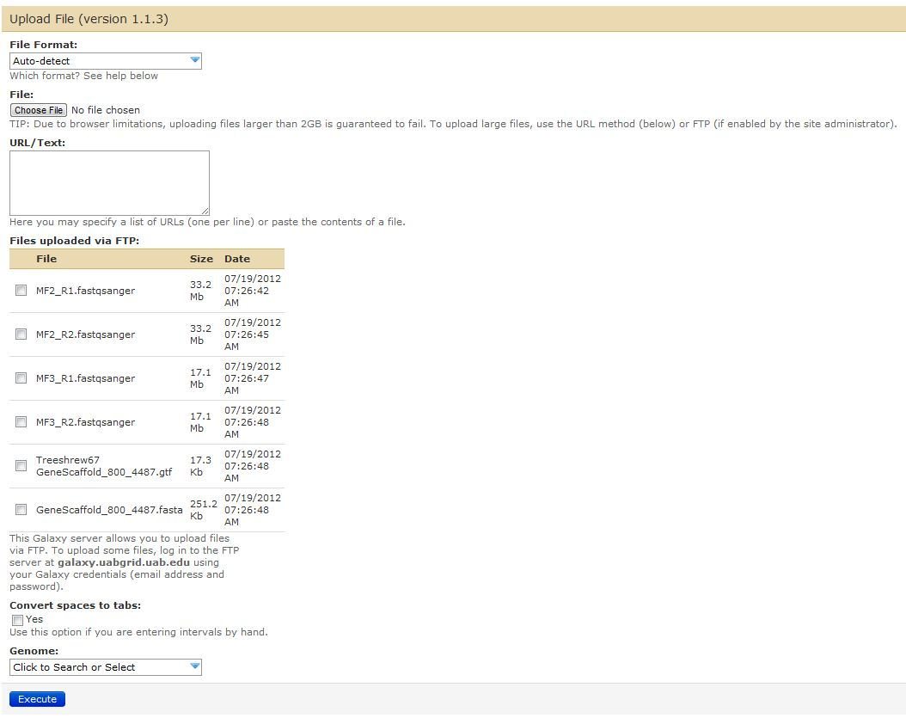
Upload/Import Data
1
2
3a
3b-1
3b-2
Click “Get Data”
Click “Upload File”
Boxes to be aware of:
  File Format
  File to be uploaded:
    File from computer
    URL/text
    FTP
  Genome
Click “Execute”
3b-3
3c
3d

Slide 6
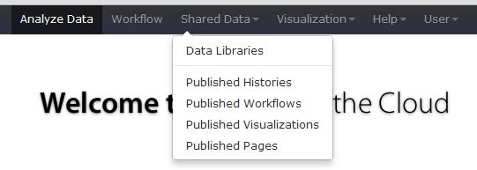
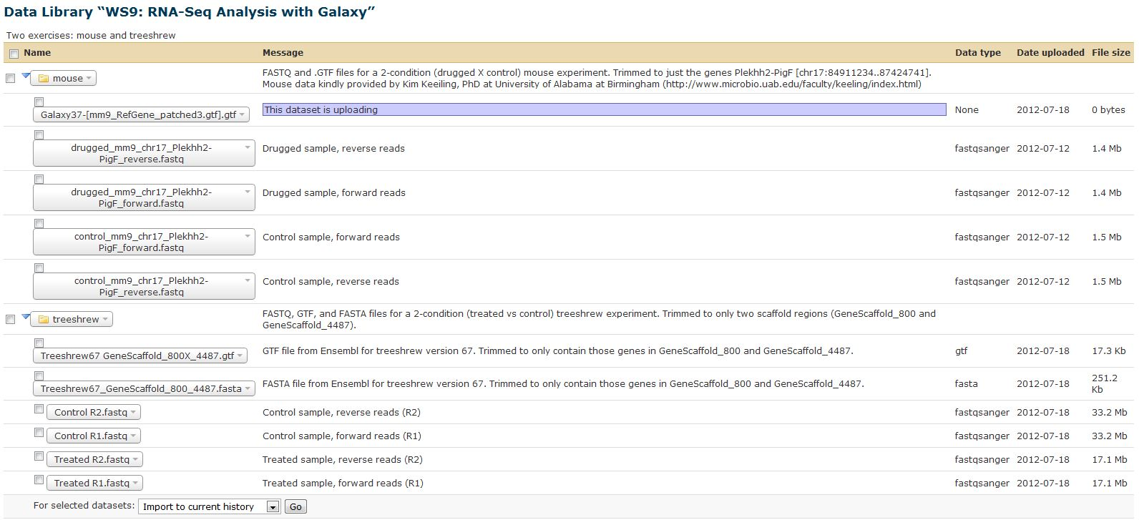
Shared Data
1
2
3
Click on “Shared Data” (located on top toolbar)
Drop down box appears; click on “Data Libraries”
Will see this Data Library. Click on it to expand (as shown)

Slide 7
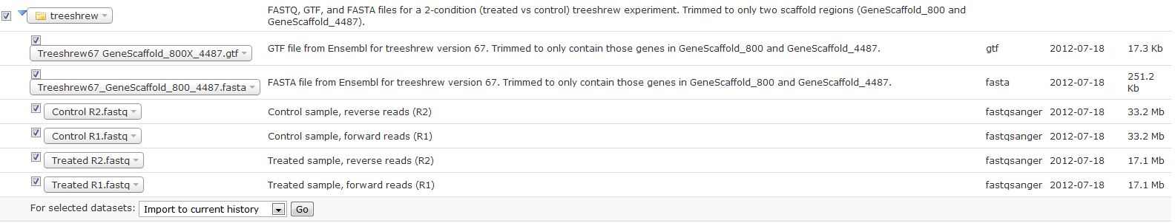
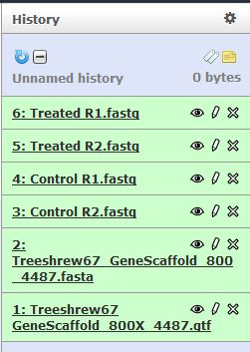
Import Shared Data to Current History
1
2
3
Check boxes of files you want to import
Choose “Import to current history” and then click “Go”
Will see the files in the right-hand pane of the Galaxy window

Slide 8
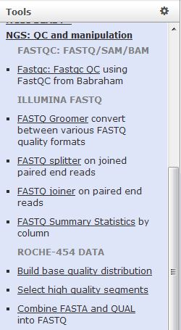
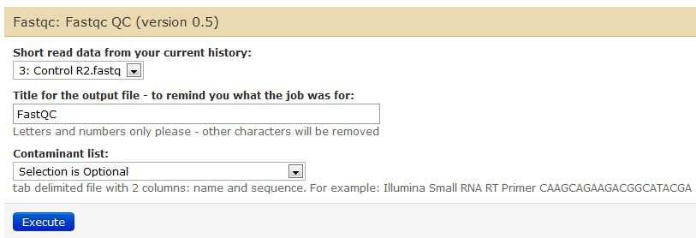
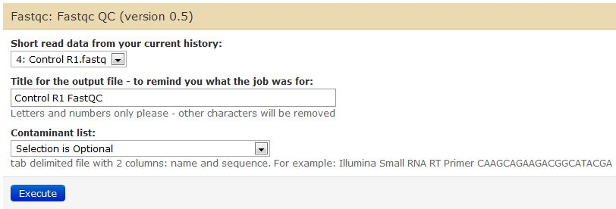
Quality Control of raw fastq reads
3a
1
2
3b
*
*
4
Click on “NGS: QC and manipulation”
Click on “Fastqc: Fastqc QC
Select options:
  This is what the window looks like when first opened
  Choose fastq file and give it a useful name
Click “Execute”
Do the exact same thing for the other 3 fastq files

Slide 9
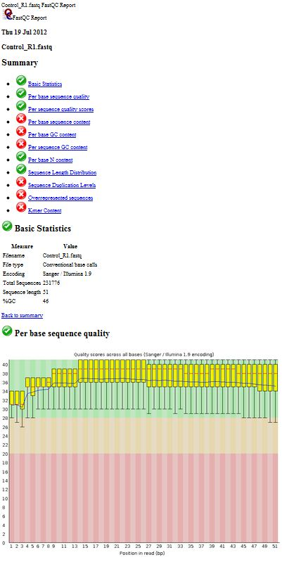
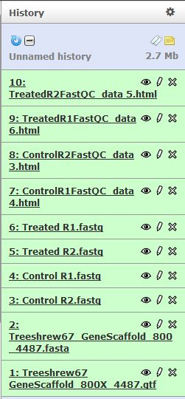
FastQC Output Report
This data looks awful because this is filtered data from a much larger fastq file. Better results when using entire file!

Slide 10
RNA-Seq Analysis Pipeline
Aligns raw reads to reference genome, identifies splice junctions between exons.
TopHat
Cufflinks
Assembles transcripts, and estimates their abundances.
Cuffmerge
Merges together several Cufflinks files.
Finds significant changes in transcript expression, splicing, and promoter use.
Cuffdiff

Slide 11
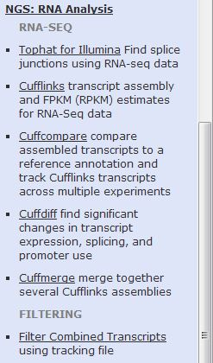
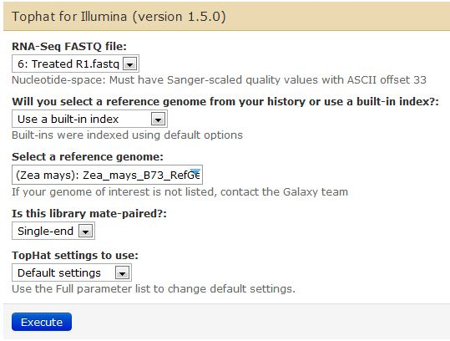
TopHat
1
2
3
Click on “NGS: RNA Analysis”
Click on “Tophat for Illumina”
Default window with options appears

Slide 12
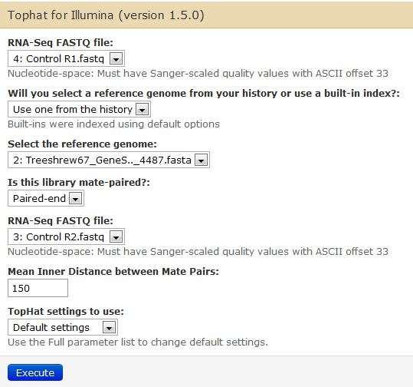
TopHat
1
2a
Select forward fastq read file
Select reference genome:
  Choose “Use one from the history”
  Select the reference genome fasta
Select “Paired-end”
Select reverse fastq read file
Input “150” (ask sequencing center for this info)
Can choose “Default settings” or “Full parameter list”
Click “Execute”
Do the exact same thing for the other sample
2b
3
4
5
6
7

Slide 13
Note about FASTA files not already indexed in Galaxy
If a FASTA is not indexed in Galaxy, then it is easy to upload the appropriate FASTA file into Galaxy. (Get Data -> Upload File)
However, it can take up to 5 hours extra to run TopHat because Bowtie has to index your uploaded FASTA file (best to have your own instance of Galaxy) each time you run TopHat!
Where do I go to get a non-model organism FASTA file?
  NCBI: http://www.ncbi.nlm.nih.gov/genome
  Ensembl: http://useast.ensembl.org/info/data/ftp/index.html
  iGenome: http://cufflinks.cbcb.umd.edu/igenomes.html
  Your favorite species website: http://www...

Slide 14
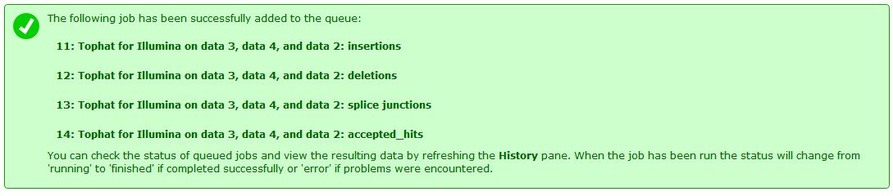
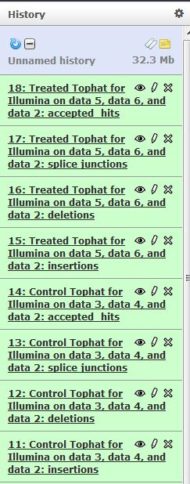
TopHat output files

Slide 15
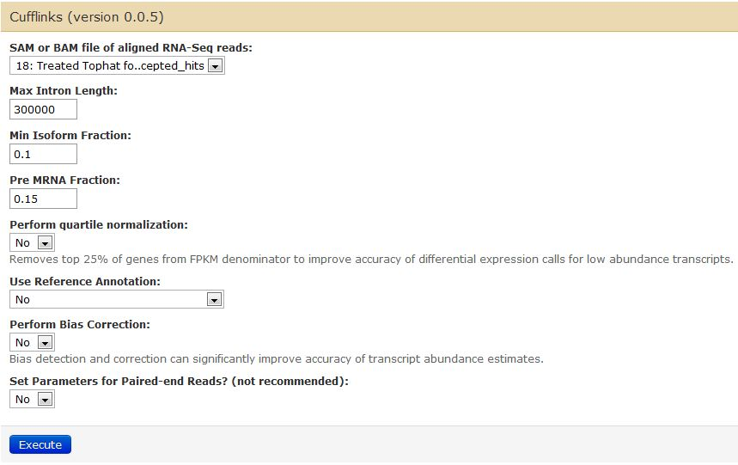
Cufflinks
1
3
2
Click on “NGS: RNA Analysis”
Click on “Cufflinks”
Default window with options appears

Slide 16
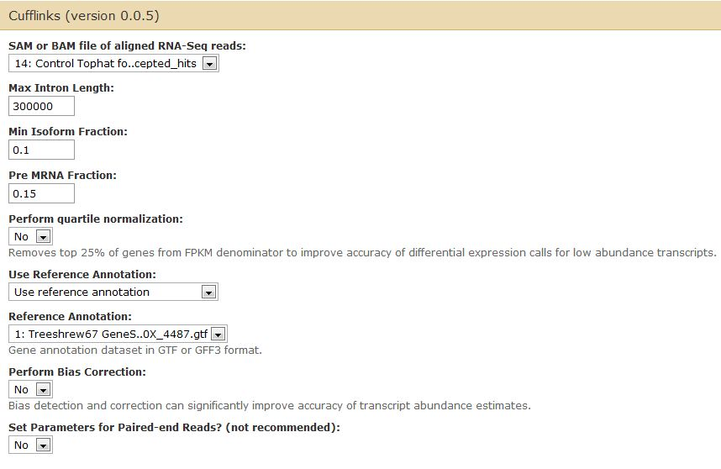
Cufflinks
1
Choose TopHat accepted hits file
Perform quartile normalization (for this demo sample, choose “No”)
Reference Annotation:
  For genomes in scaffolds, choose “Use reference annotation”
  Choose GTF file from history
Perform Bias Correction (for this demo, choose “No”)
Click “Execute”
Do the exact same thing for the other TopHat accepted hits file
2
3a
3b
4

Slide 17
Note about GTF files for Cuff*
If you use a GTF file from Ensembl, then you need to convert the chromosome column (column 1) to include ‘chr’ in front of the chromosome #. You can do this by:
  Using Jeremy’s published workflow “Make Ensembl GTF compatible with Cufflinks” in Galaxy: https://main.g2.bx.psu.edu/u/jeremy/w/make-ensembl-gtf-compatible-with-cufflinks
  Use ‘awk’ to add ‘chr’ to column 1 (if using Mac or Linux)
Where do I go to get a GTF file?
  NCBI: http://www.ncbi.nlm.nih.gov/genome
  Ensembl: http://useast.ensembl.org/info/data/ftp/index.html
  iGenome: http://cufflinks.cbcb.umd.edu/igenomes.html
  Your favorite species website: http://www...

Slide 18
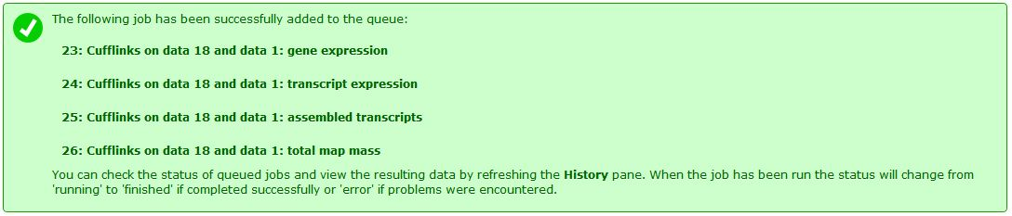
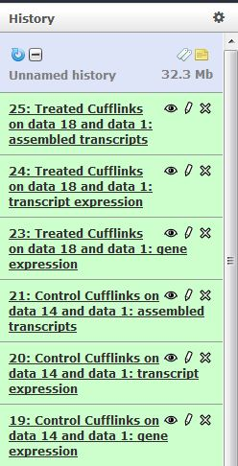
Cufflinks output files

Slide 19
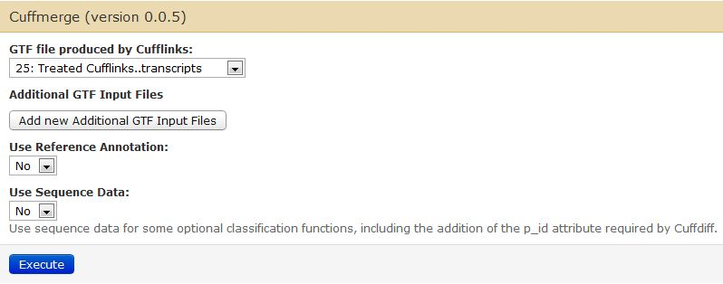
Cuffmerge
1
2
Click on “NGS: RNA Analysis”
Click on “Cuffmerge”
Default window with options appears

Slide 20
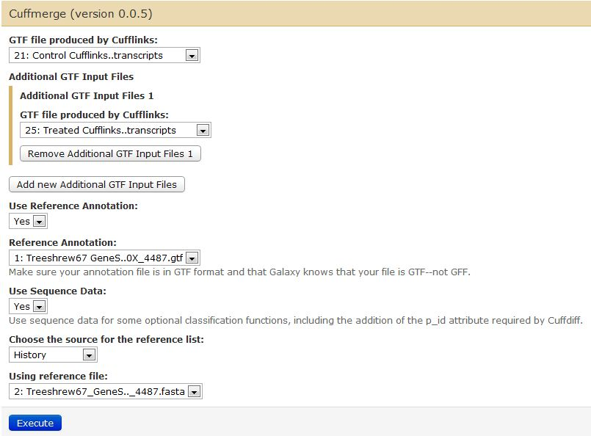
Cuffmerge
1
Choose GTF file produced by Cufflinks
Additional GTF Input Files:
  Click on “Add new Additional GTF Input Files”
  Choose other GTF file produced by Cufflinks
Reference Annotation:
  Select “Yes” to Use Reference Annotation
  Choose GTF Reference Annotation file from history
Sequence Data:
  Slect “Yes” to Use Sequence Data
  Choose “History”
  Choose FASTA file from history
Click “Excecute”
2b
2a
3a
3b
4a
4b
4c
5

Slide 21
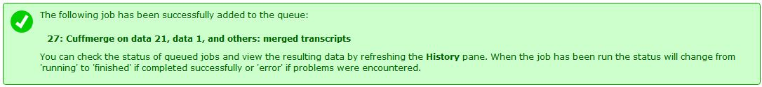
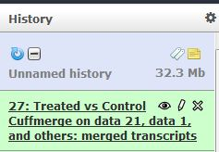
Cuffmerge output files

Slide 22
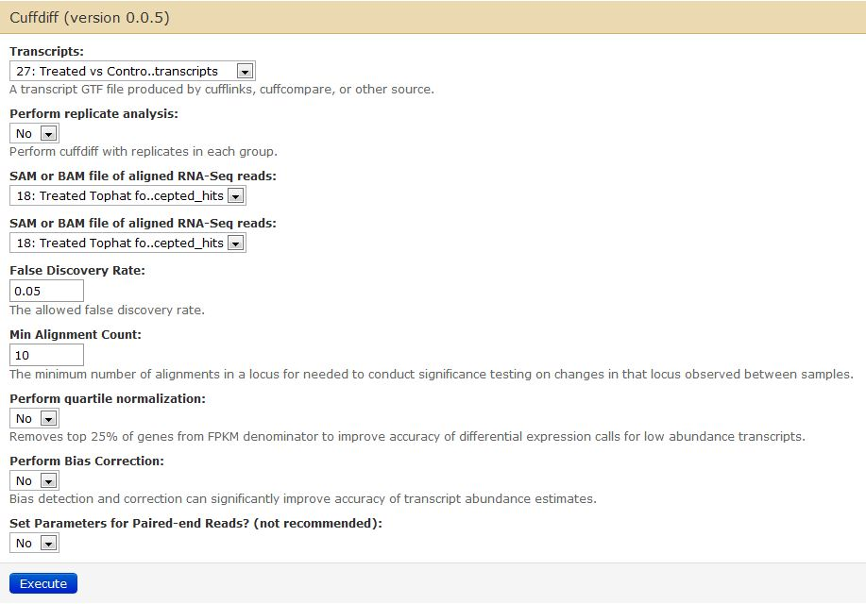
Cuffdiff
1
2
Click on “NGS: RNA Analysis”
Click on “Cuffdiff”
Default window with options appears

Slide 23
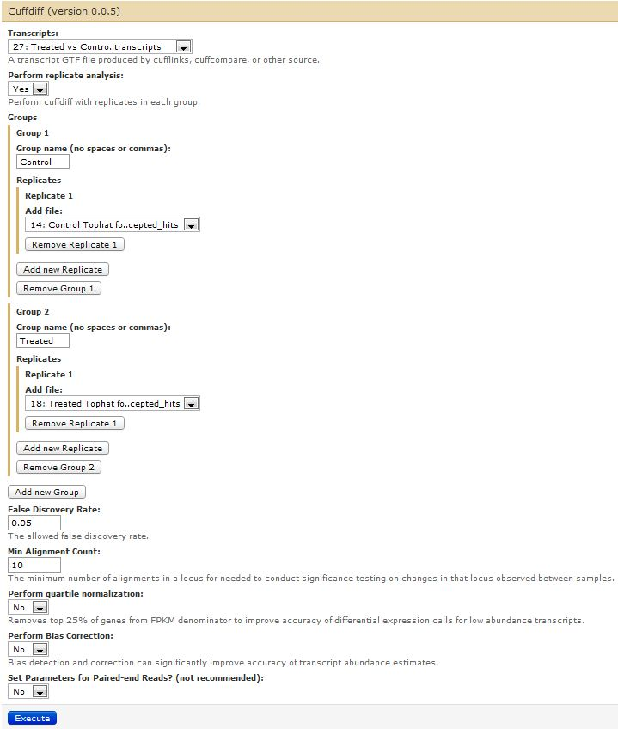
Cuffdiff
1
Choose GTF transcript file from either Cuffmerge or Cuffcompare
Perform replicate analysis:
  Choose “Yes”
  Click “Add new Group”
  Select a name to give the Group
  Choose TopHat accepted hits file associated with this Group
  If you have more than one TopHat accepted hits file associated with this Group, then click “Add new Replicate”
  Click “Add new Group”
  Select a name to give the Group
  Choose TopHat accepted hits file associated with this Group
  If you have more than one TopHat accepted hits file associated with this Group, then click “Add new Replicate”
  Click “Add new Group” if you have another Group you want to add
Select a False Discovery Rate cutoff
Select the minimum # of reads that will align to a locus in order to perform significant testing
Perform quartile normalization (for this demo, choose “No”)
Perform bias correction (for this demo, choose “No”)
Click “Execute”
2a
2c
2d
2e
2g
2h
2i
2b, 2f, 2j
3
4
5
6
7

Slide 24
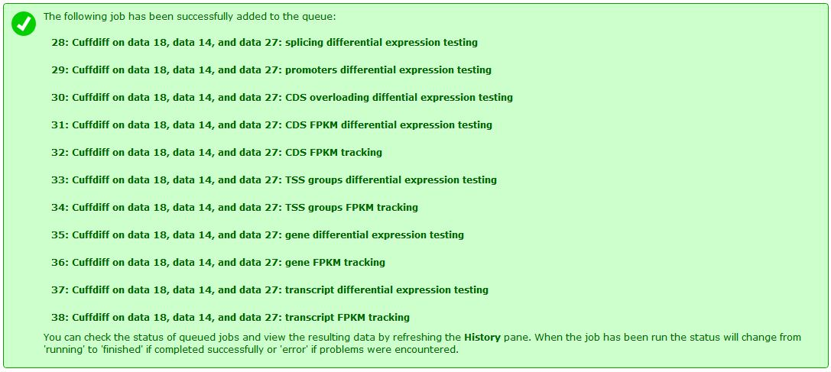
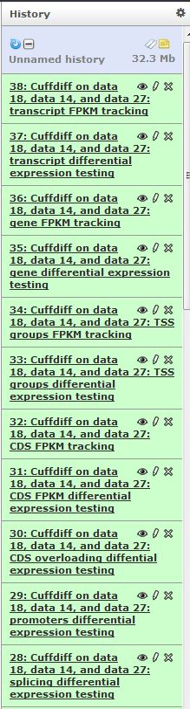
Cuffdiff output files

Slide 25
Transcript differential expression testing output
Gene differential expression testing output

Slide 26
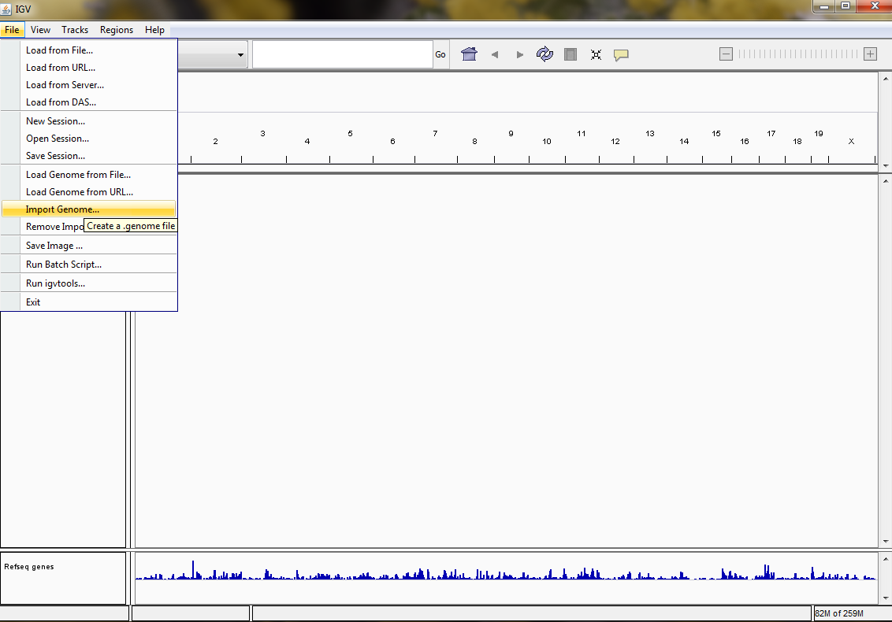
Create genome in IGV
1
2
Click on “File”
Choose “Import Genome”

Slide 27
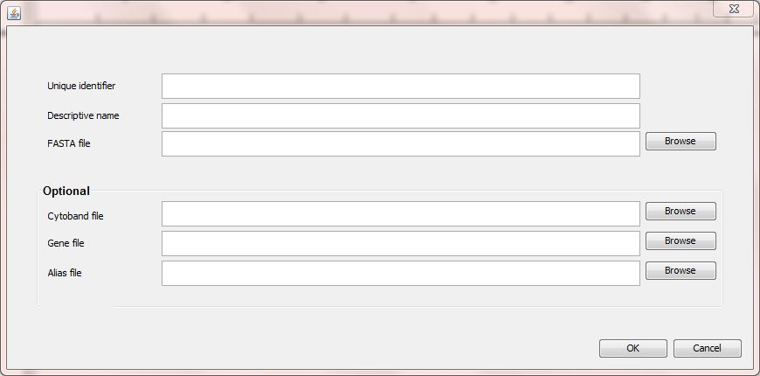
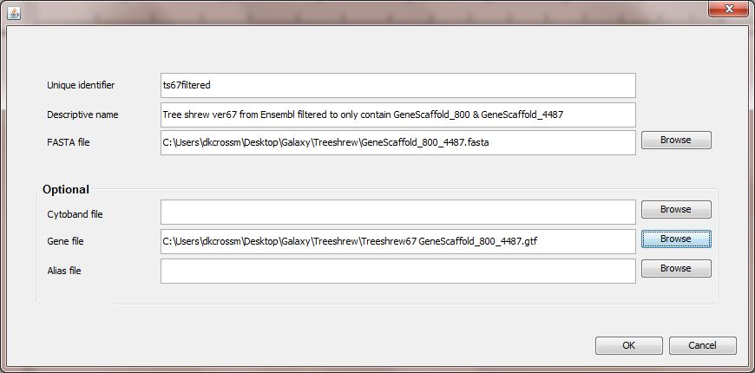
Create genome in IGV
Required
Optional
Need:
FASTA file (required)
Optional:
Cytoband file
Gene file (can use GTF)
Alias file

Slide 28
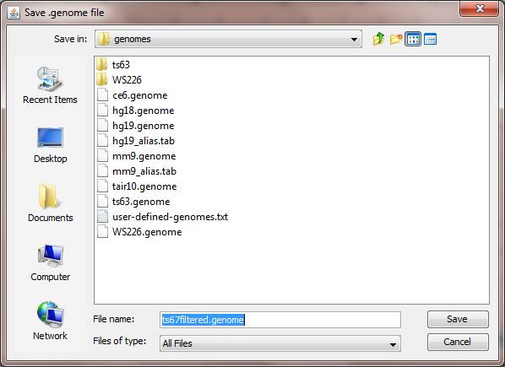
Create genome in IGV
Save the *.genome file

Slide 29
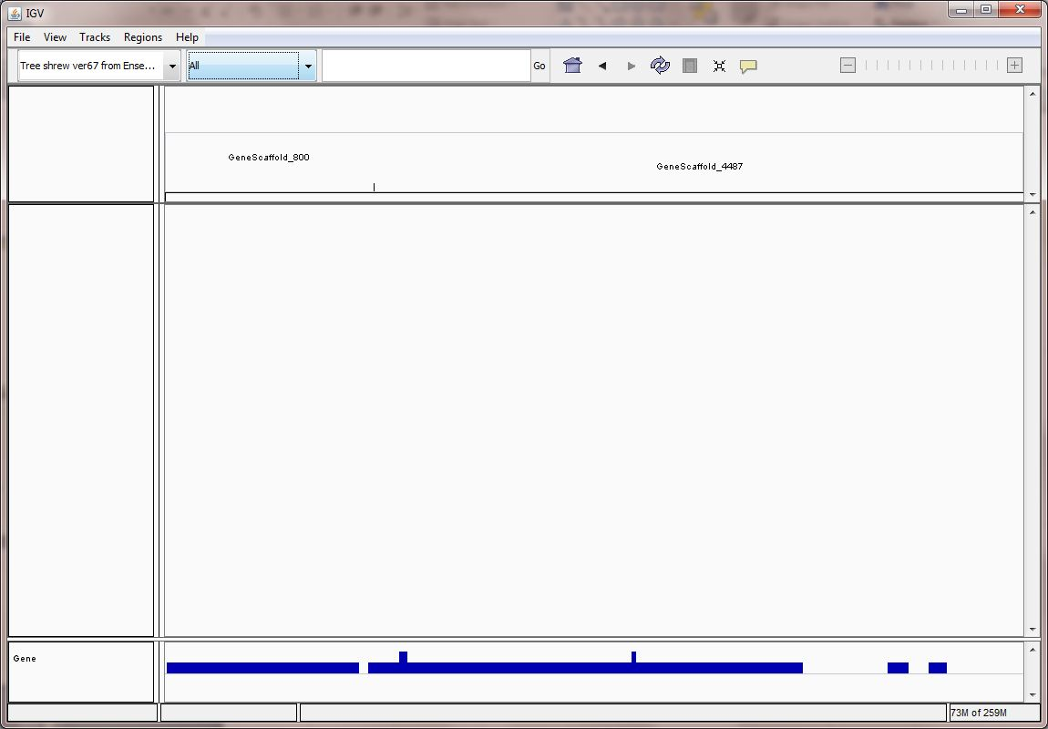
Create genome in IGV

Slide 30
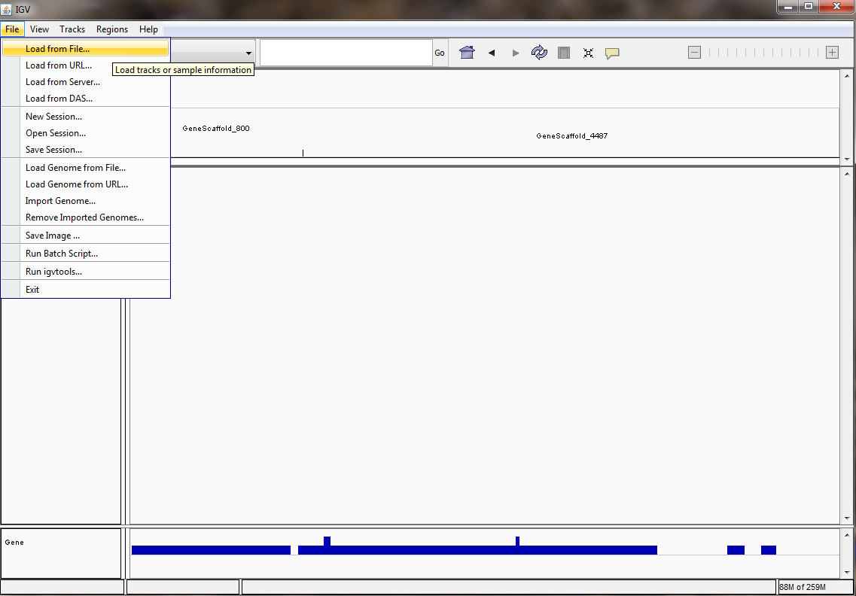
Load aligned BAM files into IGV
1
2
Click “File”
Choose “Load from File”
Choose *.bam files (*.bai files need to be in the same folder

Slide 31
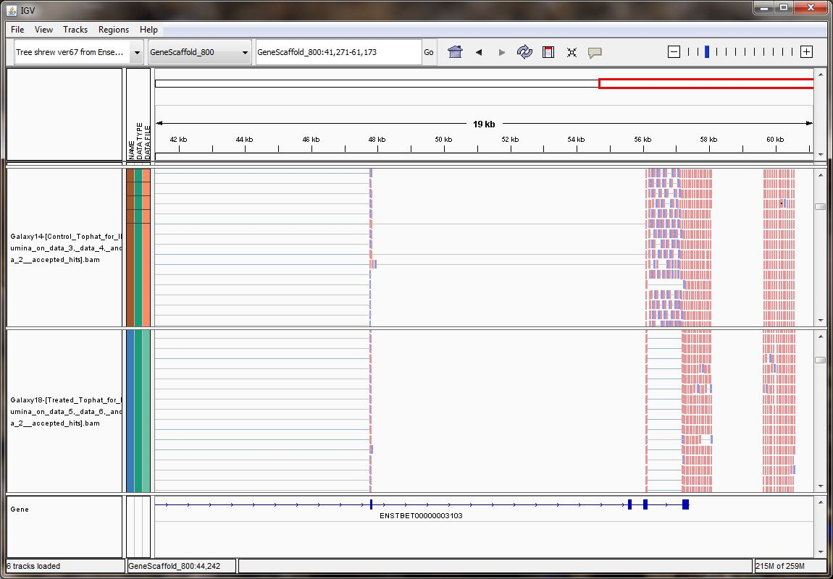
IGV

Slide 32
References and web links
TopHat
  Trapnell C, Pachter L, Salzberg SL. TopHat: discovering splice junctions with RNA-Seq.Bioinformatics doi:10.1093/bioinformatics/btp120
  http://tophat.cbcb.umd.edu/
Bowtie
  Langmead B, Trapnell C, Pop M, Salzberg SL. Ultrafast and memory-efficient alignment of short DNA sequences to the human genome. Genome Biol 10:R25.
  http://bowtie-bio.sourceforge.net/index.shtml
Cufflinks
  Trapnell C, Williams BA, Pertea G, Mortazavi AM, Kwan G, van Baren MJ, Salzberg SL, Wold B, Pachter L. Transcript assembly and quantification by RNA-Seq reveals unannotated transcripts and isoform switching during cell differentiation Nature Biotechnology doi:10.1038/nbt.1621
  Roberts A, Trapnell C, Donaghey J, Rinn JL, Pachter L. Improving RNA-Seq expression estimates by correcting for fragment bias Genome Biology doi:10.1186/gb-2011-12-3-r22
  Roberts A, Pimentel H, Trapnell C, Pachter L.Identification of novel transcripts in annotated genomes using RNA-Seq Bioinformatics doi:10.1093/bioinformatics/btr355
  http://cufflinks.cbcb.umd.edu/
TopHat and Cufflinks protocol
  Trapnell C, Roberts A, Goff L, Pertea G, Kim D, Kelley DR, Pimentel H, Salzberg SL, Rinn JL, Pachter L. Differential gene and transcript expression analysis of RNA-seq experiments with TopHat and Cufflinks Nature Protocols 7, 562-578 (2012) doi:10.1038/nprot.2012.016
IGV
  http://www.broadinstitute.org/igv/

Slide 33
Thanks! Questions?
Contact info:
David K. Crossman, Ph.D.
Bioinformatics Director
Heflin Center for Genomic Science
University of Alabama at Birmingham
http://www.heflingenetics.uab.edu
dkcrossm@uab.edu

