Slide 1
NBIC Galaxy to Strengthen the Bioinformatics Community in the Netherlands
Hailiang Mei
(hailiang.mei@nbic.nl)
David van Enckevort
(david.van.enckevort@nbic.nl)

Slide 2
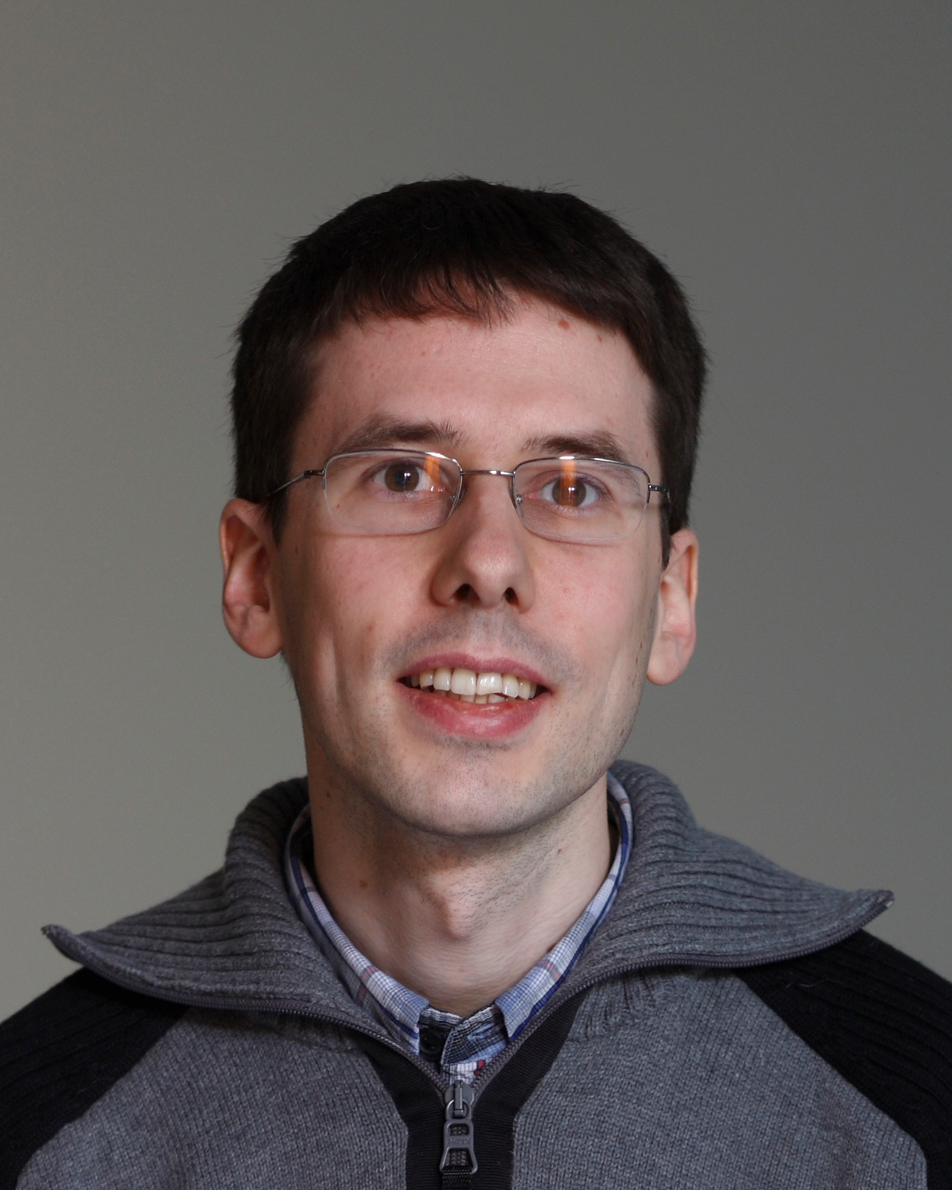
Introduction
Working for NBIC since 2010
  Scientific programmer
  Technical project leader for the NBIC Biobanks Task Force
Worked for 11 years as developer and system administrator at several companies
Classical Archaeologist by education

Slide 3
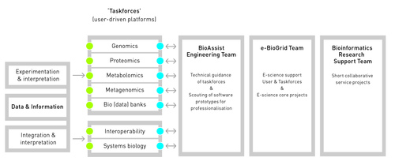
About NBIC BioAssist
One of the 3 pillars of NBIC (next to BioWise (education) and BioRange (research)).
Goal is to make other people’s data work

Slide 4
About NBIC BioAssist
One of the 3 pillars of NBIC (next to BioWise (education) and BioRange (research)).
Goal is to make other people’s data work
Consists of a Central Engineering Team

Slide 5
About NBIC BioAssist
One of the 3 pillars of NBIC (next to BioWise (education) and BioRange (research)).
Goal is to make other people’s data work
Consists of a Central Engineering Team, eBioGrid

Slide 6
About NBIC BioAssist
One of the 3 pillars of NBIC (next to BioWise (education) and BioRange (research)).
Goal is to make other people’s data work
Consists of a Central Engineering Team, eBioGrid, Bioinformatics Research Support

Slide 7
About NBIC BioAssist
One of the 3 pillars of NBIC (next to BioWise (education) and BioRange (research)).
Goal is to make other people’s data work
Consists of a Central Engineering Team, eBioGrid, Bioinformatics Research Support and Task Forces

Slide 8
Where does Galaxy fit in?
Training and demonstration
Collaboration in several consortia (e.g. CTMM TraIT)
Sharing of NBIC developed tools and pipelines
Notes:
Training: Galaxy training, NGS training
Collaboration: CTMM TraIT: evaluated as the platform to run NGS pipelines
Sharing: - avoid duplication, dissemination of knowledge

Slide 9
Where does Galaxy fit in?
Enabling scientists to run analysis on national HPC infrastructures.
Notes:
Galaxy on the HPC cloud (under development)
Galaxy for running tools on the LISA national cluster (being discussed) – haplotype tool http://www.e-biogrid.nl/project.html?pid=34

Slide 10
Where does Galaxy fit in?
Provisioning of tools developed by BRS
Persistence of tools and publications

Slide 11
What do we have?
Running several galaxy instances (Task forces, BRS)
Running a public instance (http://galaxy.nbic.nl/)
Host a public subversion repository with several Galaxy related tools (https://trac.nbic.nl/)
Galaxy VM (https://wiki.nbic.nl/index.php/Galaxy_VM)
Wiki (https://wiki.nbic.nl/index.php/Category:NBIC_Galaxy)

Slide 12
Galaxy.nbic.nl
8 cores, 24GB RAM, 1.5TB disk
10GB quota for users, extendable upon request
Pipelines and Tools from NBIC & partners
  NGS, Proteomics, etc.
Flexible access:
  FTP, API access
Extended from demo to production level in 2011

Slide 13
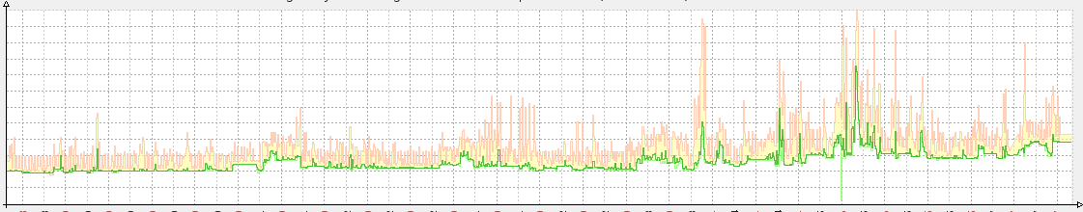
Usage
451 registered users
900GB data
Steady growth in usage
(# processes over the last year)

Slide 14
Some of the NBIC Tools
Benchmarking Wrapper – benchmarks several alignment and denovo assembly pipelines (Bowtie, BWA, Abyss, Velvet)
MS compare – proteomics benchmarking
Taverna workflows – run Taverna workflows from within Galaxy
Genome of the Netherlands Alignment pipeline (planned)
And many more…
Available at https://trac.nbic.nl/

Slide 15
More
CLI-Mate – generate tool wrappers (LUMC)
(http://cli-mate.lumc.nl/)
Courses, e.g.:
  GAPSS tutorial (LUMC)
  RNA-Seq data analysis (NBIC BioWise)
Galaxy hackathon (together with the main Galaxy Team – Sorry, I should have brought some stroopwafels for you guys)
Organized the 2011 GCC

Slide 16


Near Future: Galaxy at the SARA HPC Cloud
HPC Cloud: 608 cores 4.75TB RAM, 400TB shared resource provided by SARA
Galaxy installed with CloudMan and the NBIC Galaxy Tools
Auto scaling
BigGrid project in collaboration with SARA (Niek Bosch), Netherlands Institute for Ecology (Mattias de Hollander)
Expected to be available Mid 2012

Slide 17
Acknowledgements
NBIC
Leon Mei
Freek de Bruijn
Rob Hooft
Mark van Driel
Netherlands Institute of Ecology (NIOO-KNAW)
Mattias de Hollander
Erasmus MC
Saskia Hiltemann
Galaxy Admin Team
Pieter Neerincx (UMCG)
Jeroen Laros (LUMC)
Ishtiaq Ahmad (AMC/RUG)
SARA
Niek Bosch
Machiel Jansen
eBio-Grid
BigGrid
CTTM TraIT

