Slide 1




LiSIs: a Galaxy-based platform for Life Sciences Informatics Research
Christos Kannas
Department of Computer Science University of Cyprus

Slide 2
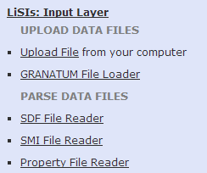

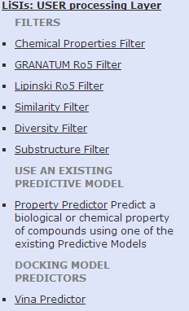
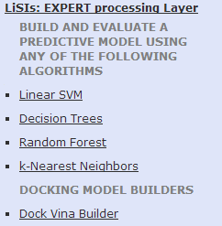
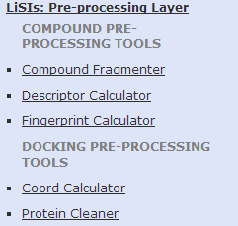
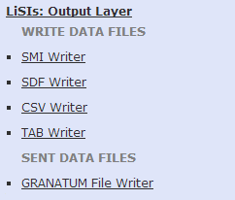
What is LiSIs?
Scientific Workflow platform for Virtual Screening.

Slide 3
Powered by…
Galaxy (galaxyproject.org)
  Scientific Workflow Management System
RDKit (www.rdkit.org)
  Cheminformatics Toolkit
R (www.r-project.org)
  Statistical environment for data mining, machine learning and statistics
AutoDock Vina (vina.scripps.edu)
  Molecular Docking Prediction

Slide 4
Funded by…
EU FP7 GRANATUM project, ”A Social Collaborative Working Space Semantically Interlinking Biomedical Researchers, Knowledge and data for the design and execution of In Silico Models and Experiments in Cancer Chemoprevention”, contract number ICT-2009.5.3.
www.granatum.org
lisis.cs.ucy.ac.cy

Slide 5

Acknowledgements
eHealth Laboratory, UCY
  Kleo Achilleos
  Zinonas Antoniou
  Christodoulos Nicolaou (PhD)
  Prof. Constantinos Pattichis
Bioinformatics Laboratory, UCY
  Ioanna Kalvari
  Ioannis Kirmitzoglou
  Athina Theodosiou
  Stella Tamana
  Prof. Vasilis Promponas
Department of Pharmaceutical Chemistry, NUA
  George Lambrinidis (PhD)
  Prof. Emmanouel Mikros
Cancer Biology and Chemoprevention Laboratory , UCY
  Christiana Neophytou
  Christiana Savva
  Prof. Andreas Constantinou
Cancer Chemoprevention and Epigenomics Workgroup, DKFZ
  David Scherf (PhD)
  Prof. Clarissa Gerhauser
IITRI
  Prof. Rajendra Mehta

