Slide 1
Galaxy
Introducing the Scratchbook
www.getgalaxy.org
Aysam @ Taylor Lab @ Emory

Slide 2
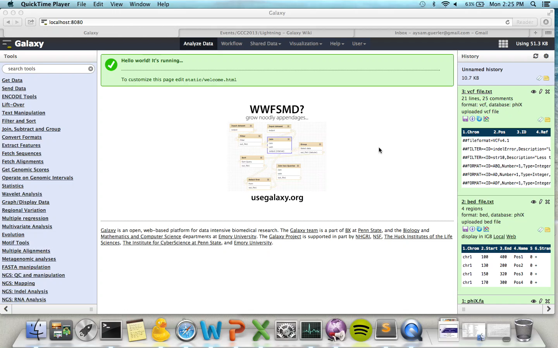





Slide 3
Outlook
Integrate new visualizations
Allow persistent states
Improve through feedback

