Slide 1
modENCODE Galaxy: Uniform ChIP-Seq Processing Tools for modENCODE and ENCODE Data
Quang M Trinh
Ontario Institute for Cancer Research
qtrinh@oicr.on.ca

Slide 2
Outline
Model Organism ENCyclopedia Of DNA Elements ( modENCODE ) project & mandates for the modENCODE Data Coordinating Center ( DCC )
modENCODE data & Galaxy on Amazon Cloud
Uniform Processing/Peak calling pipeline for modENCODE & ENCODE (ENCyclopedia Of DNA Elements ) data using Galaxy

Slide 3
Model Organism ENCyclopedia Of DNA Elements ( modENCODE ) Project
Funding by the National Institutes of Healths (NIH)
  http://www.genome.gov/modencode/
Aim of modENCODE is to provide a comprehensive encyclopedia of functional genomics for both worm and fly
  11 groups of data providers
  1 analysis center
  1 Data Coordinating Center ( DCC )

Slide 4
Mandates for the DCC
Collect, validate, and release data submitted from the 11 groups of data providers
Collection
  Data upload via a website or an ftp site
Validation
  uses controlled vocabularies to describe data and metadata
  QC to ensure consistency and completeness of submission
  Integrates data
Release
  Over 10 TB of data publicly available on faceted browser, modmine, and clouds ( Amazon & Bionimbus )

Slide 5
modENCODE Data on Amazon Cloud
The entire set of modENCODE data is on Amazon Cloud as a list of snapshots
Custom modENCODE Amazon Machine Image (AMI) with the entire data pre-mounted for convenience.
  Users can also select and mount any of the snapshots
    automated
Step-by-step instructions on how to use the custom AMI or how to mount modENCODE data snapshots
  http://data.modencode.org/modencode-cloud.html

Slide 6
Main Challenges With Accessing the Entire modENCODE Data Set
Downloading the entire data set ( over 10TB ) from Amazon Cloud will take a while
  Additional local disks & computing resources are needed
Tools for analysis
  Setup tools locally will also take a while

Slide 7
Our Solution: modENCODE Galaxy on Amazon Cloud
Bring tools and analysis to our data on Amazon Cloud
Build and integrate tools and workflows to Galaxy on Amazon Cloud
  Automate Galaxy launching on Amazon Cloud and installations of modENCODE tools on Galaxy and Galaxy cluster

Slide 8
modENCODE Galaxy on Amazon Cloud
Put together by our co-op students
  Ravpreet Setia, Fei-Yang (Arthur) Jan, Ziru Zhou, Karming Chu
https://github.com/modENCODE-DCC/Galaxy
  Scripts to launch Galaxy and install tools and their dependencies
  Peak calling and QC tools
    SPP, macs2, peak ranger, and bamedit
  Workflows
    Uniform processing/peak calling pipeline for modENCODE and ENCODE data
      Worm, fly, human, and mouse
  Enable users to import modENCODE data directly from the faceted browser to Galaxy
  Step-by-step documentations

Slide 9
Simple Steps to Launch modENCODE Galaxy & Installations of Tools
Setup Amazon credentials and environments ( one time )
Setup Galaxy config.txt ( one time )
Launch Galaxy on Amazon Cloud
  bin/modENCODE_galaxy_create.pl config.txt
Setup Galaxy Cluster using CloudMan console
Setup modENCODE tools for Galaxy
  Install tools in parallel using bin/auto_install.pl

Slide 10
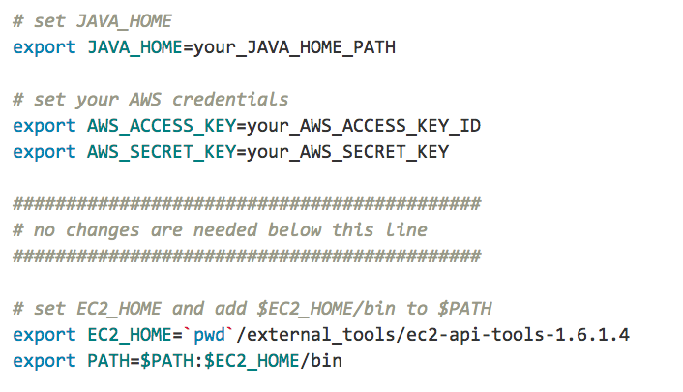
Setup Amazon Credentials and Environments ( env.sh )

Slide 11
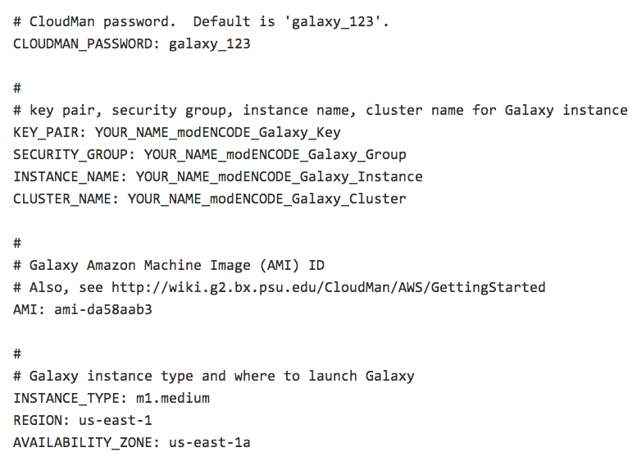
Setup Configurations ( config.txt )
New Galaxy AMI is available on June 29 – see
email from Enis Afgan to galaxy-dev

Slide 12
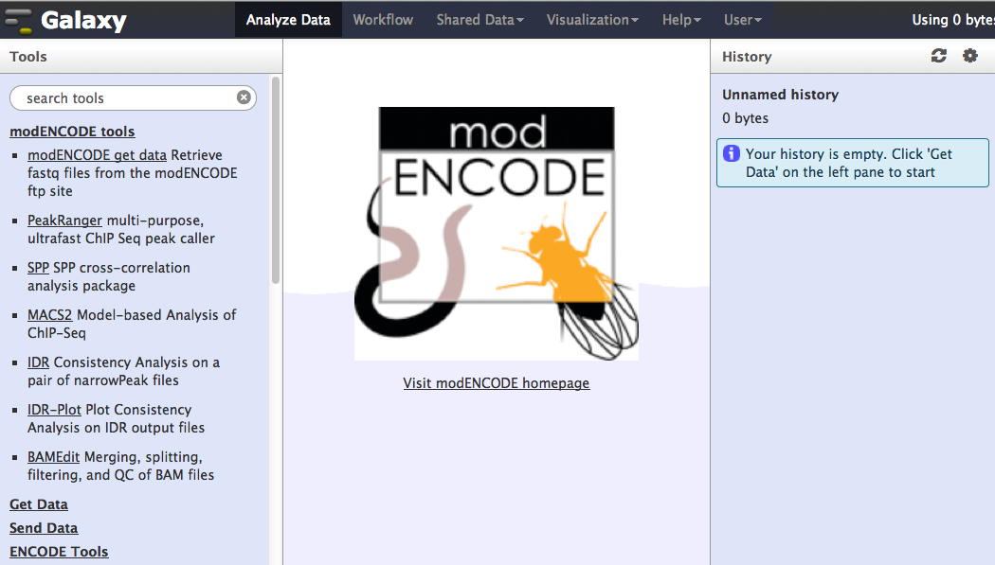

Slide 13
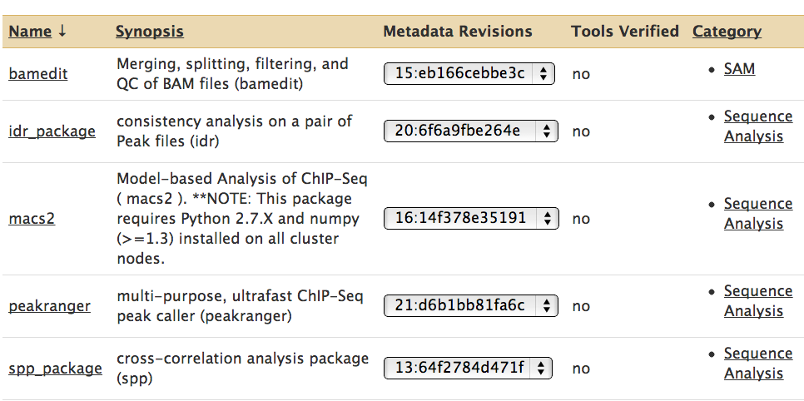


Slide 14
Uniform Processing/Peak Calling Pipeline
A uniform pipeline for calling peaks and ranking reproducibility between replicates for ChIP-seq data
Used by both modENCODE and ENCODE communities for human, mouse, worm, and fly
Begins with raw FASTQ files and ends with peak files in BED format and pdf plots of consistency comparisons between replicates.

Slide 15
Uniform Processing/Peak Calling Pipeline for 3 replicates
ControlRep1
Groomer
BWA
ControlRep2
Groomer
BWA
merge
ControlRep0
ControlRep3
Groomer
BWA
ChIP
Rep1
Groomer
BWA
ChIP
Rep1
ChIP
Rep2
Groomer
BWA
ChIP
Rep2
ChIP
Rep3
Groomer
BWA
ChIP
Rep3

Slide 16
Uniform Processing/Peak Calling Pipeline for 3 replicates ( cont’d )
ChIPRep1_VS_ControlRep0
ControlRep0
MACS2
IDR
IDR-Plot
ChIPRep1
VS
ChIPRep2
ChIP
Rep1
ChIPRep2_VS_ControlRep0
MACS2
IDR
IDR-Plot
ChIPRep1
VS
ChIPRep3
ChIP
Rep2
MACS2
IDR
IDR-Plot
ChIPRep2
VS
ChIPRep3
ChIP
Rep3
ChIPRep3_VS_ControlRep0

Slide 17
Uniform Processing/Peak Calling Workflows
https://github.com/modENCODE-DCC/Galaxy/tree/master/workflows
  3-replicate and 2-replicate workflows

Slide 18
Conclusions
Galaxy is a great platform for data analysis
We chose Galaxy because of its availability, functionality, and ease of result reproducibility
Integrated modENCODE tools & workflows with Galaxy on Amazon Cloud
  Works great with the entire modENCODE data set on Amazon Cloud
For more info, see
  https://github.com/modENCODE-DCC/Galaxy

Slide 19
Acknowledgments
Co-op students
  Rav Setia
  Fei-Yang ( Arthur ) Jen
  Ziru Zhou
  Karming Chu
modENCODE DCC Data Wranglers
  Marc Perry
  Ellen Kephart
  Sergio Contrino
  Peter Ruzanov
  Lincoln Stein ( PI )

Slide 20


Funding provided by

