Slide 1
GCC2018 + BOSC 2018

Slide 2









Slide 3
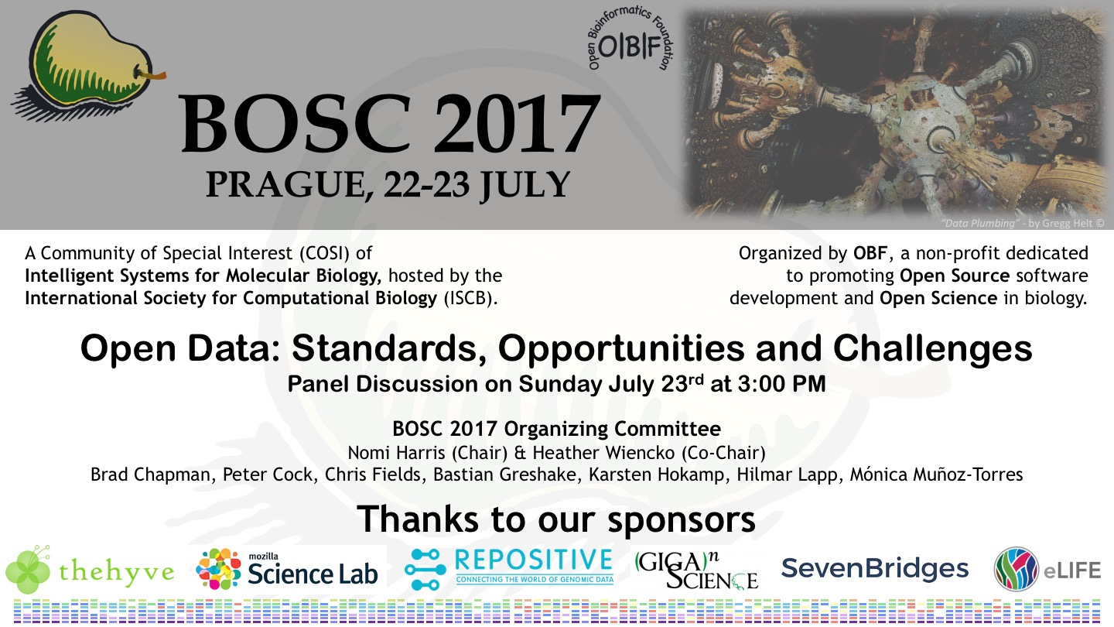

Slide 4
BOSC
Bioinformatics Open Source Conference
Open Bioinformatics Foundation
Meeting since 2000
Have been meeting as a SIG/COSI @ ISMB

Slide 5

GCC2018 &
BOSC 2018
are joining up
June 25-30, 2018
Reed College
Portland, Oregon
United States
gccbosc2018.sched.com

Slide 6

Hosted by
Oregon
Health & Science University
https://www.ohsu.edu/

Slide 7

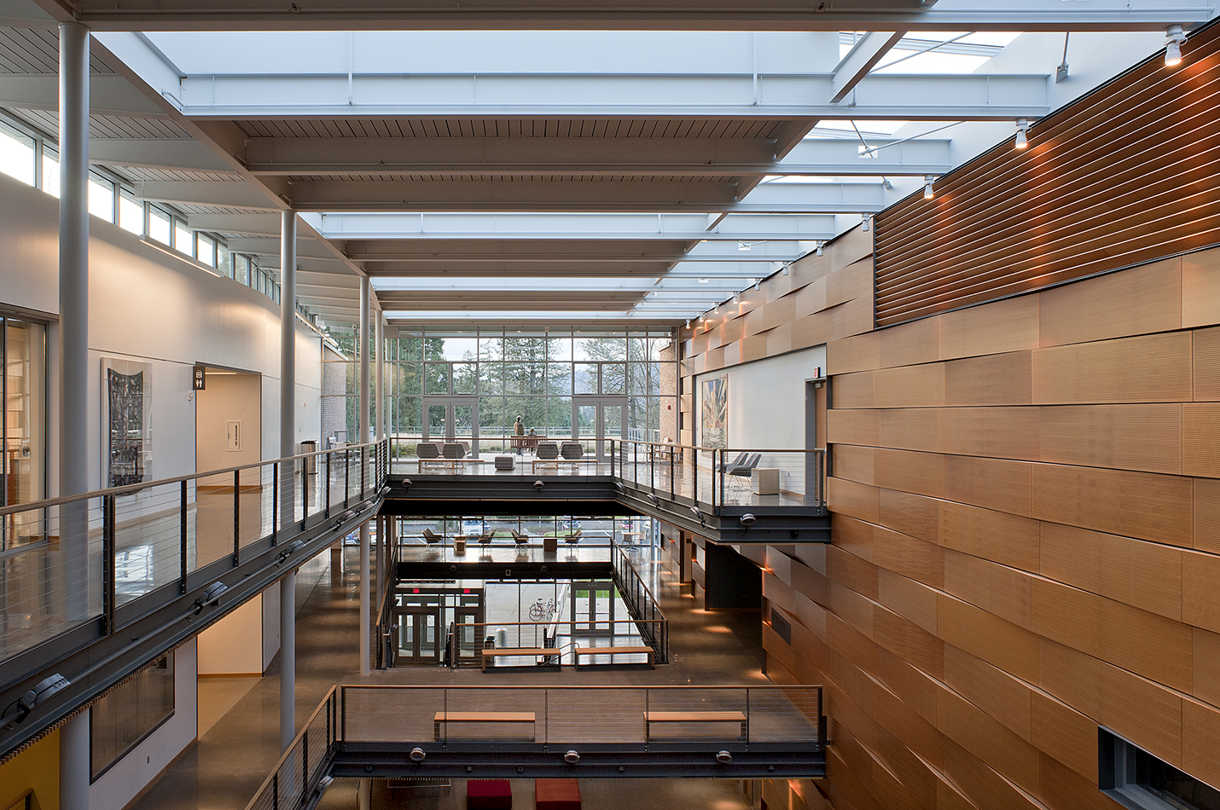
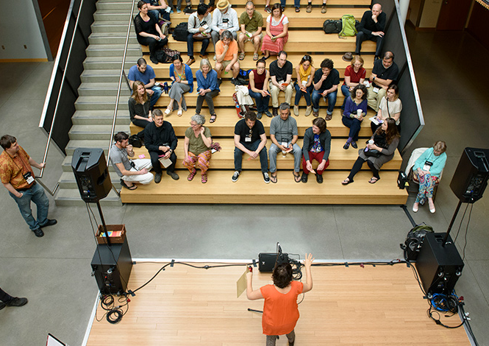
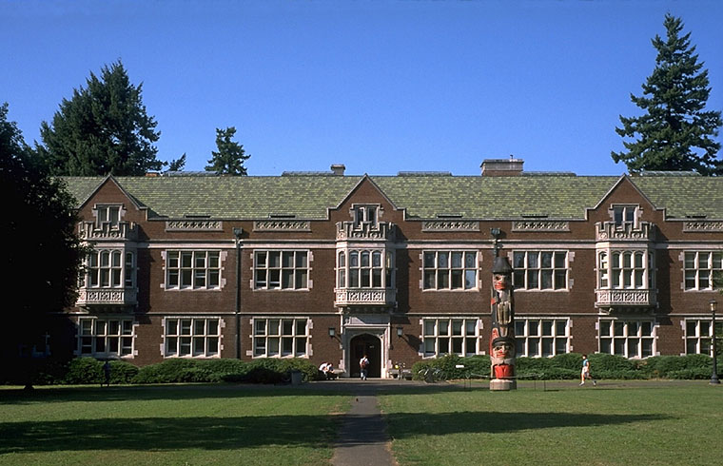
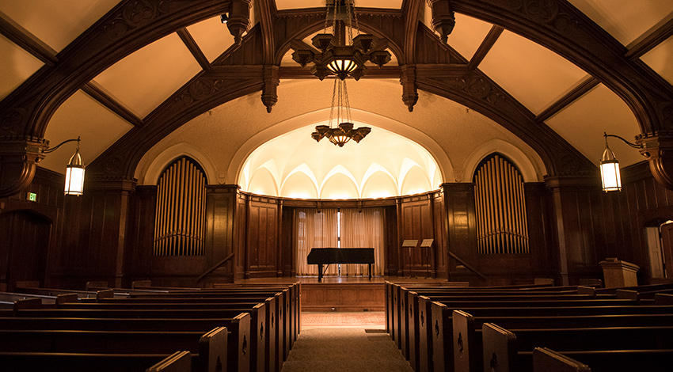
Notes:
Meeting at Reed College
Small liberal arts college
Good access to neighborhoods and public transit
Great campus, meeting rooms, and collaborative spaces
Affordable on campus lodging.

Slide 8

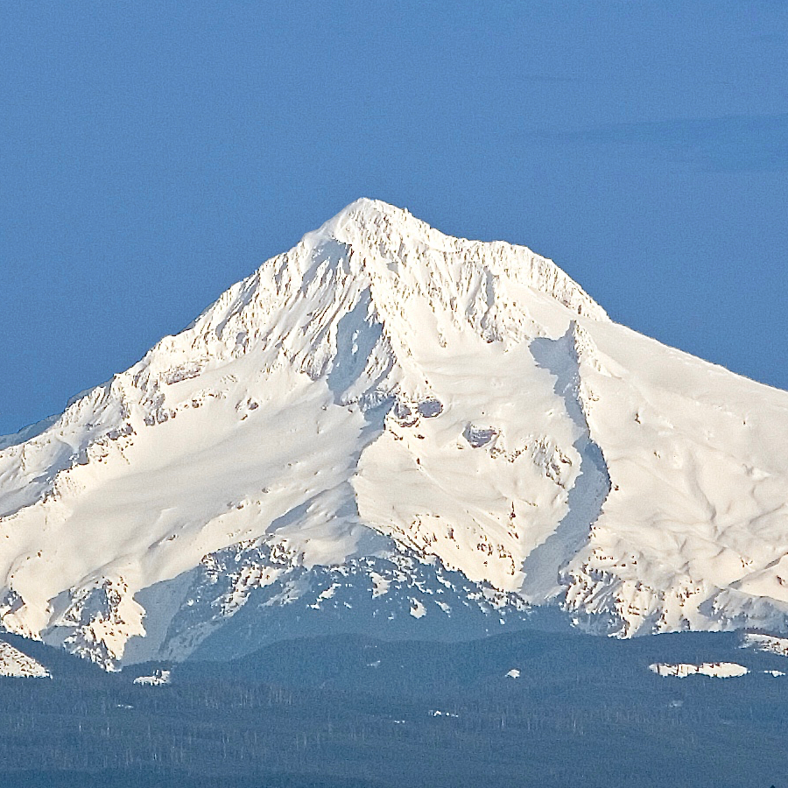


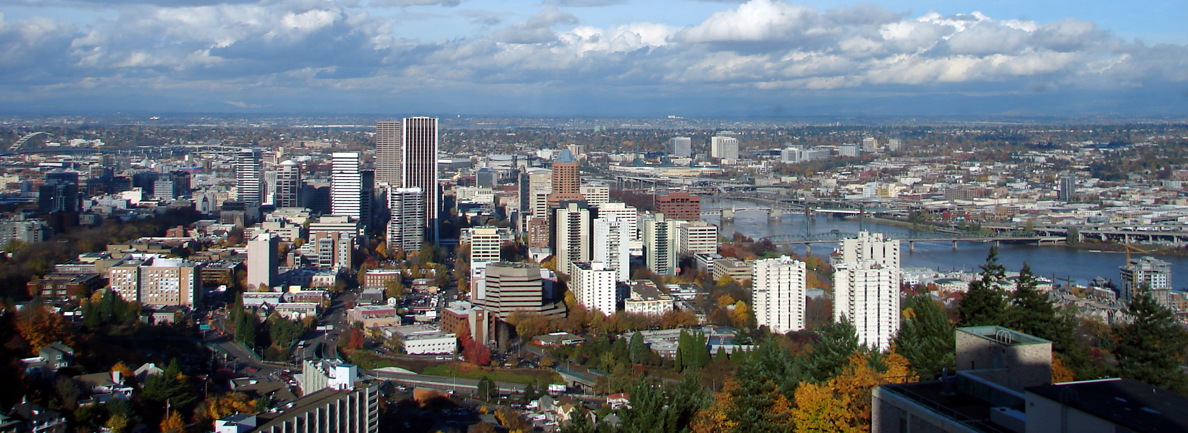
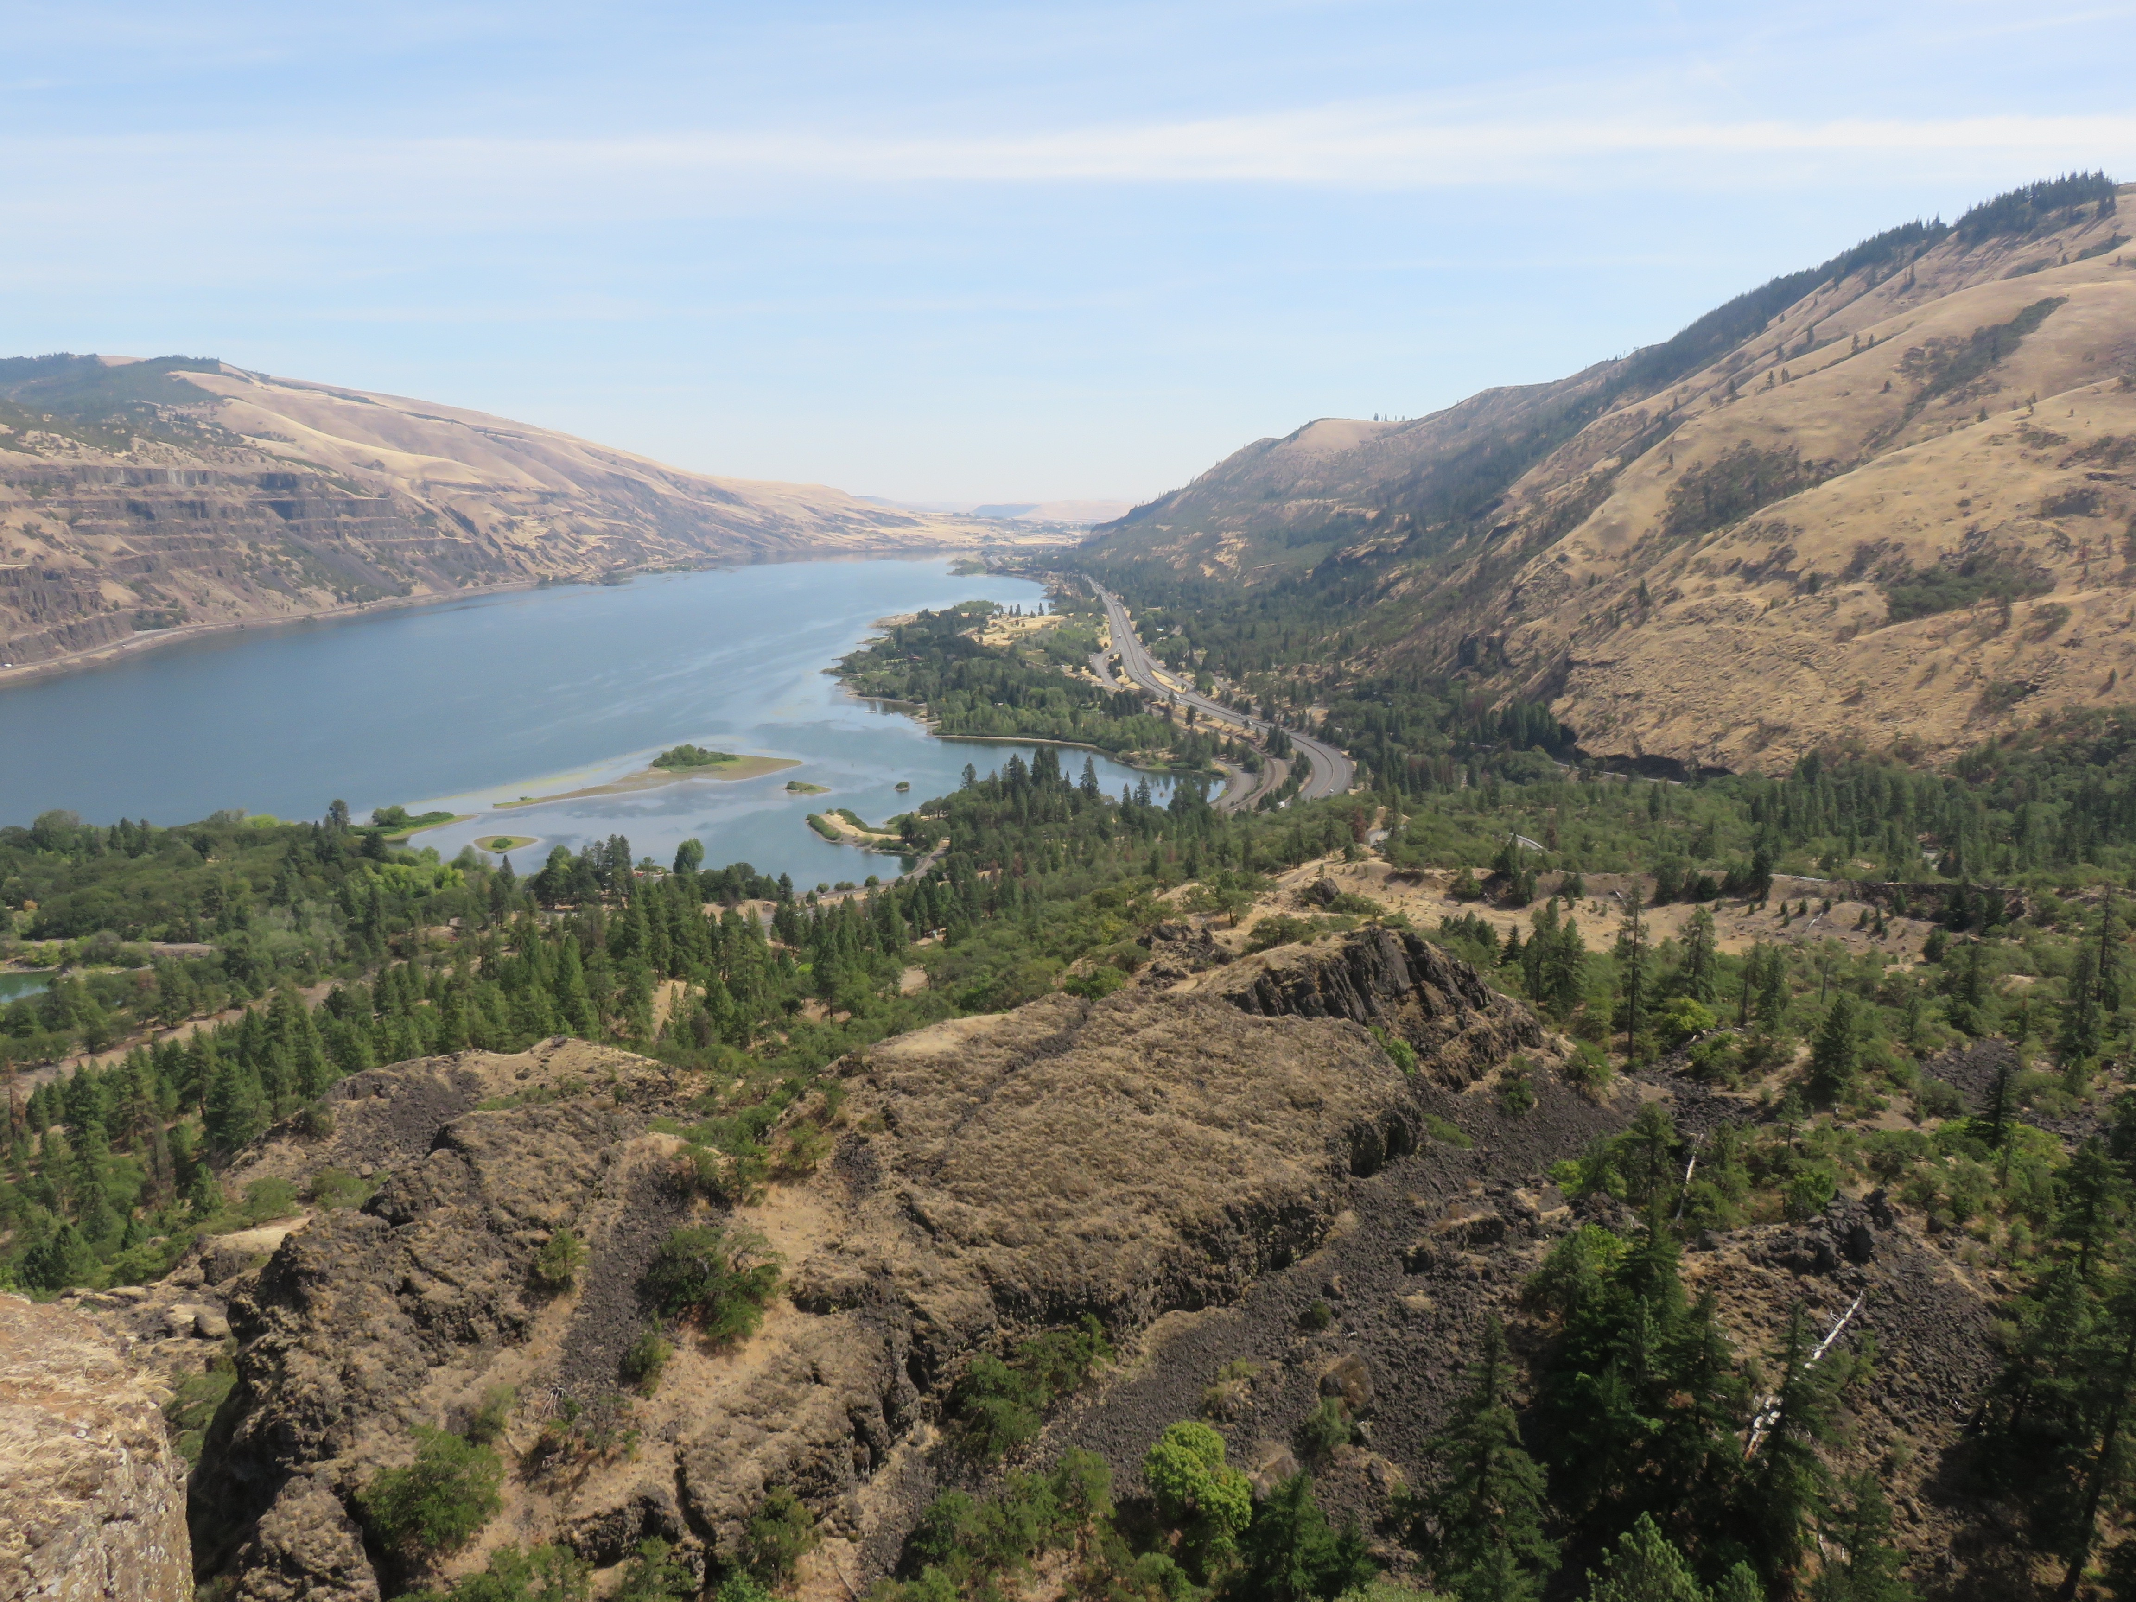

Slide 9
New schedule
June 25-26: Training
June 27-28: Meeting
June 29-30: Collaborating

Slide 10
See you next year.
gccbosc2018.sched.com

