Slide 1


Assembly and annotation using Galaxy
Konrad Paszkiewicz
Sequencing Service, University of Exeter, UK.
25th May 2011

Slide 2
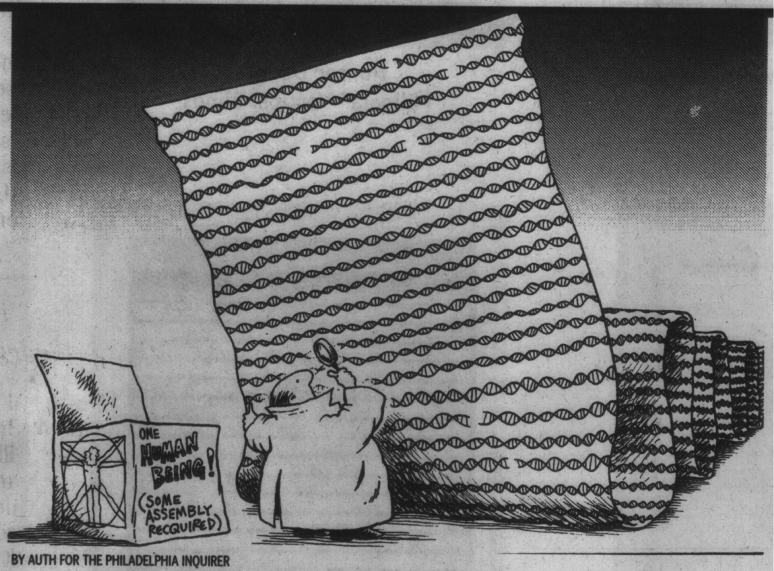

Slide 3


Overview
Why de-novo assembly?
What is de-novo assembly?
Types of assemblers
Annotation
A toy example in Galaxy
Future developments

Slide 4
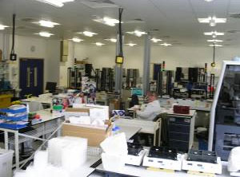
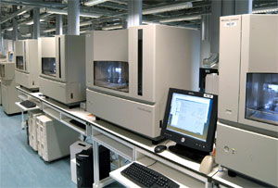
Sequencing - 2007
PRODUCTION
Rooms of equipment
Subcloning > picking > prepping
35 FTEs
3-4 weeks
SEQUENCING
74x Capillary Sequencers
10 FTEs
15-40 runs per day
1-2Mb per instrument per day
120Mb total capacity per day

Slide 5
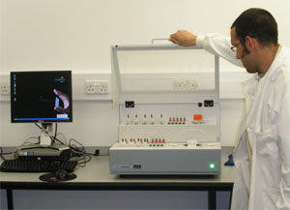

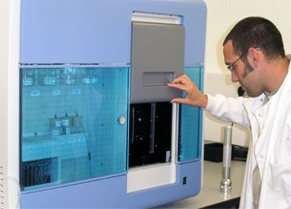
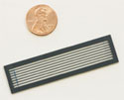
2nd generation sequencing - Today
PRODUCTION
1x Cluster Station
1 FTE
1 day
SEQUENCING
1x Genome Analyzer
Same FTE as above
1 run per 3-10 days
5 - 90Gb per instrument per run

Slide 6
Why de-novo assembly?

Slide 7
Why is de-novo sequence assembly useful?
- No reference genome available
What is the most suitable reference genome?
(e.g. species definition problem in bacteria)
  What’s new in a genome?
    Remapping will not tell you what is new in a genome (e.g. plasmids, novel genes, novel chromosomes)
  What’s really missing from a genome?
    Remapping may fail to detect homologous regions
Notes:
Ideally do both denovo assembly and remapping

Slide 8
What is de-novo assembly?

Slide 9
De-novo sequence assembly
Sequence DNA fragments from each end
Insert length

Slide 10
De-novo Sequence Assembly
Sequence DNA fragments from each end
Reads aligned to generate contigs

Slide 11
De-novo Sequence Assembly
Sequence DNA fragment from each end
Reads aligned to generate contigs

Slide 12
De-novo Sequence Assembly
Sequence clones from each end
Reads aligned to generate contigs
Supercontigs derived from paired reads on different contigs
Notes:
Often called scaffolding

Slide 13
De-novo Sequence Assembly
Sequence reads from each end
Reads aligned to generate contigs
Supercontigs derived from paired reads on different contigs
Ordering of contigs is determined
Different insert lengths and read lengths can resolve ambiguities

Slide 14
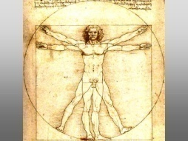
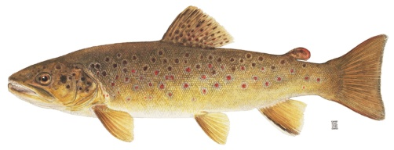
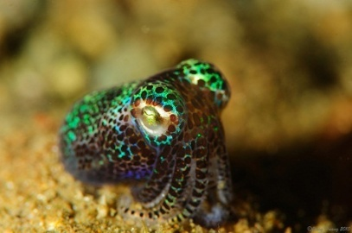
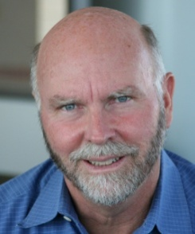
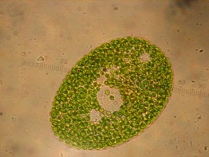
De-novo assembly:
It’s not just for genomes.
Traditional single homogenous genome assembly
Single organism transcriptomes without a reference
- Estimates of expression
Genomic/transcriptomic assembly of symbionts and metagenomes
Notes:
Highlight that this is without a reference genome of any sort

Slide 15
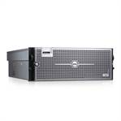
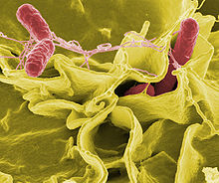
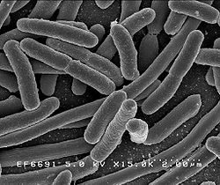
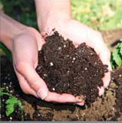
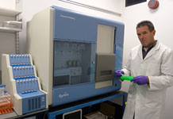
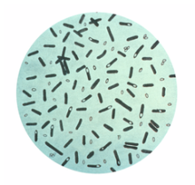

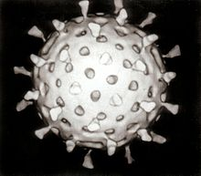
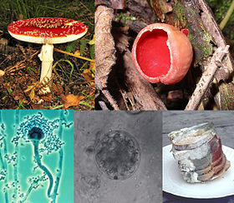
Metagenomics

Slide 16
Denovo Sequence Assembly
Caveats
  No assembly is perfect
  Assemblies from 2nd generation tend to be worse in a number of ways than Sanger based-assemblies
    + Easier to generate data
    + Easier to generate lots of assemblies
    - Shorter reads/higher error rates
    - Man/brainpower is more thinly spread
    - Harder to evaluate assemblies
    - Harder to annotate and compare between samples
    - Very difficult to curate and make best use of all data
Notes:
Harder to annotate precisely because of

Slide 17
Types of assemblers

Slide 18
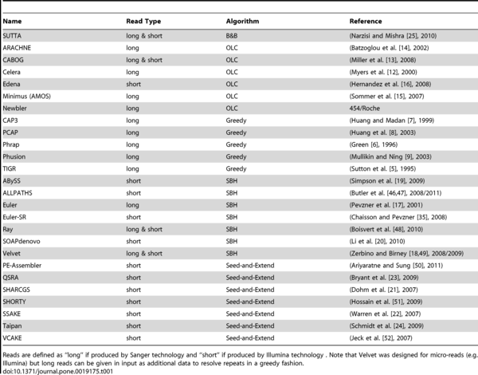
Types of assemblers
4 categories, many variations
Each tends to have its own niche
Memory and hardware requirements can differ substantially
Galaxy has support either in-built or via Galaxy Tool-shed for Velvet, MIRA, AbySS, Phrap Newbler
Typically a parameter scan is need to get the ‘best’ assembly
Narzisi G, Mishra B, Comparing De Novo Genome Assembly:
The Long and Short of It. 2011 PLoS ONE 6(4):
De novo assembly of short sequence reads
Paszkiewicz, K. Studholme, D.
Briefings in Bioinformatics
August 2010 11(5): 457-472

Slide 19
Annotation

Slide 20
Annotation
Identification of
genes
exons
promoters
signal peptides
regulatory regions
alleles
non-coding RNAs
repeats...
2 broad categories of annotation methodology:
Sequence homology-based (e.g. Blast)
Profile/HMM-based (e.g. PFAM, TMHMM, SignalP)

Slide 21
Annotation
To do this effectively it is often necessary to gather additional data:
e.g.
ChIP-Seq
RNA-seq

Slide 22
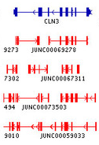
Annotation
Exon structure
Transcription start sites
Annotated gene structure
Notes:
Transcription is a lot more complicated than at first sight

Slide 23
A toy example in Galaxy

Slide 24
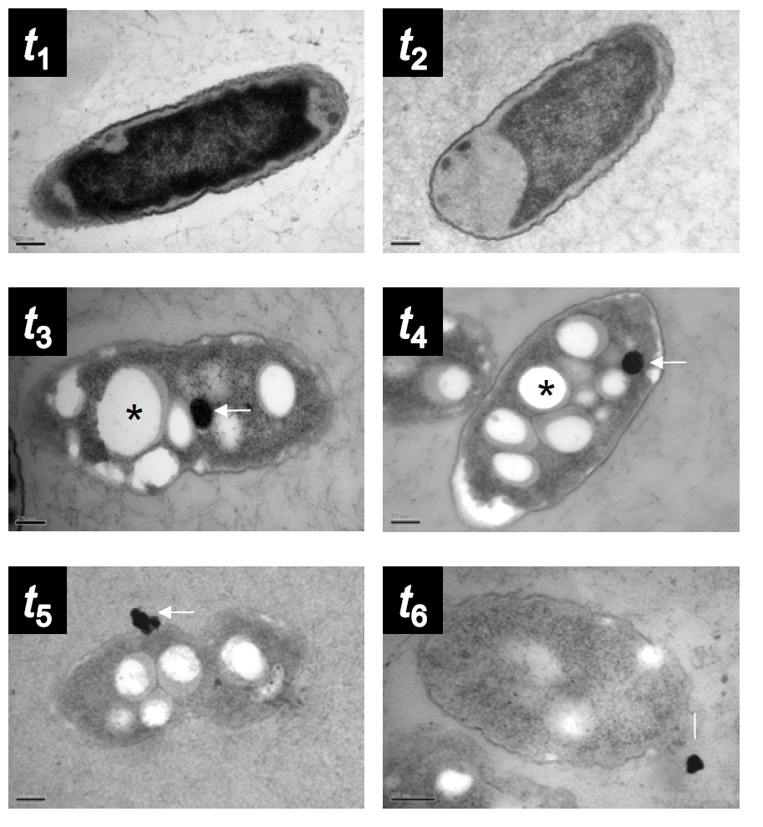
Denovo sequencing project
A new beta-proteobacterium which secretes elemental metal
60% GC content
Approximately 8 Mb genome
Method: 1 lane Illumina sequencing
Mass spectrometry
Aim: Which genes(s) are responsible for translocation?

Slide 25
Process
Uploading files from Illumina sequencing
Filtering reads
De-novo assembly
Annotation
Locating secretion protein using mass-spectrometry information

Slide 26
1. Uploading files

Slide 27
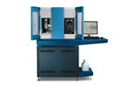
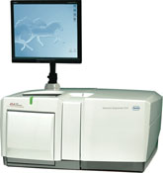
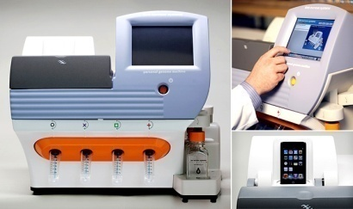
2nd generation sequencing output formats
Illumina
SoLID/ABI-Life
Roche 454
Ion Torrent
FASTQ (various flavours)
Colourspace FASTA
SFF
SFF or FASTQ

Slide 28
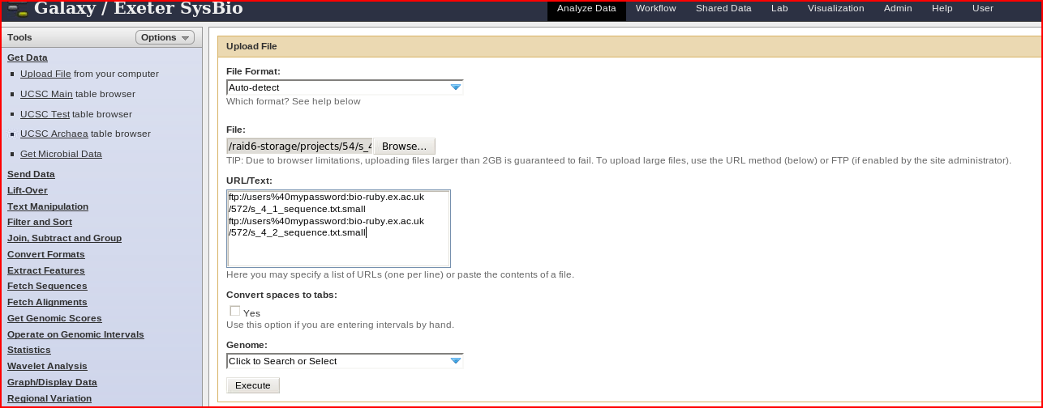
Uploading FASTQ files
Or via Galaxy LIMS
Or (maybe) direct from SRA/ENA
Notes:
Either via FTP server or via HTTP. We need a better system for users with large fastq files (>2Gb).

Slide 29
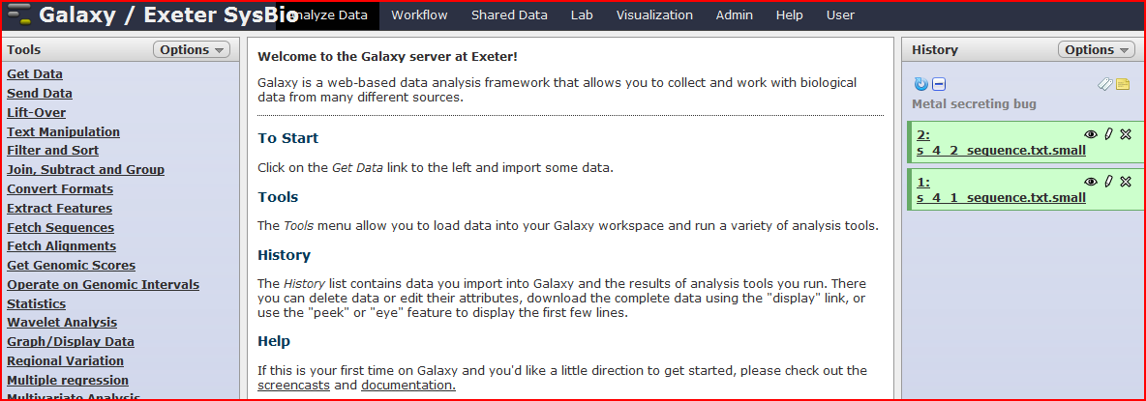
Uploading FASTQ files
Notes:
Either via FTP server or via HTTP. We need a better system for users with large fastq files (>2Gb).

Slide 30
2. Filtering reads

Slide 31

All platforms have errors and artefacts
Illumina
SoLID/ABI-Life
Roche 454
Ion Torrent
Removal of low quality bases
Removal of adaptor sequences
Platform specific artefacts (e.g homopolymers)

Slide 32
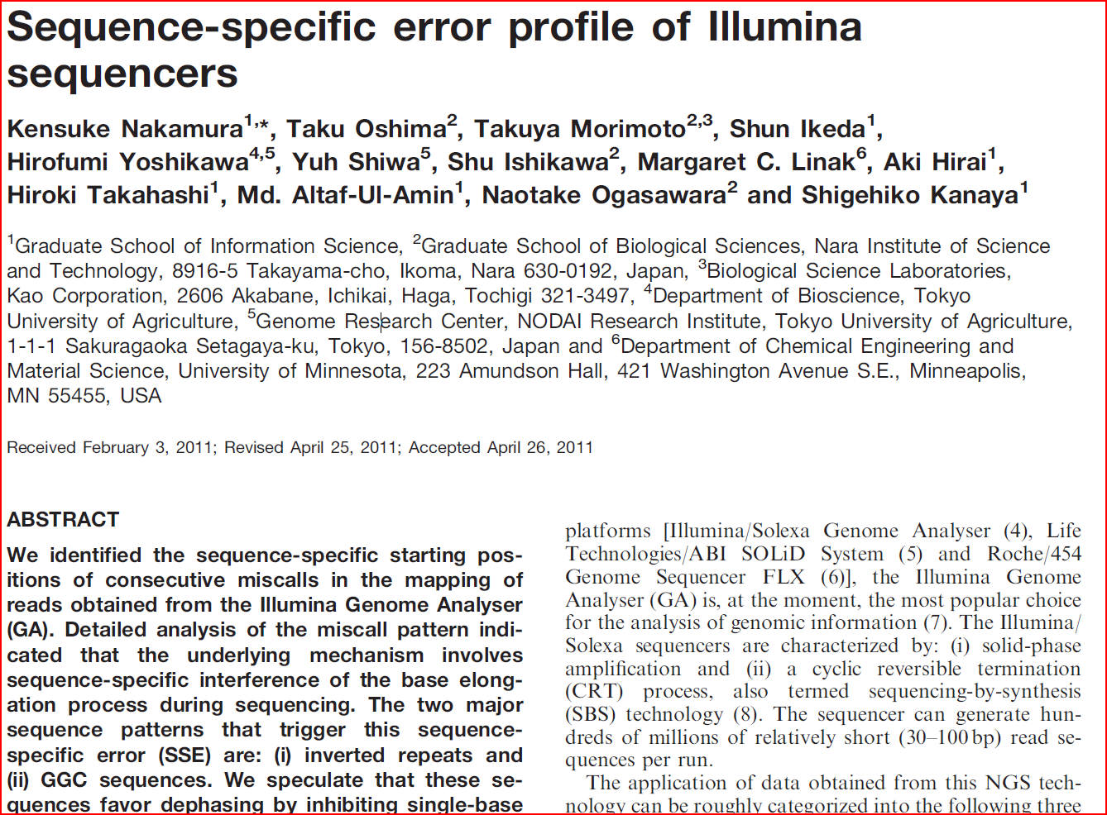
Illumina artefacts
Nakamura, K. et al Sequence-specific error profile of Illumina sequencers
Nucl. Acids Res. (2011) May 16, 2011

Slide 33
Illumina artefacts
GC rich regions are under represented
    PCR
    Sequencing
Substitutions more common than insertions
3. GGC/GCC motif is associated with low quality and mismatches
4. Filtering low quality reads exacerbates low coverage of GC regions
Assembly and/or filtering software should account for this technology specific bias but doesn’t yet

Slide 34
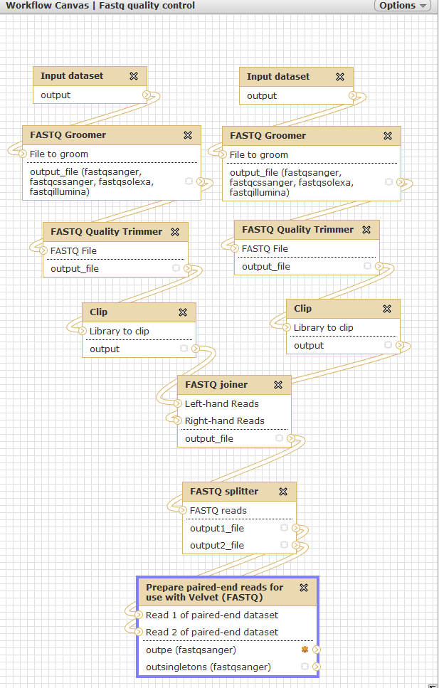
Quality controlling workflow
Notes:
But this does not account for the errors and biases highlighted in the previous slide. To do that the Velvet assembler would need to be ‘sequence specific error’ aware

Slide 35
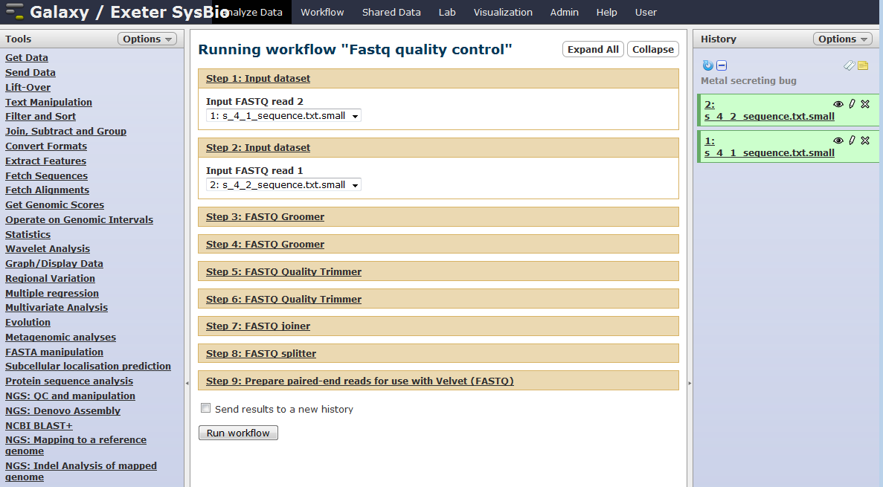
Quality controlling workflow

Slide 36
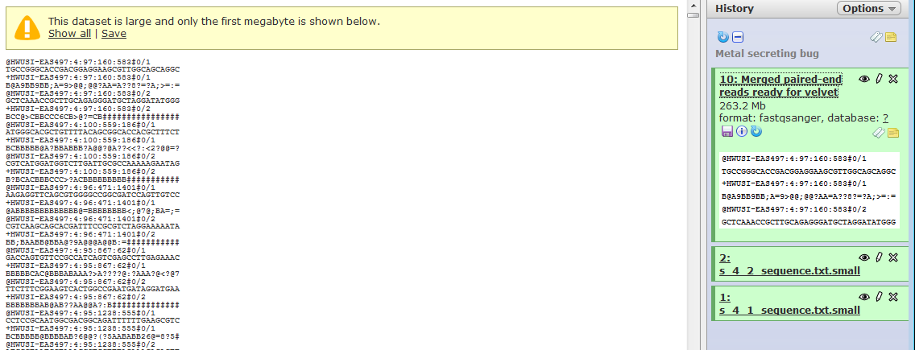
Quality controlling workflow

Slide 37
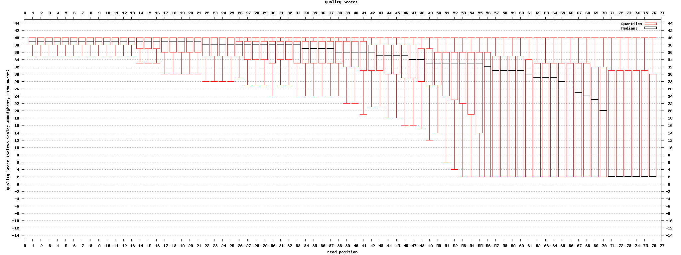
Quality visual summaries

Slide 38
3. De-novo Assembly

Slide 39
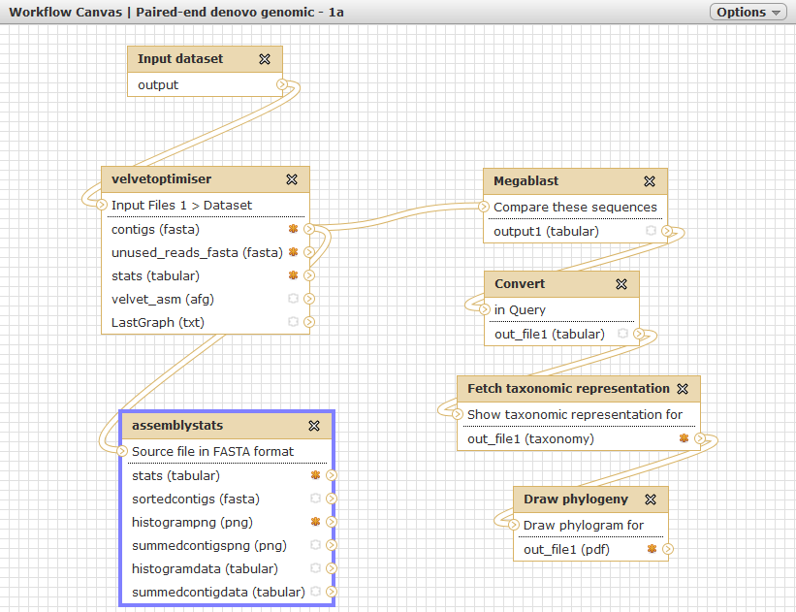
Assembly workflow

Slide 40
Velvet optimiser for genomic de-novo assembly
De-bruijn graph assembler
Runs a selection of k-mer lengths and parameters
Selects optimum assembly based on contig length and N50 size (adjustable)
Originally written by Simon Gladman, CSIRO
Available at the Galaxy Tool Shed

Slide 41
However...
We need a method of benchmarking the assembly using biological knowledge
GC value
Genome size ~ Total number of bp in contigs?
Fraction of genes fully assembled
  Measured against closely related genome
Manual finishing, gap closure only if really necessary
Most assemblies only need to be ‘good-enough’... whatever that means...

Slide 42
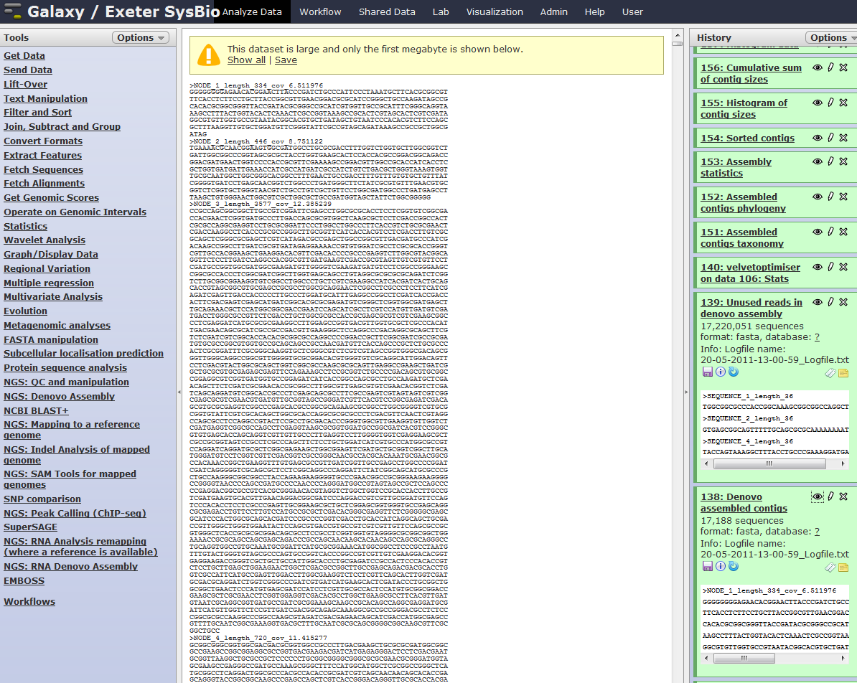
Assembly results

Slide 43
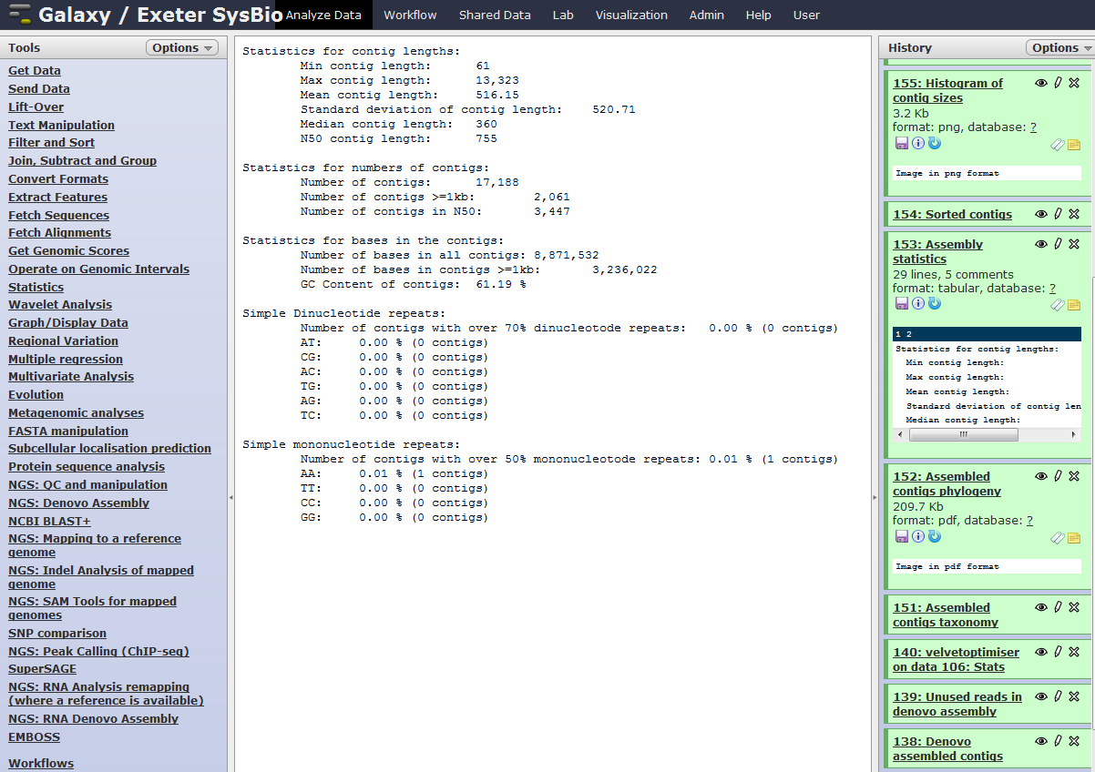
Assembly statistics
Notes:
This is a poor assembly due to a poor prep. But we can still get something out of it.

Slide 44
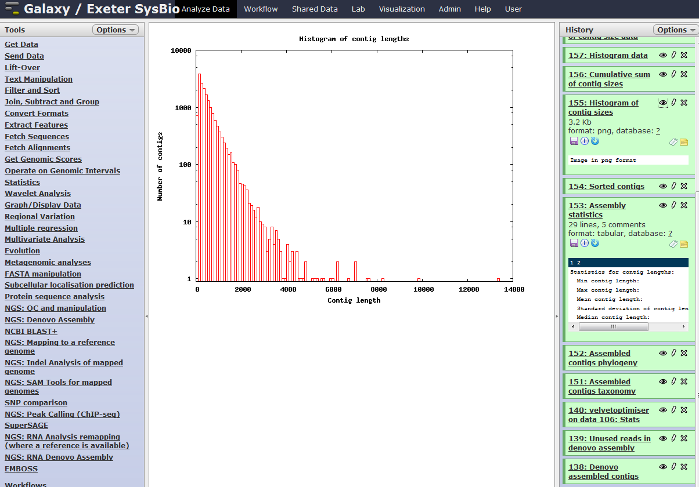
Assembly statistics

Slide 45
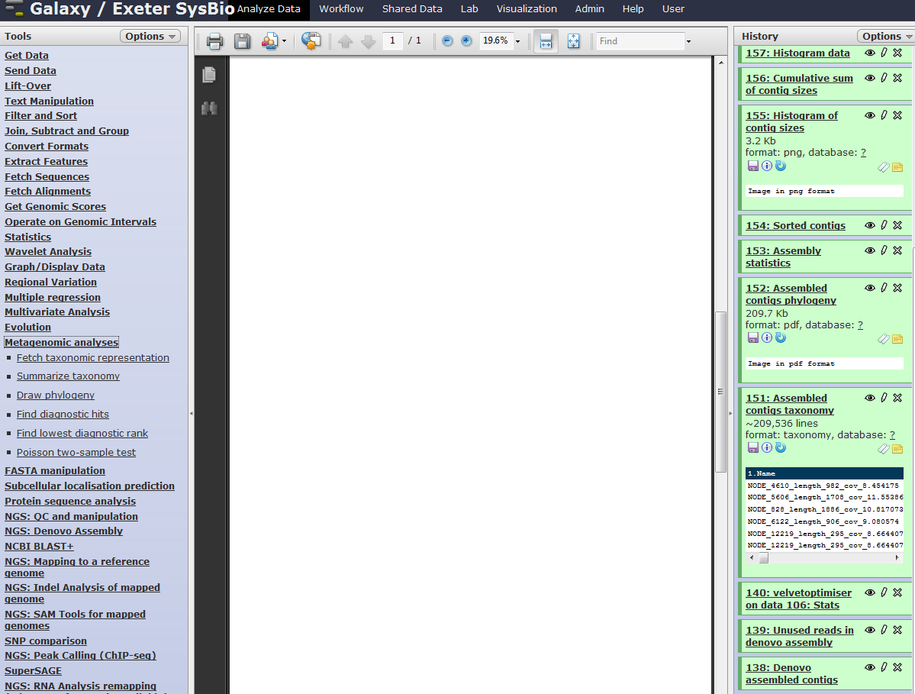
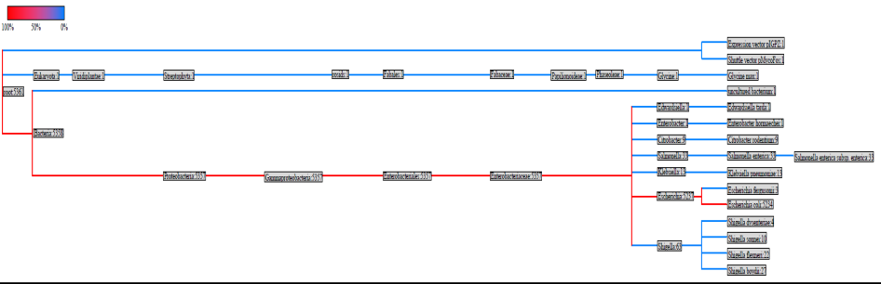
Taxonomy of contigs
Notes:
Essentially this is a sanity check – are the contigs mapping to related species? Or are we just picking up contaminants?

Slide 46
4. Annotation

Slide 47
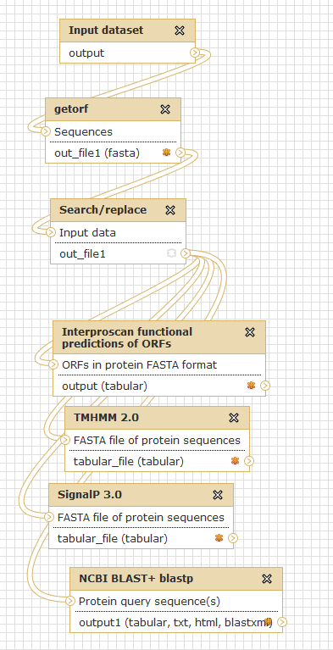
Annotation workflow
Notes:
SignalP and TMHMM are courtesy of Peter Cock

Slide 48
Still to be included
De-novo gene prediction
EST and other evidence needs to be included
tRNAs
RepeatMasker
Non-coding features
Other annotation software pipelines

Slide 49
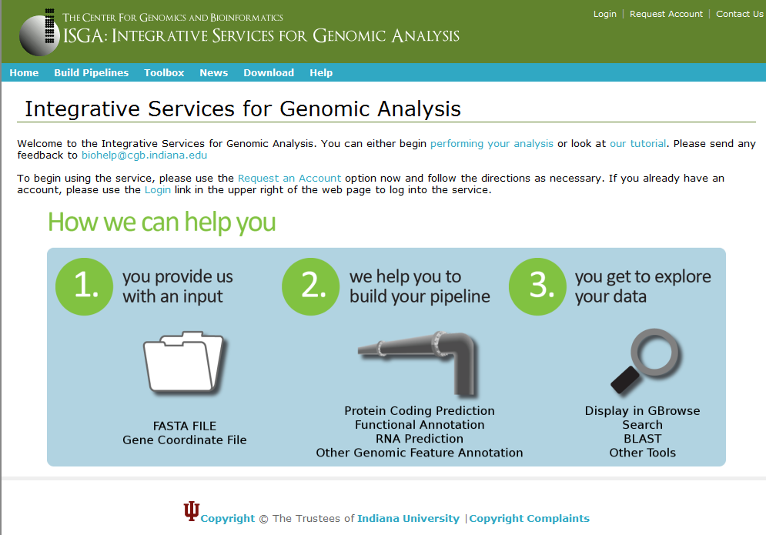
Can we incorporate these?

Slide 50
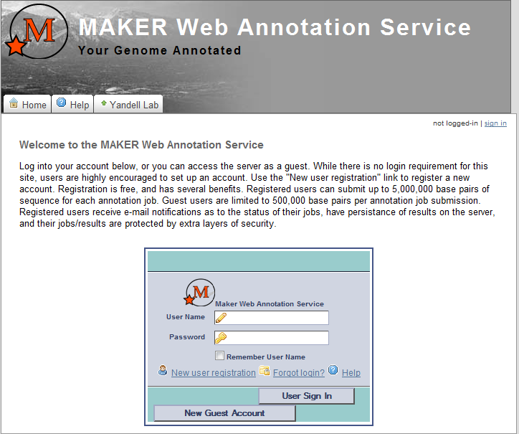
Can we incorporate these?

Slide 51
Do we want to incorporate these?
If so:
Locally?
Web services?
Is the service sustainable if it becomes really popular?

Slide 52
Denovo sequencing project
A new bacterium which secretes elemental metal
60% GC content
Approximately 8 Mb genome
Aim: Which genes(s) are responsible for translocation?

Slide 53
5. Where is the secretory protein?

Slide 54
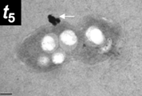
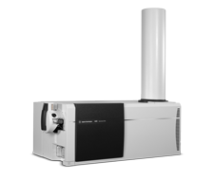
Mass spectrometry evidence
MTITASQSRTEVVVRSA..

Slide 55
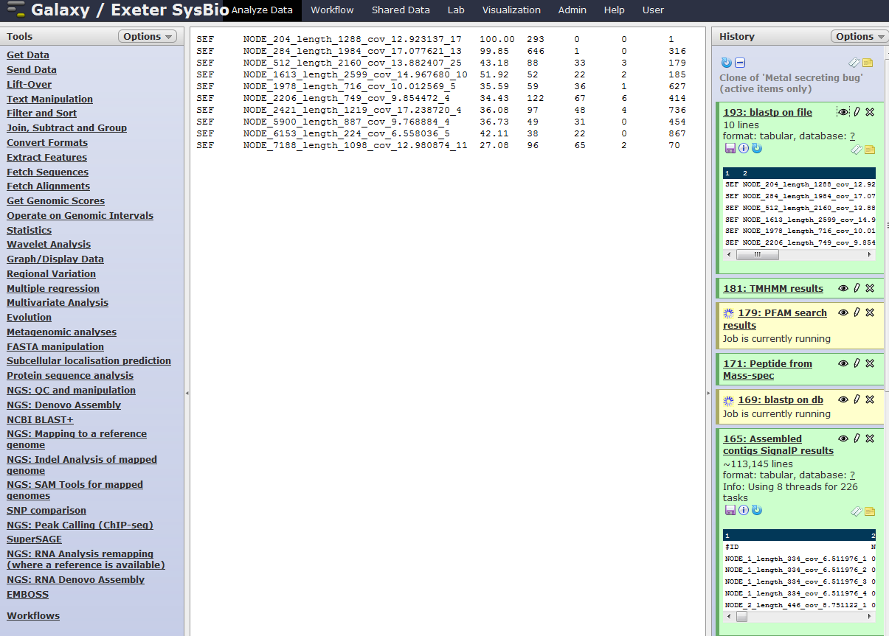
Locate peptide within contigs ORFs using BlastP
MTITASQSRTEVVVRSA....
Contig 204 ORF 17

Slide 56
Check with annotation tools
  SignalP predicts a signal peptide using both NN and HMM
  TMHMM also predicts that the peptide is external
  PFAM reports a DUF (Domain of Unknown Function)
  BlastP NR reports Hypothetical proteins
  ORF located and characterised as coding for a novel metal export factor

Slide 57
Summary
Filtered and formatted raw data
Assembled a draft 8 Mb genome – no finishing
Evaluated metrics and taxonomy of contigs
Called ORFs bacterial codon usage table
Basic annotation with BlastP against NCBI NR
PFAM, SignalP, TMHMM
Identified peptide within contigs
No hits in PFAM, NCBI NR. Signal peptide present
Time frame < 1 day

Slide 58
Other assemblers
Minimus2 (Galaxy wrapper by Edward Kirton)
  Merge contigs from different assemblies
MIRA (Galaxy wrapper by Peter Cock, SCRI)
  Recent upgrades for PacBio and Ion Torrent
AbySS (Galaxy wrapper by Edward Kirton)
Newbler (Galaxy wrapper by Edward Kirton)
  Roche/454 proprietary assembler and remapper
Phrap (Galaxy wrapper by Edward Kirton)
  Sanger read assembly
String Graph Assembler (Jared Simpson, Sanger)
  Useful for large (> human) genomes with short reads

Slide 59
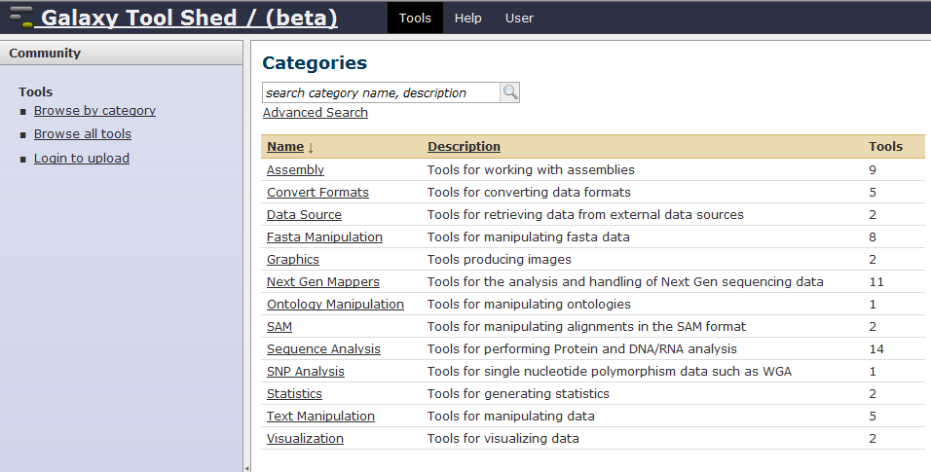
Available at Galaxy Toolshed

Slide 60
Other applications

Slide 61
Oases optimiser for de-novo RNA-seq
Sister program of Velvet
Runs a selection of kmer lengths
Combines all results
Uses these as a scaffold to assemble transcripts at shortest kmer length

Slide 62
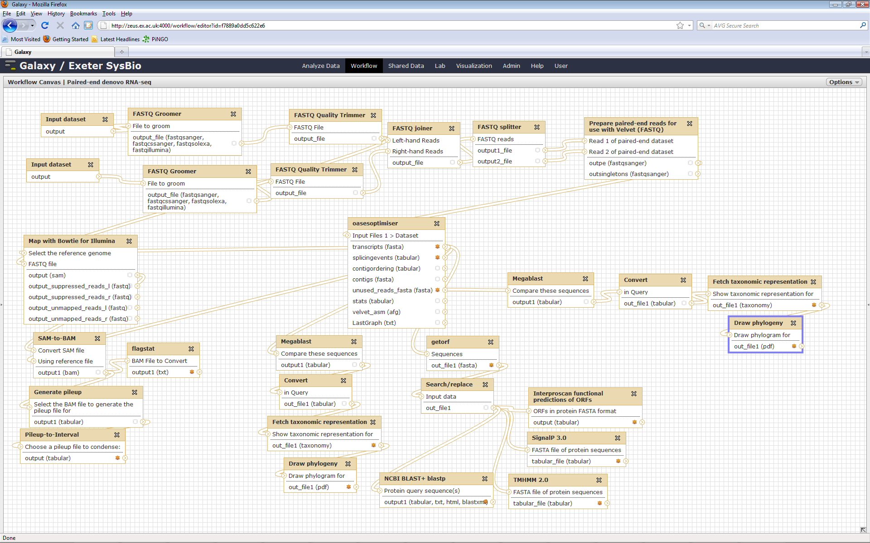
Galaxy denovo RNA-seq Pipeline
Notes:
It would be very useful to have workflows-of-workflows to avoid sprawling diagrams and aid in testing

Slide 63
Future developments

Slide 64
Community to-do/wish list
Adding tools dedicated to evaluating assembly quality (e.g. Using EST sequences or related sequences)
Tools to aid in finishing assemblies
AFG or other assembly-format visualisation
Collating and formatting annotation (e.g. GFF files)
Metagenomics/transcriptomics (e.g. MetaVelvet)
Gene prediction software
Blast2Go
Comparison of GO or PFAM terms between samples
Enabling workflows of workflows
AMOS tools (Amos validate etc), web-services

Slide 65
Future developments
A single Illumina GAIIx run can produce data for ~ 100 bacterial genomes in less than a week.
Cost: ~10,000 Euro
Question: How do we deal with 100s of comparisons between datasets in Galaxy?
Do we want to?
Do we have a choice?

Slide 66
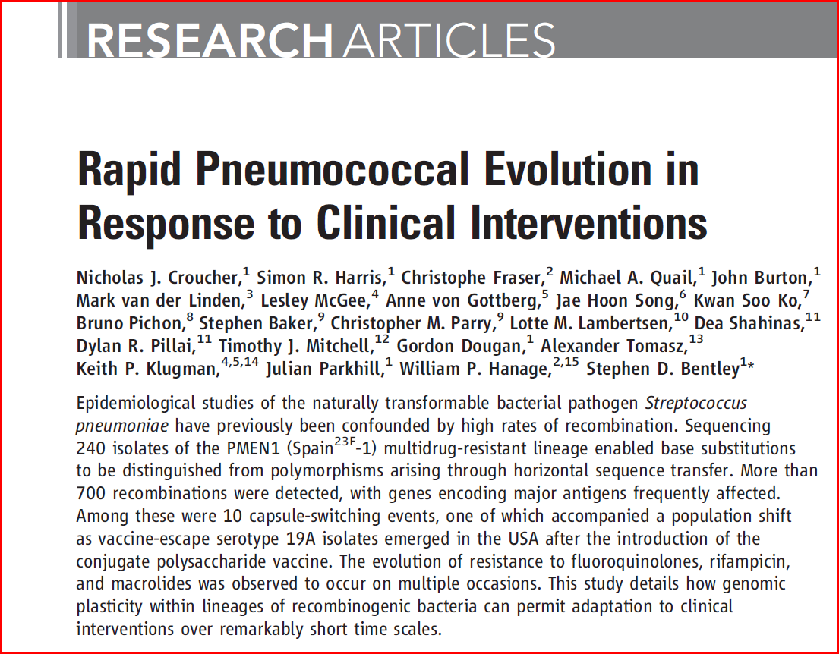

Slide 67
DNA sequencing generations
Then + Now
Now
Now + anticipated
Anticipated
1st Gen
Sanger
2nd Gen
-parallised
3rd Gen
-single mol or electronic
Next
-single mol AND electronic
Low
throughput
High cost
Accurate
Broad user
base
Optical
Amplification needed
Highly parallel
Improved cost and
Throughput
New applications
Optical
Single-molecule
Highly parallel
Cost similar
New applications
Or electronic,
clonal
Direct electrical (no optics)
Single-molecule, highly parallel
Transformation of workflow
Designed to broaden user base,
deliver step change in cost, power
New applications
Sanger
GAII (Solexa/Illumina)
SOLiD (ABI/LIFE)
454 FLX (454/Roche)
Helicos
Pacific Biosciences
Ion Torrent
(LIFE Starlight)
Nanopores
Estimated cost of a human genome using these technologies
$70M
$200k --- $50k ---- $20k --- 15k---
?$5k - $1k?
Notes:
67

Slide 68
Questions?
Konrad Paszkiewicz
k.h.paszkiewicz@exeter.ac.uk

Slide 69
“We need to start thinking about how to train people, both health-care professionals and scientists, to be facile in bioinformatics. We need to foster development of professionals who have expertise analyzing large data sets of the size that biologists haven't had to think about. We need to entice smart people into genomics.”
Eric Green,
Director National Human Genome Research Institute

Slide 70
Acknowledgements
University of Exeter
Murray Grant
Karen Moore
Alex Moorhouse
Peter Cock – James Hutton Institute
Galaxy team and tool shed contributors

