Slide 1
Galaxy for High Throughput Sequencing
Notes:
1. Supporting the open-source community, 2. interested to know what our customers would go through. Scaling, organization of input and results, performance, user interaction – Looking at the data processing problem in the context

Slide 2
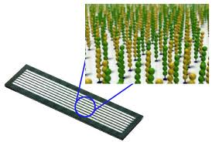
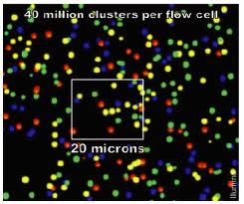
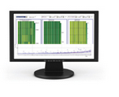

Agenda: Galaxy for High Throughput Sequencing
Introduction: Speaker – Kirt Haden, Illumina, Software Engineering
Key Requirements
Why Galaxy?
Significant Challenges
System Architecture
Ideas and Solutions
Experiences with Galaxy
Illumina’s Vision
Conclusion

Slide 3
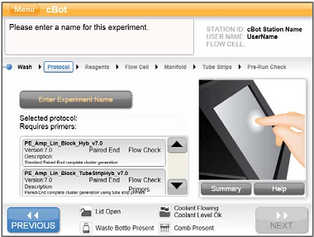
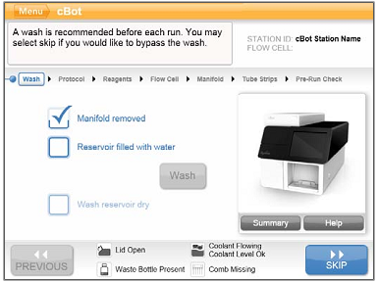
Key Requirements
Analysis of up to 100TB of sequencing data per month
Ease of use – no informatics background required
Parallel processing that results in equal or better performance to existing workflows
Reproducibility of analysis across institutions – ability to share workflows
Customization and easy integration of workflows
Automation of workflows – offline and online
Notes:
40 Hi Seq running 24/7, implications for bandwidth, storage and processing, accessible, performant, convert people from command line

Slide 4

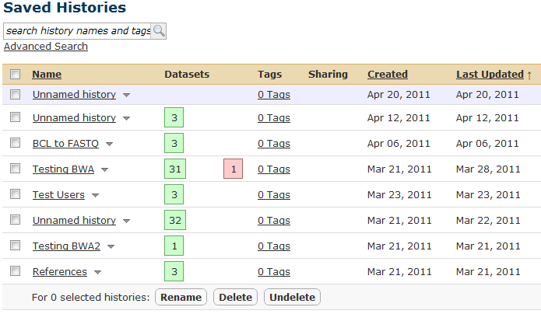
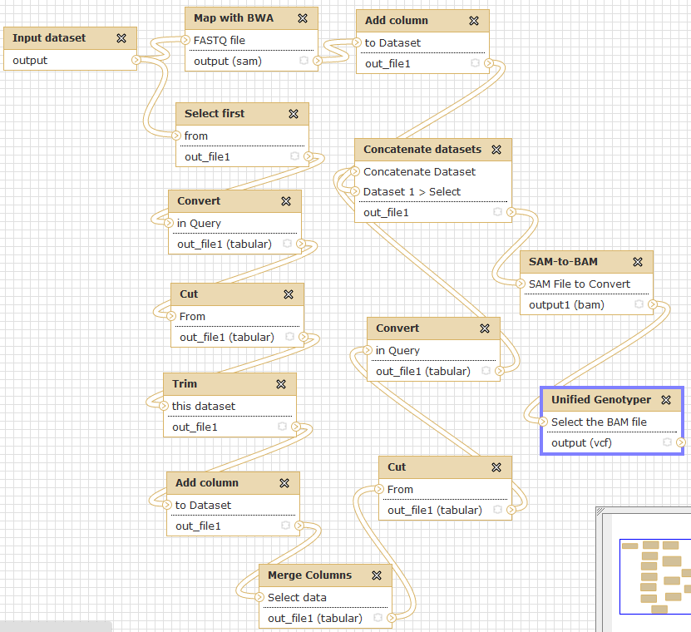
Why Galaxy?
Ease of use and distribution
Tool integration
Availability of sequencing workflows
Data and workflow sharing
Tracking history
DRMAA integration
API support
  Ability to automate repetitive tasks
Ability to modify the presentation layer
  Customization for specialized roles and reduce complexity
Cloud implementation
Community supported
Notes:
Galaxy’s design provides many of our requirements out of the box, sharing to promote publishing, Cloud allows for fast startup

Slide 5
Significant Challenges
Big Files
  Dilemma of linking files and keeping control or uploading and passing control to Galaxy
  Scanning entire file, computing meta data is useful but costly for compressed files
  Splitting vs. indexing into large files
Parallelization within a file
  No easy solution for handling a large input set without creating many small files
Temp files consume vast amounts of storage space, disk space monitoring
Handling tools that produce a variable number of files
  Scatter - gather/ Collections / Demux model / Variable number of files
File system caching (file system as communication mechanism)
  Temp directory may not be there when the job runs (NTFS V3 vs V4 issue?)
  OS write level caching means that output files may not be completely written before they are used by the next process
Too much manual intervention required to handle transient conditions
Organization of results
Complex interface for multiple roles
Notes:
Linking demotes sharing, manipulation of files becomes costly like # lines, Tweak all knobs and then forget about it – pick your level of detail, running out of storage space, clean up

Slide 6
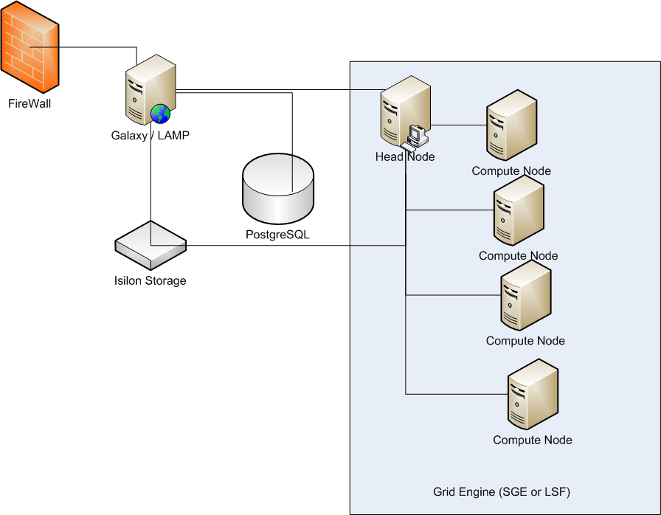
System Architecture to Support Scalability
Notes:
Isilon is optimal

Slide 7

Ideas and Solutions
Within module parallelization may be a useful strategy
Splitting of FASTQ files (ex. ELAND)
  Changing tools to operate on a subsets of a file
  Allow a set (collection) of files as a primitive
  Parallelization type per input port and use BWA splitting scheme
  Indexing the gzipped files
Automatic retry for failed operations to recover from transient events
  This is useful for write caching issue/ transient events
  How do you clean up from a failed operation?
Enhance separation between user interface and function with API to support alternate presentation layers and more automation
  Allows independent development without a huge investment to support multiple different users requirements
???

Slide 8
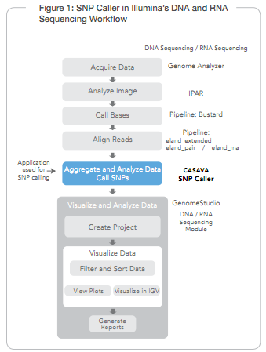
Experiences with Galaxy
Custom simplified GUI
Workflows/tools
  DNA Seq, RNA Seq, Methylation, Chip Seq, GT (microarrays)
Utilities
  Visualization, BEDtools, VCFTools, Broad GATK, Google charts
Submissions to Galaxy code base
  Broad IGV
  API changes
  Parallelization
CASAVA in Galaxy
  With and without make, qmake

Slide 9
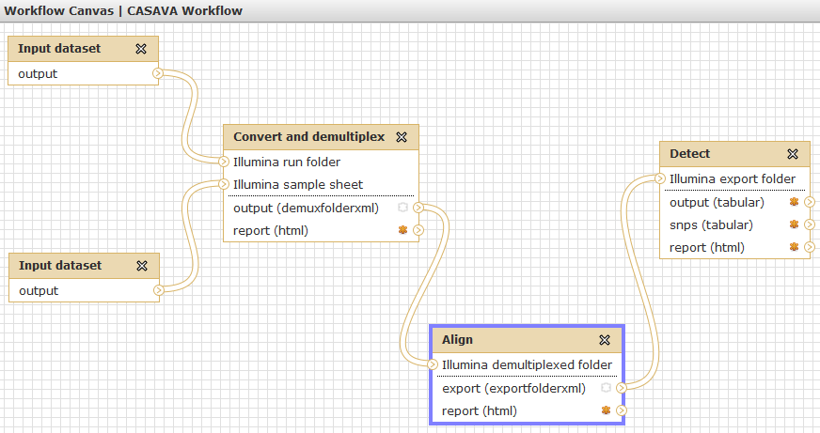
CASAVA workflow in Galaxy

Slide 10
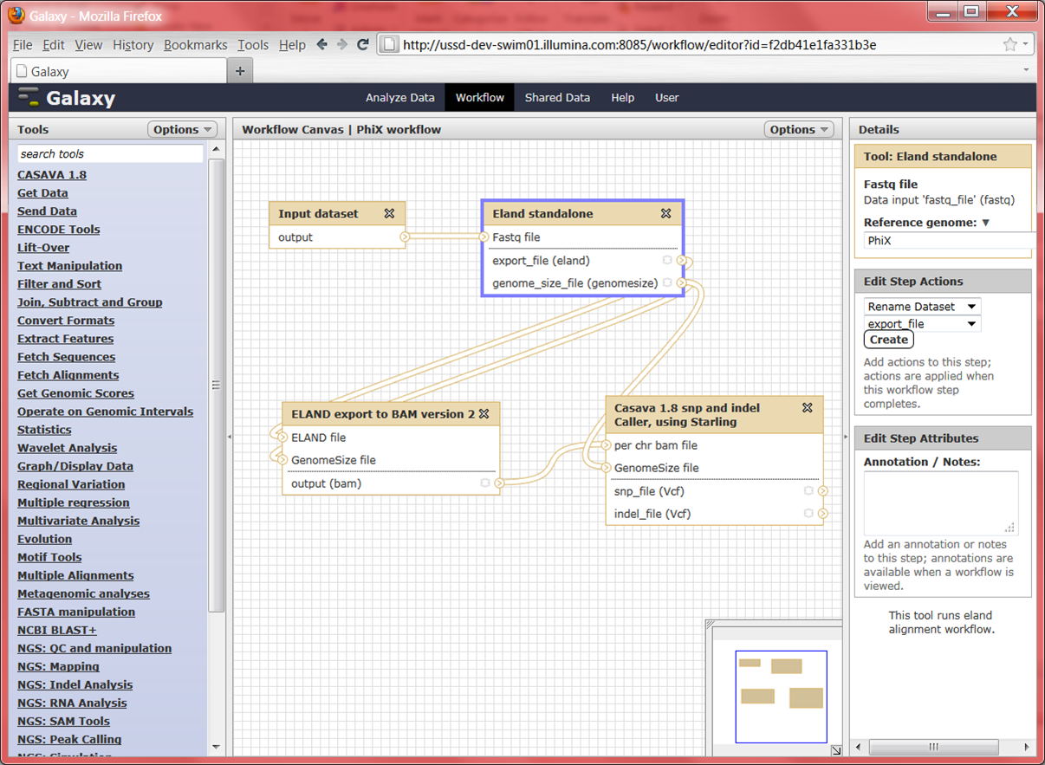

Slide 11
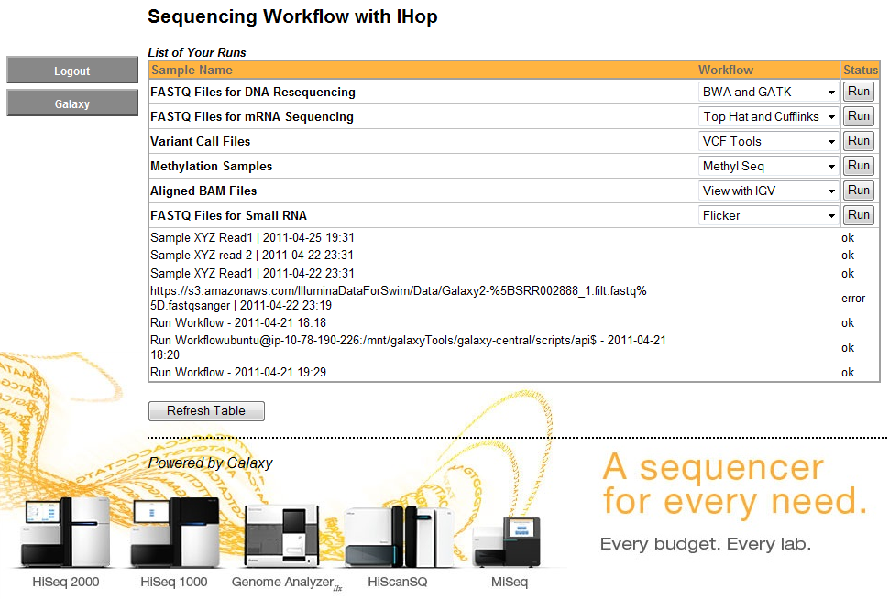
Mock-up of a Simplified and Stylized GUI

Slide 12

Illumina’s Vision
Set of recommended workflows
  Used for common sequencing applications
  Highly optimized for performance
Promote availability and easy integration of third party tools
Ability to process locally or in the Cloud (location agnostic)
Modular workflows with reduced coupling between components – plug and play
Data playground – sample data sets and performance numbers
Allow Galaxy users to create their own end-to-end analysis workflows with the CASAVA tool set
Help our customers get the most out of Galaxy
Support the open source community
Notes:
Promote 3rd party tool extensions to these workflows, capital expense should not be a barrier

Slide 13

Conclusion
Galaxy is an attractive workflow engine candidate
  engineers tend to focus on risk
A large number of useful workflows already exist and new ones are rapidly being added
We have found that adding new workflows is straightforward
Our usage of CASAVA in Galaxy demonstrates the feasibility of running very large data sets efficiently
Key challenges to relying on Galaxy for our secondary analysis still exist and will need to be resolved in the short term
We see great potential in the tool and look forward to working with the Galaxy community to create:
  Modular workflows
  Efficient analysis in the Cloud

Slide 14
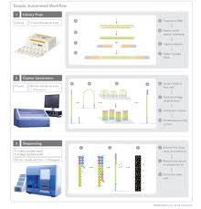

Contributors
    Galaxy Development team
    Galaxy Community
    Illumina
      Bioinformatics
        Semyon Kruglyak
        Jean Lozach
        Eric Allen
        Tobias Wohlfrom
      Services
        Brad Sickler
      Software
        Francisco Garcia
        Steve Burgett
        Mauricio Varea
        Come Racy
        John Duddy
      Marketing
        Jordan Stockton
        Dipesh Risal
      Project Management
        Scott Kirk

