Slide 1
Integrating Galaxy and Globus Online
Ravi K Madduri
The Globus Project
May 24, 2011

Slide 2
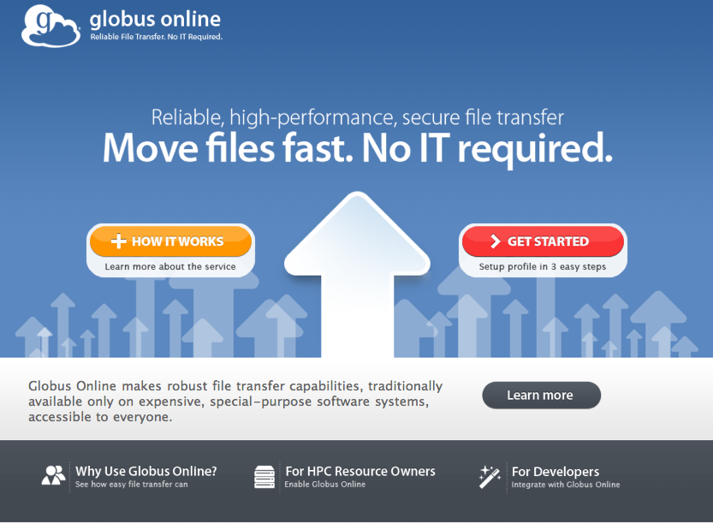

Slide 3


Globus products
Globus Toolkit
Globus Online
Use the Grid
Reliable file transfer Software-as-a-Service
globusonline.org
Build the Grid
Components for building custom grid solutions
globustoolkit.org
Notes:
This is something new. Not just more of the same Globus Toolkit stuff.
Globus Toolkit: hasn’t change. Been around 15 years. Still a toolkit for building custom Grids such as LHC and ESG.
Globus Online: Provides easy access for end users to use Globus GridFTP-based grids (e.g. TeraGrid, OSG, BIRN, EGEE, LIGO, etc.). If you don’t have GridFTP,

Slide 4

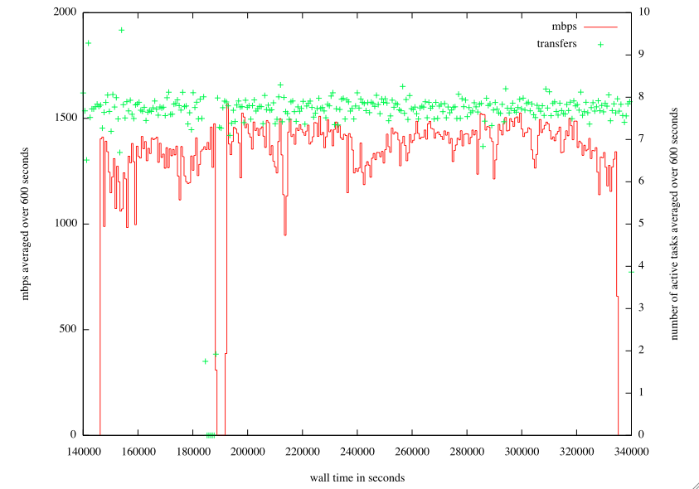

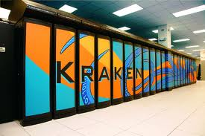
Globus Online In Action
28.6 Terabytes
31,000 files
56h 44m
No human involvement
Astrophysics simulation data
generated in Tennessee,
moved to Illinois for visualization
(Enzo, UCSD; Futures Lab, Argonne)
Notes:
How are we going to help you?
October 2010
Image from: http://www.flickr.com/photos/argonne/4244642347/sizes/s/in/photostream/
Briefly describe 2-3 other use cases here

Slide 5


Benefits of Globus Online
Reliable file transfer.
  Easy “fire and forget” file transfers
  Automatic fault recovery
  High performance
  Across multiple security domains
No IT required.
  No client software installation
  New features automatically available
  Consolidated support and troubleshooting
  Works with existing GridFTP servers
  Globus Connect solves
  “last mile problem”
Data
Data
Data
Data
Notes:
Point out the Globus Online picture with endpoints

Slide 6
Who can benefit from Globus Online
Ad-hoc: Non-programmers who need to move many files can use Web GUI
Scripted: Users who want to create automated workflows can use Command Line Interface (CLI)
System builders: Programmer who don’t want to re-engineer file transfer solutions can use REST API
Notes:
System builders: Condor, Swift, LIGO, etc.

Slide 7
GO Galaxy Capabilities
Use GO transfer service to transfer data in and out of Galaxy reliably using high performance data transfer protocol, GridFTP
Provision a EC2 cluster with Galaxy, Condor, GridFTP server and a set of users in <15mins
Upload data sets of size more than 2GB reliably using Globus Connect
Solve the last mile data transfer problem by making it easy to download data sets after analysis in Galaxy using Globus Connect

Slide 8
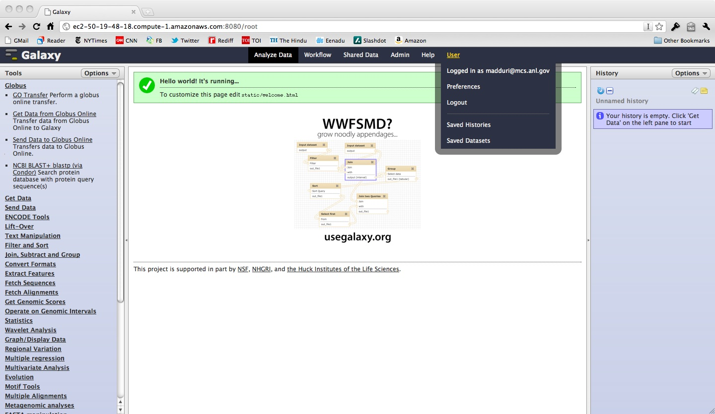
Integration of Globus Online with Galaxy

Slide 9
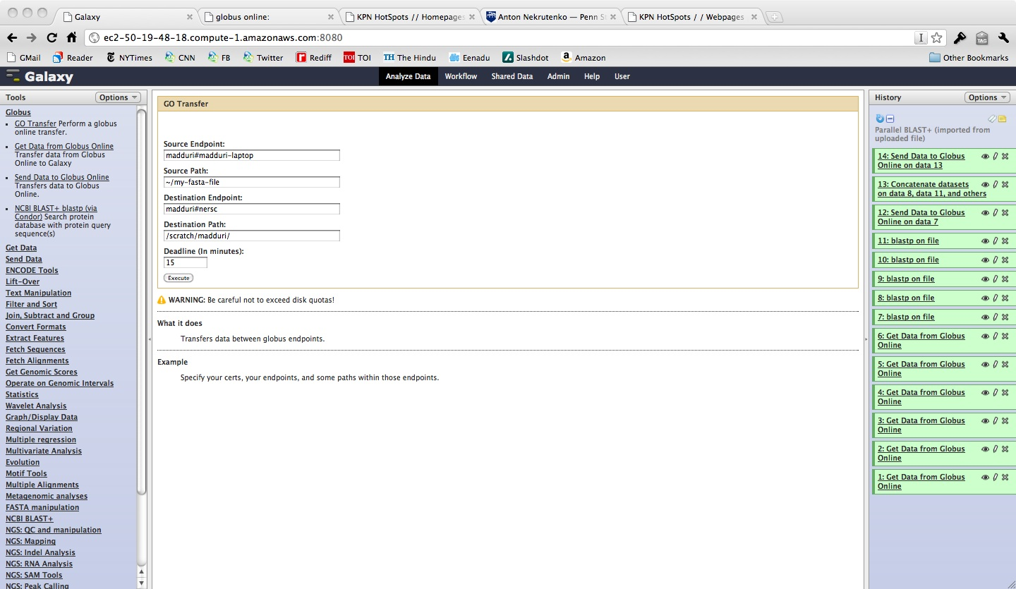
Globus Online Tools in Galaxy

Slide 10
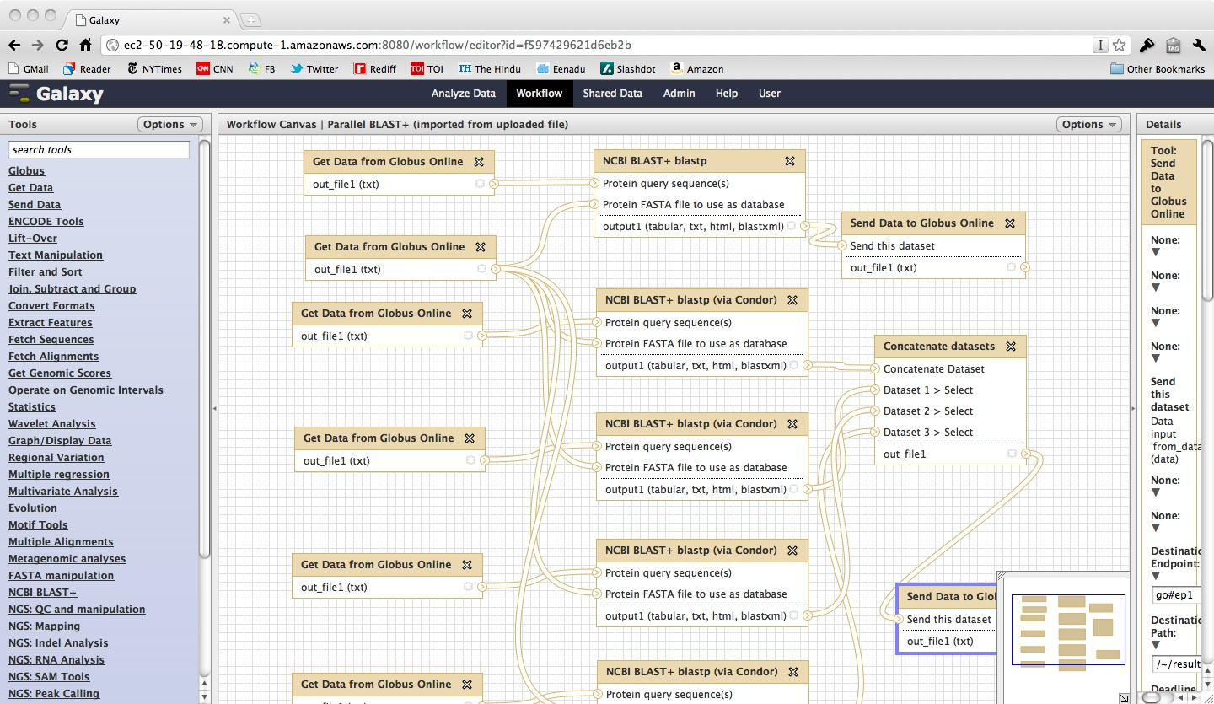
Sample workflow (Serial and Parallel Blast with GridFTP transfers using GO)

Slide 11
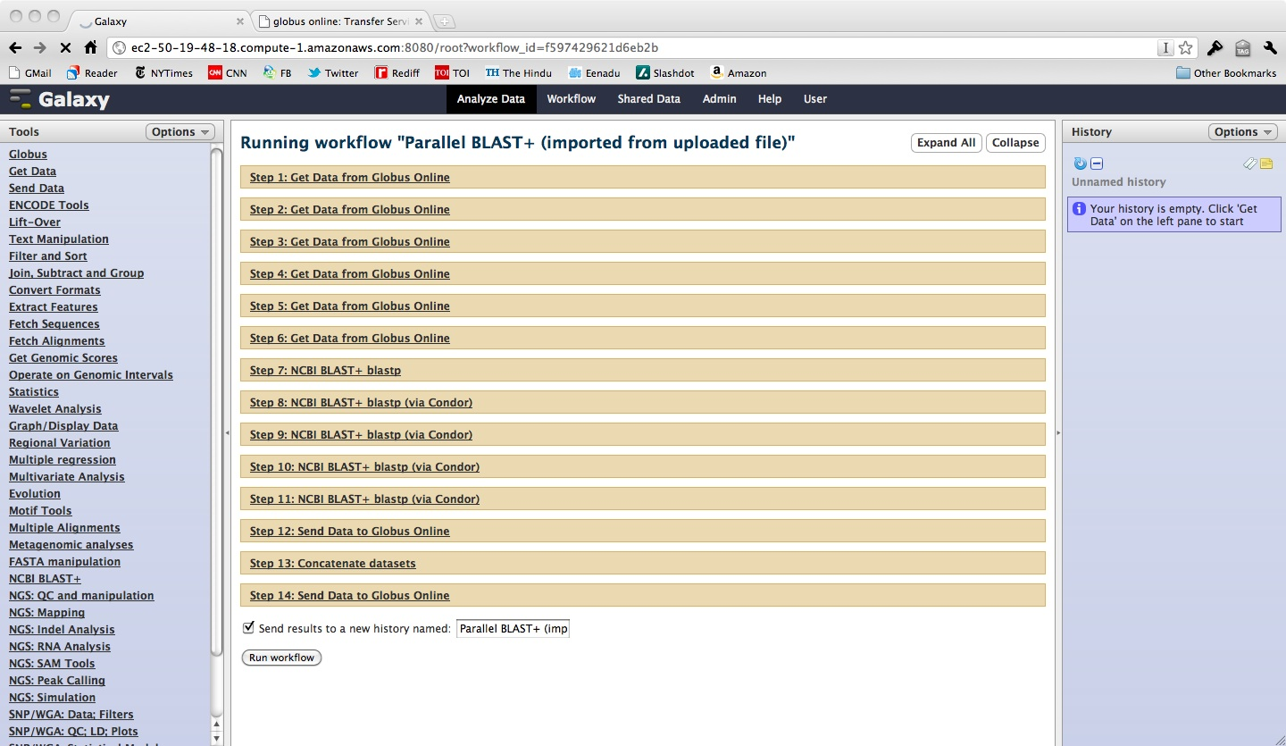
Workflow with all the steps

Slide 12
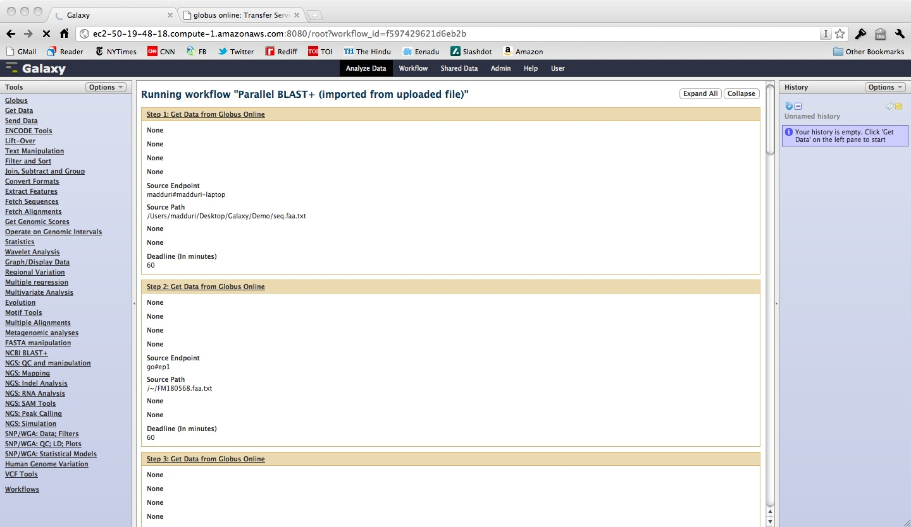
Workflow with all the steps

Slide 13
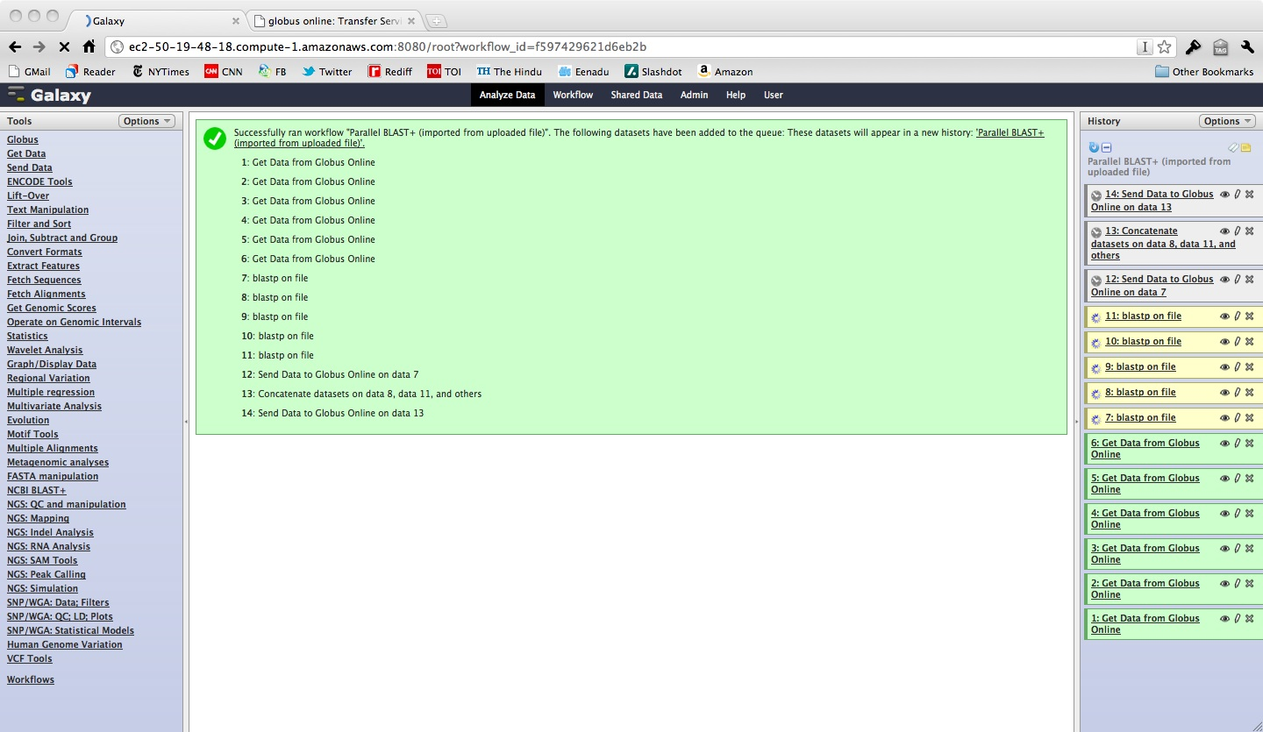
Workflow in Progress

Slide 14
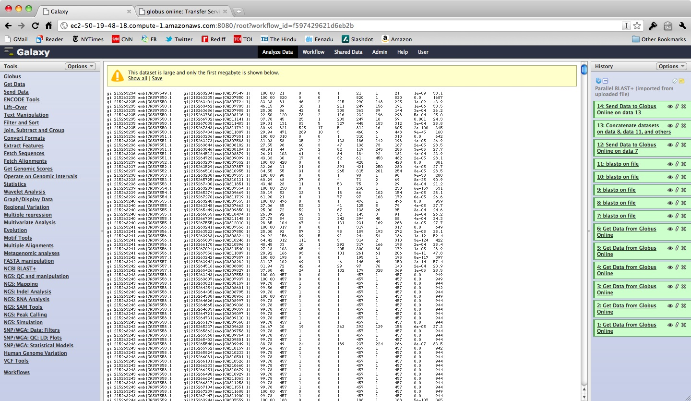
Final Results

Slide 15
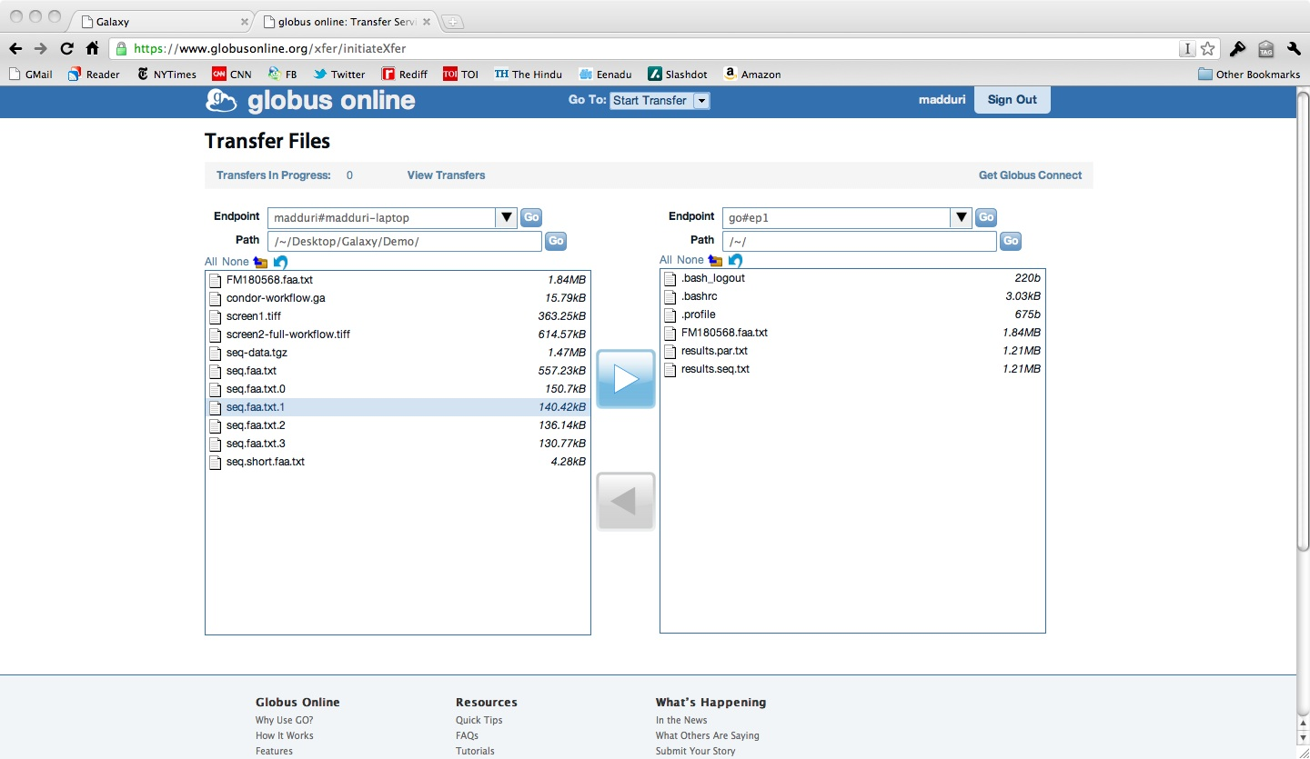
Final Results on a EC2 endpoint

Slide 16
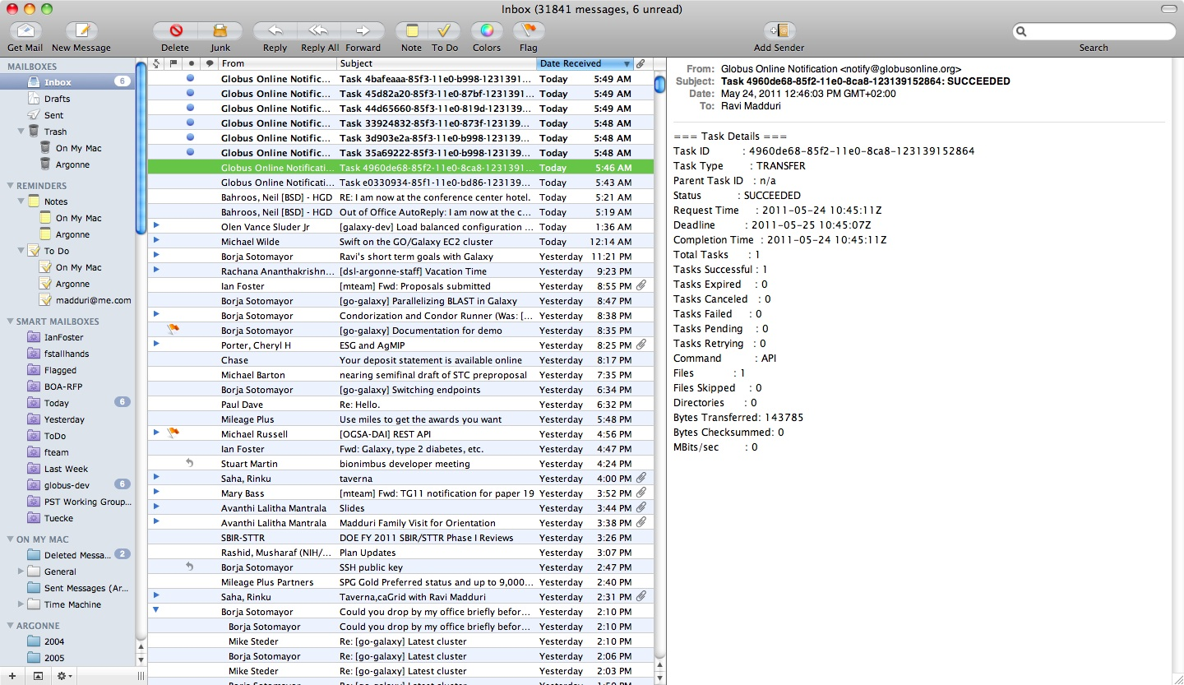
Email Notifications of Transfers

Slide 17
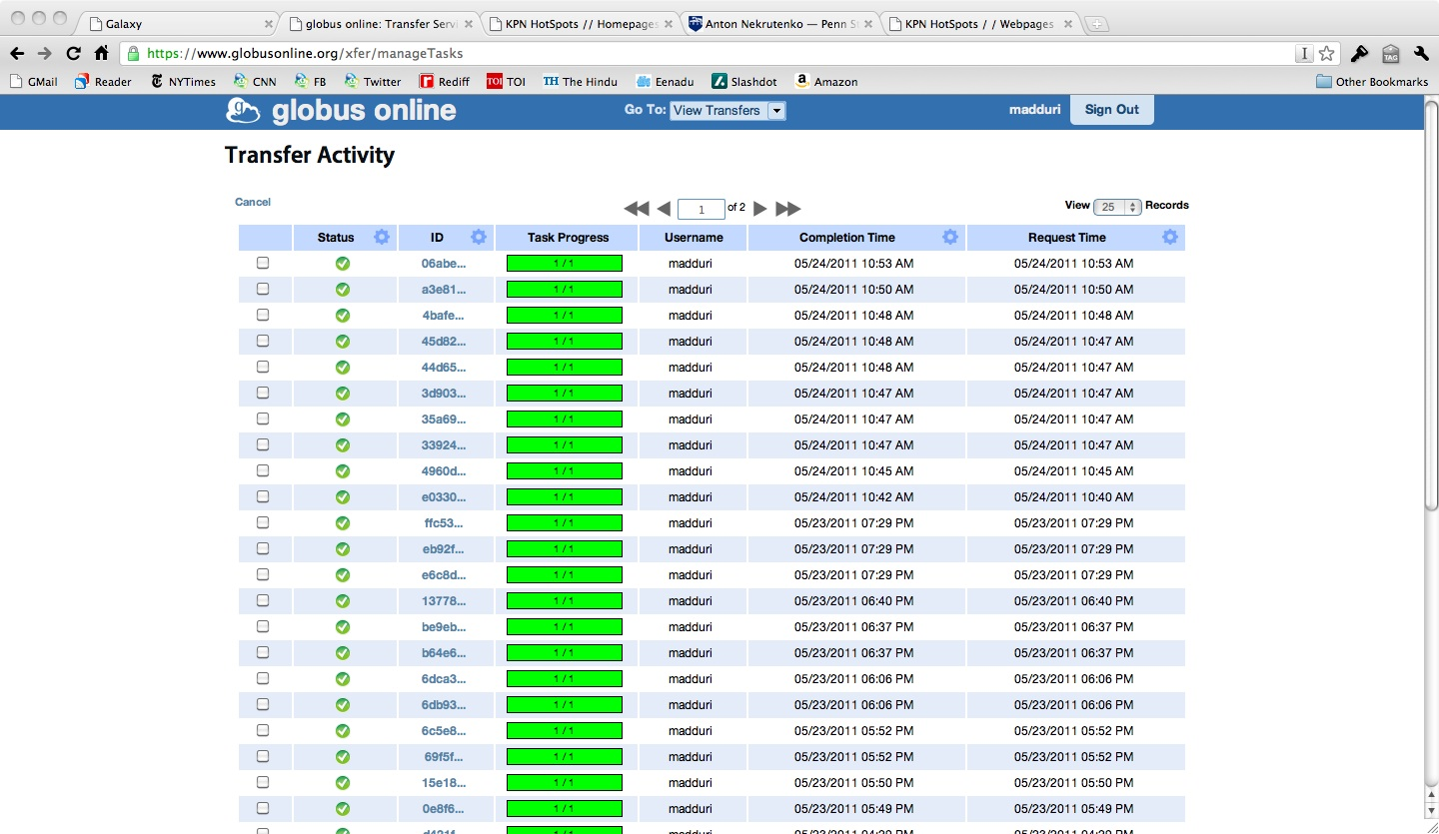
Transfer Monitoring

Slide 18
Sequence Vs Parallel Blast Using Condor
Using m1.small instances:
  Sequential: 15m19s (BLAST only: 13m57s)
  Parallel: 06m22s (BLAST only: 03m45s)
Using c1.medium:
  Sequential: 6m06s (BLAST only: 4m59s)
  Parallel: 3m20s (BLAST only: 1m50s)

Slide 19
GO Galaxy Future Capabilities
Integrate flexible Globus Online Identity management, group management with Galaxy (BIRN project wrt InCommon, campus identity etc)
Ability to easily share data with collaborators
Ability to create a VO with the above capabilities (User/Groups management, File system, Transfer, HTC, Parallel execution, EC2 Cluster, data sharing) with click of a button.

Slide 20
Demo

