Slide 1
Integrated variant detection
Erik Garrison, Boston College

Slide 2
Overview
Single-sample variant detection
Population-based variant detection
Our implementation (freeBayes)
Challenges for population-based variant detection.

Slide 3
What varies?
Given short read data from some individual, how do we determine what true polymorphisms they have relative to another?
A few approaches come to mind:
  Count alternate (non-reference) alleles
  Use a binomial test
  Integrate quality scores from reads

Slide 4
Maximum likelihood variant detection
Short reads are noisy
Alignments are noisy
Even with a relatively low base error rate for short read sequence data, we need coverage to ensure that we have sufficient power.

Slide 5
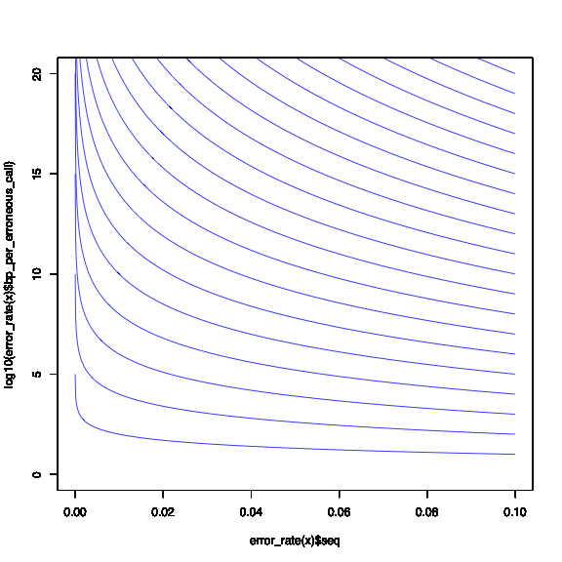
~Error rate versus coverage, 1-20x
Haploid detection error rate:
log10(bp per false detection)
10x coverage
1x coverage
Sequencing base error rate

Slide 6
Maximum likelihood variant detection
Looking at one sample is informative, but limited by per-sample coverage.
Using a single-sample model is difficult because we lack power to filter out artifacts which result from errors within our sequencing and alignment system:
  paralogs
  spurious mismatch agreement
  systematic misalignment

Slide 7
Population calling
1 sample is noisy
Your study may obtain data from many. Why not use them together to improve the power of your variant detection?

Slide 8
Bayesian population-level variant detectors and genotypers
freeBayes
  Marth Lab, Boston College: http://bioinformatics.bc.edu/marthlab/
GATK
  http://www.broadinstitute.org/gsa/wiki/index.php/Unified_genotyper
glfMultiples
  http://genome.sph.umich.edu/wiki/GlfMultiples
others …

Slide 9
How does a population model cope with errors?
Directly, via incorporation of information from multiple samples.
It’s much less likely to miss or miss-call variants with even low frequency in the population.
  In the 1000 Genomes project, we see error rates (both FP and FN) drop very low at alternate allele count >10, ~ 1% allele frequency.

Slide 10
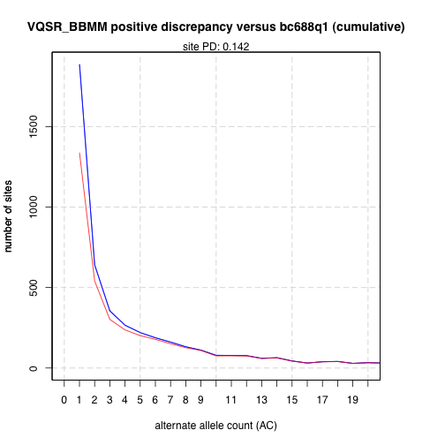
Sites found in the 1000G working low-coverage consensus against sites in 688 exomes
low-coverage calls
overlap with exome calls

Slide 11
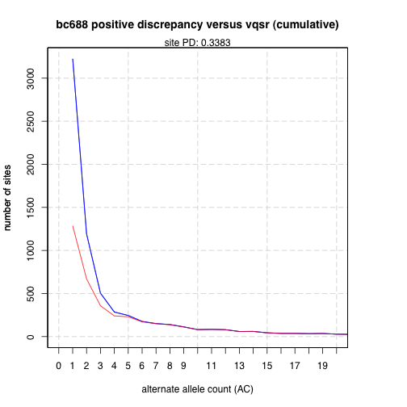
Sites found in 688 exomes against sites in the 1000G low-coverage consensus
exomes
overlap with low-coverage calls

Slide 12
Bayesian detection, multiple samples
We can improve power by collecting our samples together in a Bayesian framework.
Because population-based variation looks very different than sequencing error and alignment artifact, we can compare what we observe against prior expectations about the way that alleles are distributed in a population.
The natural way to do this is in a Bayesian setting.

Slide 13
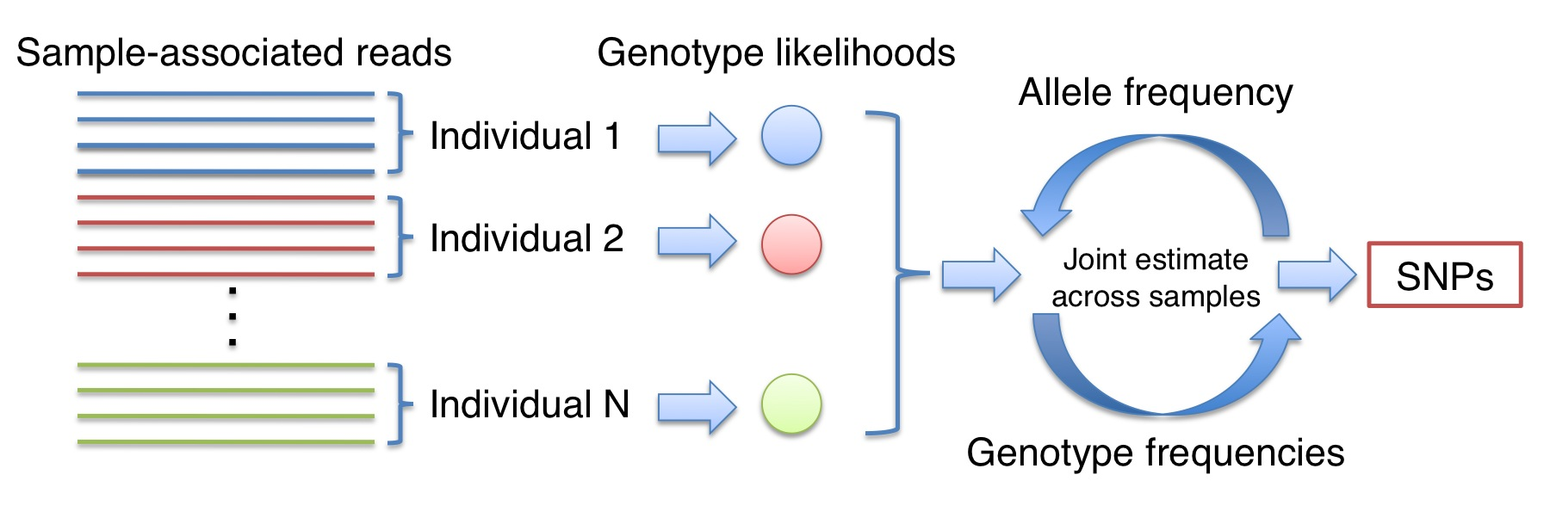
A population of samples
GATK documentation
http://www.broadinstitute.org/gsa/wiki/index.php/Unified_genotyper

Slide 14
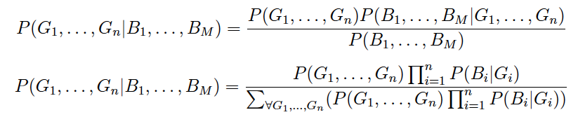
A population of samples
Genotyping across samples
Prior probability of the genotyping
Sequencing observations from the entire population
Data likelihoods
G_i = genotype for a sample, B_i = observations for a sample

Slide 15
The Neutral Model
Most variation in populations is relatively neutral with reflect to base context.
Assuming neutrality, we can build some simple mathematical descriptions of the probability of observing a given set of alleles and genotypes at a given locus.
We can use this model to integrate data likelihood estimates from a population of samples.

Slide 16
Genotype sampling probability
~ Hardy-Weinberg Equilibrium (as used in other callers).
Genotypings like this: AB, AB, AB, AB, AB, AB have much lower probability than AA, AA, AB, BB, AA, AB, AA.
(Technical: discrete scaling allows us to use numerical integration methods….)

Slide 17
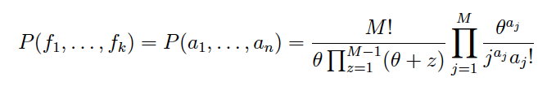
Allele frequency prior probability: Ewens’ sampling formula
Provides the probability of a given set of allele frequencies at a locus given an expected diversity rate (we use estimated pairwise diversity ~0.001).
Seamlessly incorporates multiple alleles.
The probability of a given
set of allele frequencies…
… can be expressed as allele
frequency counts …
… over which the Ewens’ sampling
formula is defined, given some theta.

Slide 18
Technical issues
Posterior integration…
  freeBayes uses a greedy method centered on the data likelihood maximum (OK in most cases due to extreme “spikiness” of the distribution)
Maximum a posteriori estimation
  Convergent, greedy method: local search followed by gradient ascent.
  Provides a decent balance of speed and sensitivity relative to MCMC approaches often used.
  Deterministic

Slide 19
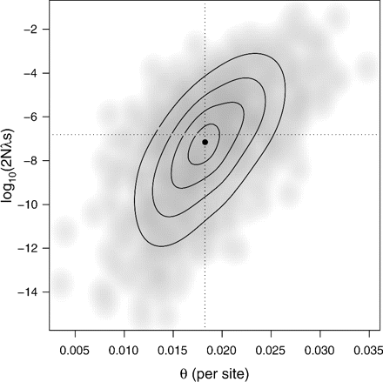
Finding the posterior maximum
(From: Ingvarsson, “Natural Selection on Synonymous and Nonsynonymous Mutations Shapes Patterns of Polymorphism in Populus tremula.”)

Slide 20
All together now…

Slide 21
SNPs, INDELs, and MNPs
Abstract representation of alleles allows freeBayes to simultaneously call all these classes.
Piping BAM input allows for base quality recalibration methods, INDEL realignment, gap opening realignment, and other approaches on the fly, without rewriting BAM files.
Call all small variants in one pass over the data.
Full support for poly-allelic sites (>2 present alleles).

Slide 22
Polyploidy, variable copy number, and pooled sequencing analysis
We use a fully generalizeable mathematical model, allowing for per-sample, per-region specification of ploidy.
Pooled sequencing is a special case of variable ploidy, and is enabled via a flag to freeBayes and the specification of ploidy == the number of genomic copies in the pooled sample.

Slide 23
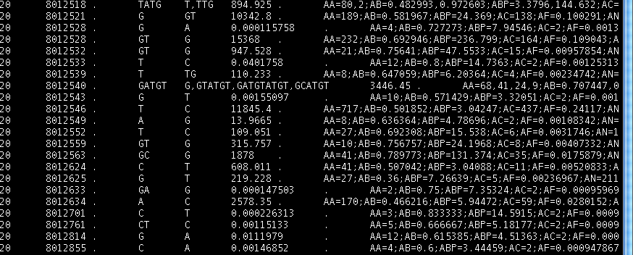
Combined variant output
(VCF 4.1)
Poly-allelic INDEL
SNP
+ Sample-specific genotyping information (not shown)

Slide 24
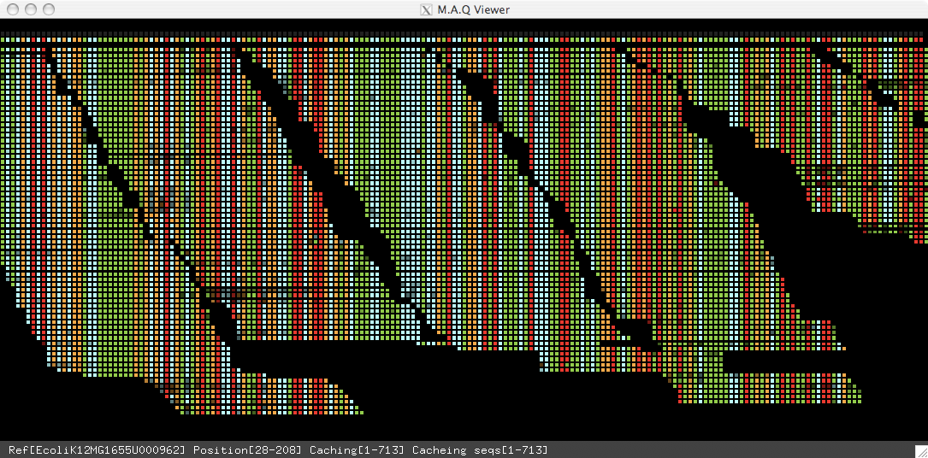
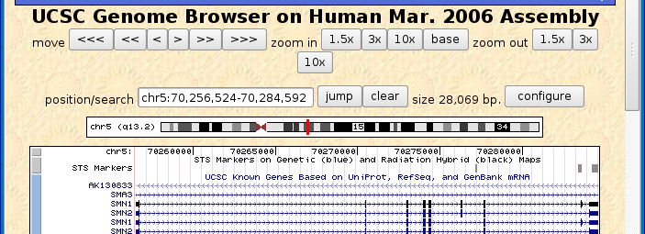
Variant detection pipeline
Alignments (BAM)
freebayes
Variants (VCF)
Reference Genome

Slide 25
Problems with population-level variant detection
With present callers, you’ll need ALL the alignments from the samples you want to include in the population.
  This is good if you want to use complex priors involving read positional information, allele balance across all heterozygotes,
  But this is bad if you don’t have 50TB of storage space available!

Slide 26
Solution: use a VCF file to describe the population allele frequencies and sites
Read sites and allele frequencies from a VCF file, such as that produced by the 1000 Genomes project.
Report results for input samples at all sites, conditioned on allele frequencies provided by the input.
Implementation in freeBayes ongoing
  tabix indexing system for VCF files (allows data parallelization via analysis targeting).

Slide 27
Adding prior variants
Alignments (BAM)
freebayes
Variant report
Reference Genome

Slide 28
Benefits of VCF-derived variant priors
Genotype your samples at known sites.
Variations with low supporting information can still be called.
No need to shuffle around dozens of terabytes of BAM alignments, or process them!
Priors are unlikely to overwhelm true variant sites (testing is underway to balance this).

Slide 29
FreeBayes and Galaxy
We’ve done preliminary work integrating freeBayes into the Galaxy framework:
  https://bitbucket.org/galaxy/galaxy-central/src/2f84c42a548a/tools/human_genome_variation/freebayes.xml
  But we want to know more about how Galaxy users envision using freeBayes!

Slide 30
FreeBayes and Galaxy, plans
Incorporation of data parallelization framework (aka map+reduce) for freeBayes.
Integration of of described VCF input system into Galaxy.
VCF filtering systems for post-processing (vcflib).

Slide 31
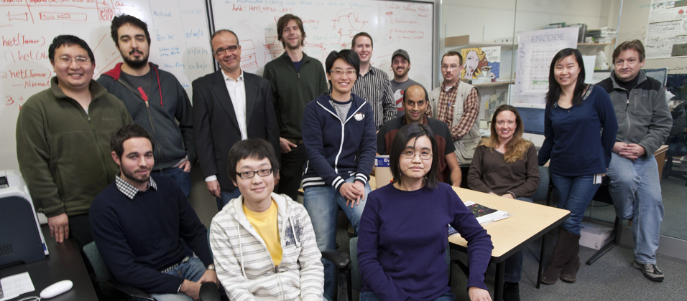
Acknowledgments
Gabor Marth, Alistair Ward, Chase Miller (galaxy integration), Amit Indap, Wen Fung Leong, & the rest of the Marth Lab

Slide 33
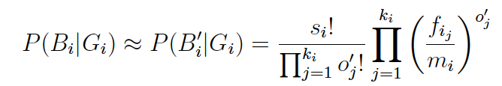
Single-sample maximum-likelihood Bayesian model, no errors
true alleles
observations
multinomial sampling probability
s_i = number of observations
k_i = number of observed alleles
o’_j = number of observations of allele
f_i_j = frequency of allele in genotype
m_i = sample ploidy
genotype

Slide 34
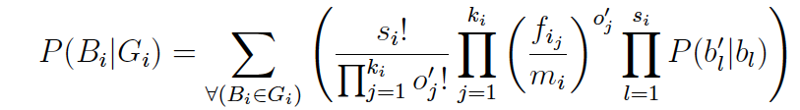
Single-sample maximum-likelihood Bayesian model, incorporating errors
error estimate via
base qualities
sampling probability
s_i = number of observations
k_i = number of observed alleles
o’_j = number of observations of allele
f_i_j = frequency of allele in genotype
m_i = sample ploidy

Slide 35
A population of samples
Genotyping across samples
Prior probability of the genotyping
Sequencing observations from the entire population
Data likelihoods

Slide 36
Genotype priors
The integration of allele frequency and genotype frequency information is a common theme among callers using this approach. We break our genotype prior term into its subcomponents like this:
Via Bayes’s rule:
Now we have two prior components which are very straightforward to model.

Slide 37



Genotype sampling probability
The probability of sampling a given genotyping
across all samples, a-priori, given a specific
allele frequency distribution
(Multiset permutations of alleles in genotypes * multinomial sampling probability)

Slide 38
Allele frequency prior probability: Ewens’ sampling formula
Provides the probability of a given set of allele frequencies at a locus given an expected diversity rate (we use estimated pairwise diversity ~0.001).
Seamlessly incorporates multiple alleles.
The probability of a given
set of allele frequencies…
… can be expressed as allele
frequency counts …
… over which the Ewens’ sampling
formula is defined, given some theta.

