Slide 1
JAX: Exploring The Galaxy
Glen Beane, Senior Software Engineer

Slide 2
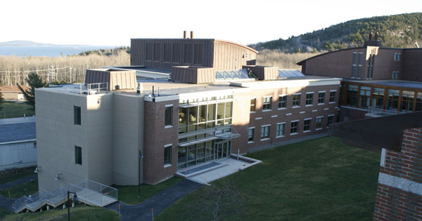
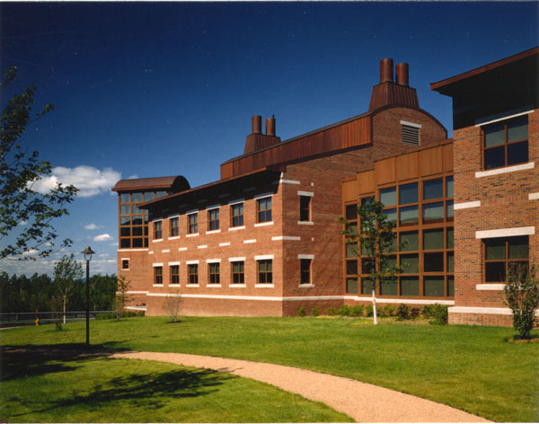
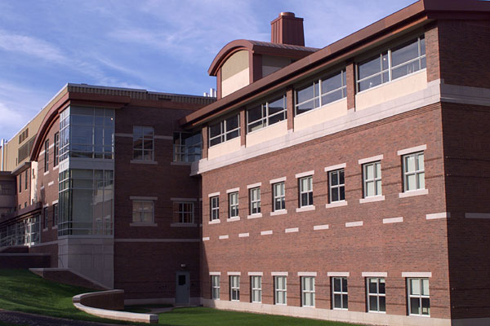
The Jackson Laboratory
Bar Harbor, Maine
Non-profit genetics research
Founded in 1929
36 principal investigators
1,300+ employees
$200 million budget
NCI-designated Cancer Center

Slide 3



Slide 4



Slide 5
Scientific Computing Group: Who We Are
Part of core software engineering and statistical analysis service (not IT)
  scientific software development
  High Performance Computing
  not Linux/Unix system administrators
  domain expertise

Slide 6
Why Galaxy?
Needed a HTS analysis platform
  make routine analysis accessible to scientists
  preferred local installation vs. hosted
  wanted to integrate with existing HPC resources (using TORQUE/Moab)
  looked at GenomeQuest, GenePattern and others
Open Source (no license cost, customizable)
Out of the box support for HTS tools
Active community (users and developers)
Facilitates collaboration
  Share Histories, Data, Workflows

Slide 7
Why HTS?
RNA-seq
  greater fidelity of expression levels
  unbiased by microarray spot sequences
  alternative splicing / RNA editing
ChIP-seq
  unbiased
  new approaches for epigenetics
Targeted re-sequencing
  mutagenesis projects
  spontaneous mutations in the production colony

Slide 8
What we are doing with Galaxy
High throughput sequencing analysis
  RNA-Seq
  DNA-Seq
  ChIP-Seq
Other Genomic Analysis
  e.g., Array Genotyping (Diversity Array, MUGA)
  developing/wrapping new tools

Slide 9


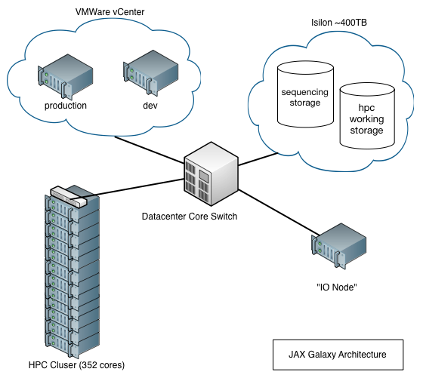
Our Installation
VM
VM

Slide 10
What we’ve been up to so far
Custom Tools & Workflows
  e.g., Array Genotyping Workflow
    custom “get data” tool
    group by SNP probe set tool
    genotyping tools (Alchemy, MDG)
    EMMA (mixed-model association mapping)
RNA-Seq and DNA-Seq workflows, Whole-Genome workflows
“Toothbrush” (custom “FASTQ groomer” written in C)
Search Mouse SNPs Tool (Sanger 17 strains)
Tools for custom statistical calculations on tabular data files
HDF5 support (“sniffable”)

Slide 11
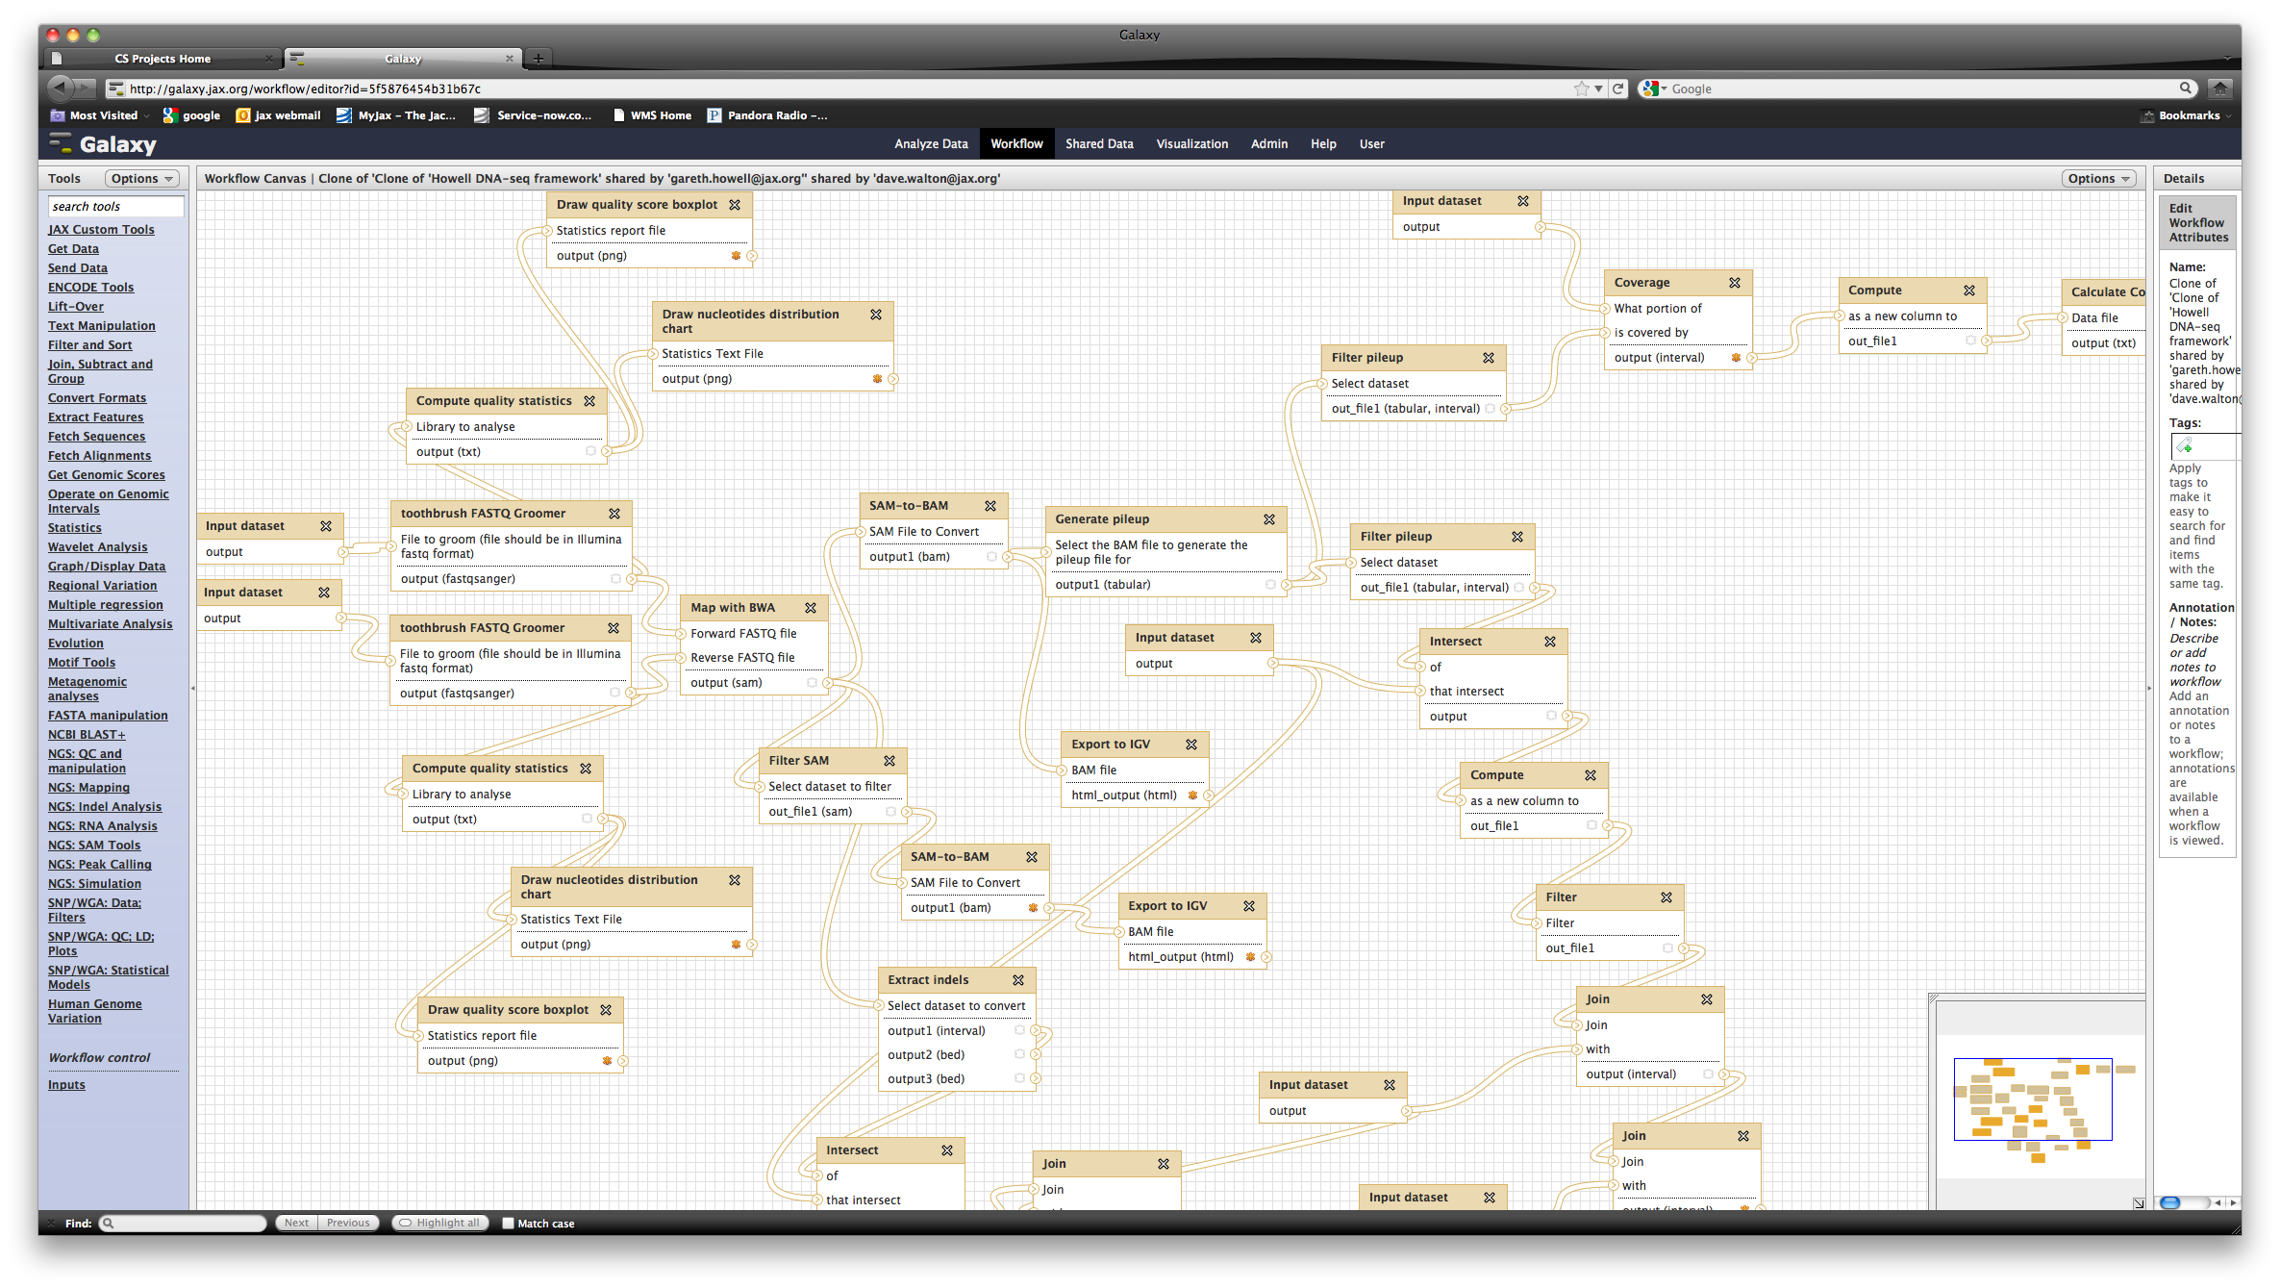
Users creating non-trivial workflows
user would not have done this from the command line on our cluster

Slide 12
Challenges
Importing Data!
  ftp uploads a big help!
  using “upload directory of files” heavily
  plan to automate uploads
Sparse developer docs (e.g. API)
Truncated error messages from tools
difficulty managing experiments w/ large numbers of samples (e.g. run 40 samples through same workflow)
  output file names difficult to match up with original sample names (get 40 “N toolX on Y” in history)
  merging results from many workflows is manual
  can’t automatically run multiple pairs of files through same workflow

Slide 13
Wish List
Input file name or parameter value as variable in workflow (we want to name output files based on initial input name)
Auto delete intermediate files in WF (not just hide)
Tools with associated roles
Reduction
  merge results from multiple WFs (with custom “Reduce” tool or something standard like simple concatenation)
more developer documentation
more reports (e.g. disk space per user, active/inactive data files, etc)
“favorite tools”
list tool versions

Slide 14
Acknowledgements
Dave Walton, Manager Scientific Computing
Keith Sheppard & Matt Vincent, Software Engineers, Center For Genome Dynamics
Rich Brey & Michael Genrich, Linux Systems Administrators, IT
Matt Hibbs, PhD – Assistant Professor
Joel Graber, PhD – Associate Professor
Gary Churchill, PhD – Professor
Carol Bult, PhD – Professor
Gareth Howell, PhD – Research Scientist (workflow image)

