Slide 1
NBIC Galaxy Hackathon a marathon for programmers
Freek de Bruijn
Scientific programmer
NBIC

Slide 2
About NBIC and me
NBIC: is the Dutch network of bioinformatics experts
NBIC: active in research, education and support
NBIC: collaboration of 100+ bioinformatics scientists and 50+ programmers
me: studied computer science
me: interested in biology
me: working for NBIC for almost 1 year

Slide 3
NBIC hackathon
yearly event for community building
2011: April 13th and 14th
25 developers in 3 teams:
  Amazon’s Mechanical Turk: community intelligence
  combine GCSF and MOLGENIS (2 systems to help model experimental protocols)
  Galaxy (12 developers)
Hailiang Mei already told about it yesterday

Slide 4
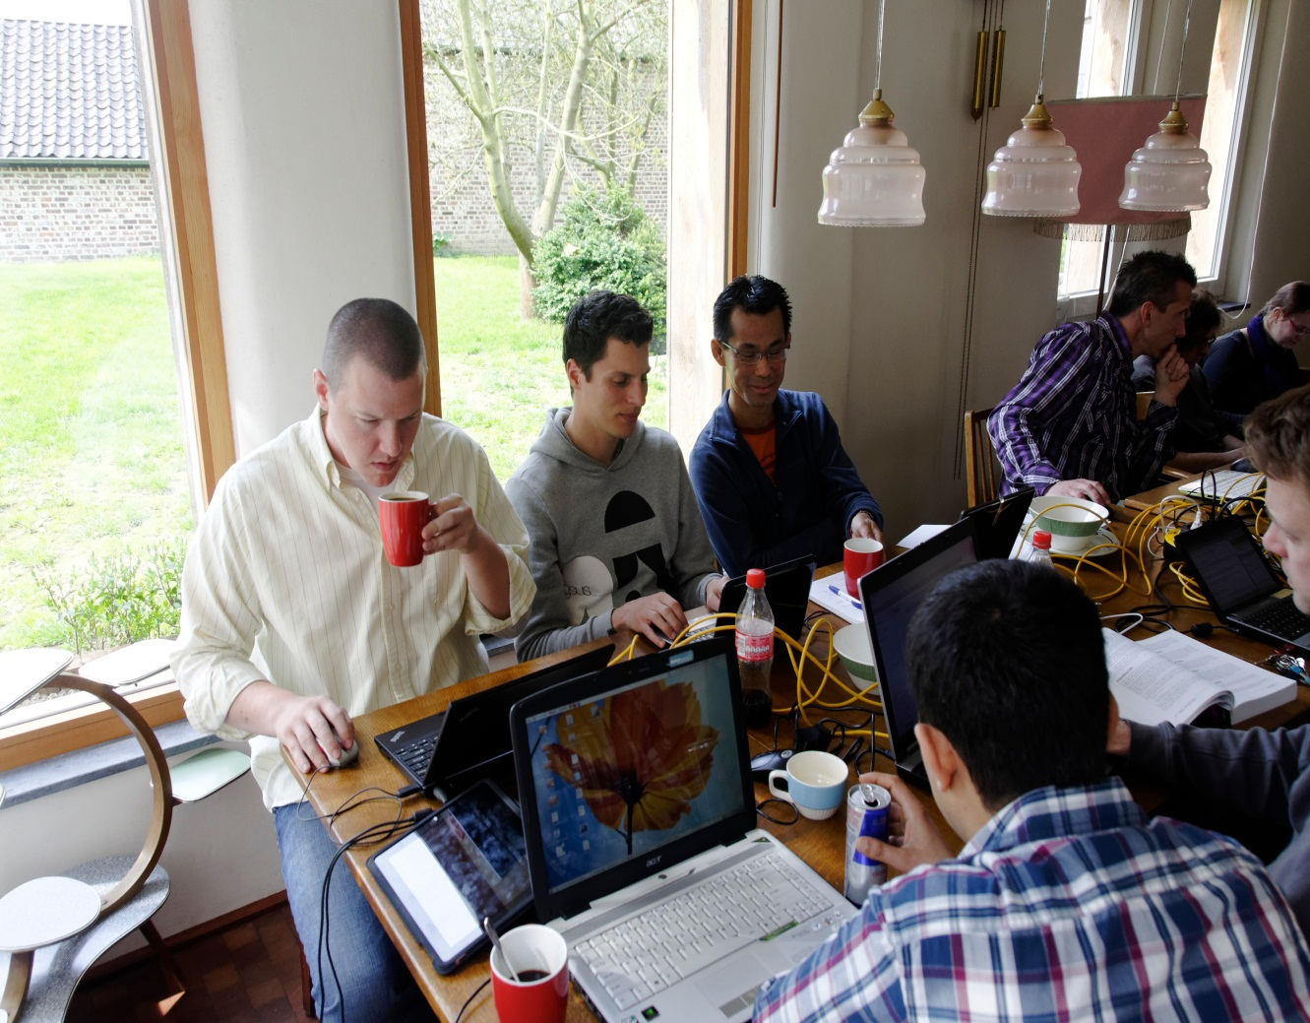
Getting started: coffee, red bull and coke
10 times hg pull [...]galaxy-central and a flaky wifi connection took some time

Slide 5
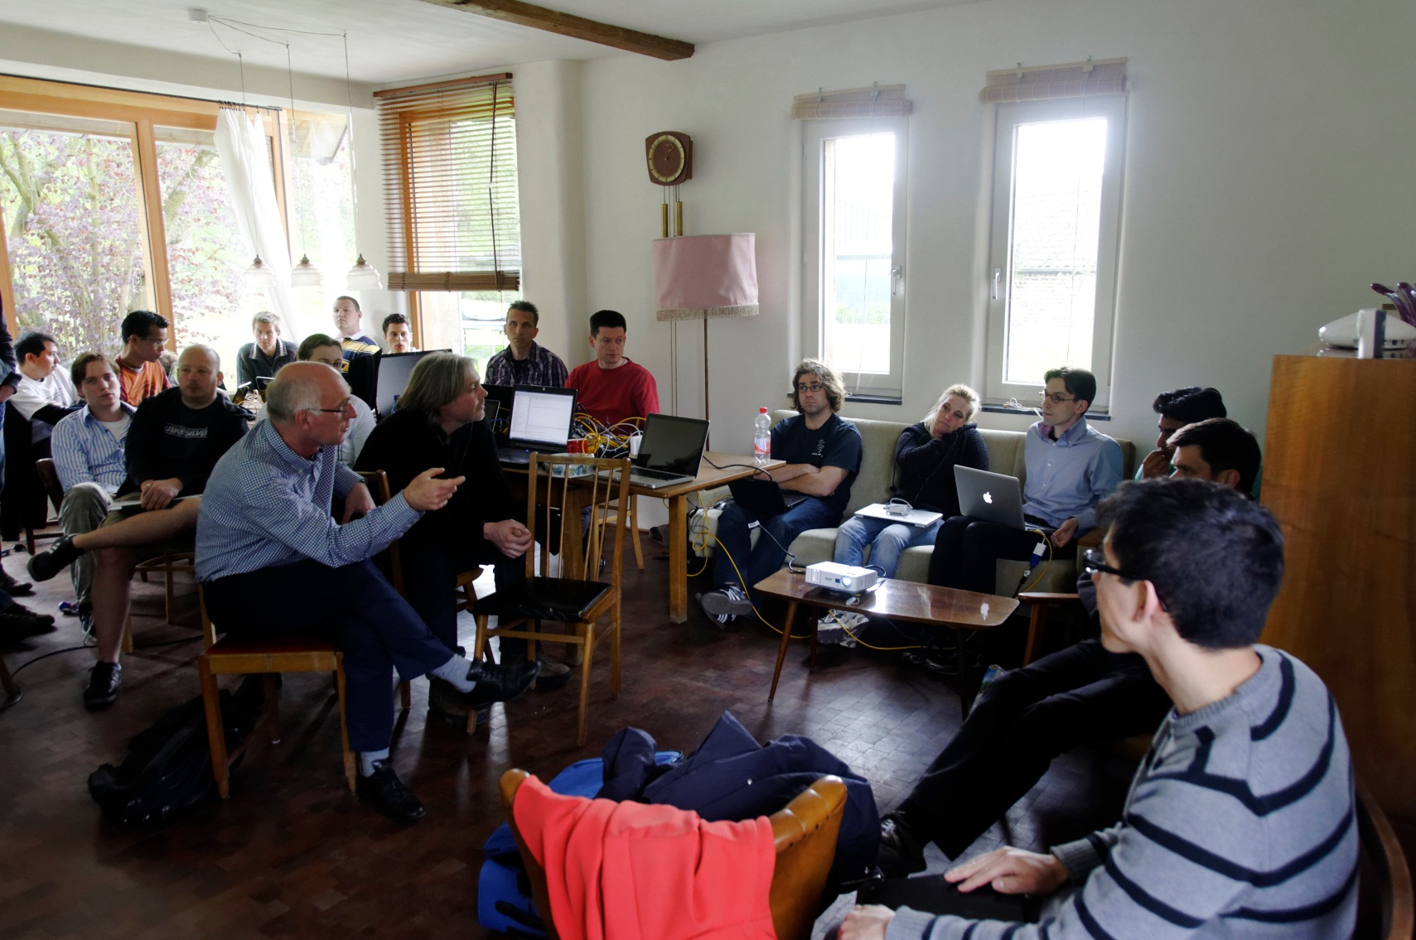
Two days flew by

Slide 6
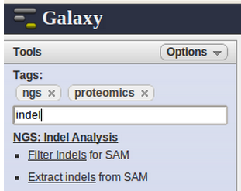
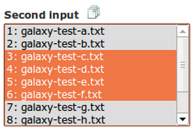
Results
new: loop over files in a directory
new: tool configs in separate files → easier installation
new: tool selection with tags

Slide 7
What did we learn - 1
Galaxy is very easy to modify (with some Galaxy devs)
we learned a lot about the internals of Galaxy
we stumbled upon something previously unheard of
Guido did a great job: Python is very elegant
hackathons are lots of fun!
we learned that there is international interest for Galaxy hackathons organized in tiny European countries
we are of course already thinking about planning the next hackathon, so we will keep you informed

Slide 8
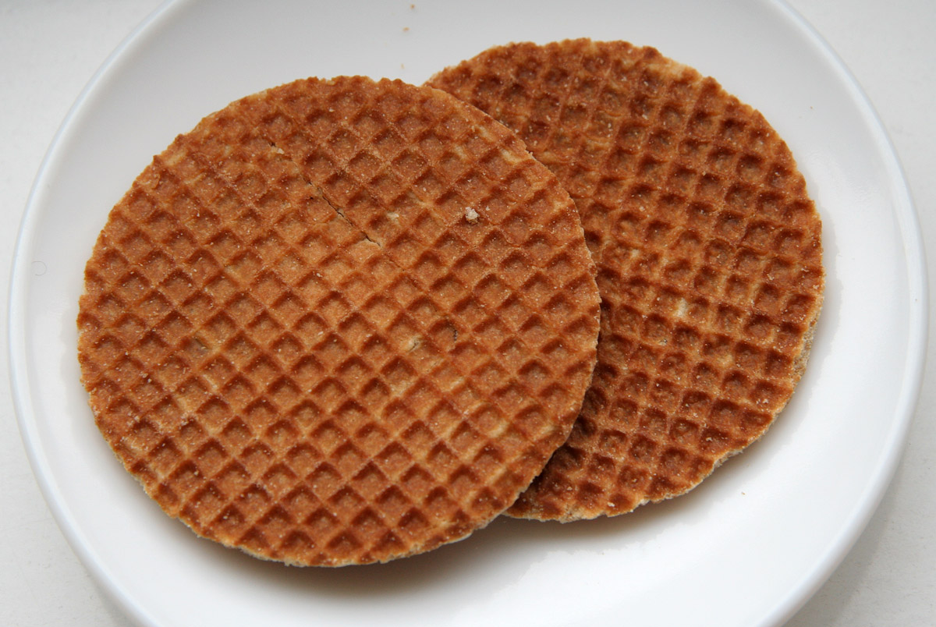
What did we learn - 2
Nate and Dannon discovered that they really like "stroopwafels" (Dutch syrup waffles)
Dannon and Nate found out that hotel reservations can go wrong - it can be a way to get free drinks

Slide 9
Acknowledgements
participants (Galaxy hackathon team): Alex Bossers (WUR), Dannon Baker (Emory), Frans Paul Ruzius (NGS), Freddy de Bree (CVI, WUR), Henk van den Toorn (UU), Ishtiaq Ahmad (RUG), Joachim Jacob (VIB-BITS), Martijn Vermaat (NGS), Nate Coraor (Penn State), Rob Hooft (NBIC) and Wil Koetsier (UMCG)
hackathon organization: Christine Chichester, Hailiang Mei, NBIC Office and many others
Galaxy team for enabling Dannon and Nate to join & help
NBIC for organizing and funding
photography: Rob Hooft (bit.ly/nbichack3)

