Slide 1
SNPedia
You might care if you
Work with human samples
Have your own DNA analyzed (23andMe etc)
...

Slide 2

Single
Nucleotide
Polymorphism
wikipedia
since 2006

Slide 3
Single
Nucleotide
Polymorphism
wikipedia
"a wikipedia about DNA"

Slide 4
Where We're Going
http://files.snpedia.com/reports/promethease_data/genome_Lilly_Mendel_v4_ui2.html
Can read .VCF with dbSNP rs#s
(and TONS of other formats)
Tab delimited output also provided

Slide 5
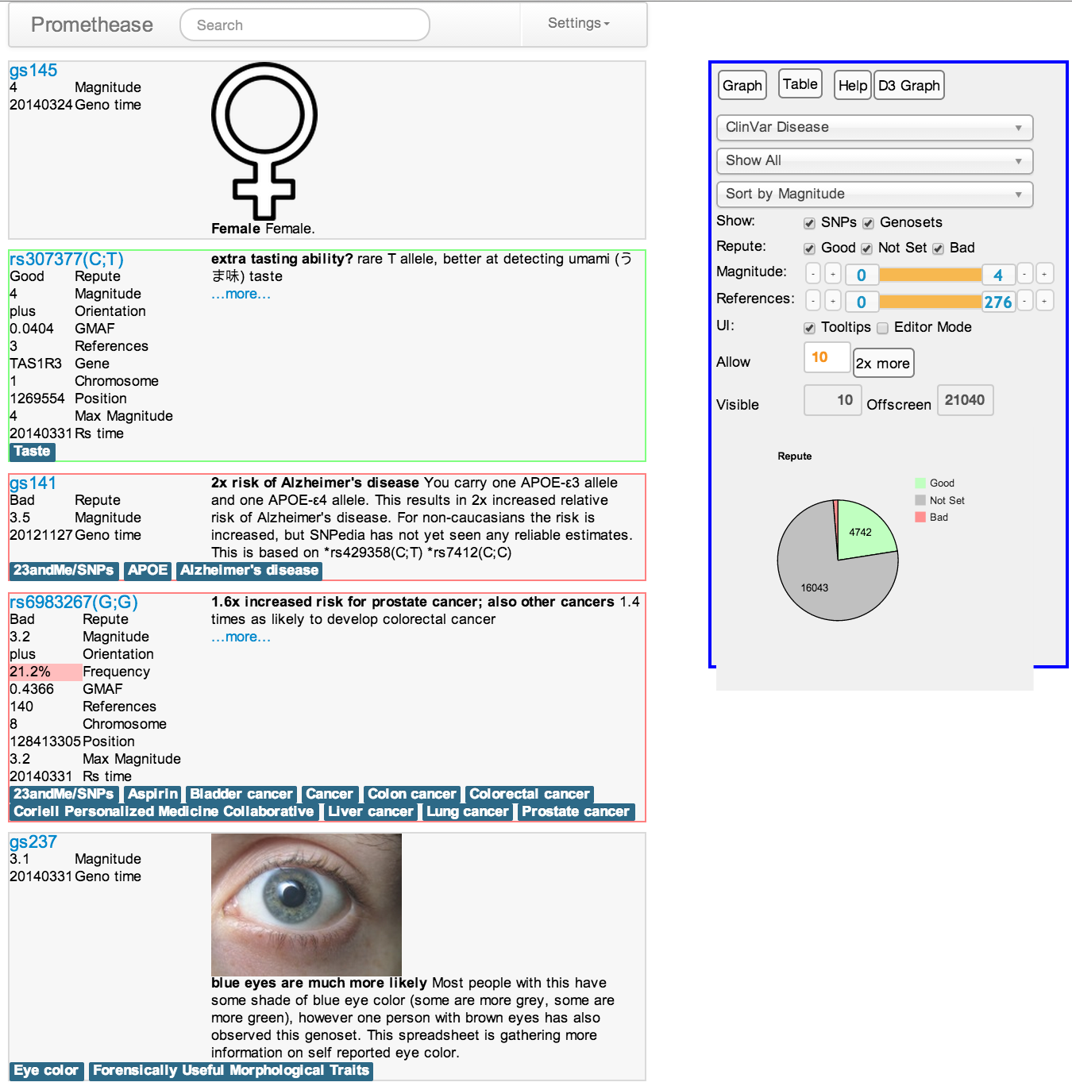

Slide 6
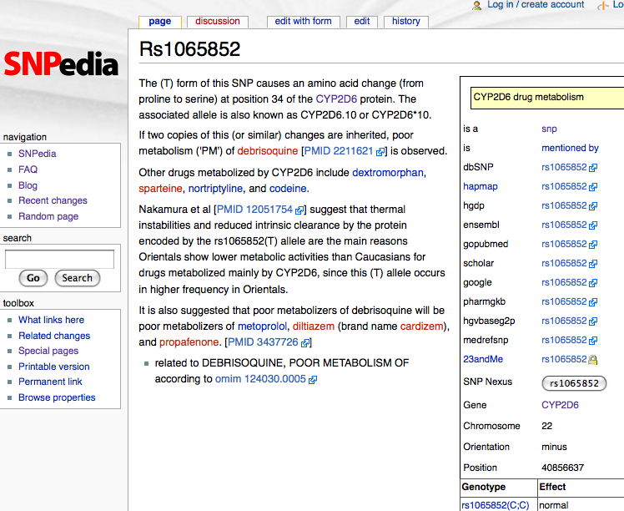

Slide 7
Summary Text
Links to PubMed
Links to Related Pages
Structured Information

Slide 8
55,000 pages like this
=
1 page for each SNP with literature
Pages are structured, so they can be used to make customized reports

Slide 9
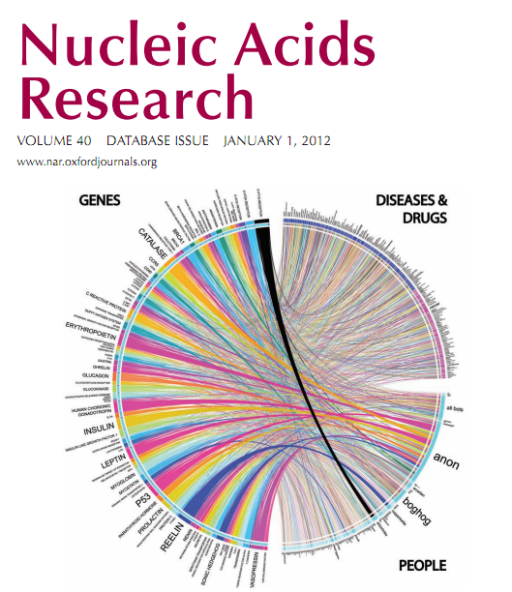
Published Paper
SNPedia: A Wiki supporting Personal Genome Annotation, Interpretation and Analysis
Michael Cariaso; Greg Lennon
Nucleic Acids Research Jan 1 2012
PMID 22140107

Slide 10
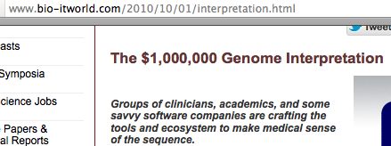
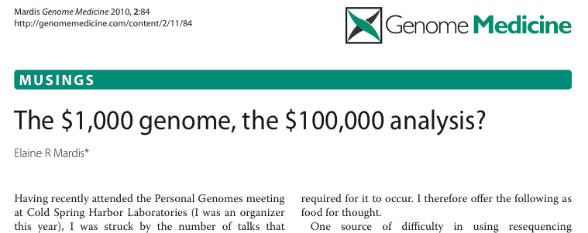

Slide 11
$5
$5, $2, $0

Slide 12
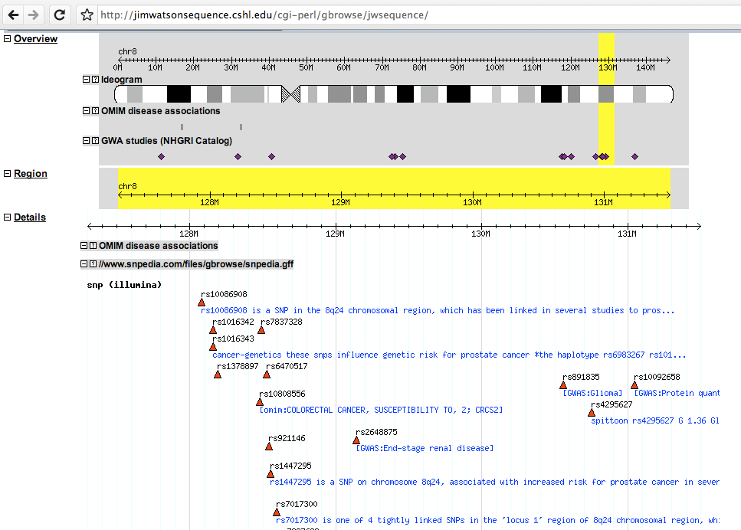
GFF3 / Gbrowse

Slide 13
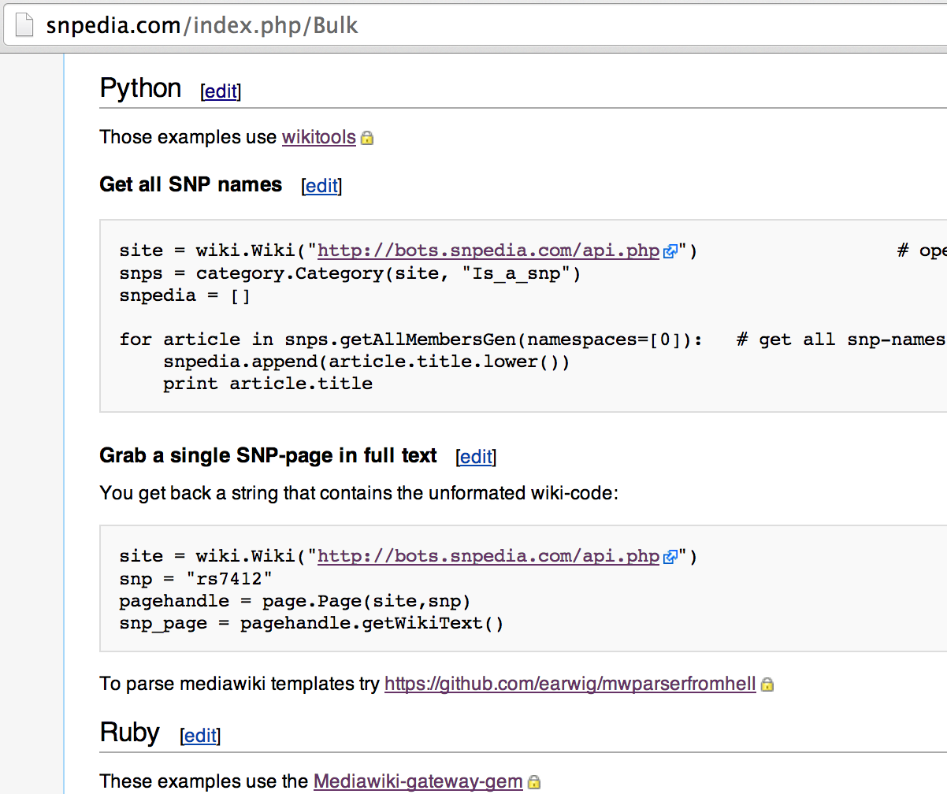

Slide 14
Magnitude
Numeric score of importance
  6 Alzheimer's APOE4
  5 HIV resistance
  2 hmm ... interesting
  1 blank, not yet classified
  0 normal
Community consensus score
Interesting SNPs rise to the top
  Boring ones hide at the bottom

Slide 15
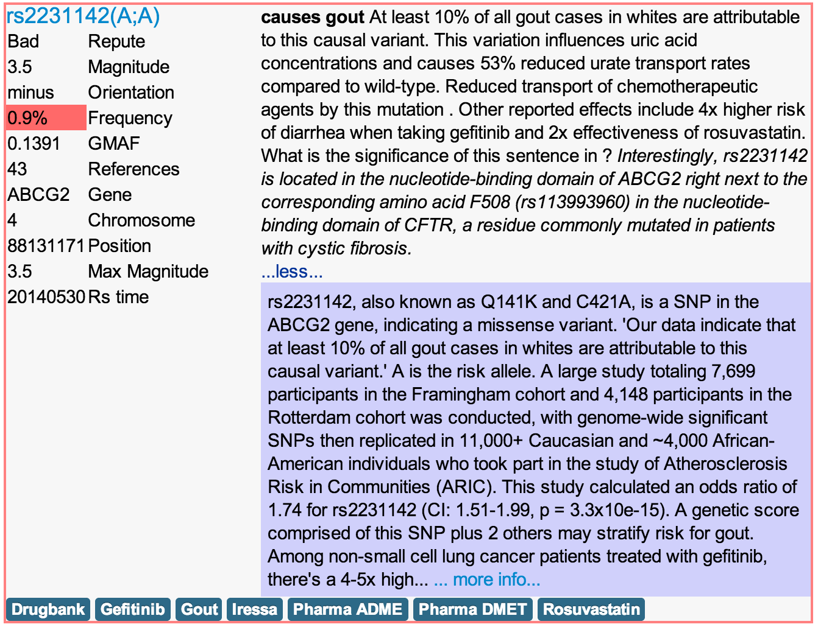

Slide 16
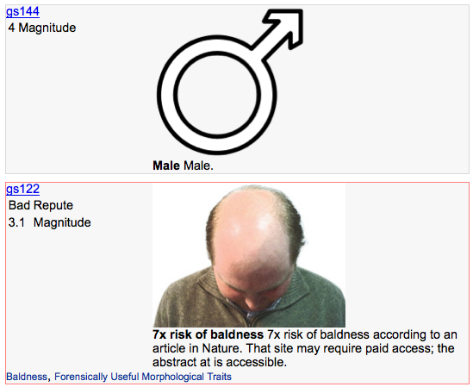

Slide 17
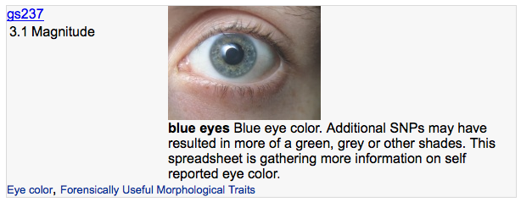

Slide 18
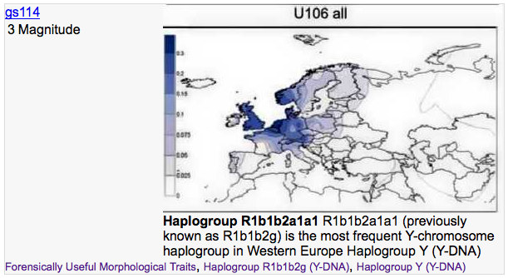
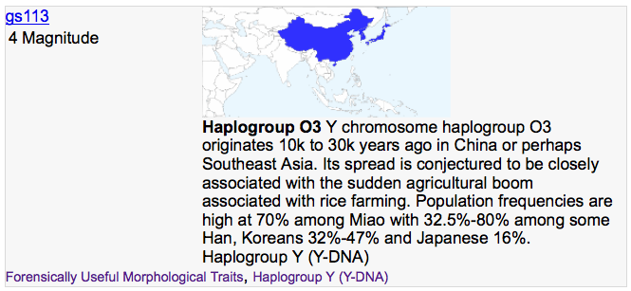

Slide 19
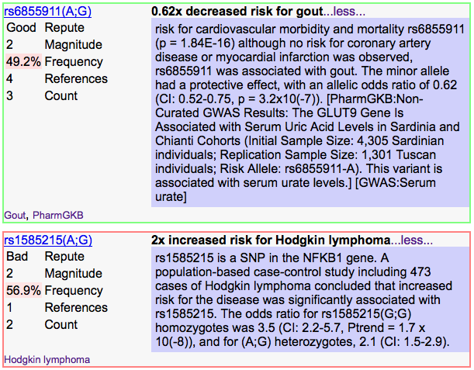

Slide 20
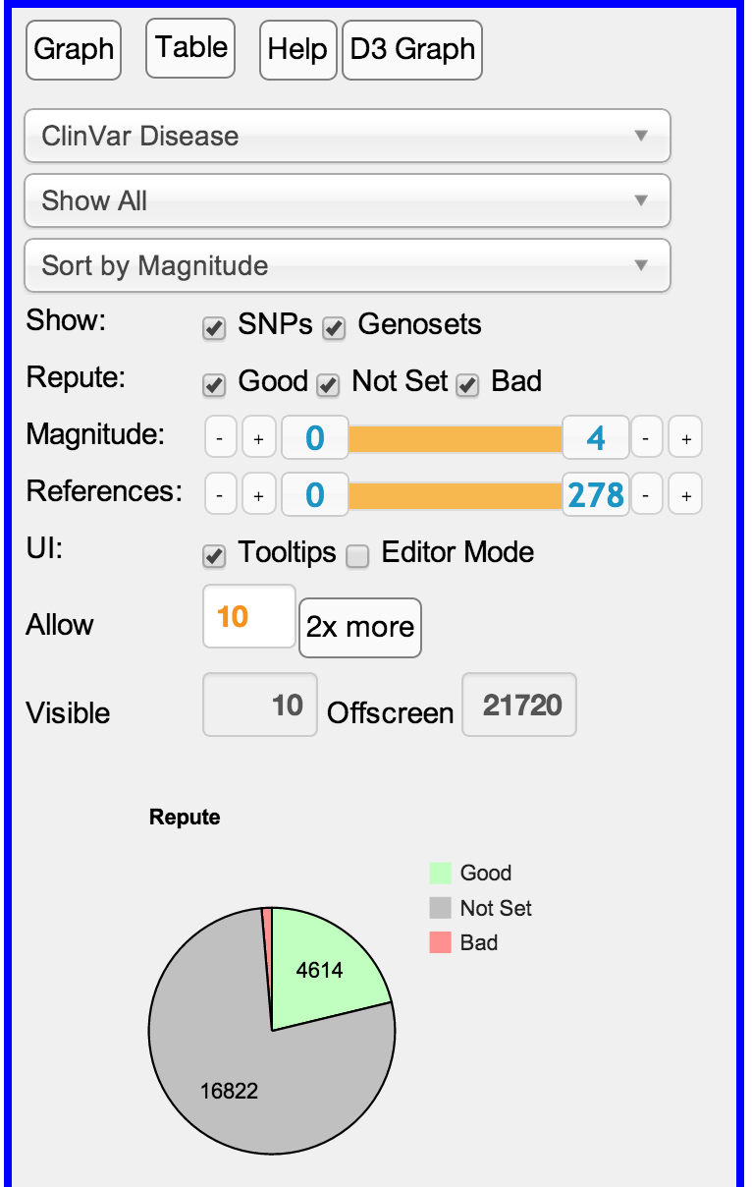
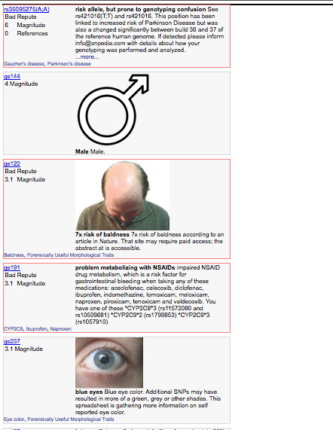

Slide 21
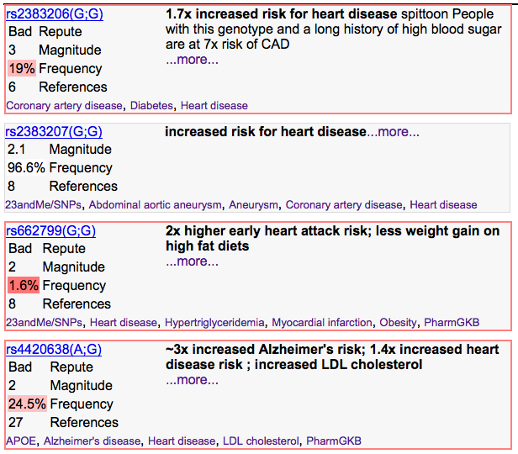

Slide 23


