Slide 1
Deploying Galaxy in a secure environment to analyse sensitive data
Abdulrahman Azab
ELIXIR-NO, EXCELERATE-NO

Slide 2

Services for sensitive data
TSD

Slide 3



TSD Architecture
Colossus
BeeGFS
p01
p02
pN
Two factor Authentication
NFS
p01
p02
pN

Slide 4

Galaxy inside TSD 2.0: Challenges
Access from/to the outside world is highly restricted (Cannot install/update Galaxy from public repositories)
Galaxy is a web-portal which needs regular updates.
Galaxy shed tools need regular updates as well.

Slide 5
Galaxy as a Docker
container

Slide 6
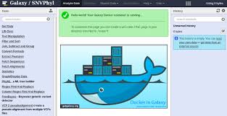
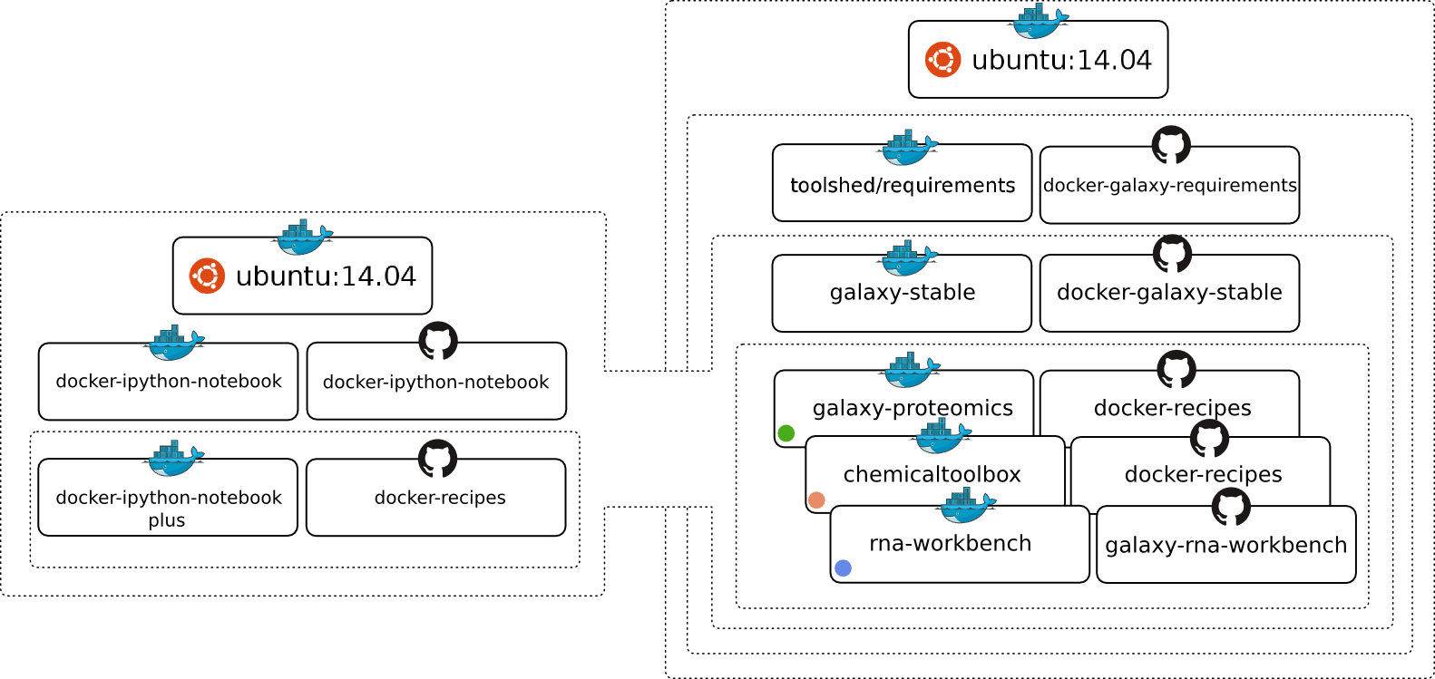
Galaxy Docker

Slide 7

Galaxy Docker
$ docker run -d -p 8080:80 -v /home/user/galaxy-export/:/export/ bgruening/galaxy-stable
Host
Container
P:8080
P:80
/export/
/home/user/galaxy-export/

Slide 8
Galaxy Docker
Host
Container2
Container1
/export/
/export/
/home/user/galaxy-export/

Slide 9
Galaxy inside TSD as a Docker Container
tsd/p77
Dockerfile
insilico.hpc.uio.no
p77-galaxy01-l
Container
Container
image
/export/
Tarball
/export/
tools
/home/user/galaxy-export/
/galaxy/galaxy-export/
Tarball

Slide 10

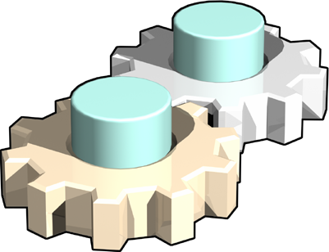
Docker containers on VMs Connecting to the HPC cluster
VM
P65 Project Area
Container
Stroll Job
Runner
Virtual
path
/tsd/p65/data
/cluster/
Stroll
File-system
Job Input
data
Slurm
Job Output data
Colossus
W
W
W
W
W
W

Slide 11
Running Docker Tools from Galaxy Docker
container

Slide 12
Galaxy Tools as Docker containers
TSD
VM
WRONG
Containers
Container
Project Area
Tools

Slide 13
Galaxy Tools as Docker containers
TSD
VM
Containers
Docker Container
Project Area
Tools

Slide 14
Running Docker Tools from Galaxy Docker
Container on the Cluster

Slide 15
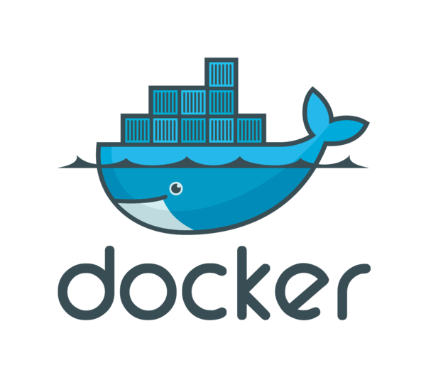
Galaxy Tools as Docker containers on the cluster
VM
Project Area
Docker Container
Slurm
Colossus
Compute
Node
Compute
Node
Compute
Node
Compute
Node
Docker Engine
Docker Engine
Docker Engine
Docker Engine
Pull
Docker repositories
Local Registry

Slide 16
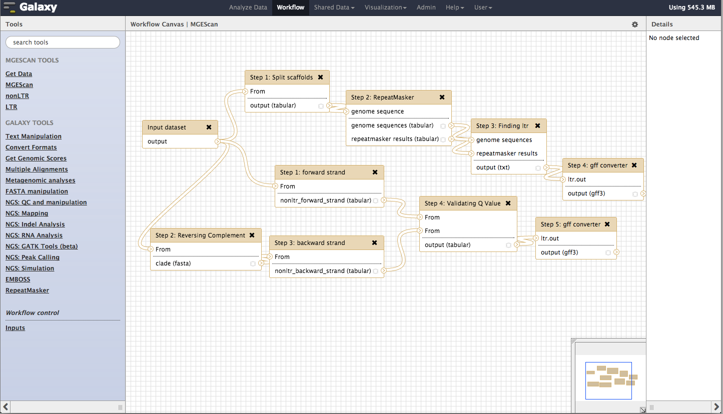



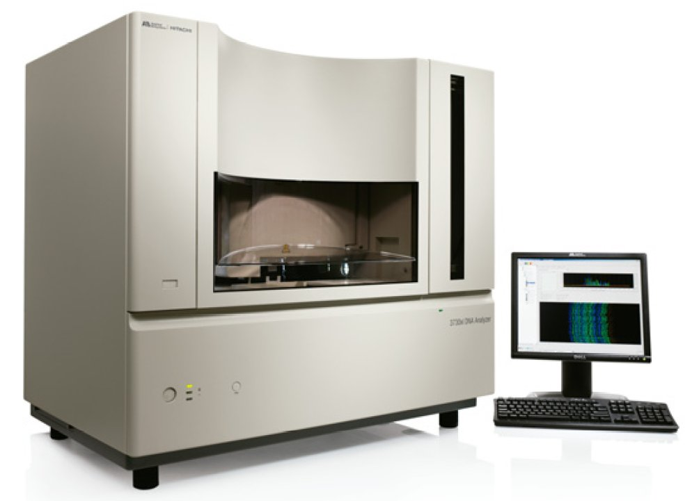
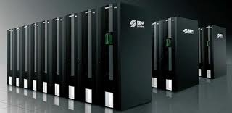
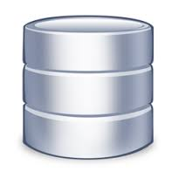
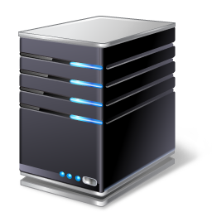


Big picture – future plan
Galaxy Portal
phenotypic
data
cPouta
HPC Cloud
storage
SURFsara
HPC
Cloud
storage
TSD
HPC
storage
genotypic
data
SFTP Proxy
(Tryggve)
Data sharing
ELIXIR
Docker
Registry
BioShaDock
Tool sharing
HPC Cluster
Compute
Node
Compute
Node
Compute
Node
Compute
Node
Controller
Docker Engine
Docker Engine
Docker Engine
Docker Engine
Docker repository

Slide 17
Running Docker Tools from Galaxy Docker
Container on the Cluster in the Cloud

Slide 18
Docker on the cluster – HTCondor on cPouta
VM
Docker Container
Condor
CM
Docker Engine
HTCondor Pool
Compute
Node
Compute
Node
Compute
Node
Compute
Node
Docker Engine
Docker Engine
Docker Engine
Docker Engine
Pull
Docker repositories
Local ePouta
Registry

Slide 19
Run Docker on your own HPC cluster?

Slide 20
HTCondor
universe = docker
executable = /usr/local/bin/bowtie
arguments = -p 8 -S -v 2 -m 1 /work/hg19/hg19
/work/bowtie-input/$(process).normal.fastq
docker_image = genomicpariscentre/bowtie1
output = $(process).normal.sam
error = $(process).normal.err
log = normal.log
queue 46

Slide 21
SLURM (socker)
#!/bin/bash
#SBATCH --nodes=1
#SBATCH --partition=docker
srun -n 32 socker bowtie -p 8 -S -v 2 -m 1 /work/hg19/hg19
/work/bowtie-input/$(process).normal.fastq

Slide 22
Swarm is shit
Kubernetes and Openshift are not for HPC ‘yet’

Slide 23
Issues
Containers won’t solve the Hardware architecture incompatibility
Containers won’t clear your operational maintenance mess
Must have a valid Linux kernel
Image replication for all compute nodes.

Slide 24


